Slide 1
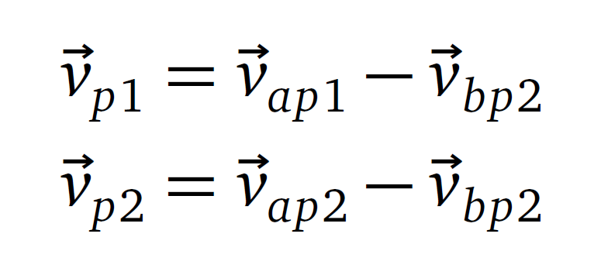
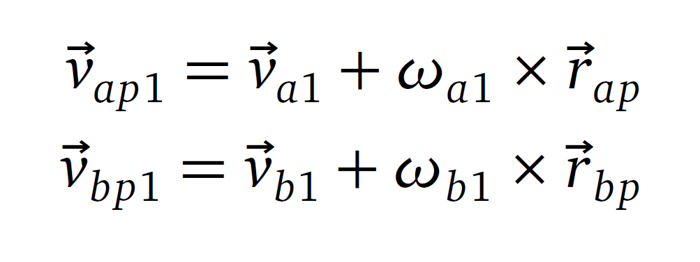
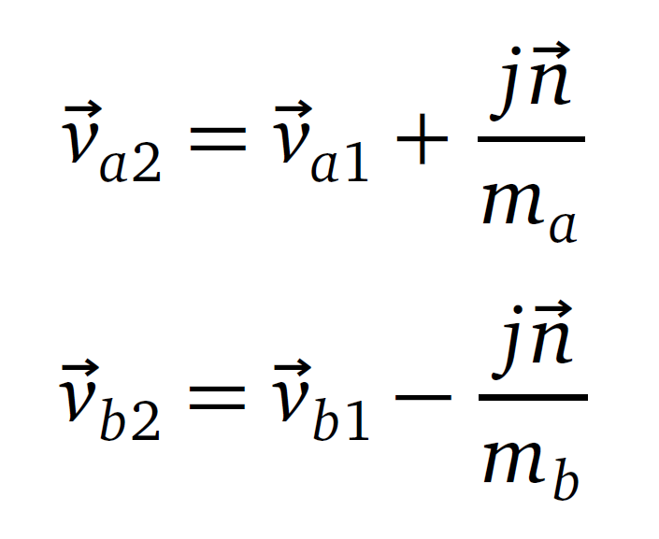
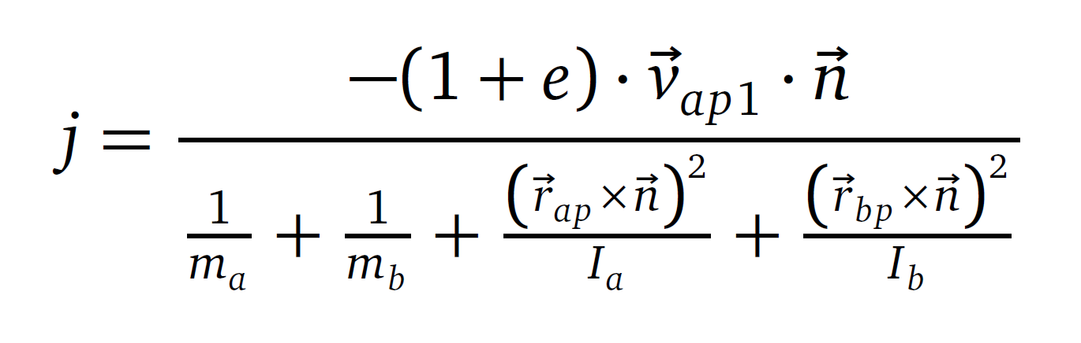
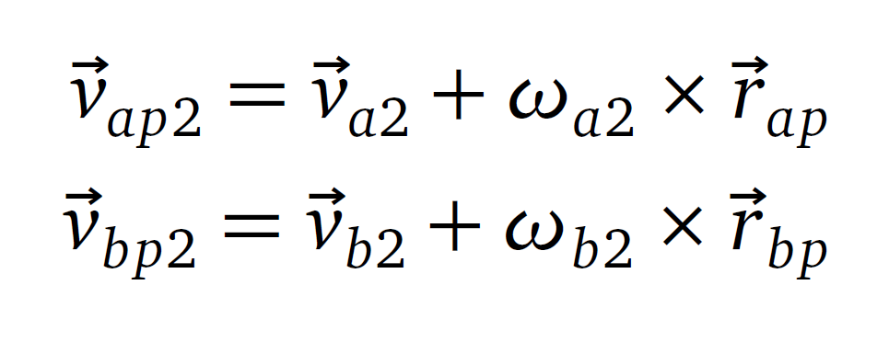
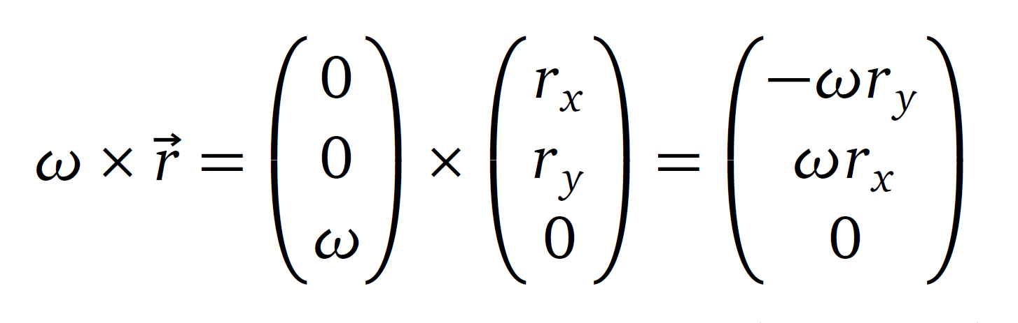
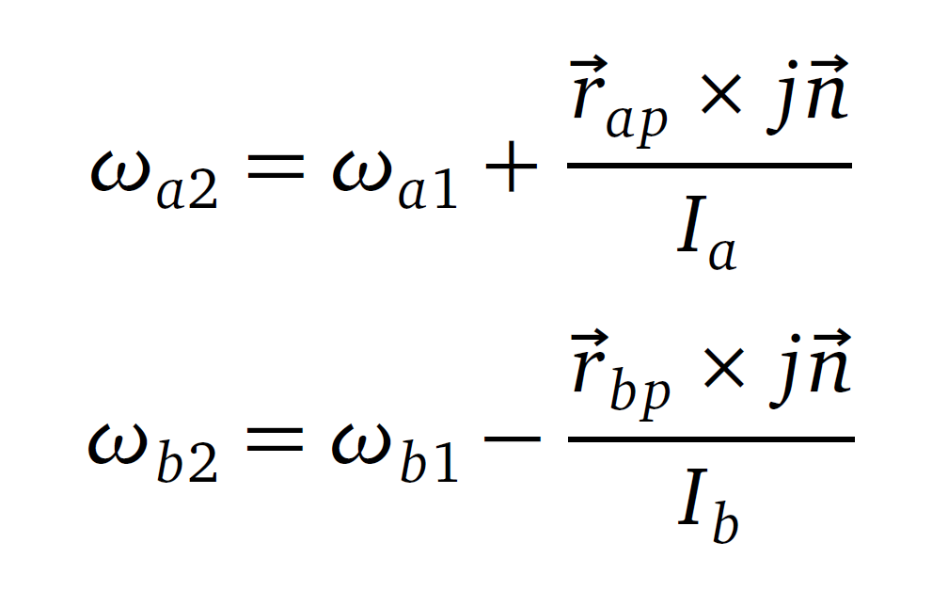


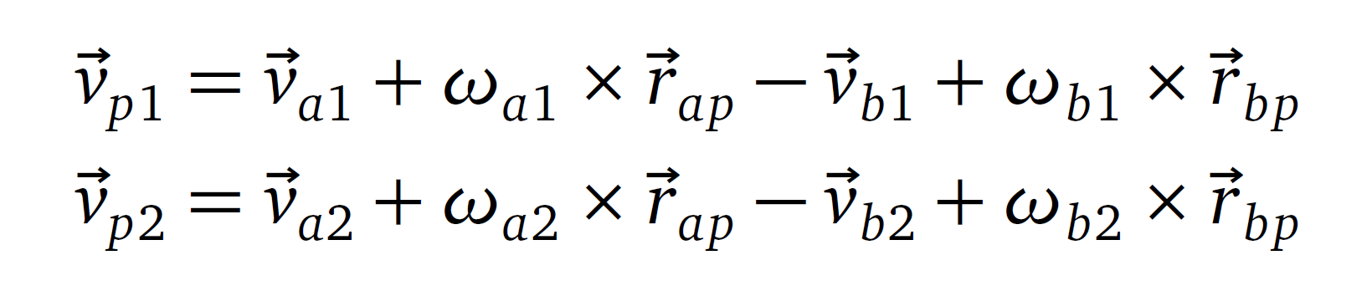
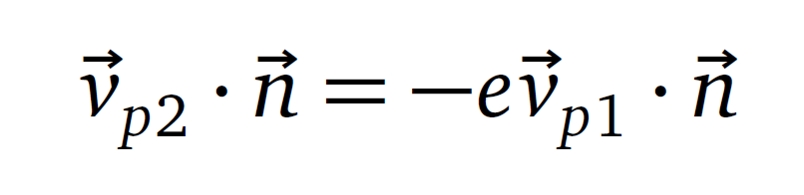
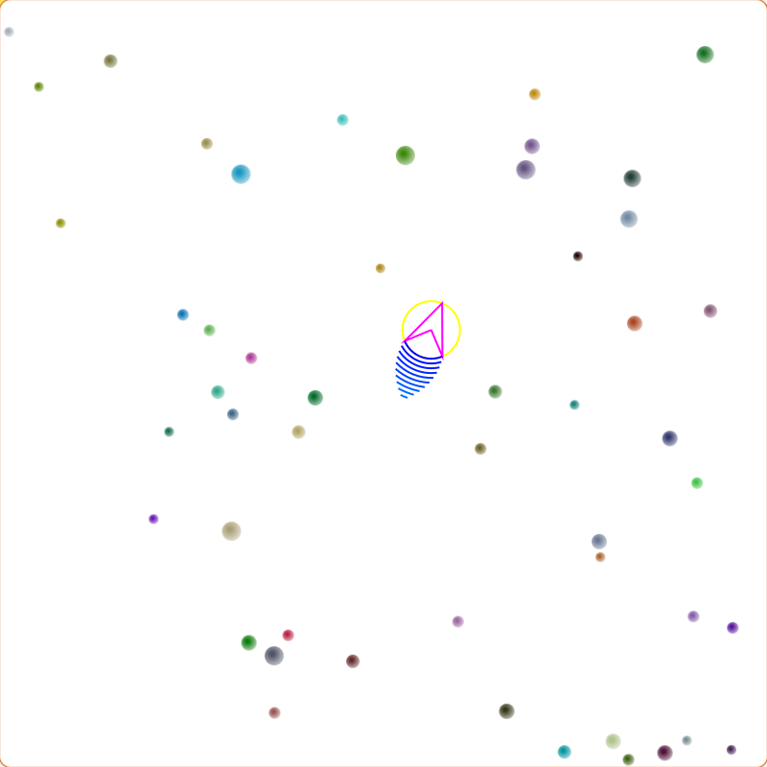
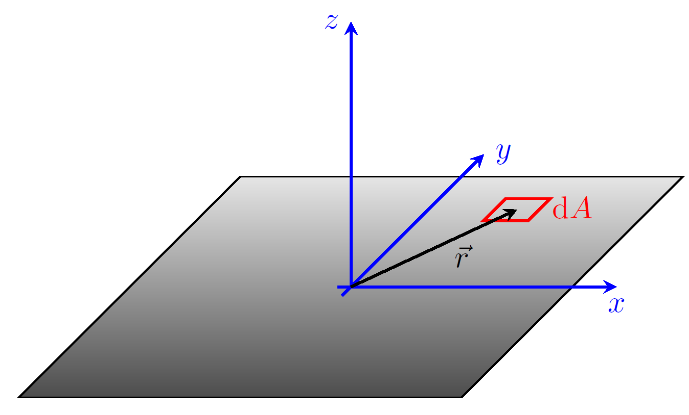
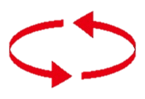
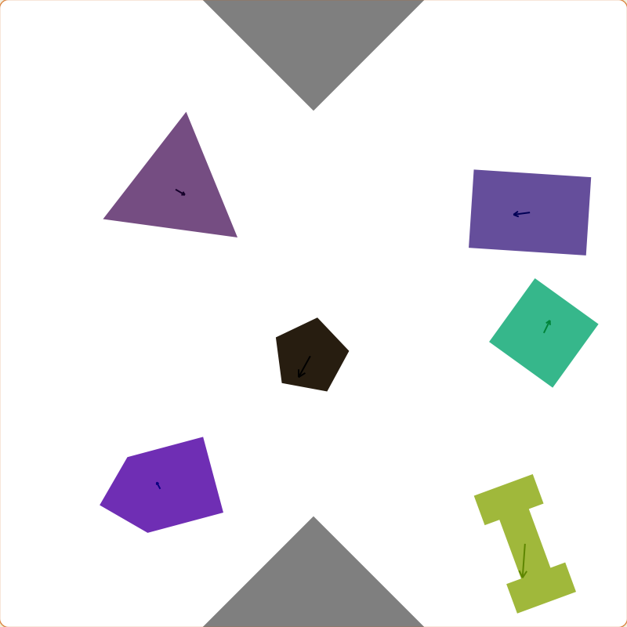

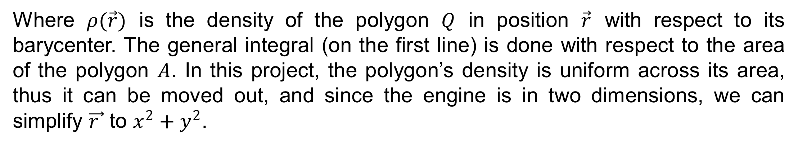
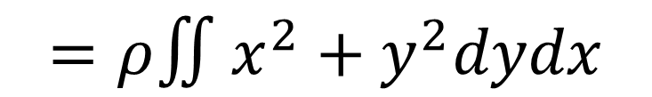
From Flying Balls to Colliding Polygons
Student: Arnaud Fauconnet
Advisor: Prof. Antonio Carzaniga
Motivation
Collision Resolution
The goal of the project is the extension of a pre-existing 2D physics engine implemented by Prof. Carzaniga. That engine, called “flying-balls”, only simulated interactions between circles. They bounced off of each other and off the walls represented by the edges of the window they were evolving in. The extension decided was to add the possibility to make arbitrary polygons collide with each other similarly to the balls in the initial project.
Technologies
PHYSICS FORMULAS
I could write stuff that doesn’t make sense, you wouldn’t even notice :)
Before vs After Comparison
Flying balls
Moment of inertia
The moment of inertia represents an object’s resistance to changes in its rotational motion and how its mass is distributed with respect to is axis of rotation.
$$I_{Q}=∫{\vec{r}}^{2}ρ\left(\vec{r}\right)dA$$
$$=ρ∬x^{2}+y^{2}dydx$$
Where $ρ(\vec{r})$ is the density of the polygon $Q$ in position $\vec{r}$ with respect to its barycenter. The general integral (on the first line) is done with respect to the area of the polygon $A$. In this project, the polygon’s density is uniform across its area, thus it can be moved out, and since the engine is in two dimensions, we can simplify $\vec{r }$ to $x^{2}+y^{2}$.
Colliding polygons
Collision detection
Most common case: vertex on edge
Rare cases: vertex in vertex and parallel
Challenges
Parallel
Vertex on vertex
Understanding what the moment of inertia meant
Finding the formula of the moment for arbitrary polygons
Handling a collision that spanned over multiple frames:
Frame 1: collision detected between A and B, apply resolution
Frame 2: collision detected again between A and B, but no resolution must occur, because it already was applied on previous frame, so we need to “ignore” the collision. Finding the “ignoring” criteria was quite difficult.

