Slide 1
PROJECT LUTHER
Laura Colón-Meléndez
October 7, 2016

Slide 2

Problem Statement
You are an actor…
You want to know how to get more people to get to know you.
How do you increase your
average widest (theater) release?

Slide 3

Data & Modeling
Obtained movie data from
FILM GENRES
FILM RATINGS
AVERAGE DOMESTIC GROSS
RELEASE SEASON
Gradient-Boosted Regression Trees model
Notes:
GBR trees -- trees learn from the errors of its predecessors.

Slide 4
Actionable Insights
Look for parts in PG-13 movies
Avoid drama
Avoid movies with long runtimes
*Increase your average gross!

Slide 6
DATA

Slide 7
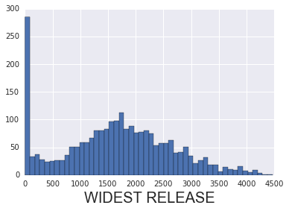
Mean: 1639 theaters Median: 1680 theaters

Slide 8
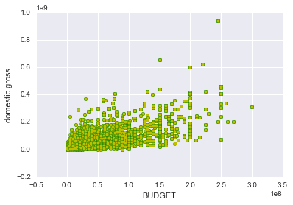
Lots of budget information was missing, so I used domestic gross instead, since these tend to be positively correlated
Notes:
Budget and Domestic gross

Slide 9
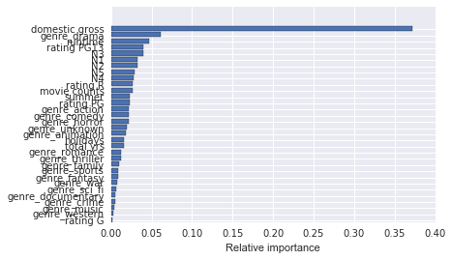
Gradient Boosted Regression Tree model
Score: ~0.87
Selected features that did better than random noise!

Slide 10
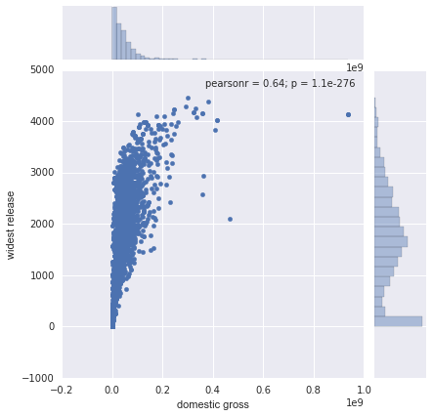
AVG DOMESTIC GROSS

Slide 11
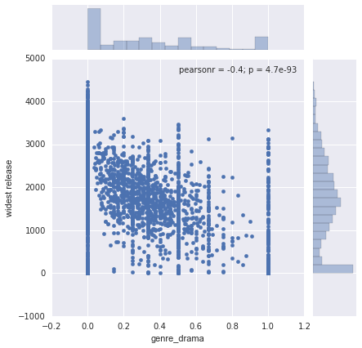
Genre: DRAMA

Slide 12
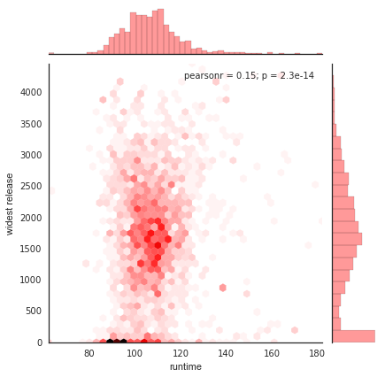
RUNTIME

Slide 13
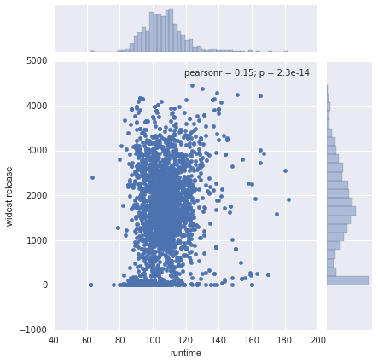

Slide 14
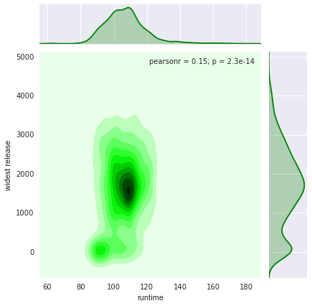

Slide 15
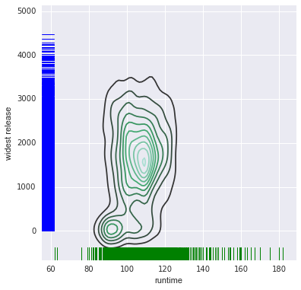

Slide 16
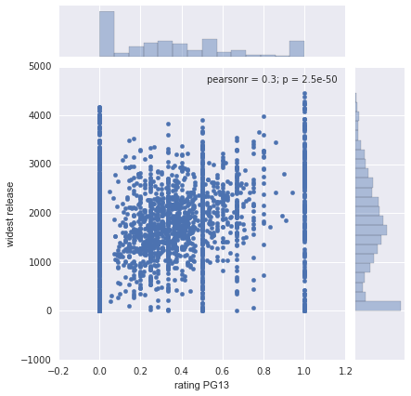
PG13 RATING

