Slide 1
PROJECT LUTHER
Laura Colón-Meléndez
October 7, 2016

Slide 2

Problem Statement
You are an
actor or actress
How do you increase your
average widest (theater) release?

Slide 3



Data & Modeling
Obtained movie data from
FILM GENRES
FILM RATINGS
AVERAGE DOMESTIC GROSS
RELEASE SEASON
Gradient-Boosted Regression Trees model
Notes:
GBR trees -- trees learn from the errors of its predecessors.

Slide 4
Actionable Insights
Look for parts in PG-13 movies
Avoid drama
Avoid movies with long runtimes
(Increase your average domestic gross!)
Notes:
For future work: it might be useful to ignore actors with less than a given number of movies and run the model again without considering avg domestic gross.

Slide 5
Questions? Laura Colón-Meléndez lauradelmar@gmail.com

Slide 6
PLOTS

Slide 7
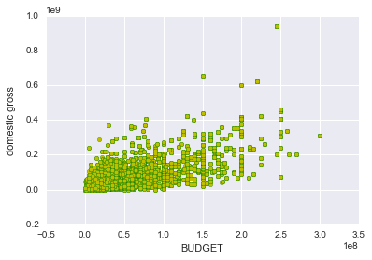
Lots of budget information was missing, so I used domestic gross instead; measured an actor’s average movie domestic gross
Notes:
Budget and Domestic gross

Slide 8
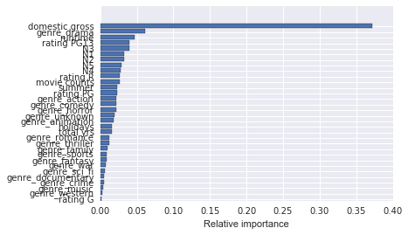
Gradient Boosted Regression Tree model
Score: ~0.87
Selected features that did better than random noise!

Slide 9
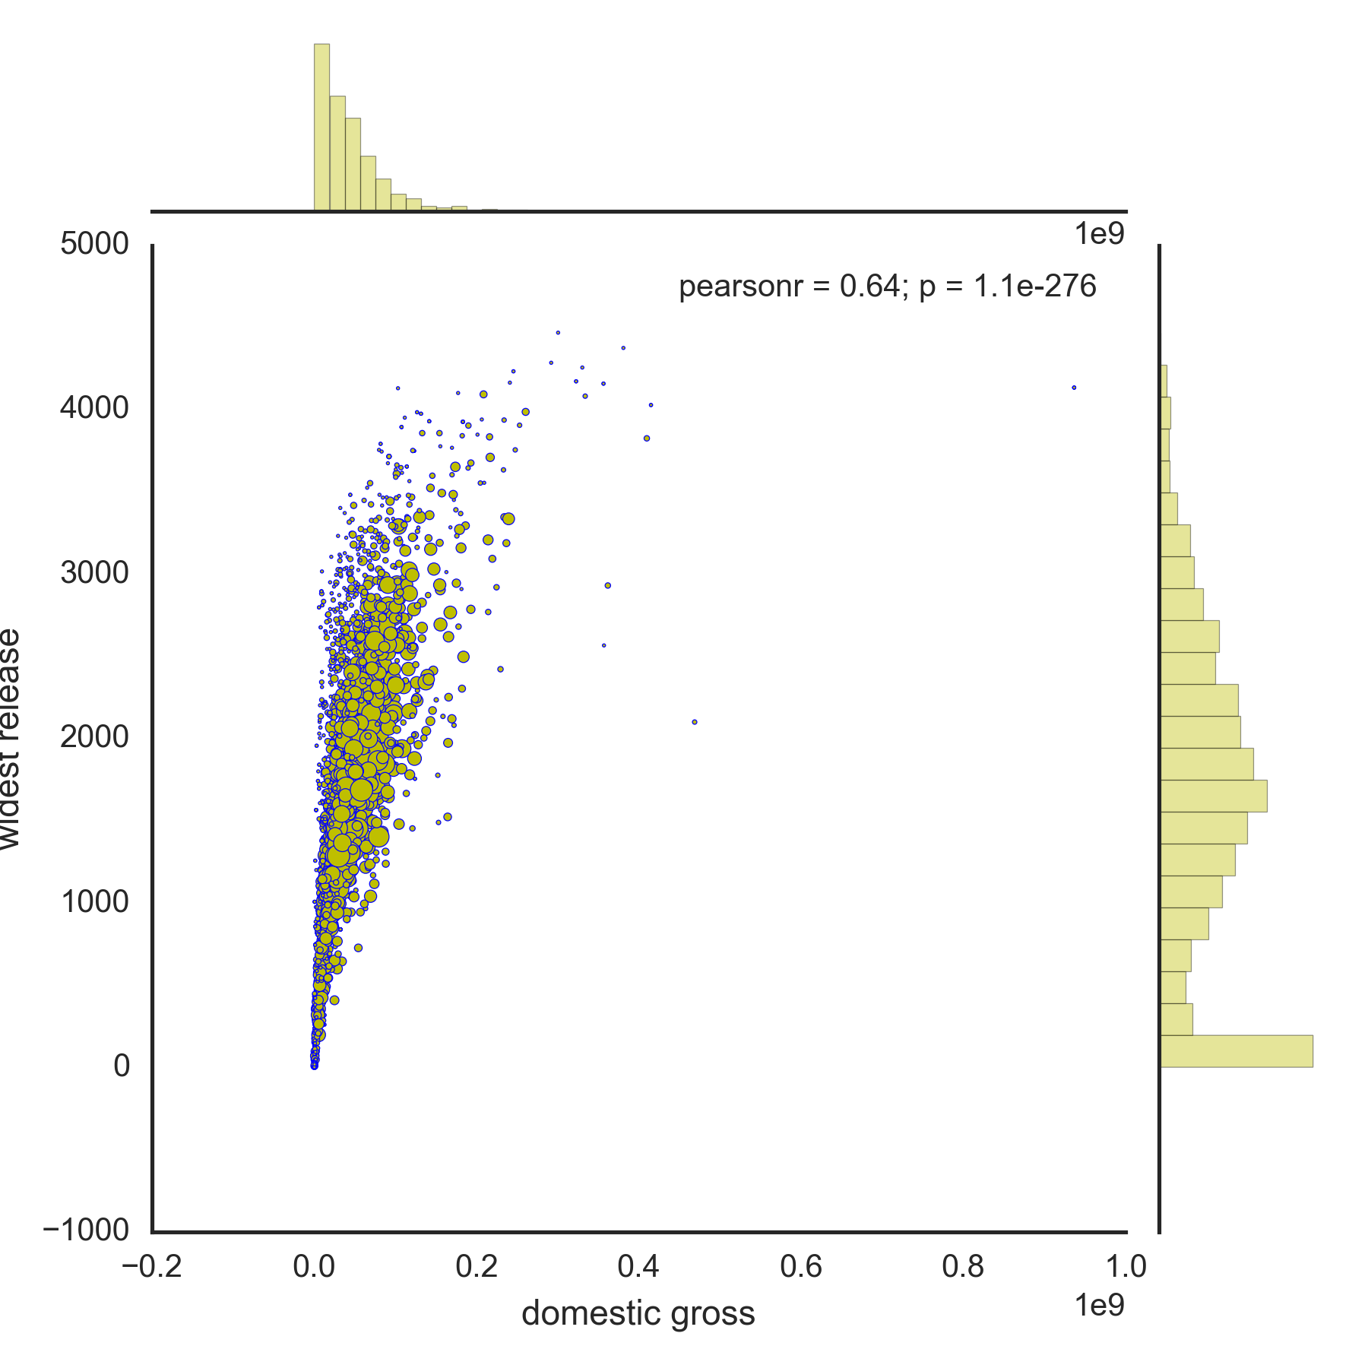
AVG DOMESTIC GROSS
Notes:
SIZE OF DOTS – MOVIE COUNTS?

Slide 10
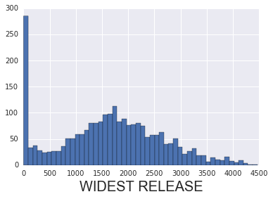
Mean: 1639 theaters Median: 1680 theaters

Slide 11
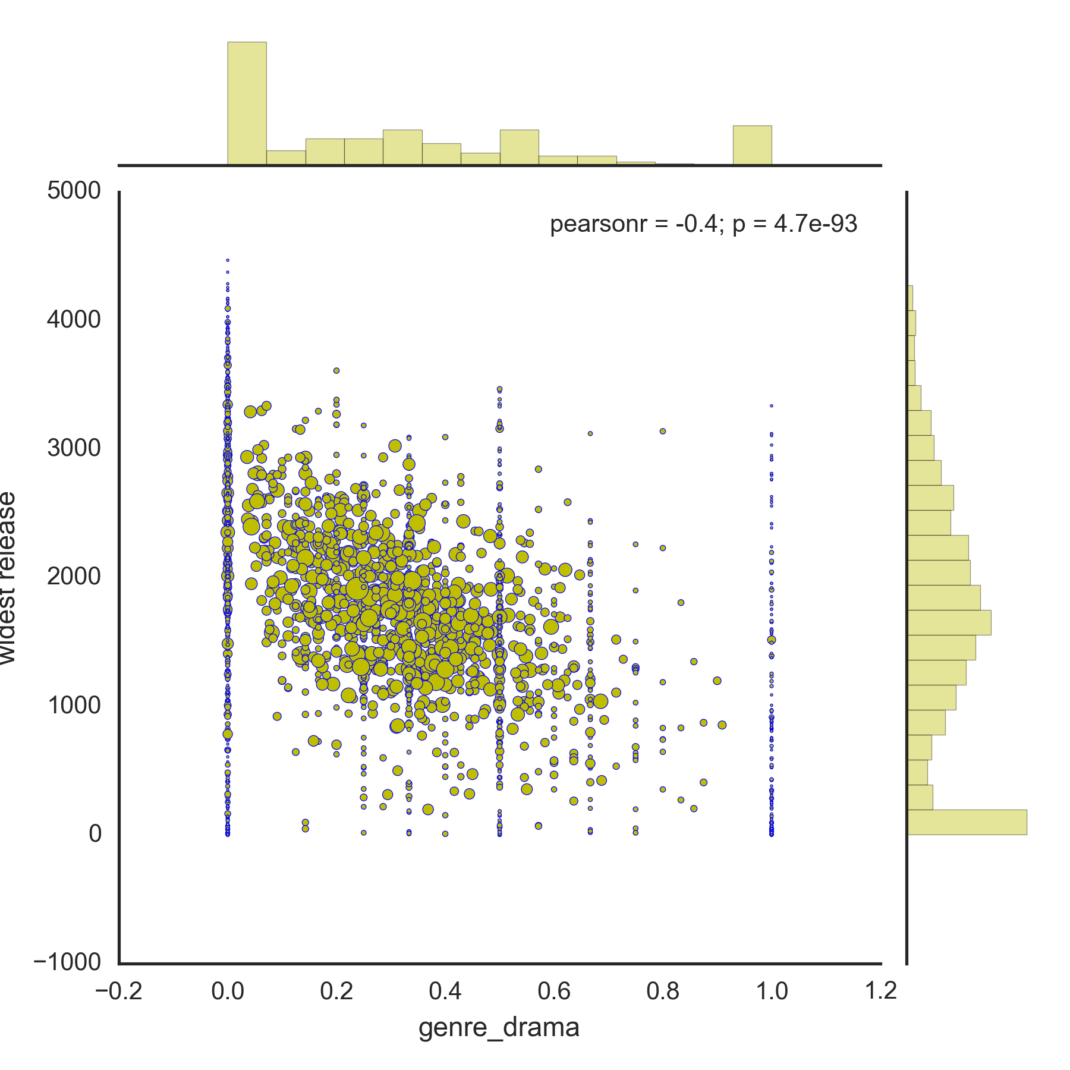
Genre:
DRAMA
Data could be filtered by rejecting actors who have made less than a given number of films

Slide 12
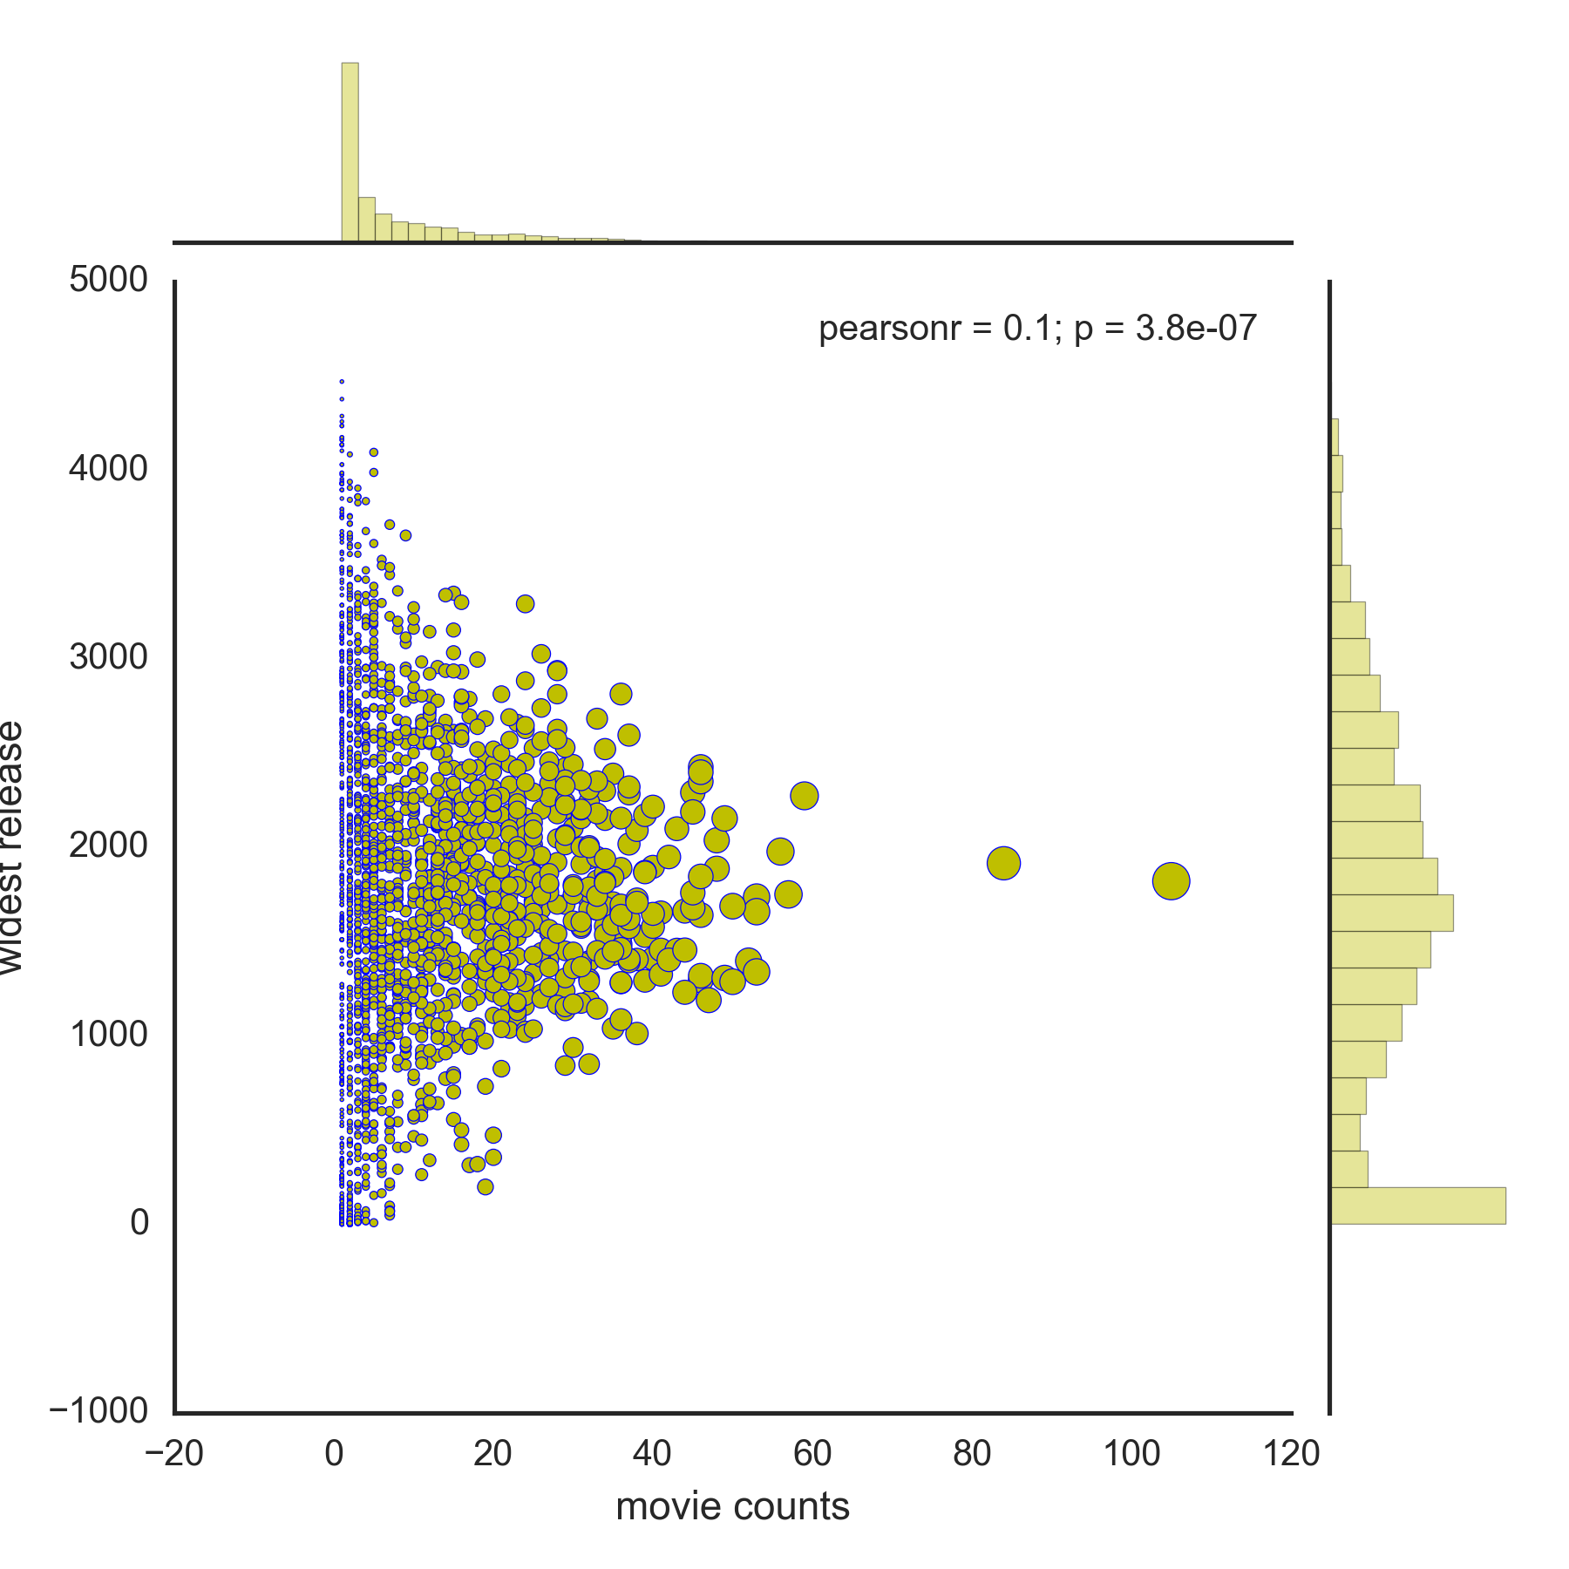
MOVIE COUNTS

Slide 13
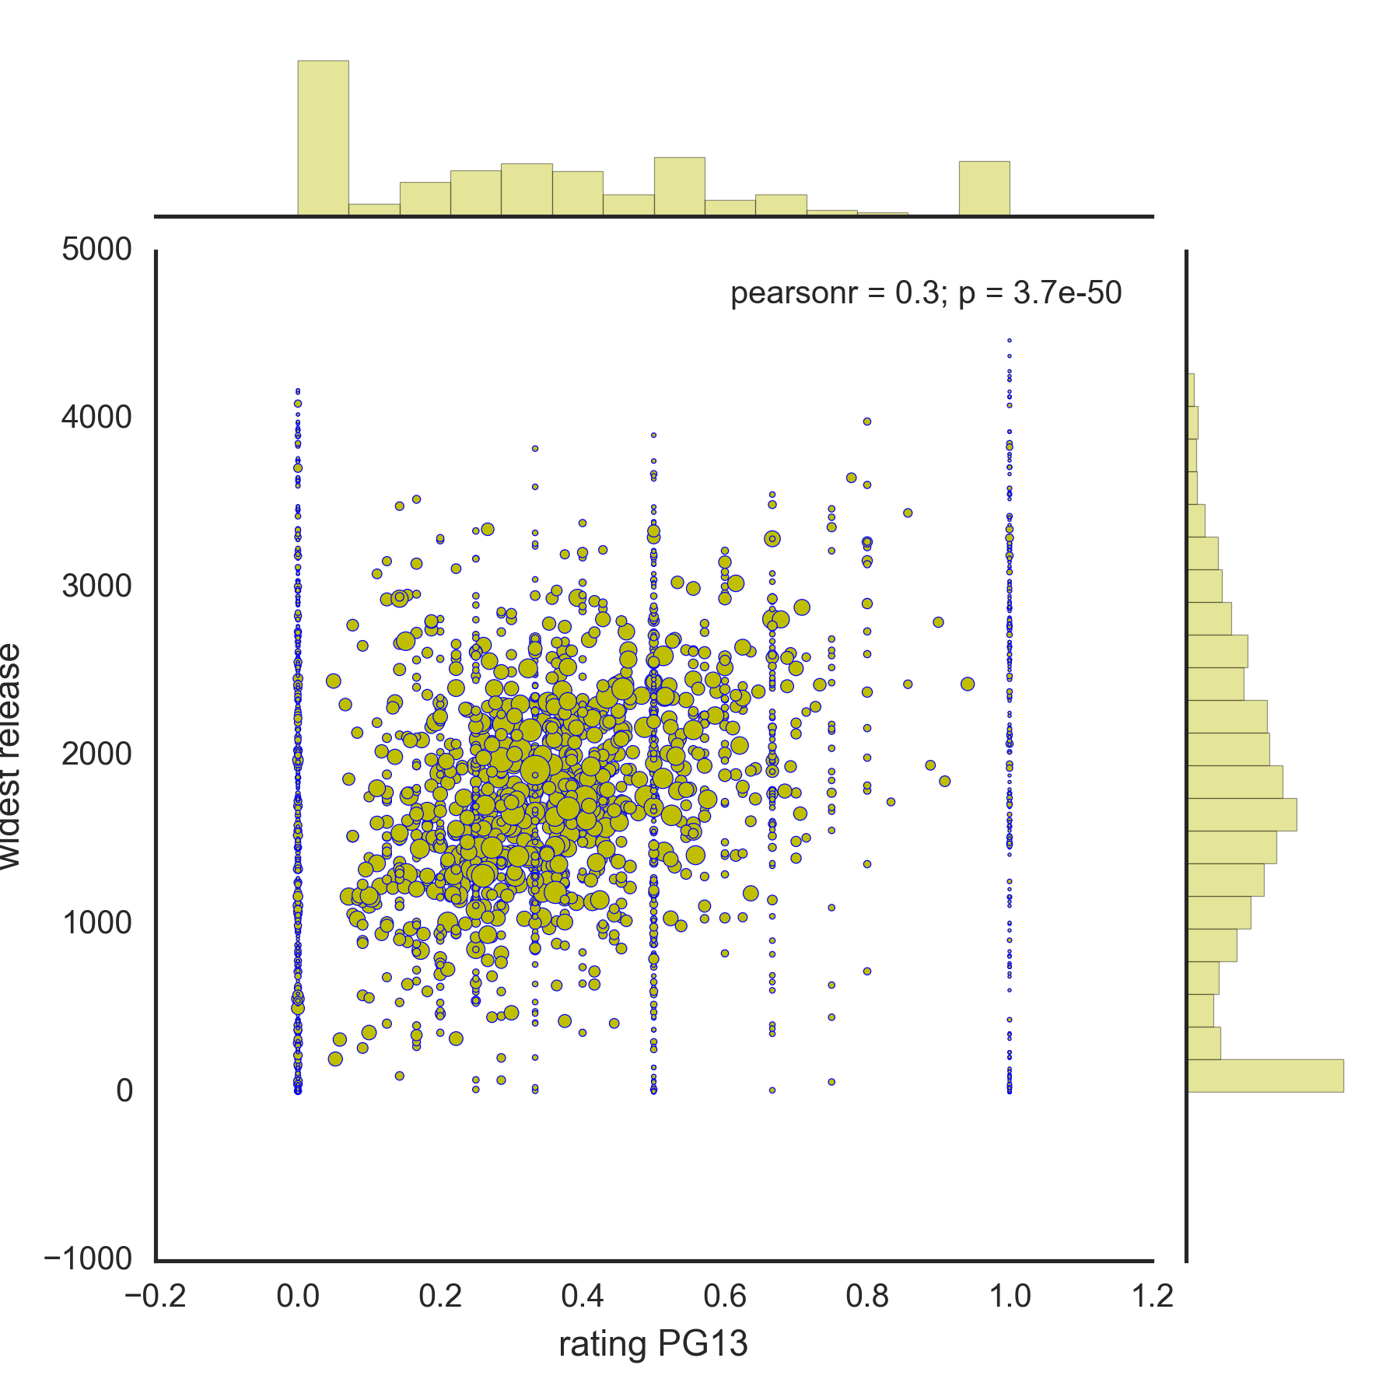
RUNTIME

Slide 14
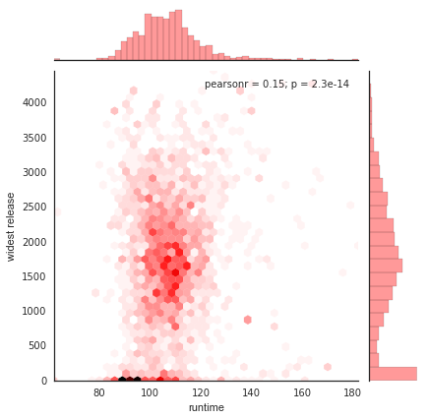

Slide 15
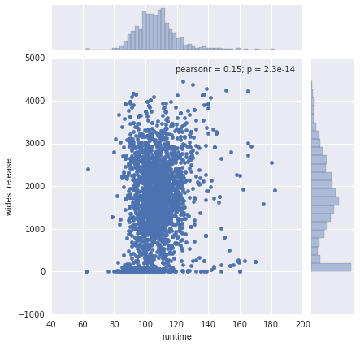

Slide 16
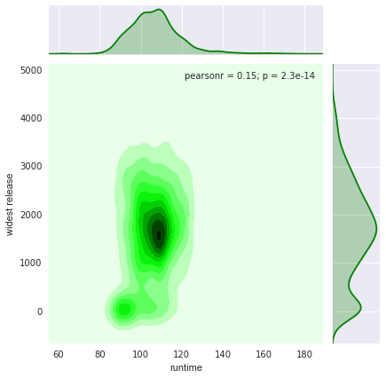

Slide 17
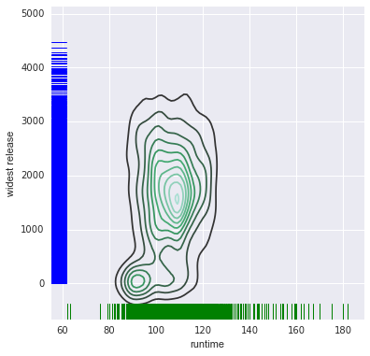

Slide 18
PG13 RATING

