Slide 1
Project Luther
Laura Colón-Meléndez
Metis NYC DS9
October 7, 2016

Slide 2

Problem Statement
You are an
actor or actress*
How do you increase your
average widest (theater) release?
Notes:
What kinds of actors have high widest theater release #s?
What predicts an actor’s avg widest release?

Slide 3




Data & Modeling
BeautifulSoup
Obtained movie data from
ACTOR
Average widest release #
Gradient-Boosted Regression Trees model
Notes:
1990 films onwards
Roughly 2500 actors
Dropped actors whose avg runtime was > 200

Slide 4
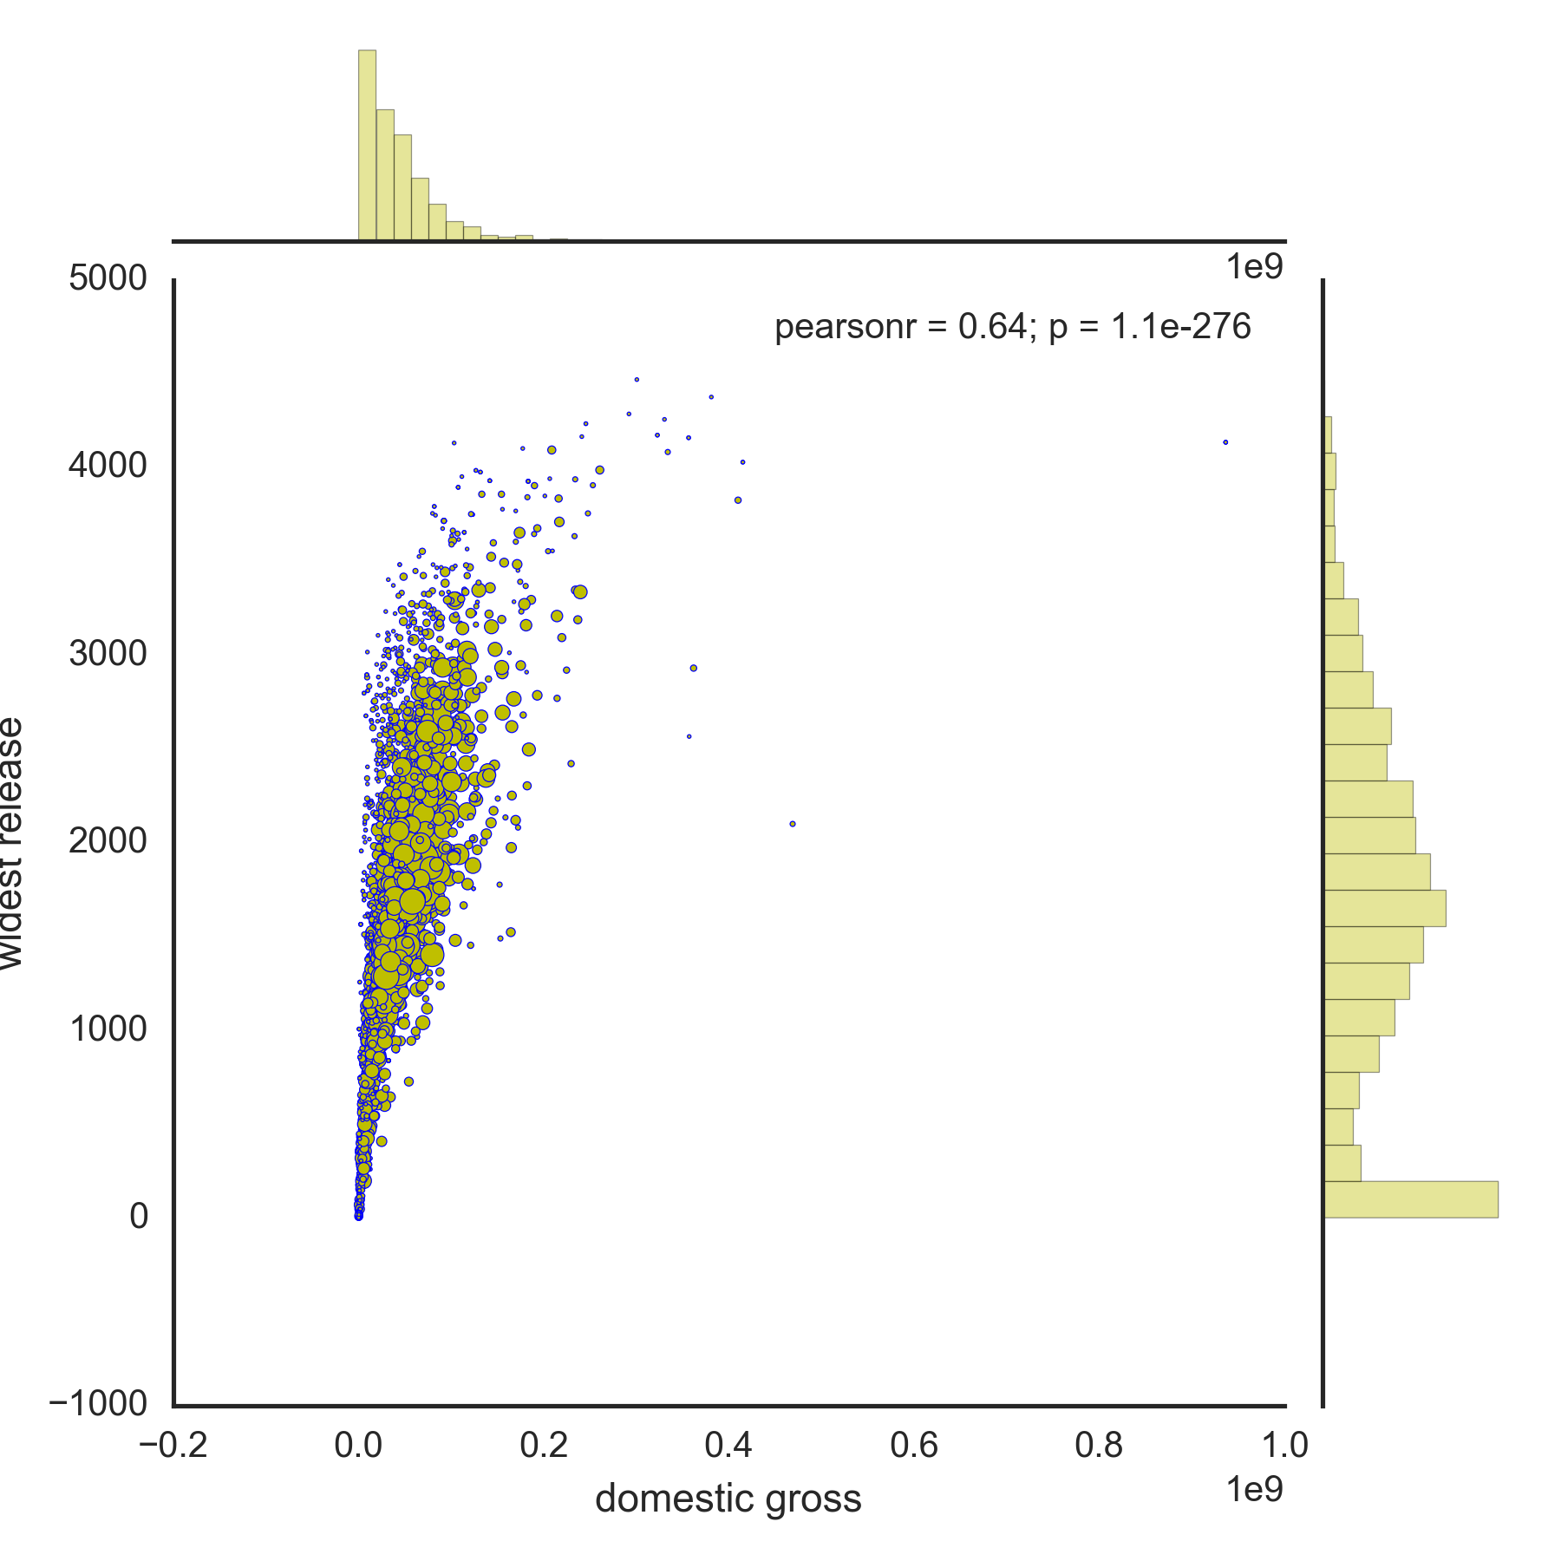
ACTOR’S AVERAGE DOMESTIC GROSS
Having a high average domestic gross is correlated with having a high average widest theater release #

Slide 5
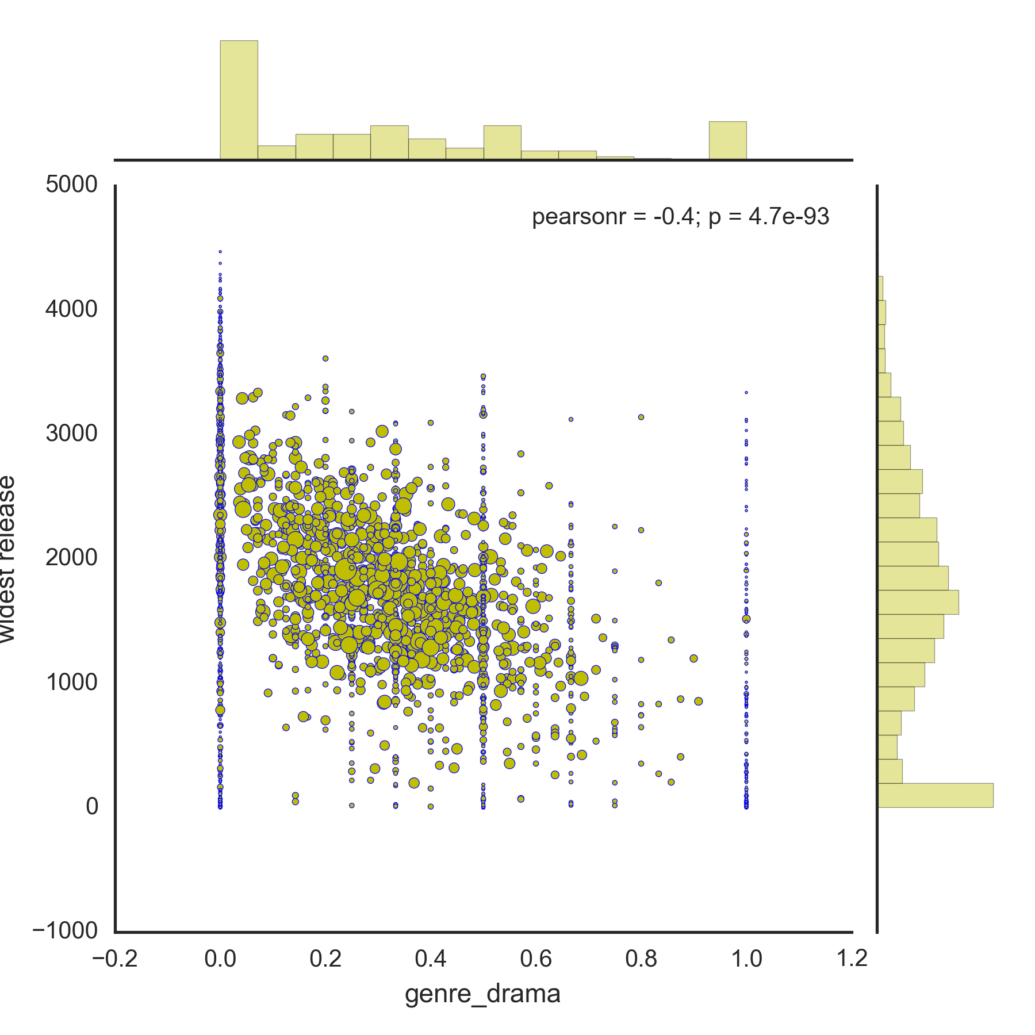
Genre:
DRAMA
Data could be filtered by rejecting actors who have made less than a given number of films

Slide 6
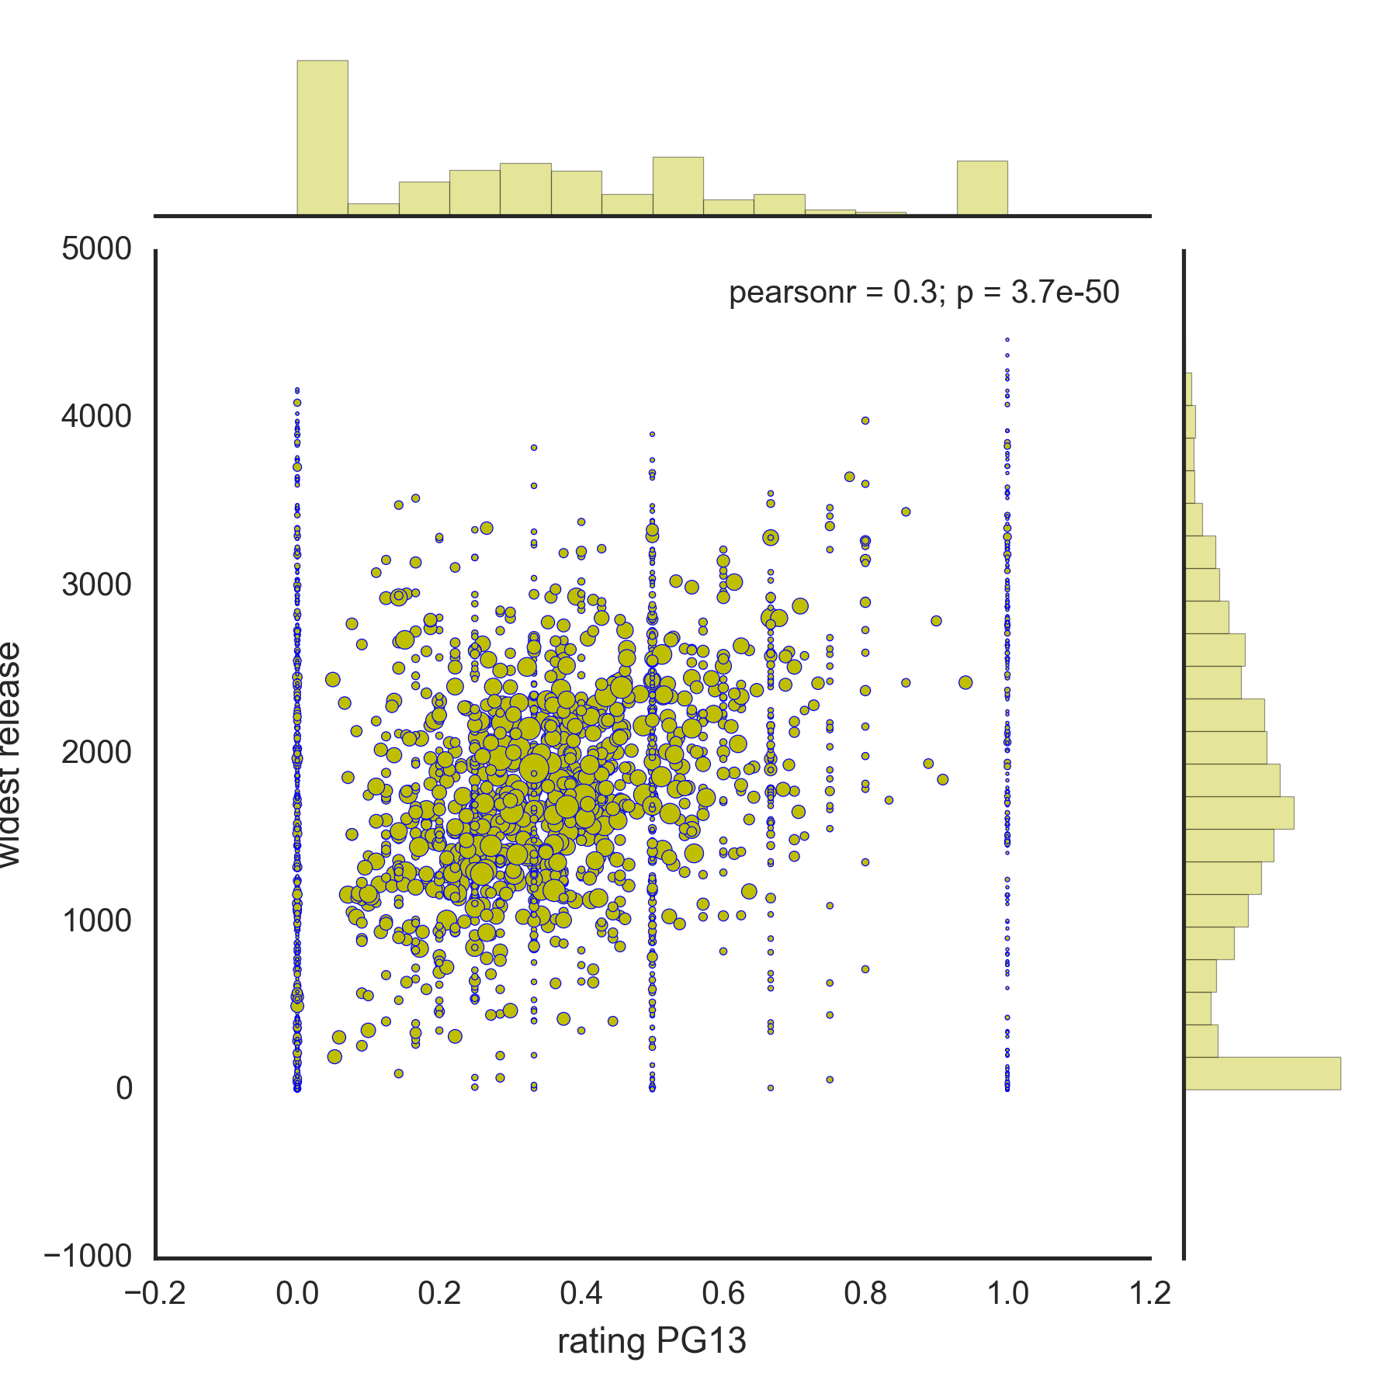
MPAA Rating PG13

Slide 7
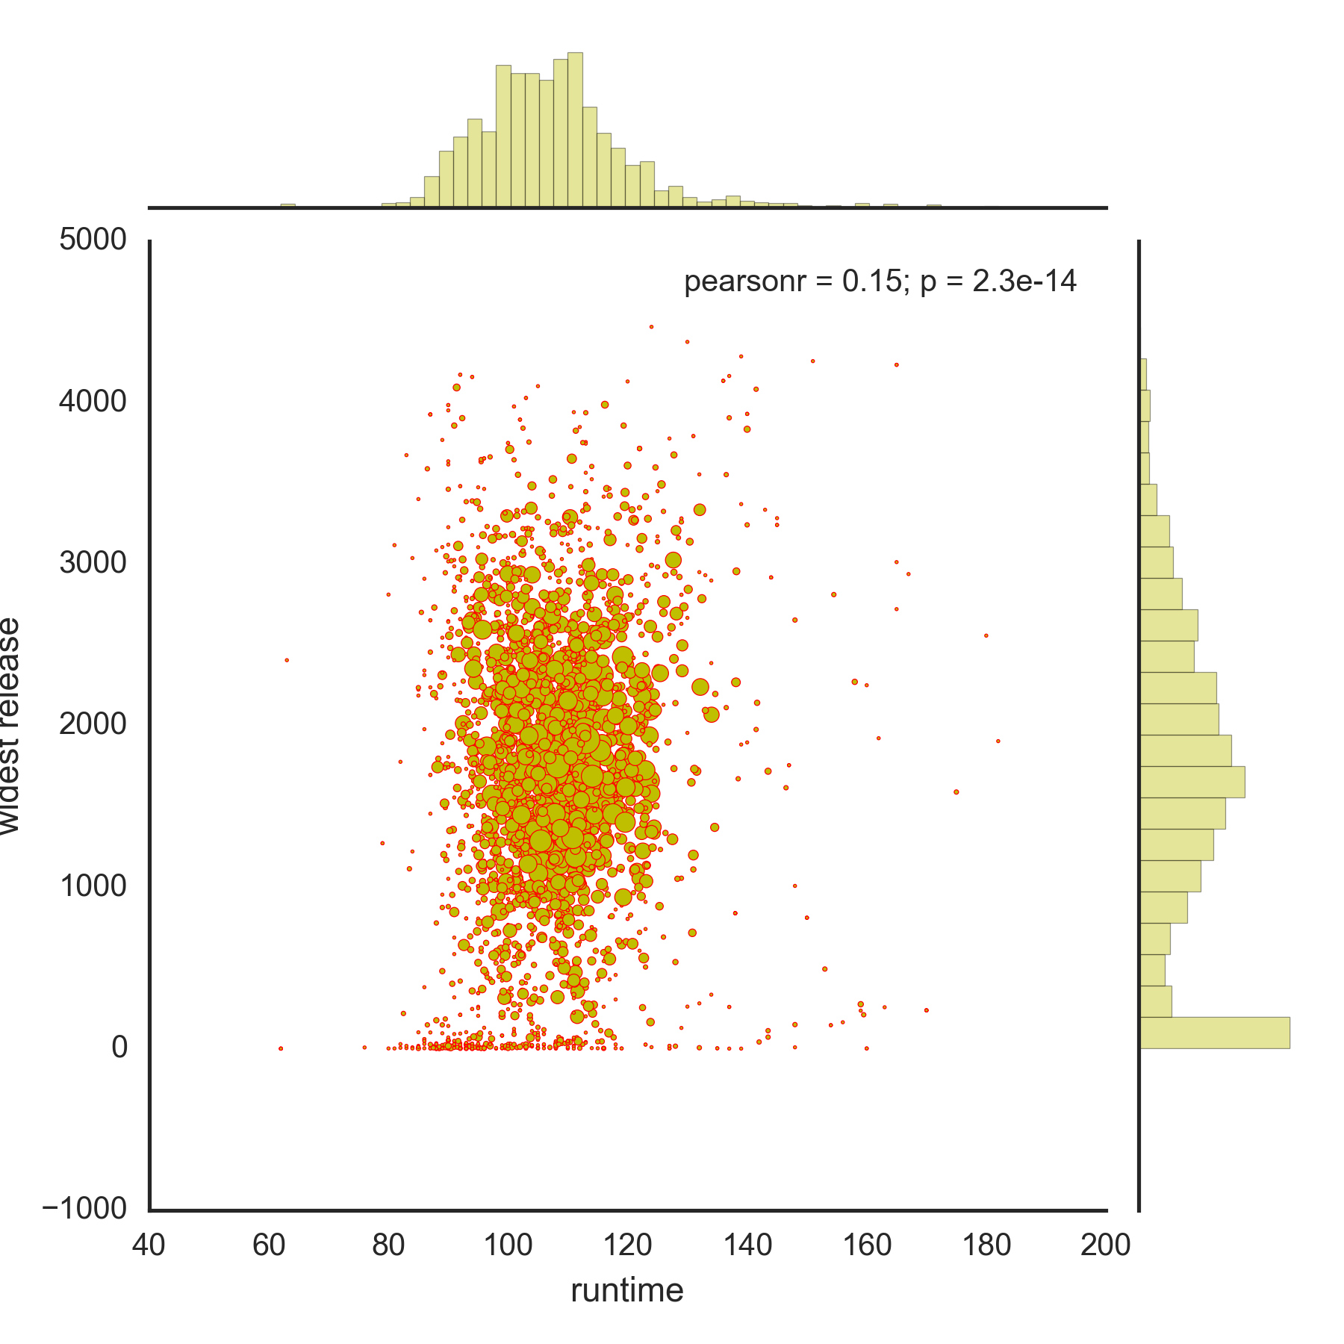
RUNTIME

Slide 8
Actionable Insights
Look for parts in PG-13 movies
Avoid drama
Avoid movies with long runtimes*
High average
domestic gross
Notes:
For future work: it might be useful to ignore actors with less than a given number of movies and run the model again without considering avg domestic gross.

Slide 9
What’s next
Clean the data further!
Get rid of actors with few movies
Consider directors and distributors
Find additional sources of data

Slide 10

Questions? Laura Colón-Meléndez lauradelmar@gmail.com
karmacelina

Slide 11
PLOTS

Slide 12
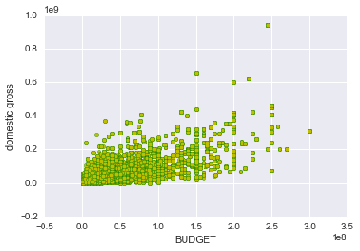
Lots of budget information was missing, so I used domestic gross instead. Measured an actor’s average movie domestic gross
Notes:
Budget and Domestic gross

Slide 13
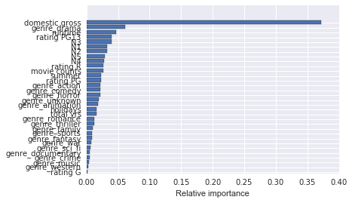
Gradient Boosted Regression Tree model
Score: ~0.87
Selected features that did better than random noise!

Slide 14
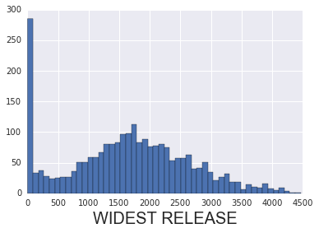
Mean: 1639 theaters Median: 1680 theaters

Slide 15
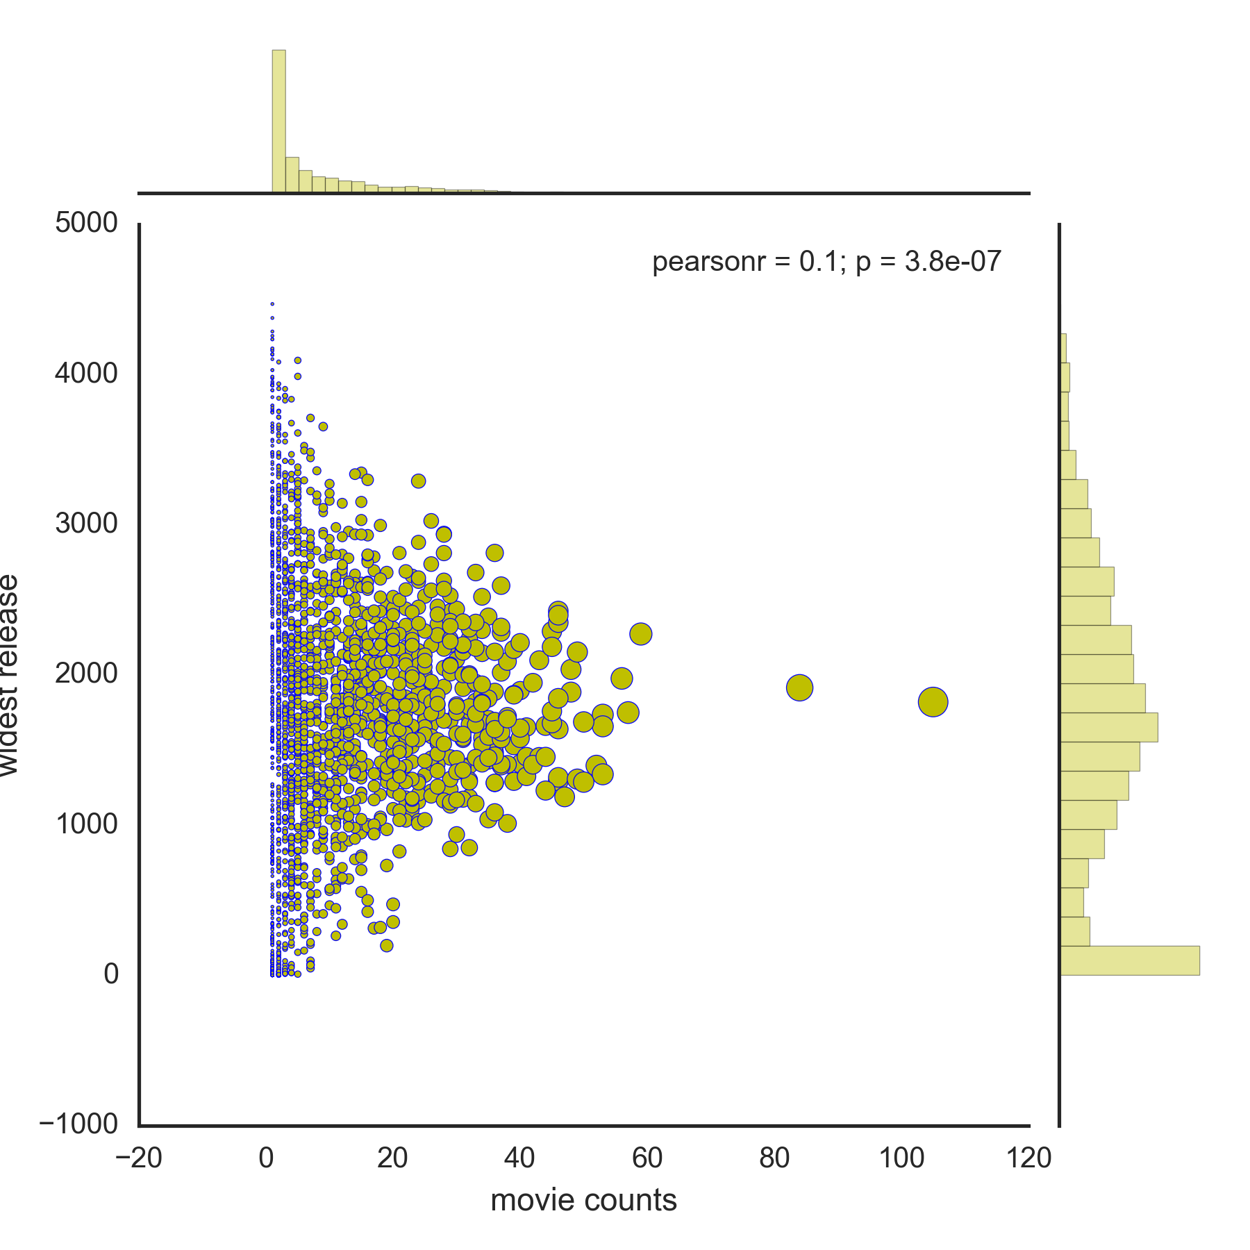
MOVIE COUNTS

Slide 16
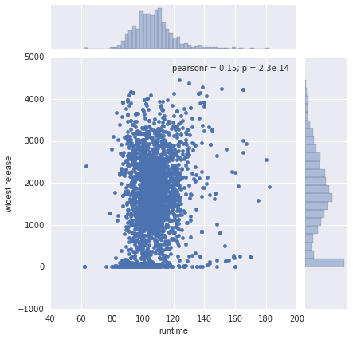

Slide 17
PG13 RATING

