Slide 1
Generative Feature Language Models for Mining Implicit Features from Customer Reviews
Shubhra Kanti Karmaker Santu (University of Illinois Urbana Champaign)
Parikshit Sondhi (Walmart Labs)
ChengXiang Zhai (University of Illinois Urbana Champaign)
Notes:
Add affiliations

Slide 2
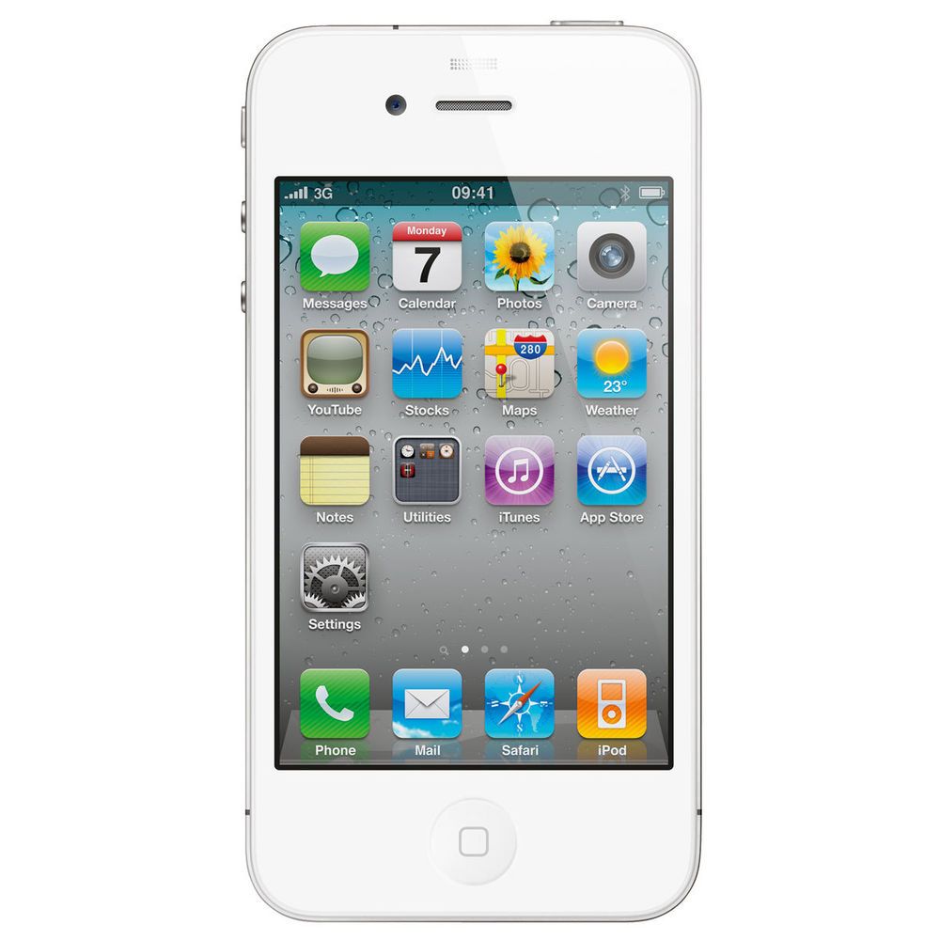
What is Implicit Feature?
“I like the size of the phone, it’s really small”
“The phone fits nicely into any pocket without falling out”
“The battery life is excellent”
“You don’t need to carry a charger with you anymore.”
iPhone 4
Notes:
Make sure to clarify that a feature is implicit or explicit in context of a given sentence

Slide 3
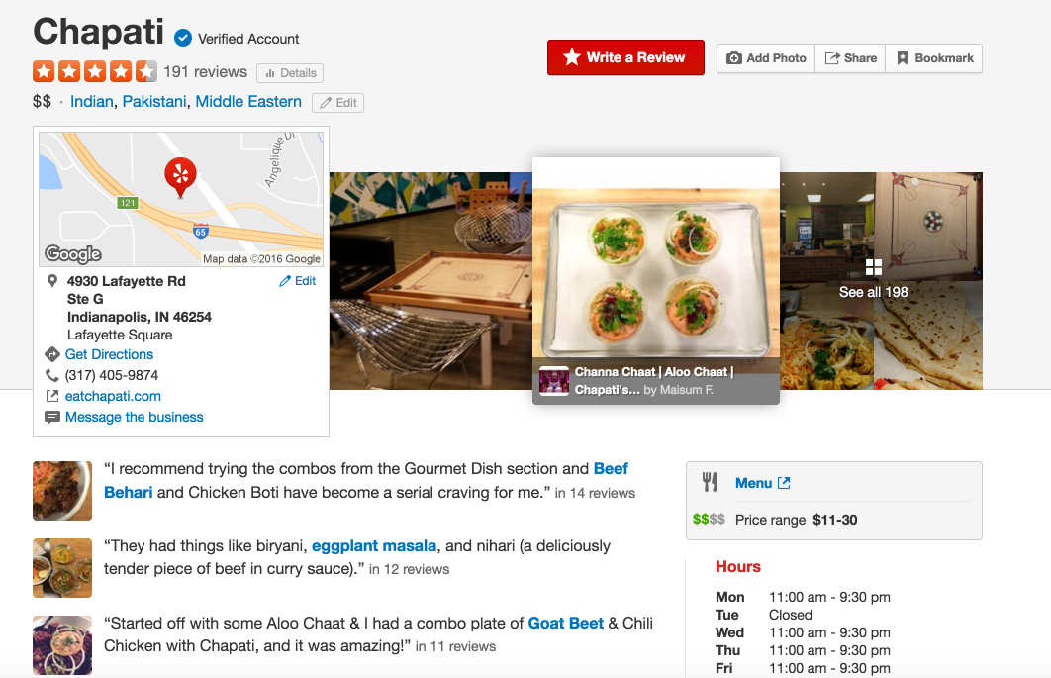
Challenges of implicit feature mining
Properties of Review text:
Noisy
Informal language
Humors
No Ground Truth Datasets in English yet
Notes:
You want to actually first give examples of what the previous methods are. You can actually avoid discussing previous approaches in this slide. And move this discussion to the experiments where you explain what the baselines are.
Here you want to give better insights into the problem itself.

Slide 4
Our approach
Generative Feature Language Model
Unsupervised approach
Exploits statistical modeling: Principled optimization problem
sound mathematical basis
Naturally handles the noisy text
Parameters are learnt automatically
No heuristic tuning
Notes:
Move this to after describing your method. It’ll be hard for people to make sense out of these without actually understanding what your method is.

Slide 5
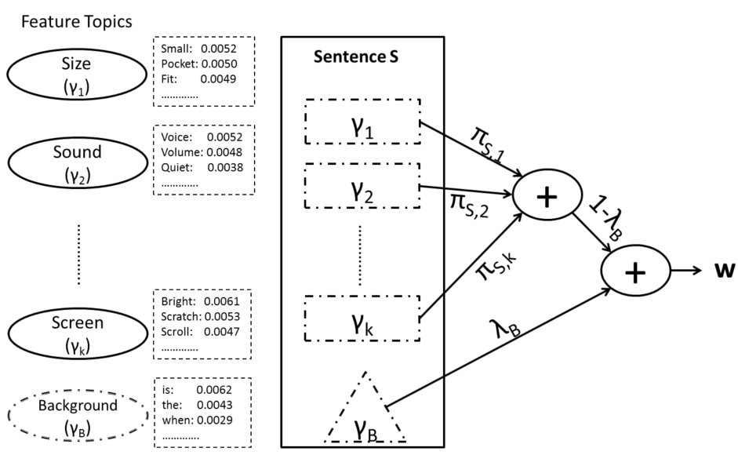

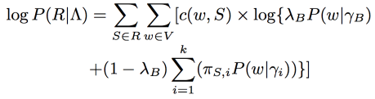

Generative Feature Language Model (GFLM)
Notes:
Before getting into the model, you want to explain with examples the key ideas behind your method. Most people will not understand the detailed math, but they will want to understand the key intuitions. This also gives you a way to compare yourself against the baselines that you describe later.

Slide 6



Estimation of the parameters
Background Model:
Feature Topic Model:

Slide 7
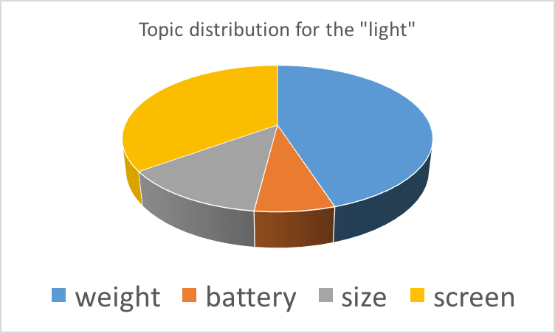
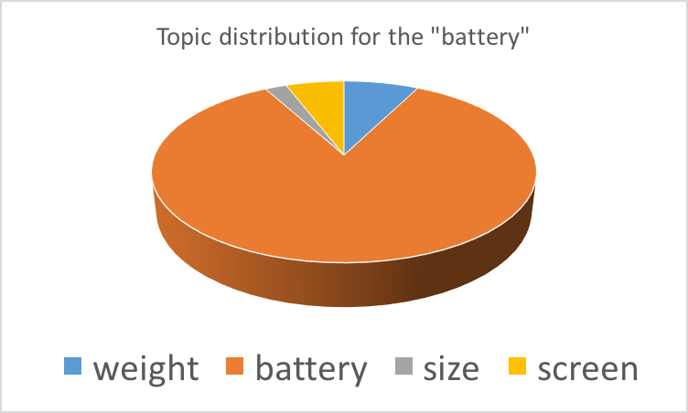
Introduction of Hidden Variables
How to estimate the ?
Solution: Introduce hidden variables Z
Z_{S,w} represents the identity of each word
Distribution of feature topics
“Its very light and holds charge for the whole day”
light

Slide 8
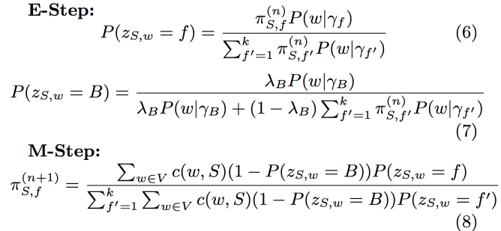
Parameter Estimation: EM framework
E-Step:
Estimate the distribution of the hidden variables
Estimate the identity of each word
Each word is divided into fractions
The fractions are generated from feature topics
M-Step:
Aggregate fractions to estimate the new Λ
The new Λ increase the log likelihood of the data
Example:
“There were scratches on the display. Its very annoying.”

Slide 9
Implicit Feature Prediction
Two different ways of prediction:
GFLM-Word (FM-W): look at feature topic distribution at the word level
GFLM-Sentence (FM-S): look at feature topic distribution at the sentence level

Slide 10
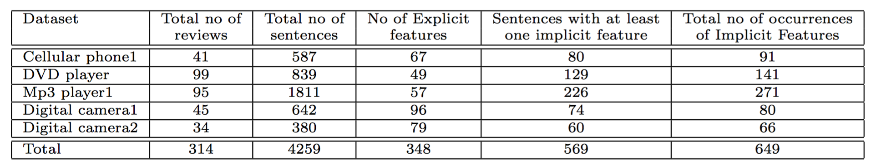
Experimental Design: Data Sets
Human Annotated Dataset [M. Hu et.al. SIGKDD 2004]
(Thanks to Prof. Bing Liu)
Notes:
You want to break this into two slides and take sometime explaining how you created the two datasets. This is important especially since no standardized datasets exist.

Slide 11
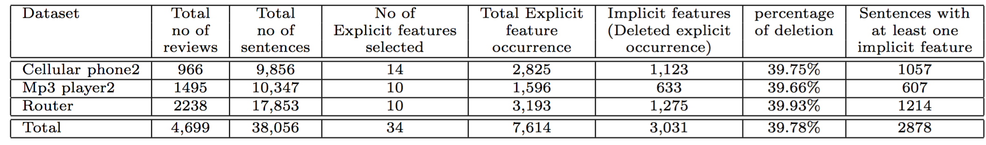
Experimental Design: Data Sets
Automatically Annotated Dataset [ J. McAuley et.al. SIGKDD 2015]
(Thanks to Prof. J. McAuley)
Notes:
You want to break this into two slides and take sometime explaining how you created the two datasets. This is important especially since no standardized datasets exist.

Slide 12
Baseline Approaches
Previous approaches :
Naive Bayes Classifier Based Ranking
Correlation Based Ranking [Y. Zhang et.al., WWW 2013]
Limitations
Heuristics: lacks theoretical grounds
Pre-selected factual and sentiment words as seeds
Many decision choices (parameters, thresholds)
hardly generalize over different datasets
Supervised classifiers

Slide 13
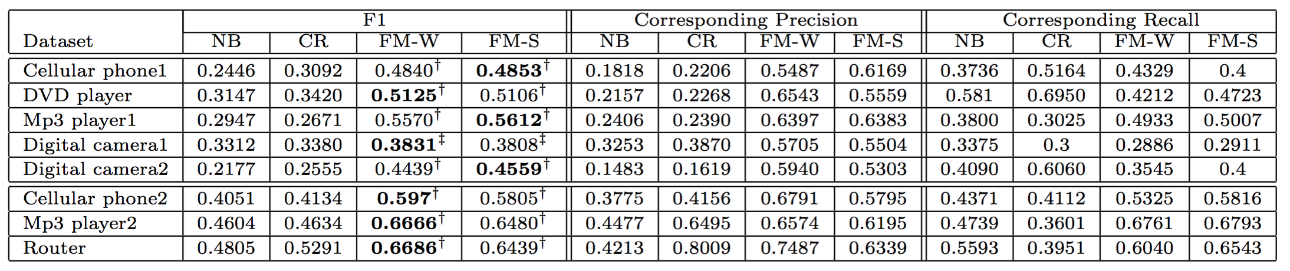
Results: Comparative Analysis
Comparison of GFLM with baseline approaches
Notes:
Just before this slide, you want to bring up the discussion on existing approaches. This is where you describe the baselines in detail. As you explain the results you can just highlight why the baselines are limited in their ability to model the data compared to your method. At this point since you already have better results for the problem, you don’t need to work too hard to highlight the advantages of your method. They become obvious, since your results are better anyway.

Slide 14
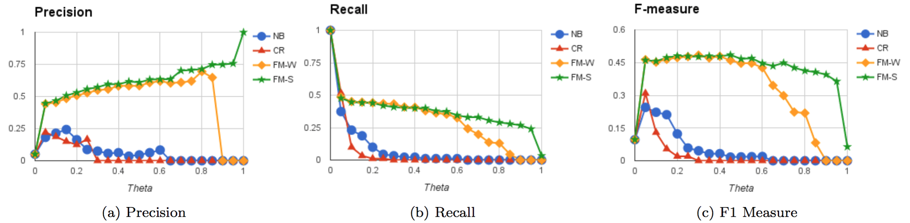
Results: Thresholding Parameter Analysis

Slide 15
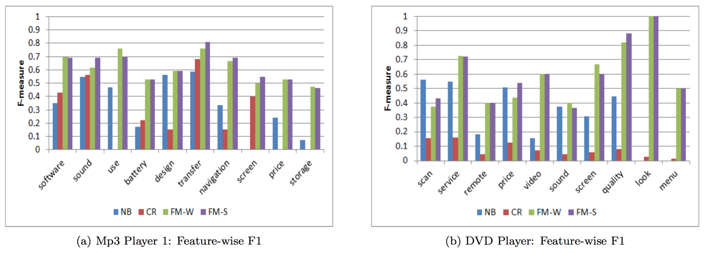
Results: Feature Level Analysis

Slide 16
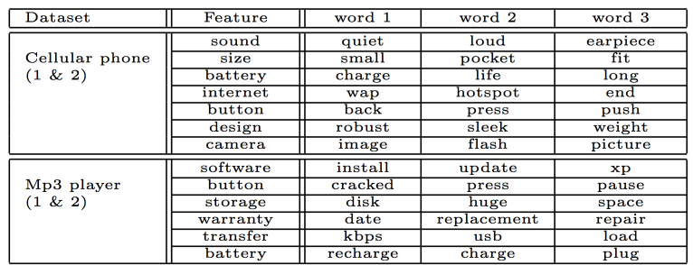
Results: Feature Level Analysis

Slide 17
Conclusion and Future Directions
Contributions
A new generative feature language model
Unsupervised way to mine implicit features
Filter noisy words by using a background language model
Eight new English datasets
Future Directions
How to leverage implicit features to improve the summary product reviews?
Try this approach on different languages?
Notes:
In contributions, claim that you built a standardized dataset for the task.

Slide 18

Questions?

