Slide 1
Modeling the Influence of Popular Trending Events on User Search Behavior
Shubhra Kanti Karmaker Santu – UIUC
Liangda Li – Yahoo Research
DaeHoon Park – Yahoo Research
Yi Chang – Yahoo Research
ChengXiang Zhai - UIUC

Slide 2
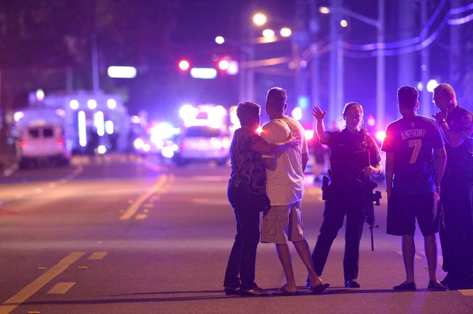

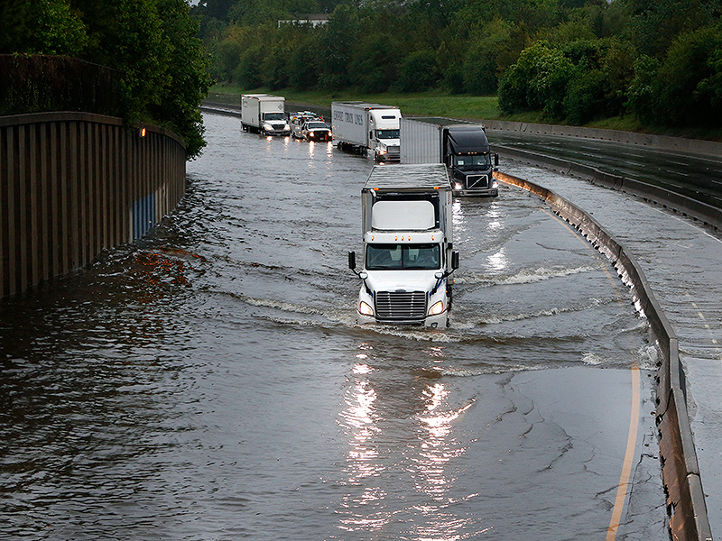


Motivation
Orlando shooting
Panama Papers
Texas Flood

Slide 3
Research Questions
How can we computationally model the influence of trending events on user search behavior?
What kind of queries are triggered by what kind of events?
What kind of events tend to be most influential?
How long does the influence last?
Can we predict whether a user's query was triggered by a particular event?

Slide 4
Influence
Number of queries triggered by an event.
Two important things to consider:
Textual influence
Temporal influence
Which event influenced the following query?
“US election”

Slide 5
Influence
Which event influenced the following query?
“US election”
US election 2016? US election 2012?
Need more information?
Timestamp of the query
Was this event trending then?

Slide 6
Three Basic Tasks
Find Influential Events
Find queries triggered by influential events
Model the trend of influence by trending events on user searhc behavior

Slide 7
Three Assumptions
Query q=<W_{q}, t_{q}, W_{U}>
Event E=<W_{E},t_{E}>
A query q is influenced by event E, if:
q is textually similar to E
q is temporally similar to E
ClickedURL (q) is textually similar to E

Slide 8
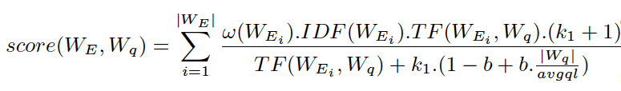

Query Textual Similarity

Slide 9

Query Temporal Similarity

Slide 10
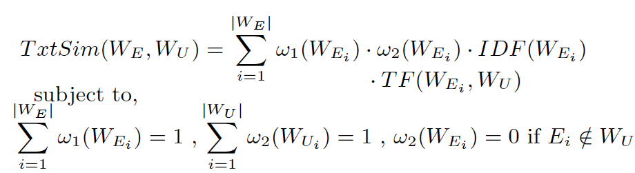
Clicked-Content Textual Similarity

Slide 11
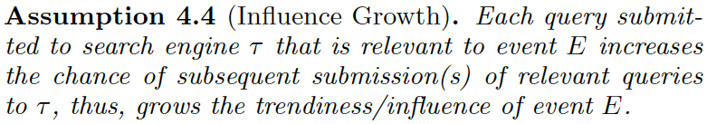
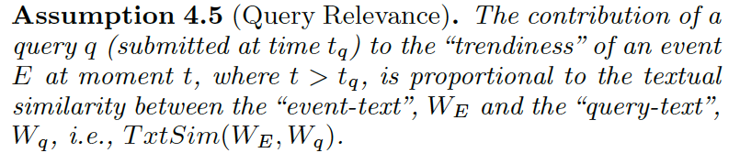
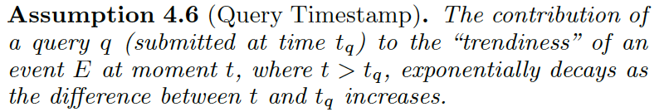
Modeling the Trend
Motivation: Hawkes Process – self exciting point process

Slide 12

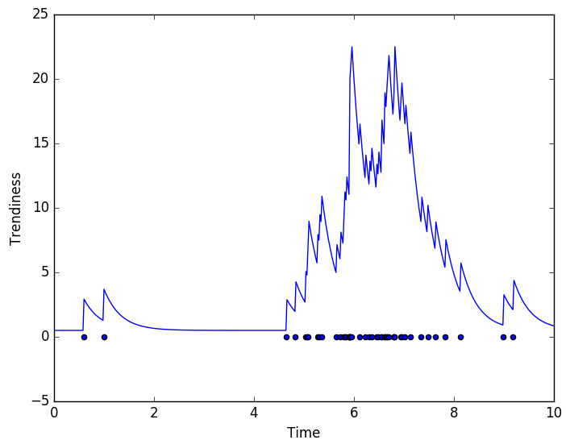
Modeling the Trend
The model of Trendiness:

Slide 13

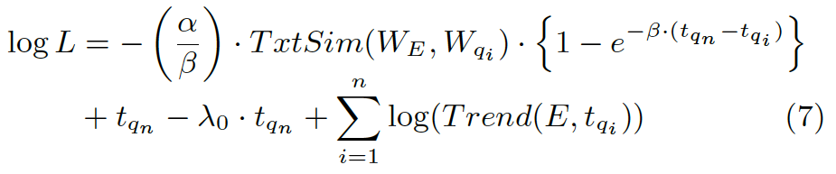
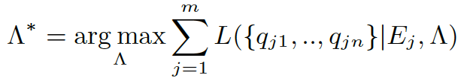
Modeling the Trend
The model of Trendiness:

Slide 14
Estimating Trend Parameters
2 different data sets
Trending event Data set
User Query Log Data set

Slide 15
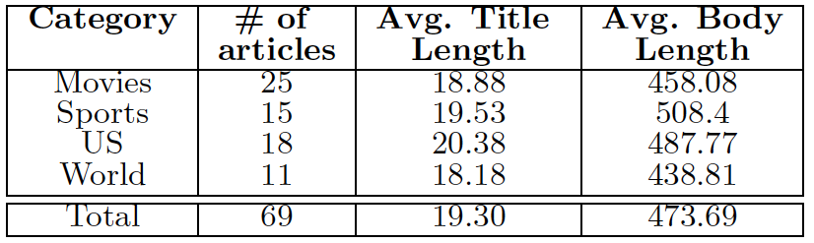
Data sets – Trending Events
Trending news articles from Nytimes.com (April and May, 2016)
Most read
Most shared
Most emailed
<title-text, body-text, timestamp>

Slide 16
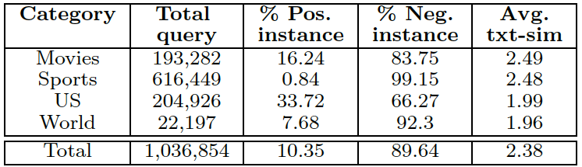
Data sets – Search Query Log
Two months query log from search.yahoo.com
105,925,732 query submissions
top 500 unique queries for each event
Keep all queries with textual similarity greater than 1.5
<Query-text, timestamp, clickedURL>.

Slide 17
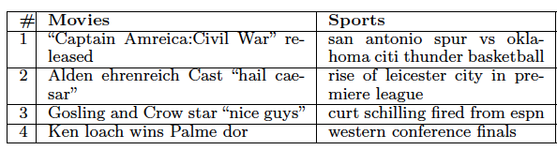
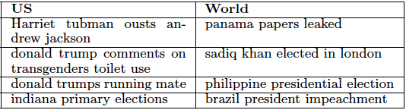
Qualitative Evaluation – Influential events

Slide 18
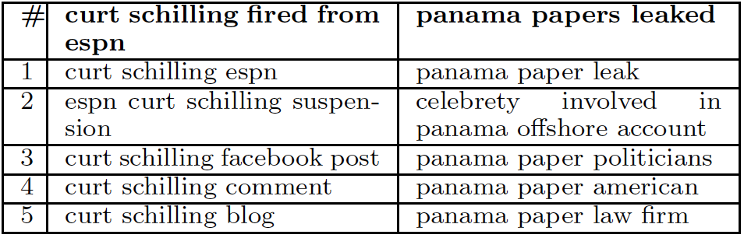
Qualitative Evaluation – queries Influenced by events

Slide 19

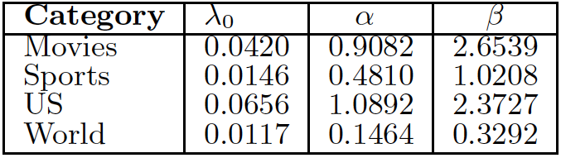
Qualitative Evaluation– interpreting learnt parameters

Slide 20
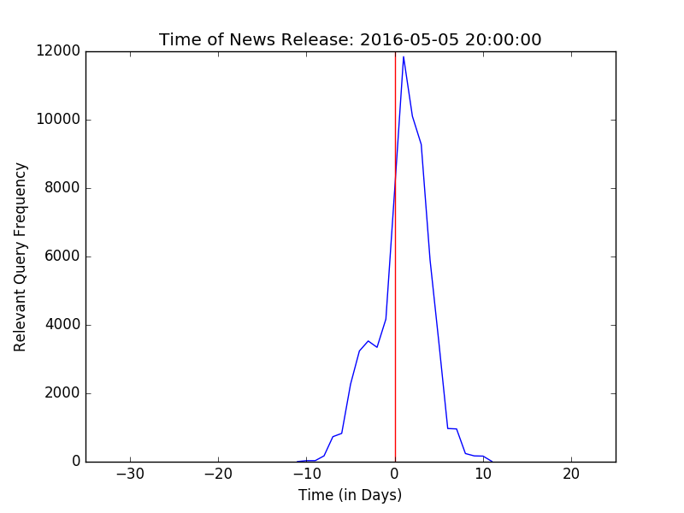
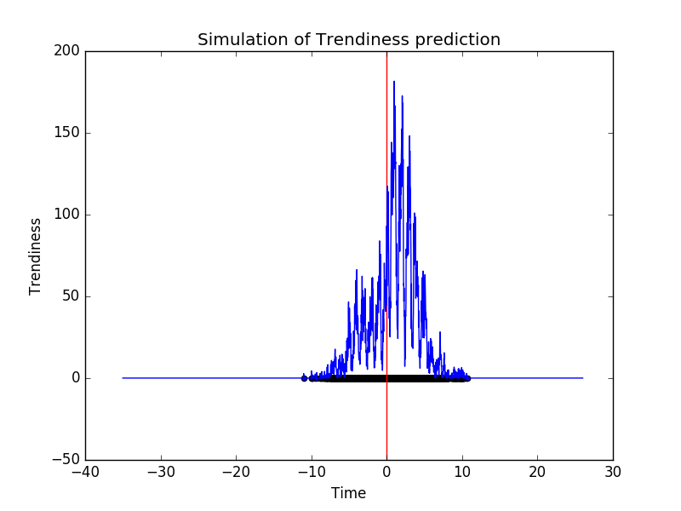
Qualitative Evaluation– Capturing Trend

Slide 21
Quantitative Evaluation – Experimental Setup
Define a new prediction task:
Given a new query and an event, can we predict whether the query was triggered by the event without looking at the click-through?
The gold standard is the one that looks at the click-through
What can we use in the absence of click-through?
Trendiness?? Exactly!!

Slide 22

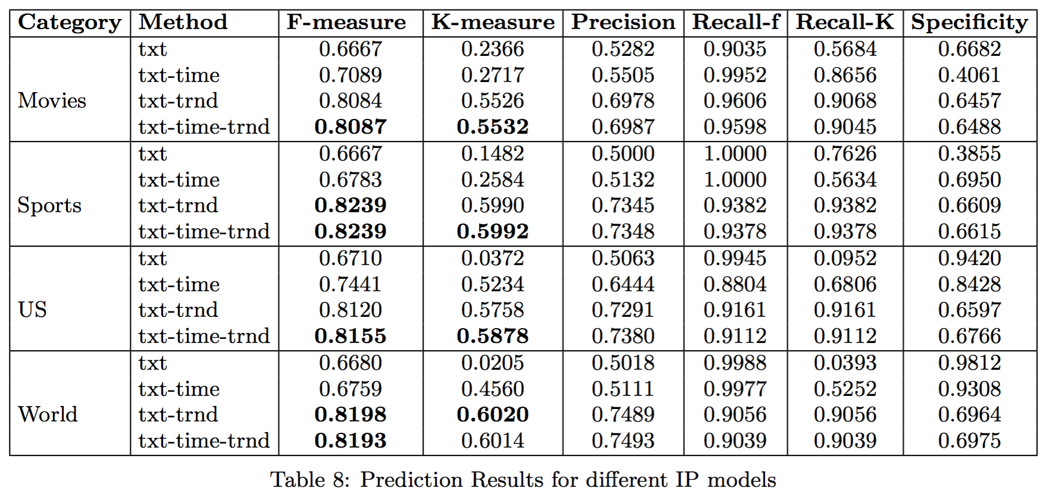
Quantitative Evaluation - Results

Slide 23

Questions?

