Slide 1
NRF: A Naive Re-identification Framework
Shubhra Kanti Karmaker “Santu” (UIUC)
Vincent Bindschadler (UIUC)
ChengXiang Zhai (UIUC)
Carl A. Gunter (UIUC)

Slide 2
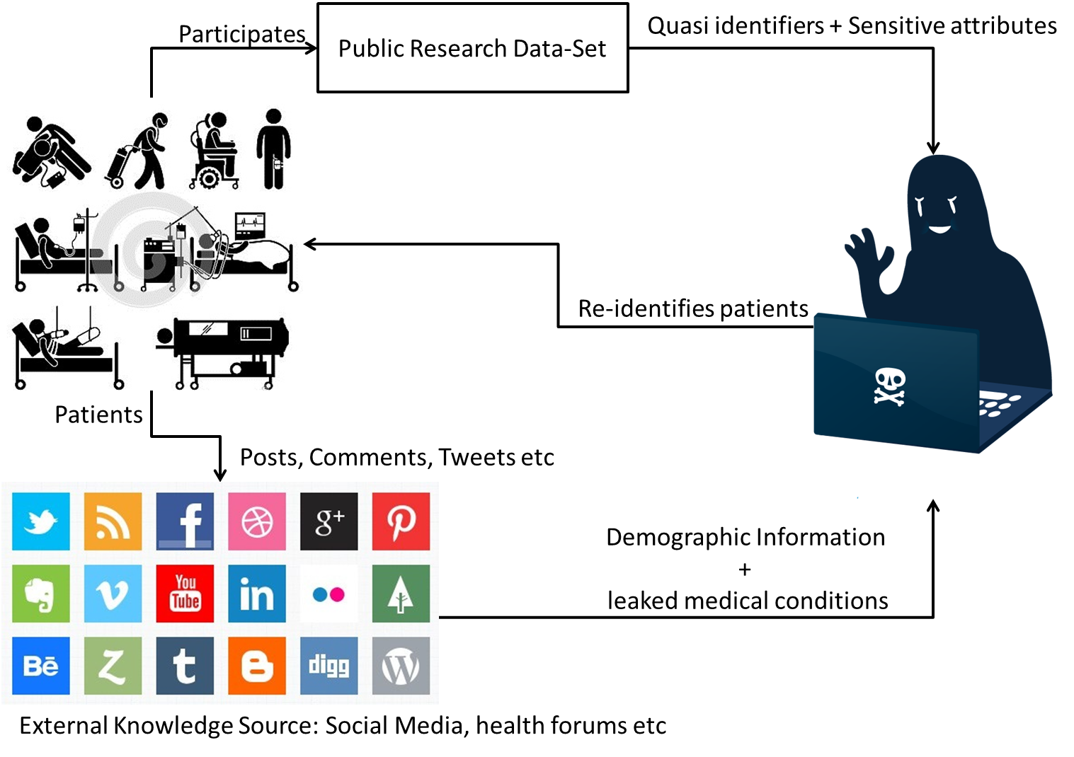
Risk of re-identification

Slide 3
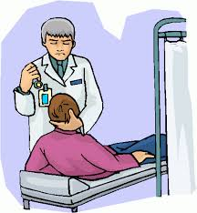


How severe is the problem?
Patient Records
Movie Ratings
Search Logs
Sweeney, 1997
Loukides, 2010
Narayanan et al., 2008
Barbaro et al., 2008
Emam et. al. 2011 reports that:
Re-identification: 26%
For medical dataset: 34%

Slide 4
Existing techniques to protect privacy
Syntactic Metrics
k-anonymity [Sweeny, 2002]
l-diversity [Machanavajjhala et.al. 2007]
T-closeness [Li et.al. 2007]
Differential Privacy
HIPAA privacy rule
Replicability
Knowability
Distinguishability

Slide 5
Existing techniques to protect privacy
Syntactic Metrics
Ignore the attacker’s external knowledge
Differential Privacy
Independent of attacker’s external knowledge
Mostly applied in a query-response fashion
How much noise we have to use?
Not a Quantification Metric
HIPAA privacy rule
Not a Quantification Metric

Slide 6
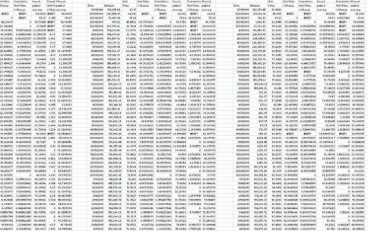

The research Question
???
How to formally quantify the risk of re-identification?

Slide 7
A toy example
Non-sensitive
Sensitive
Patient | X | Y | Z
A | x_{a} | y_{a} | z_{a}
B | x_{b} | y_{b} | z_{b}
Patient | X | Name
A | x_{a} | JOHN
B | x_{b} | ADAM
Complicated case
------------------------
Disclosure Uncertainty
Attribute Uniqueness Uncertainty

Slide 8
A GENERAL RE-IDENTIFICATION FRAMEWORK
Data Set Model
How unique are the records of the Data set
External Knowledge Model
How likely the attacker may know attribute values
Risk Model
Combine Data Set Model and External Knowledge Model
Quantify the risk

Slide 9


Data set model
key/value pair
Key: a distinct subset of all attribute set X
Value: its D-Uniqueness

Slide 10


External Knowledge Model
key/value pair
Key: a distinct subset of all attribute set X
Value: its Disclosure Likelihood and E-Uniqueness

Slide 11
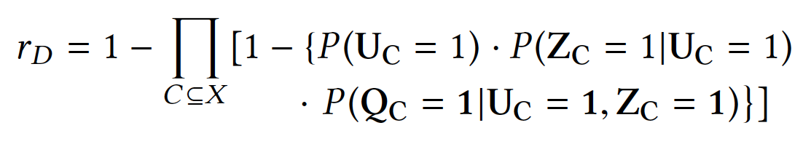
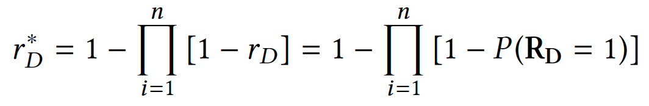
RISK Model
Individual Re-identification Risk
Defines the risk
Combines
Data Set Model
External Knowledge Model
Overall Re-identification Risk

Slide 12
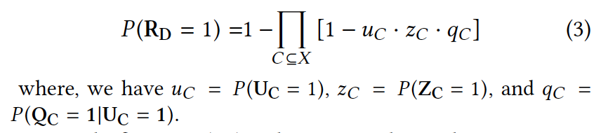
NRF: NAIVE RE-IDENTIFICATION FRAMEWORK
Disclosure Uniqeness Independence
u_{C}: D-uniqueness
z_{C}: Disclosure-Likelihood
q_{C}: E-uniqueness

Slide 13
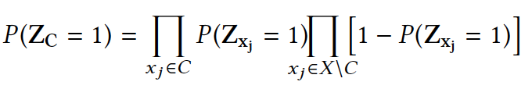
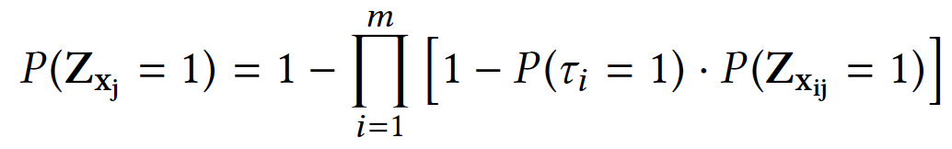
NRF: NAIVE RE-IDENTIFICATION FRAMEWORK
Name
Independent
Disclosure
Assumption
Fever
Age

Slide 14
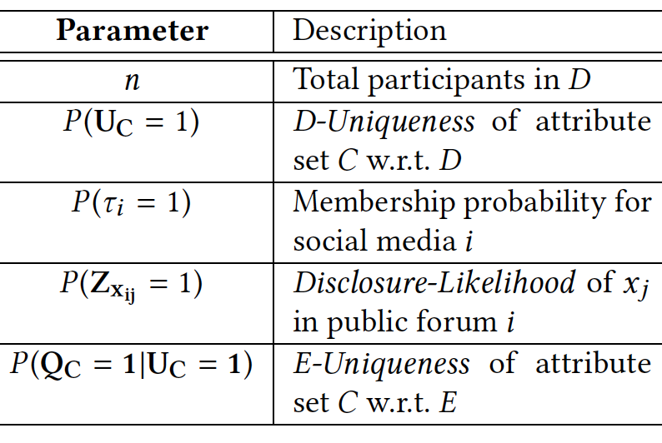
NRF: NAIVE RE-IDENTIFICATION FRAMEWORK

Slide 15
Case Study
Data Set
HCUP National (Nationwide) Inpatient Sample (NIS)
8 million de-identified inpatient
135 different attributes
ICD-9 codes for diagnosis and procedures
cost related attributes
Twitter posts
310 millions random tweets
Between February and October 2015

Slide 16
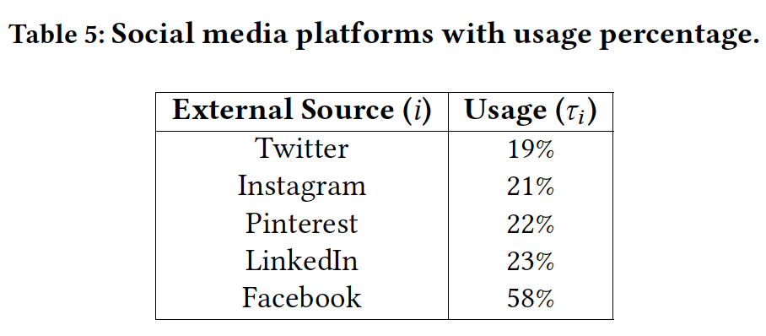


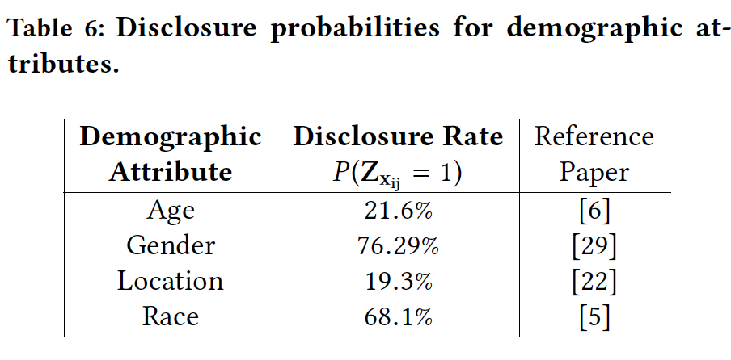
Estimation of the parameters

Slide 17
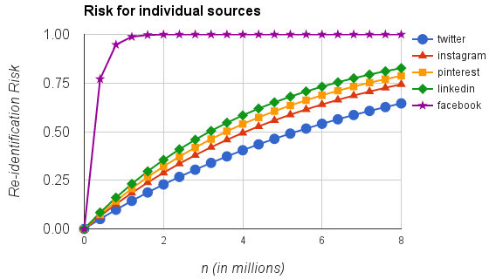
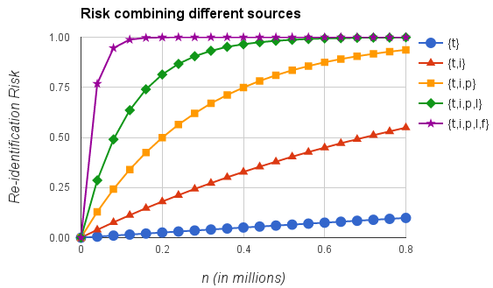
Results

Slide 18
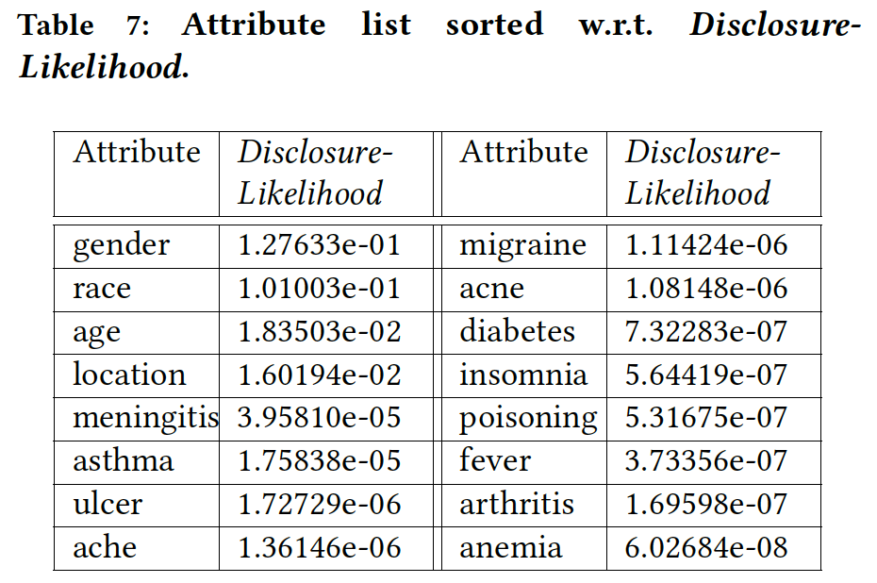
Results

Slide 19
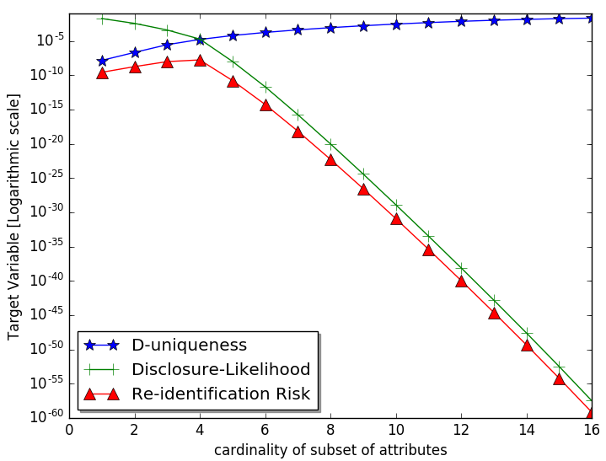
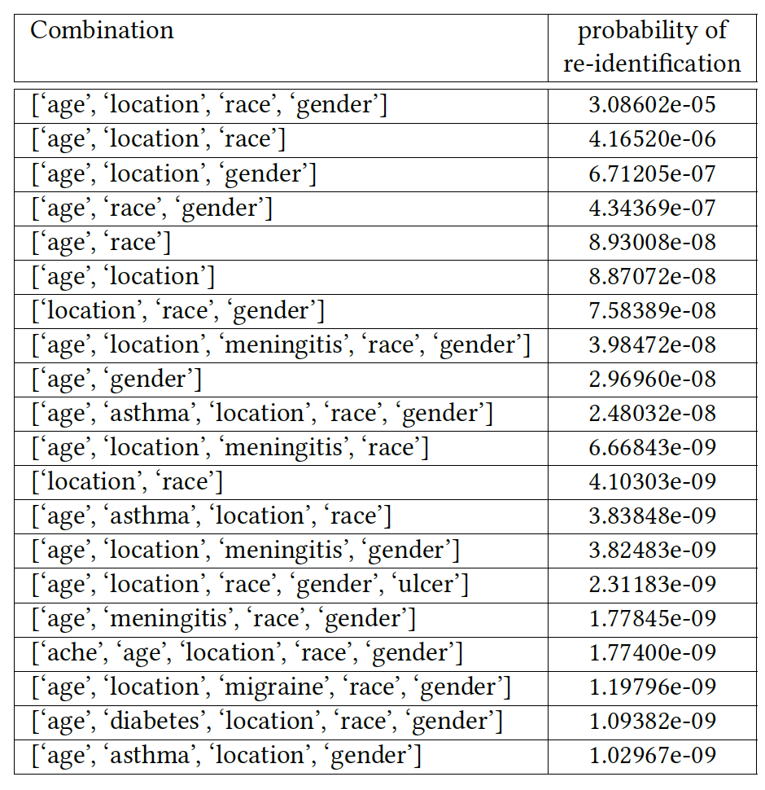
Results

Slide 20
Conclusions
Contributions
Observations
We introduced three to quantify risk of re-identification
D-Uniqueness
E-Uniqueness
Disclosure Likelihood
Social media plays a significant role in a successful re-identification
Demographic attributes pose the greatest risk
Introduced a General re-identification framework
Combining multiple social media dramatically increases the risk of re-identification
Introduced NRF: a naive re-identification framework by introducing several simplification assumptions

Slide 21
Limitations AND FUTURE WORK
Problem is very hard
Data Sparseness is a big issue
Estimation involves a lot of assumptions
Evaluation is a big challenge
Terms and conditions of HCUP data set

