Slide 1
JIM: Joint Influence Modeling for Collective Search Behavior
Shubhra Kanti Karmaker “Santu” (UIUC)
Liangda Li (Yahoo Research)
Yi Chang (College of Artificial Intelligence, Jilin University)
ChengXiang Zhai (UIUC)

Slide 2

User Behavior Modeling
User Behavior Model
Search Log

Slide 3


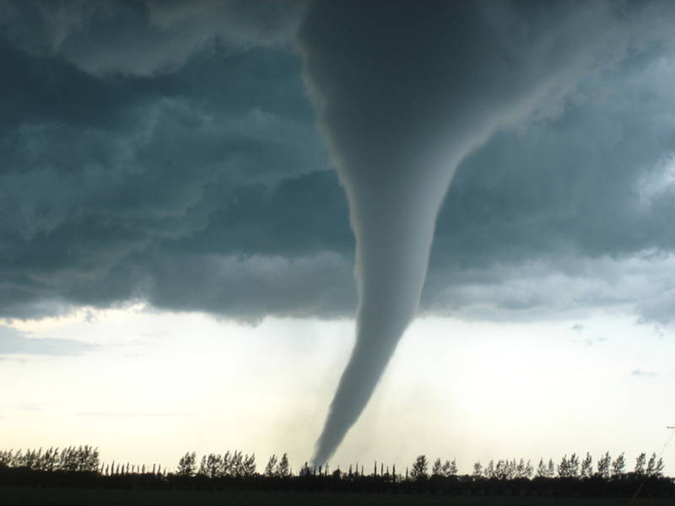
External Influence
Search Log
User Behavior Model

Slide 4

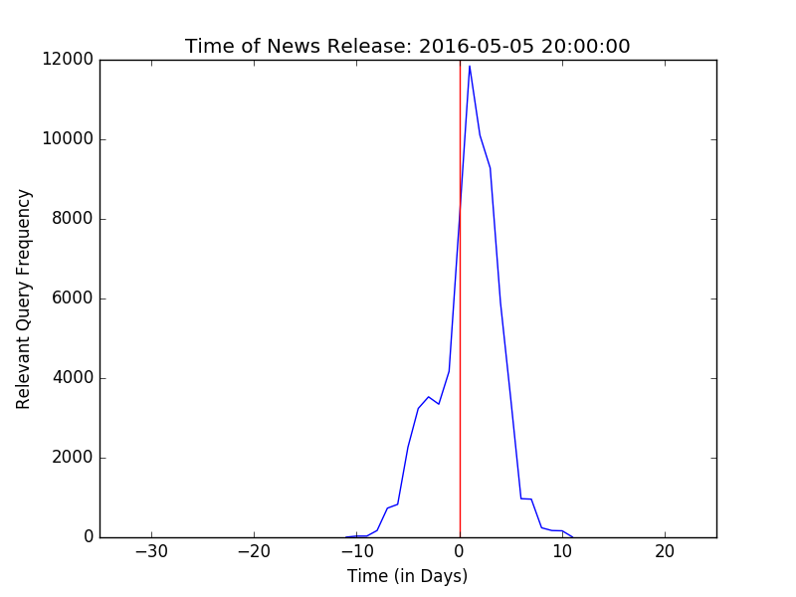
Previous Work
Karmaker Santu, Shubhra Kanti, Liangda Li, Dae Hoon Park, Yi Chang, and ChengXiang Zhai. "Modeling the influence of popular trending events on user search behavior." In Proceedings of the 26th International Conference on World Wide Web Companion, pp. 535-544, 2017.

Slide 5
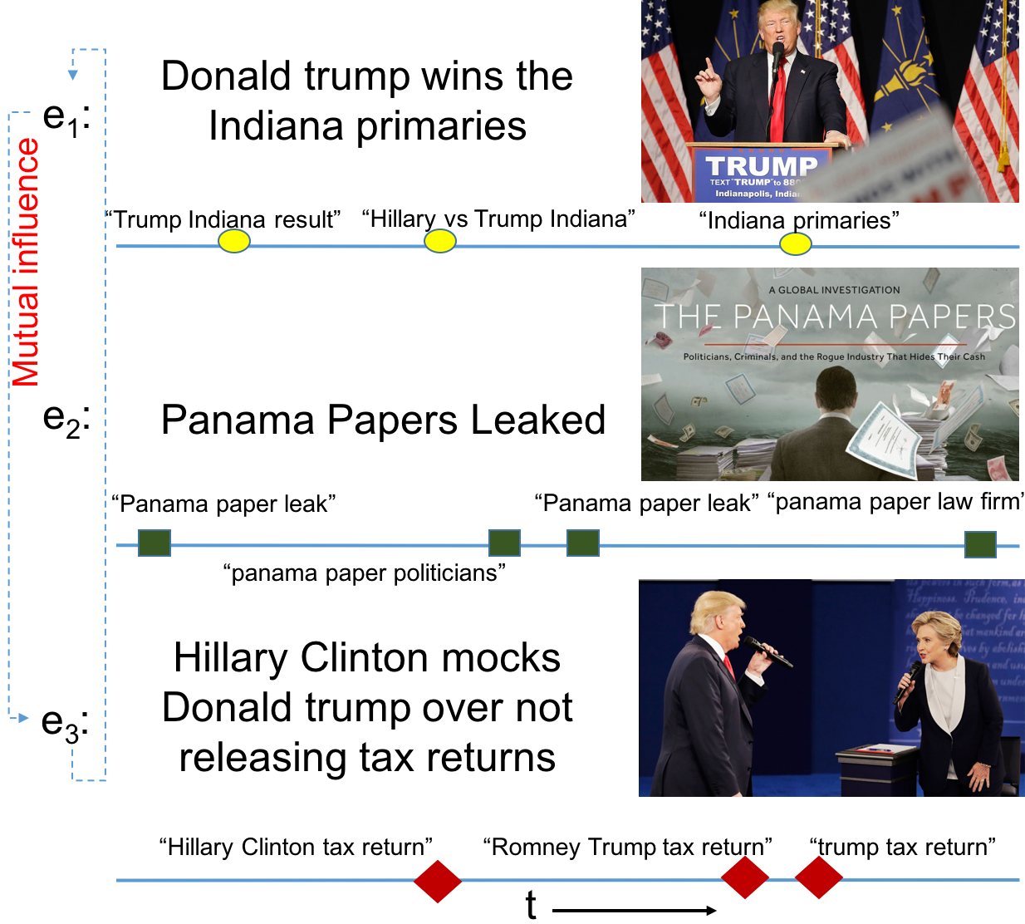
Limitations of Previous Work
Missing ???
Panama Papers Leaked
Donald Trump Wins the Indiana Primaries
Hillary Clinton mocks Donald Trump

Slide 6
How to Model the Mutual Influence Among Events?
How to define/model influence of an event
Constant Influence: Weather?
Decay of Influence
Growth of Influence
How to correlate queries with influence?
How to model Influence dependencies?
How to distinguish between Direct and Indirect Influence?

Slide 7
Our Approach
Constant Influence
Base Influence Function
Decay of Influence
Influence Decay Function
Growth of Influence:
Influence Growth Function
How to correlate queries with influence?
Query Intent Matching
How to model Influence dependencies?
Mutual Influence Coefficient
How to distinguish between Direct and Indirect Influence?
Mutual Influence Coefficient

Slide 8
Base Influence Function
Base Influence
time

Slide 9
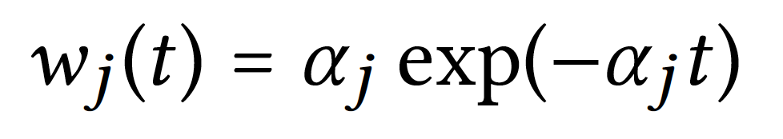
Influence Decay Function
Influence
time

Slide 10
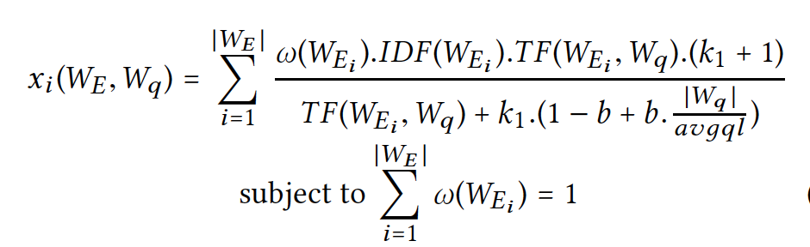
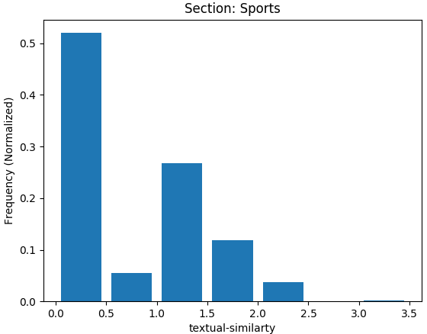
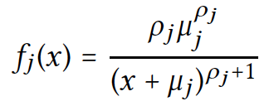
Intent-Match Distribution

Slide 11
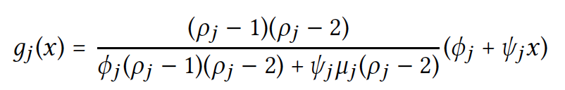
Influence Growth Function
Influence
time

Slide 12
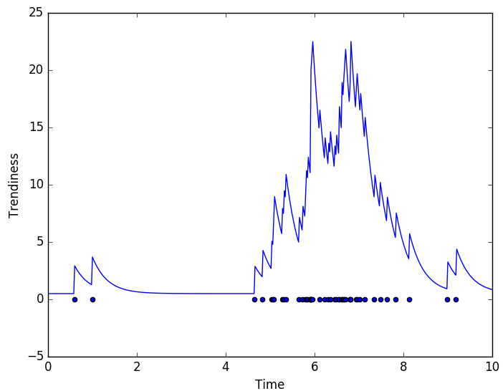
Self Exciting Point Process

Slide 13
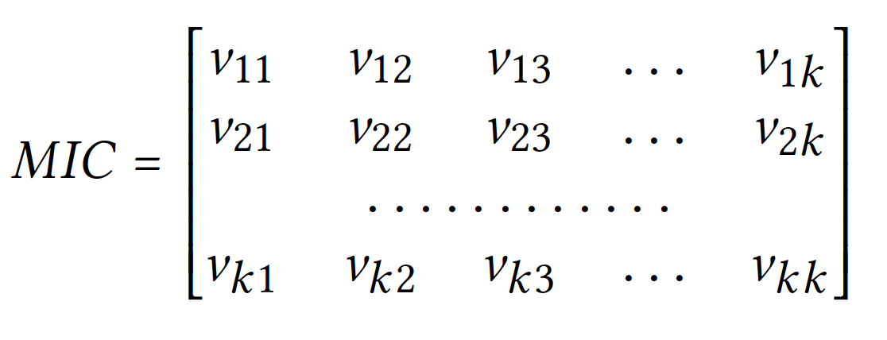
Mutual-Influence Coefficients

Slide 14
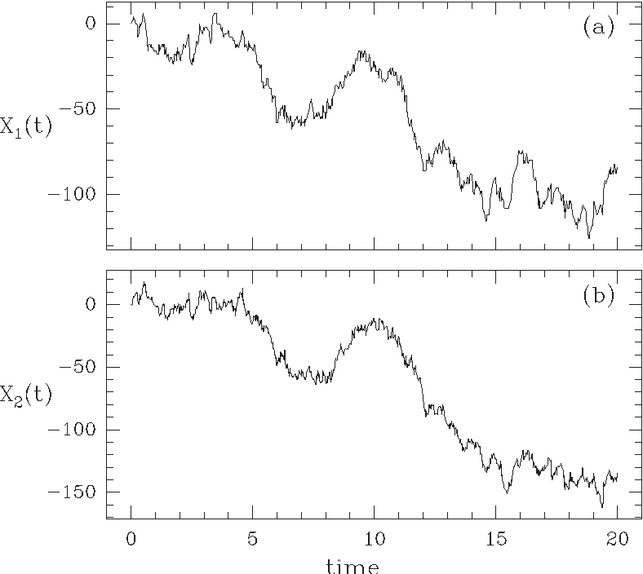
JIM: Joint Influence Model

Slide 15
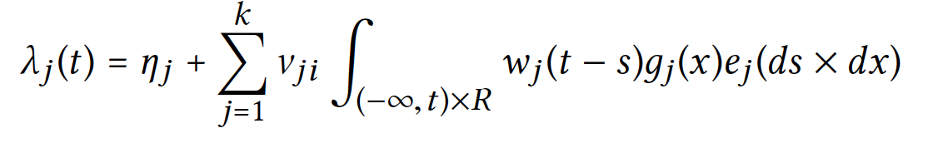
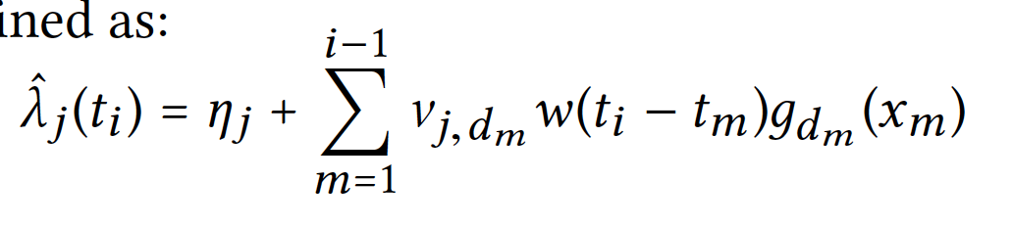
JIM: Joint Influence Model
Base Influence
Mutual Influence
Decay Function
Impact Function
Numerical Version

Slide 16

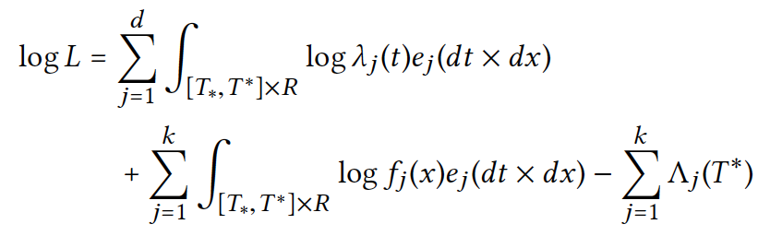
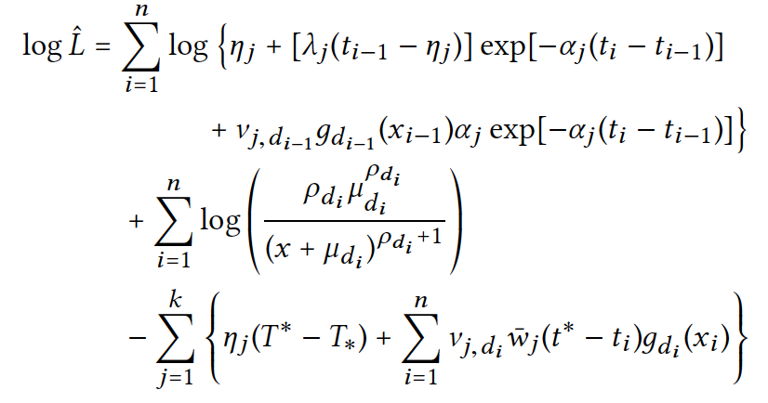
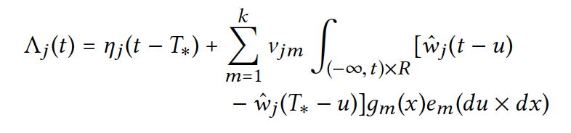
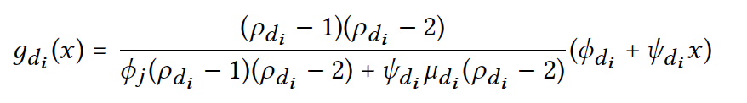
Estimation of Optimal Parameters
Log-Likelihood Function
Numerical Version

Slide 17


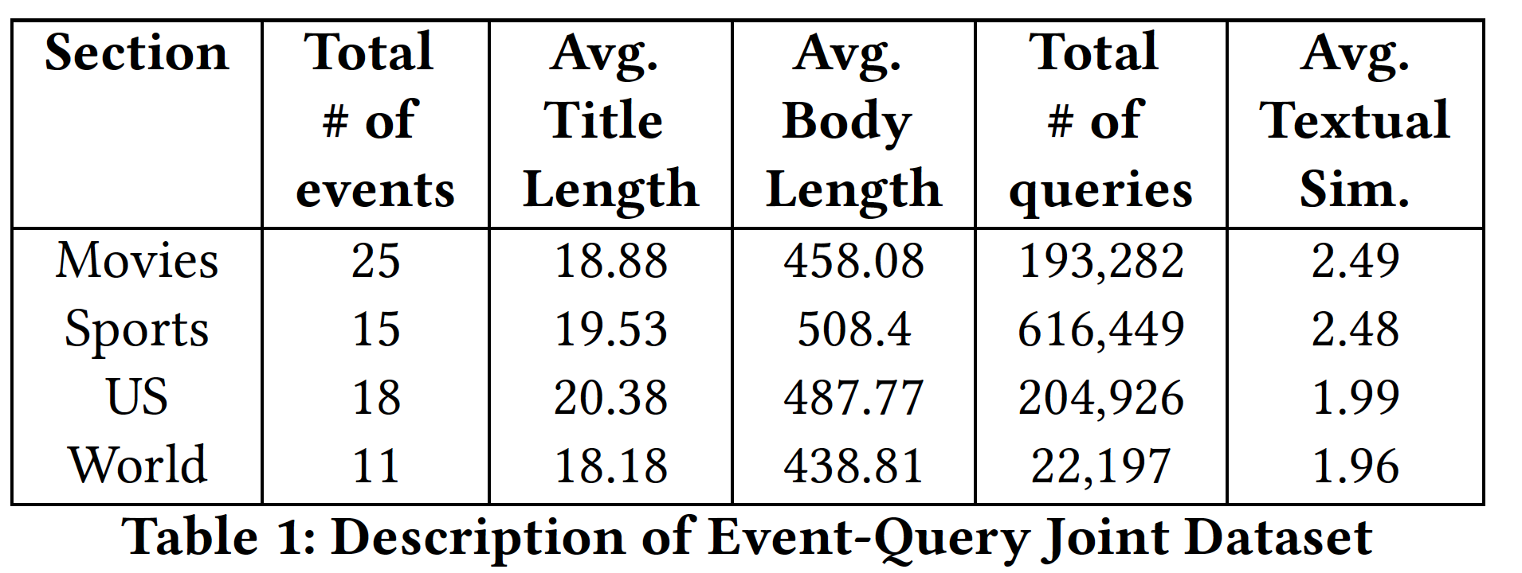
Experiments – Datasets

Slide 18
Does Joint Model Work Better than Independent Model?
NO Ground Truth !!! ➔ Indirect Evaluation
Influence???
Evaluate on some other application task

Slide 19
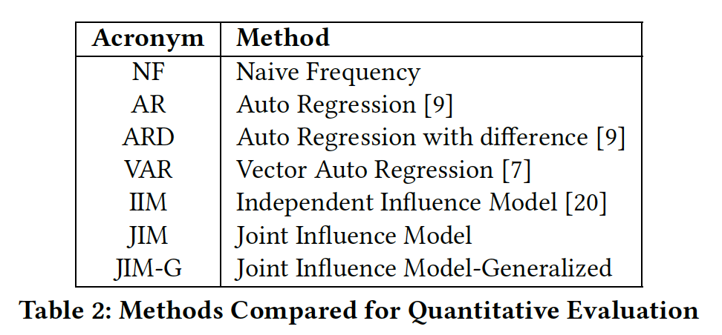
Applications & Baseline Methods
Forecast the next most influential event
Rank events based on future influence
Forecast the next most influenced query
Rank queries based on future influence
Query auto-completion

Slide 20
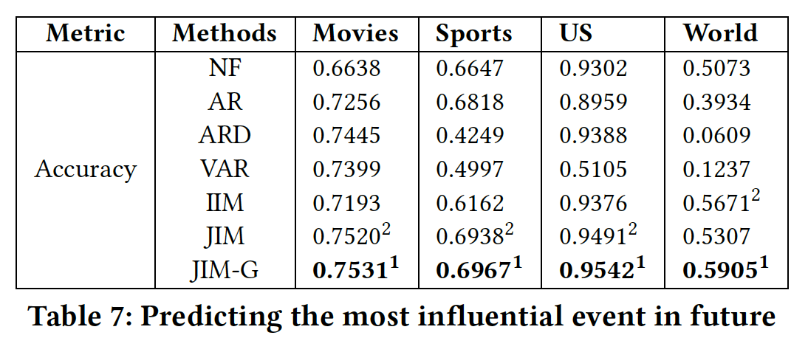
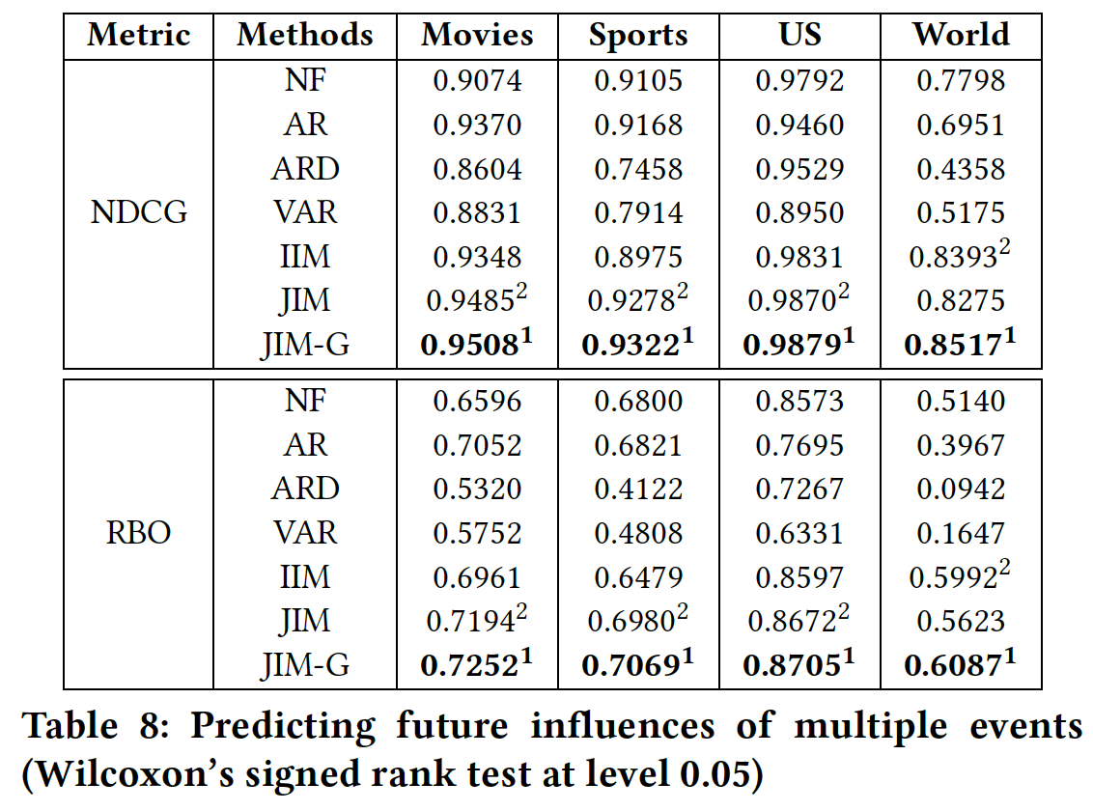
Joint Modeling significantly outperforms independent modeling
JIM-G > JIM > IIM (Event Analysis)
forecast the next most influential event
Rank events based on future influence

Slide 21
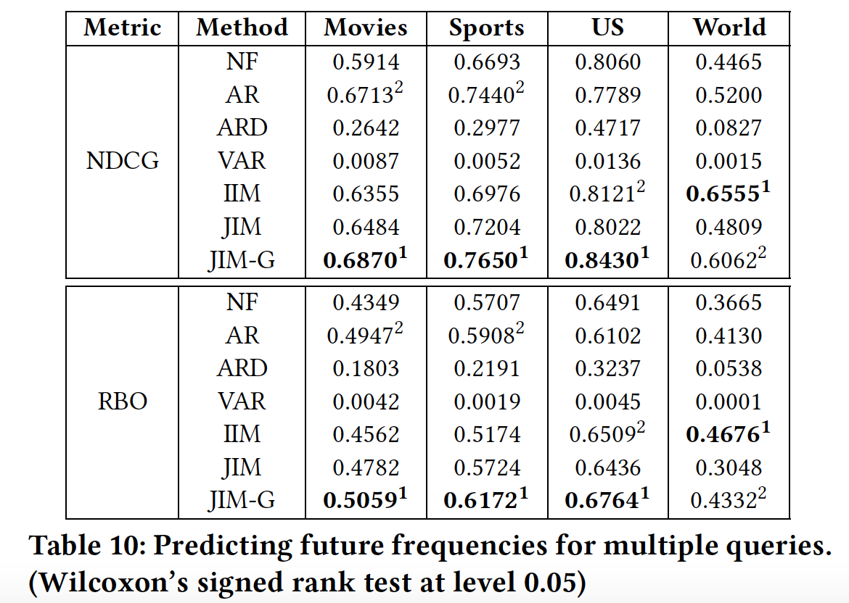
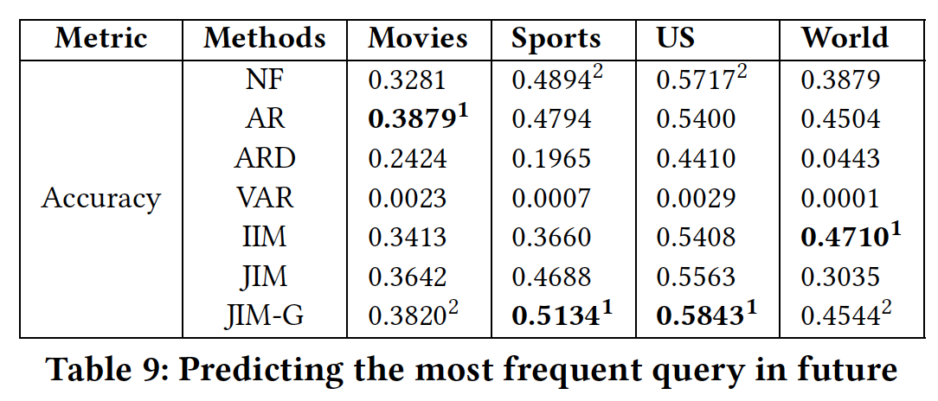
JIM-G > JIM > IIM (Query Analysis)
Forecast the next most influenced query
Rank queries based on future influence?

Slide 22
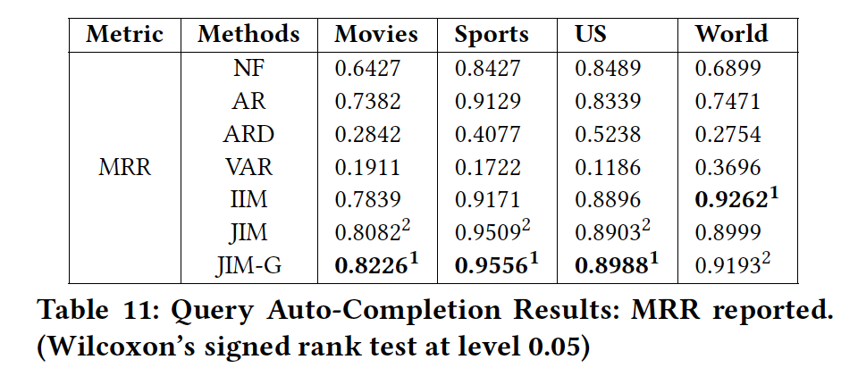
Query Auto-Completion

Slide 23
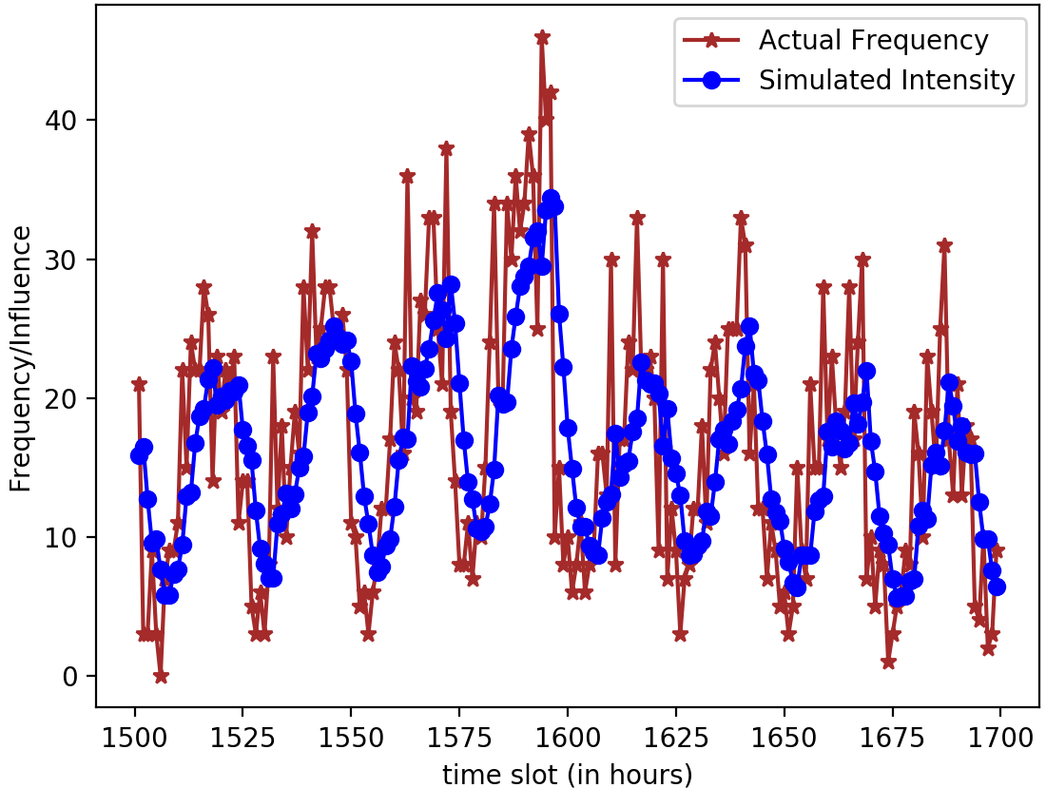
How well the Model fits the Original Data?

Slide 24
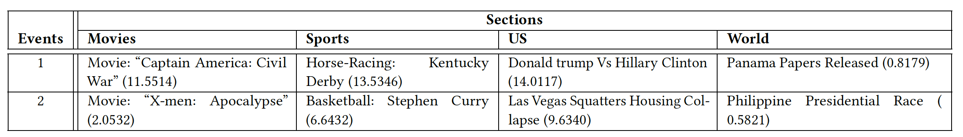
A New Data Mining Tool

Slide 25
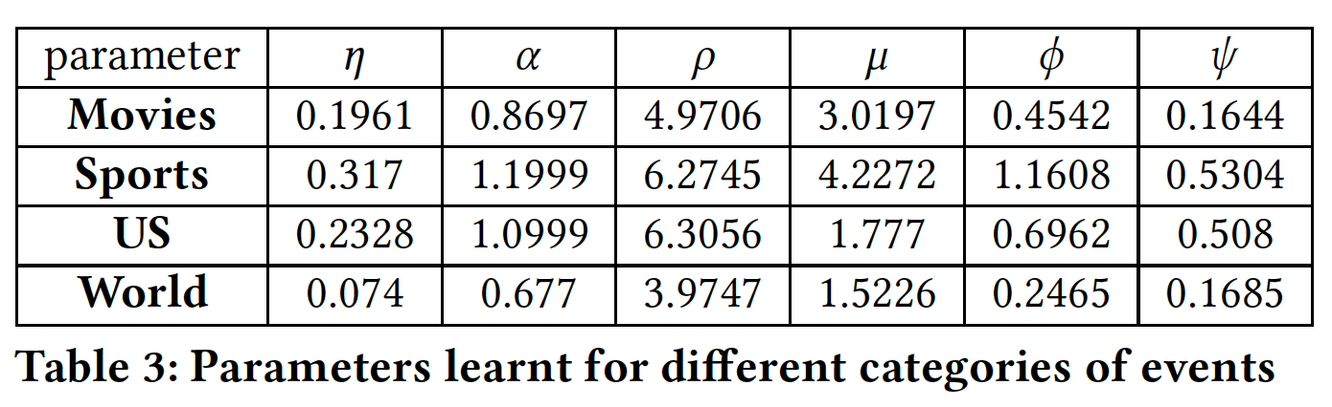
A New Data Mining Tool
Base
Decay
Growth
Movies & World are more sustaining
Sports & US are more influential in general

Slide 26
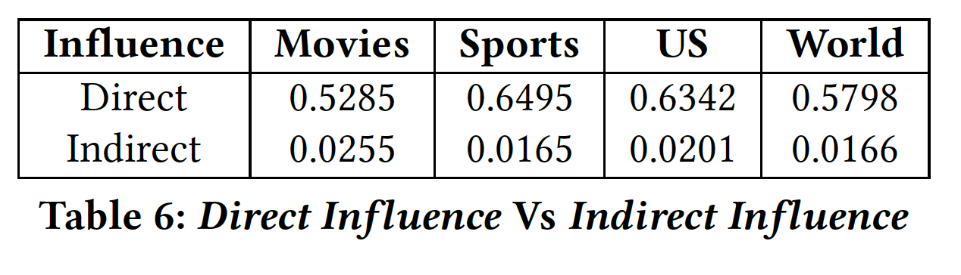

A New Data Mining Tool

Slide 27
Summary of Contributions
First Study of Joint Influence of External Events on User Search Behavior
Created Event–Search
Joint Dataset
Introduced Mutual Influence Coefficient Matrix
JIM Enhances Prediction and query Auto-completion
Modeled Decay and Growth of Influence
A new Data Mining Tool for Influence analysis

