Slide 1




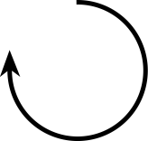







1
Left
Right
Go Forward
Eat
Eat
Turn Left
Turn Right
Turn Left
Turn Right
Turn Left
Turn Right
Turn Left
{
{

Slide 2



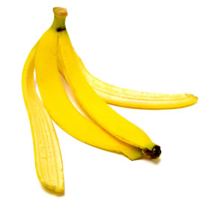
0 1 2 3 4 5 6 7 8 9 10 11 12 13 14 15 16 17 18 19 20
count
0
1
2
3
4
5
6
7
8
9
1
(a)
(b)
(c)

Slide 3

3
}
Turn Left
Turn Right
Go Forward
Eat
(1.a)
(1.b)
(1.c)
(2.a)
(2.b)
(2.c)
(2.d)
(3)
0
0
0 1 2 3 4 5 6 7 8 9 10
0
0
While
count
{
}
count
(4.a)
(4.b)
(4.c)
0
0
0
0
0
0
If
{
}
Else
{
{
(5.a)
(5.b)
(5.c)

Slide 4
Game Master
(a)
(d)
0
0
0
0
0
0
(e)
(f)
(b)
(c)
Player
If
{
}
Else
{
Eat
{

Slide 5
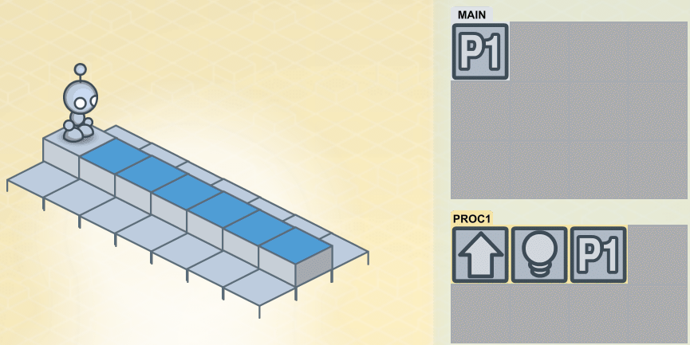
Turn Left
Go Forward
Turn Right
Go Forward
Eat
Turn Left
Turn Left
Turn Right
Turn Right
0
6
While
count
{
Go Forward
Eat
}

Slide 6
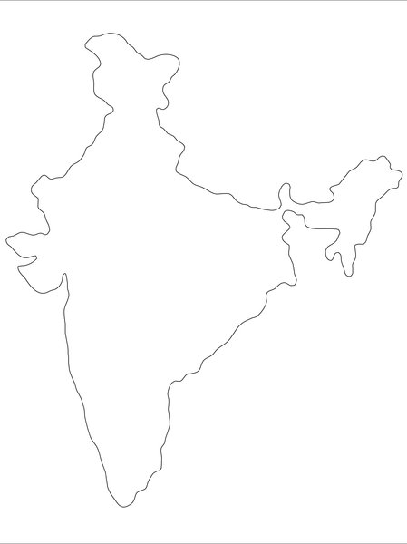
10
10
10
65
10

Slide 7
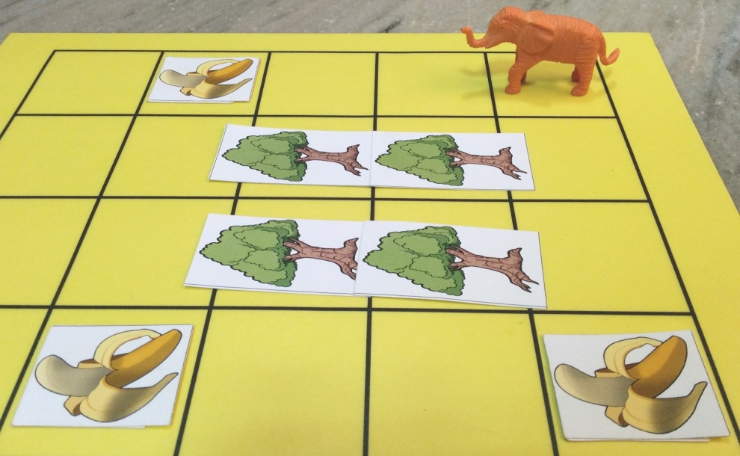
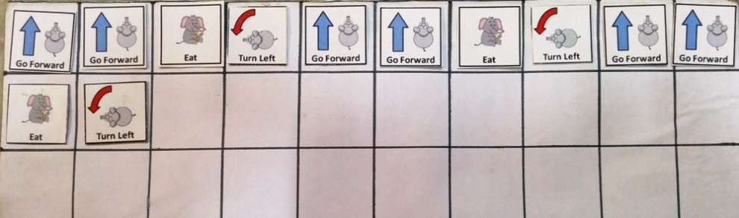
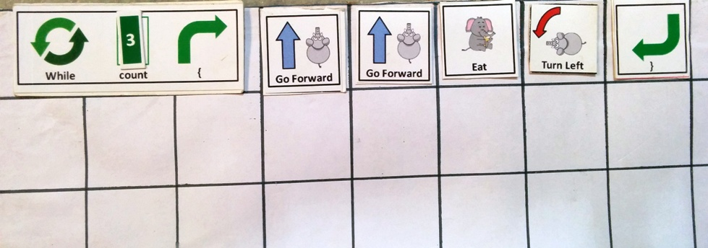

Slide 8
Writing pseudocode
Processing
Sketches
Embodied game
Demonstration
Board Game
1 hour
0.5 hour
0.5 hour
14 hours

Slide 9


Haathi Mera Saathi
Made with AMMA’s 💗 at AMMACHI Labs

Slide 10


Haathi Mera Saathi
Haathi Mera Saathi
Made with AMMA’s 💗 at AMMACHI Labs

Slide 11

Construction
Sandbox
Art
Sandbox

Slide 12
Story Creation
Sandbox
Story Creation
Sandbox

Slide 13


Slide 14
Go Forward
Eat

Slide 15


{}

Slide 16
elephun
elephun
{(.;.)}
(;}
{(.;.)}

Slide 17
Elephun
Learn 2 code

Slide 18

HMS

Slide 19


