Slide 1
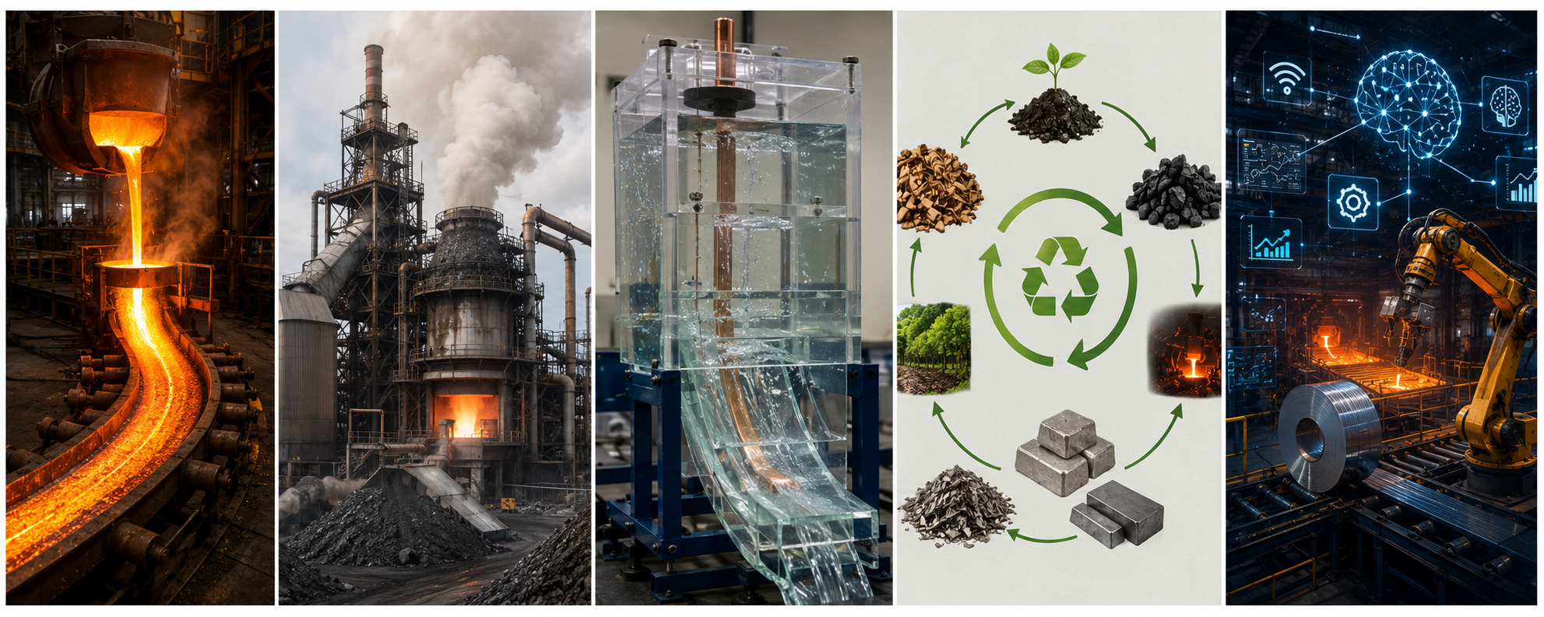
FIVE PILLARS
RESEARCH INTERESTS
What I think about most days...
01
02
03
04
05
Continuous casting
Pyro­metallurgy
Physical modelling
Circular metallurgy
Automation & SMART process
Mould fluid flow, solidification dynamics, oscillation-mark formation, mould-flux characterisation
High-temperature slag–metal–gas interactions, thermodynamic modelling, recovery of by-products.
Water and liquid-metal modelling, metrology, and industrial validation.
Secondary raw materials, low-carbon routes, valorisation of residues, biocarbon utilisation.
Automation and AI for process control, data-driven product and process quality prediction.

Slide 2
Four projects, in flight.
2025 — Ongoing
2024 — Ongoing
CC diagnostics across industrial & experimental scales
Swerim CCS — full-scale physical caster
A critical review of measurement techniques in continuous casting – industrial sensors, pilot casters, water and liquid-metal models, with emphasis on EMS as both flow control and measurement disturbance.
Bi–Sn full-scale physical model of a continuous caster. Stopper rod, SEN, mould, oil-slag surrogate. Used to study multiphase flow under EMS and EMBr.
Physical model
EMS/EMBr
Multiphase flow
Review
CC
EMS/EMBr
CROSSCUT · 2025 — Ongoing
SmartSlag · 2026 — Ongoing
Bio-based agglomeration for iron & steel
Sustainable ferrochrome & circular processing
Bio-derived binders for pelletisation and briquetting of iron-bearing fines. Reduction kinetics, mechanical properties, fossil-coke displacement.
Process-route work on ferrochrome and secondary streams – slag valorisation and circular-economy integration.
Agglomeration
Biocarbon
Fossil-free production
Sustainable cement production
Slag valorisation
LCA, TEA

