Slide 1
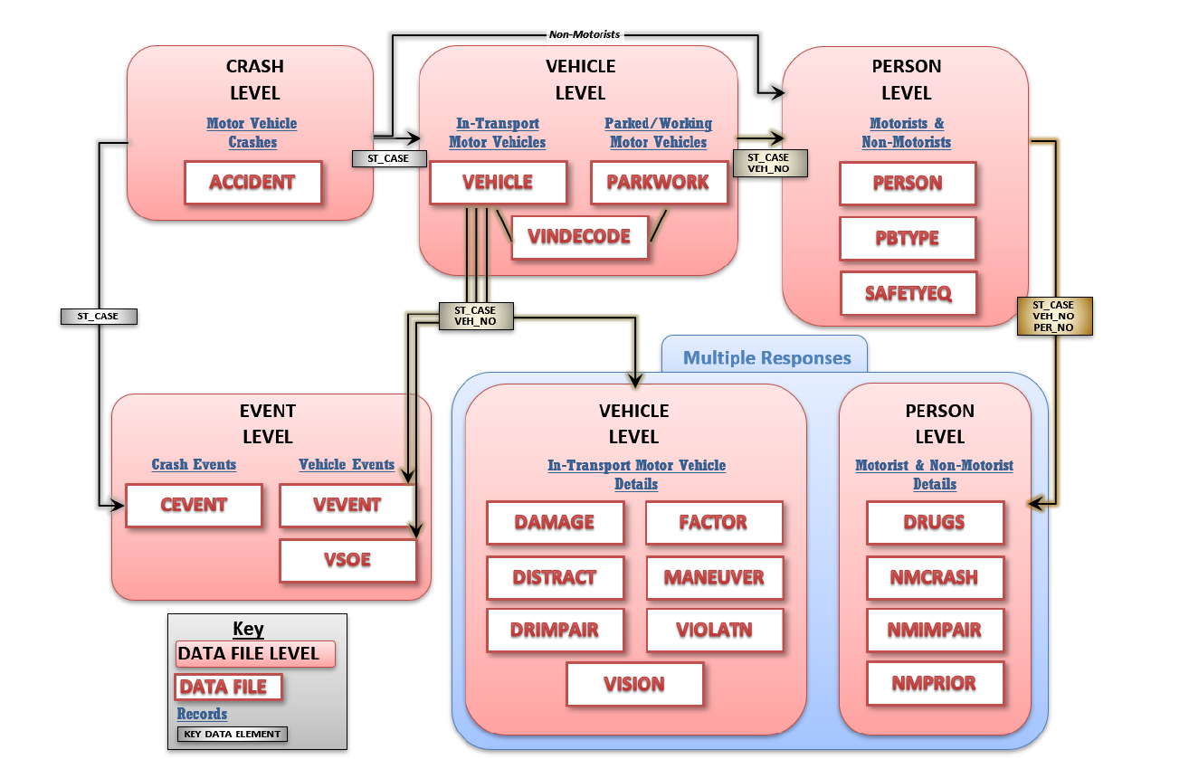

Slide 2
Accident
Person
ACC_AUX
Observations and variables used

