Slide 1
Differentially private query answering over streaming knowledge graphs
Daniele Dell’Aglio
Department of Computer Science
dade@cs.aau.dk http://dellaglio.org @dandellaglio
[Joint research Abraham Bernstein (University of Zurich)]
Amsterdam, 06.12.2022

Slide 2












Knowledge graphs evolve over time!
Nothing endures but change. Heraclitus
[Some icons in this slides are based on the clip art made by Freepik and Smashicons from www.flaticon.com]

Slide 3






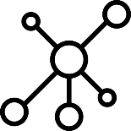






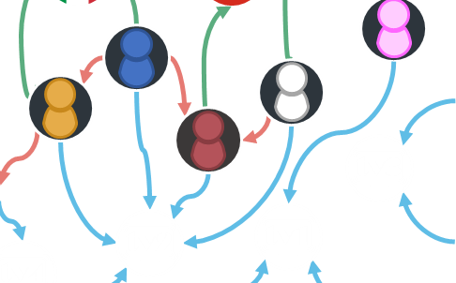
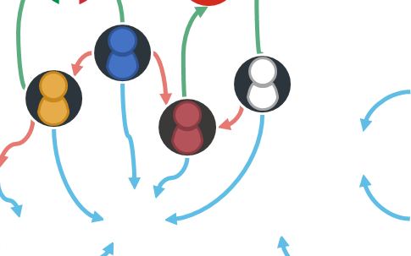
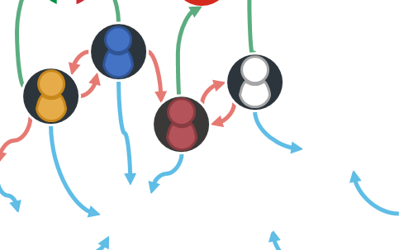
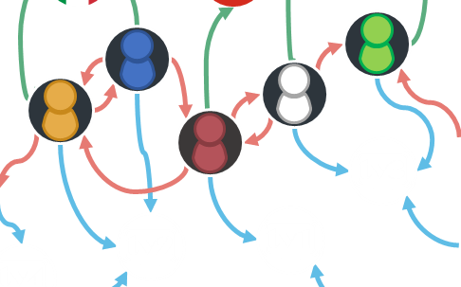
Stream reasoning
[Dell'Aglio, Della Valle, van Harmelen & Bernstein: Stream reasoning: A survey and outlook. Data Sci. 1(1-2) 2017]
[Some icons in this slides are based on the clip art made by Freepik and Smashicons from www.flaticon.com]
Notes:
We need to react to evolution of the data in the web
We need to enable the semantic web to responsively respond to evolution
We need to responsively respond to evolution of the data in the web
We need to enable the semantic web to reflect the evolution
Responsively, accurately, privately

Slide 4



From one time processing…
?v
Query
tv3
?tv
tv1
tv2
tv3
tv4
tv5
tv2
tv1
tv4
Notes:
Semantic web offers solutions to manage data on the web.
Today I will focus on RDF and SPARQL.
RDF represents information in graph-based structures.
This example shows some statements involving users.
The red arrows state that users are following each others; The green arrows relate users to their nationalities And blue arrows indicate who is watching what
SPARQL is the language recommended by W3C to query RDF graphs.
This example query extract information of Italian users,
Creating histograms where each bin represents a TV channel and the number of viewers.

Slide 5
…to continuous processing
Query
tv1
tv2
tv3
tv4
tv5
tv1
tv2
tv3
tv4
tv5
tv1
tv2
tv3
tv4
tv5
tv1
tv2
tv3
tv4
tv5
Notes:
We should consider that viewership information is not static and changes over time
Here we can look into stream reasoning, which extends the semantic web stack with methods to manage dynamic data
We have RDF streams to model the evolution of RDF graphs, capturing the ongoing changes
And we have continuous extensions of SPARQL to process RDF streams and output streams of query answers

Slide 6
Scenario
An online company offers access to IPTV channels
They collect viewership data and want to release statistics on their web site
Semantic web technologies can support the data publication process
tv1
tv2
tv3
tv4
tv5
tv6
Notes:
Let me start with an example
A web company offers access to a selection of IP TV channels
After registering in the web site, users can watch their preferred TV channels online.
The company collects information about the users and their viewership, on which it runs data science processes
To showcase their analytics capabilities, the company wants to publish some analyses on the web
Here, semantic web can support the publication process.

Slide 7
The privacy problem
Processing data containing sensitive information may lead to privacy leaks!
Anonymisation techniques do not always work…
Part of the dataset released for the Netflix prize was de-anonymised [1]
… and releasing statistics neither
Re-identification of 17% of the US population from 2010 Census [2]
Differential privacy [3] adds noise to query answers to hide the users’ presence
[1] Narayanan & Shmatikov: Robust De-anonymization of Large Sparse Datasets. IEEE SP 2008
[2] Garfinkel: Deploying Differential Privacy for the 2020 Census of Population and Housing. JSM 2019
[3] Dwork: Differential Privacy. ICALP 2006
Notes:
Semantic web can therefore help the company in publishing its data.
However, there is another challenge the company needs to face, which is privacy.
Since the company is processing viewership data, its analyses may leak private information about its customers.
Anonymisation techniques hide user identity data, but they do not always work. When Netflix released anonymised data about half million users for a challenge, researchers were able to re-identify part of the dataset.
Also releasing statistics instead of raw data does not avoid privacy leaks. Recently, researchers from the US Census Bureau explained they were able to reidentify 17% of the population from the 2010 census data, who are around 50 million people.
A solution that emerged recently to overcome such issues is differential privacy, which adds noise to query answers to hide the presence of users while preserving the utility of the response.

Slide 8
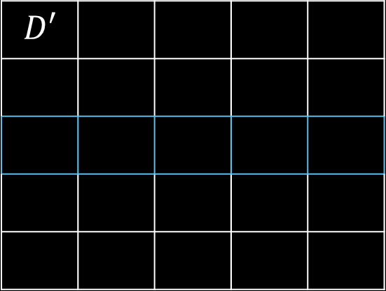


Differential privacy: neighbour datasets and indistinguishability
$$D$$
$$D′$$
tv1
tv2
tv3
tv4
tv1
tv2
tv3
tv4
tv1
tv2
tv3
tv4
tv1
tv2
tv3
tv4
$$D′$$
tv1
tv2
tv3
tv4
The answer produced by two neighbour datasets D and D’ should be indistinguishable
tv1
tv2
tv3
tv4
[Dwork & Roth: The Algorithmic Foundations of Differential Privacy. 2014]
Notes:
Let’s see differential privacy through an example.
D contains some viewership information: the yellow user is watching the TV channel 1, the blue user is watching the TV channel 2 and so on.
We can compute the histogram about channel viewership.
A basic notion of DP is the one of neighbour dataset.
D’ is a neighbour dataset of D if it contains one extra user
D’ is a neighbour dataset also if it contains one less user.
DP imposes that the answer computed by D is indistinguishable by the one computed on any neighbour dataset D’

Slide 9






Differential privacy: definition
$$P\left[Q\left(D\right)∈E\right]≤e^{ε}P[Q\left(D′\right)∈E]+δ$$
$$D$$
tv1
tv2
tv3
tv4
$ε$ is the privacy budget and controls the amount of injected noise
$$Q\left(D\right)+{\left(Lap\left(\frac{1}{ε}\right)\right)}^{n}$$
tv1
tv2
tv3
tv4
$ε_{1}$ > $ε_{2}$
$$D′$$
tv1
tv2
tv3
tv4
tv1
tv2
tv3
tv4
tv1
tv2
tv3
tv4
$δ$ quantifies the chance that the algorithm does not impose indistinguishability
tv1
tv2
tv3
tv4
[Dwork & Roth: The Algorithmic Foundations of Differential Privacy. 2014]
Notes:
Let’s now consider D and the neighbour dataset D’ below
How can we make the two histograms similar?
The way to achieve indistinguishability is by injecting noise
Differential privacy is formally defined by this formula, which is regulated by two parameters epsilon and delta.
The formula states that the probability of a query answer over D is bound by the probability that the same query over any neighbour dataset D’ produces the same answer, multiplied for e power epsilon; plus delta
Epsilon is called privacy budget, and controls the amount of noise added to the answer
This formula adds differential privacy to a histogram query Q which includes n bins. It adds a laplacian noise with parameter 1/epsilon to each bin.
The lower the epsilon, the more the injected noise, and the higher level of privacy we are introducing.
The other parameter, delta, is the probability that the differential privacy algorithm does not impose indistinguishability, potentially leading to privacy leaks.

Slide 10
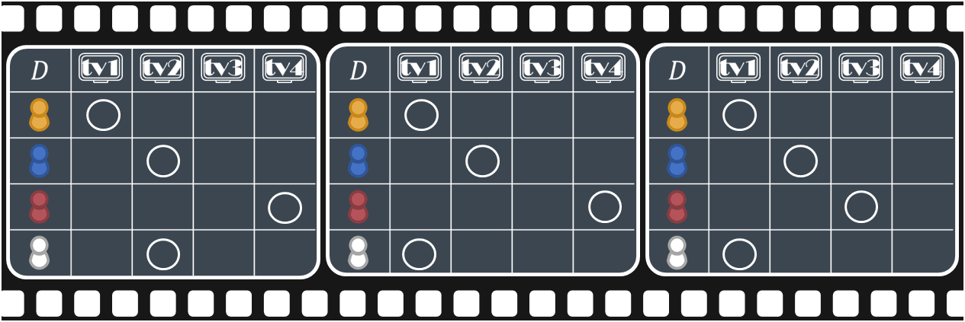
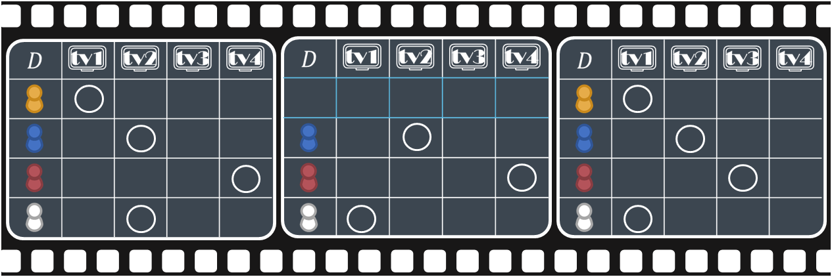
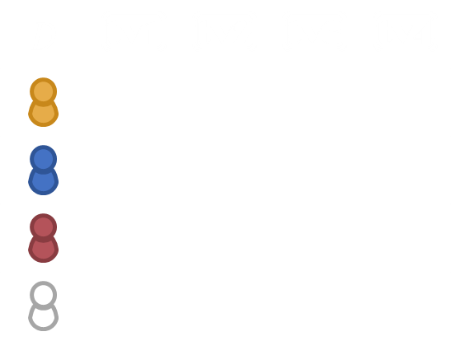
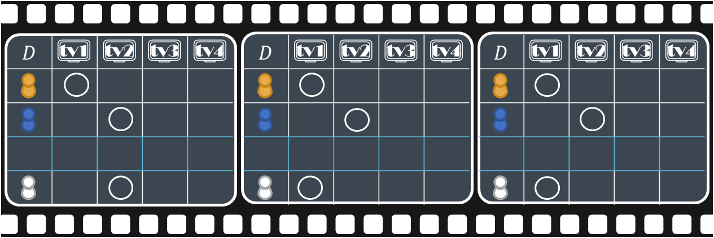
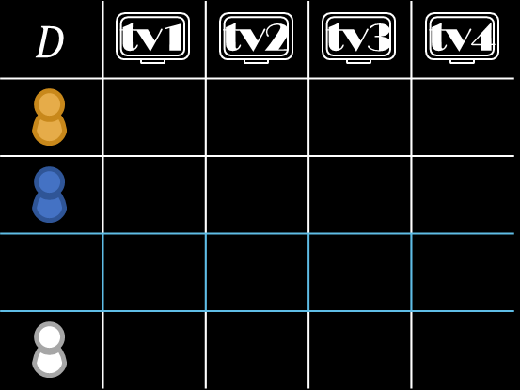










Event- and user-level privacy
$$D$$
$$D_{5}$$
$$D_{6}$$
$$D_{7}$$
tv1
tv2
tv3
tv4
What is a neighbour data stream?
Event-level privacy
Too weak to protect the privacy of a user
User-level privacy
Too strong to preserve response utility
$$D_{5}$$
$$D_{6}^{′}$$
$$D_{7}$$
$$D_{5}^{′}$$
$$D_{6}^{′}$$
$$D_{7}^{′}$$
[Dwork, Naor, Pitassi & Rothblum: Differential privacy under continual observation. STOC 2010]
Notes:
The main problem when we move to continuous data is the notion of neighbour stream
Research initially proposed two different definitions.
In event-level privacy, two streams are neighbour if they differ in exactly one event, which in the example is a row in the stream item at 6. This is a weak privacy notion because it protects the presence of one event of user, and not the user itself.
User-level privacy considers two streams as neighbour if they differ in one user. This would be ideal but in practice it requires a massive amount of noise, which destroys the utility of the answer.

Slide 11
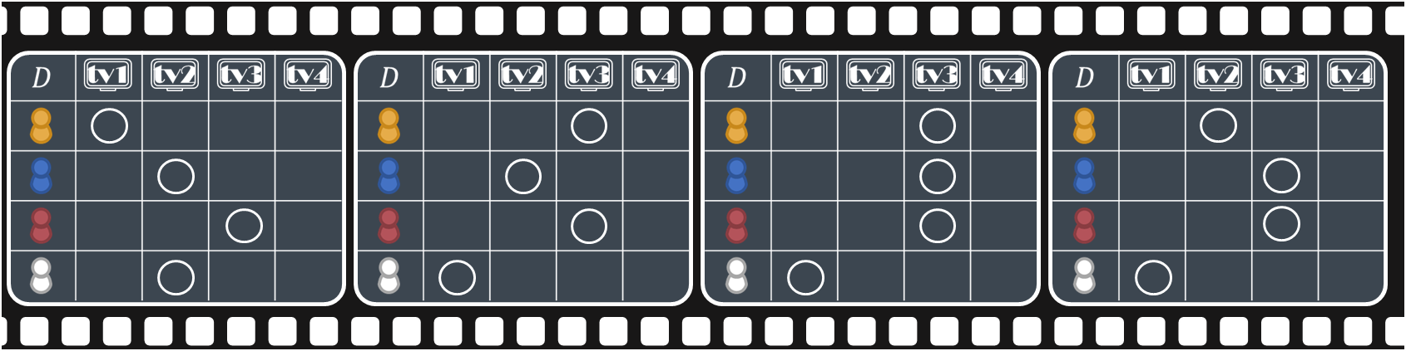
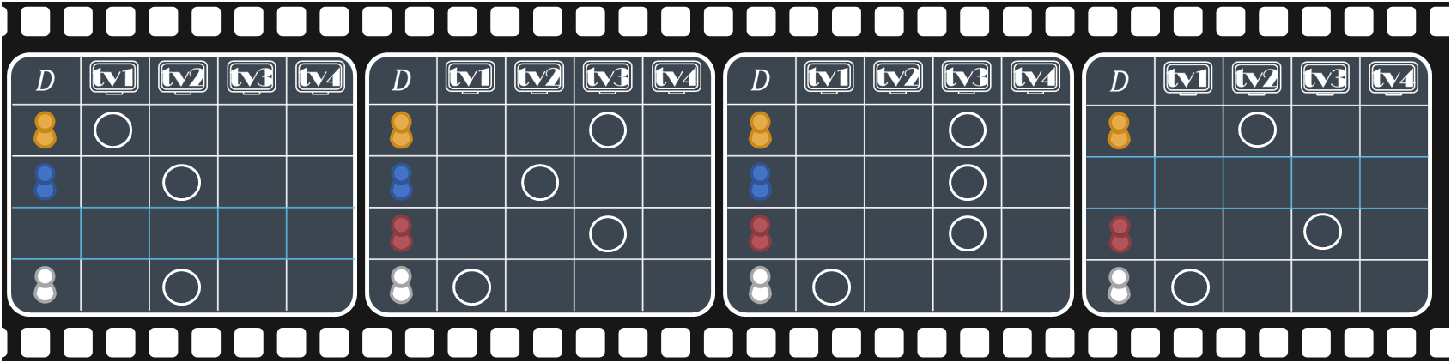







w-event neighbour
w-neighbour sets a trade-off between event- and user-level privacy
Two streams are w-neighbour if in a sliding window w:
at most one snapshot is neighbour
all the other snapshots are the same
w-event neighbour for w < 4
$$D_{5}$$
$$D_{6}$$
$$D_{7}$$
$$D_{8}$$
$$D_{5}^{′}$$
$$D_{6}$$
$$D_{7}$$
$$D_{8}^{′}$$
[Kellaris, Papadopoulos, Xiao & Papadias: Differentially Private Event Sequences over Infinite Streams. PVLDB 7(12) 2014]
Notes:
A third notion of neighbour streams is the one defined by w-event privacy
It defines a local notion of neighbouring through a sliding window of size w, which in this example is set to 3
Two streams are w-neighbour if every window contains at most a pair of neighbour stream items, and all the others are the same. In the example, D6 and D7 are the same, while D5 and D’5 are a pair of neighbour stream items, so it satisfies the condition.
Also the next window satisfies the condition since D6 and D7 are the same, and D8 and D’8 are neighbour
If we set w to 4, we don’t have w-event neighbouring because in the same window there are two pairs of neighbour stream items at time 5 and 8

Slide 12





BD w-event privacy
No more than $ε$ over w time instants
Part of the $ε$ to decide if the current answer differs from the last published one
No: skip the answer and save the budget
Yes: create a new answer and apply the noise
$$D_{5}$$
$$D_{6}$$
$$D_{7}$$
$$D_{8}$$
tv1
tv2
tv3
tv4
tv5
tv1
tv2
tv3
tv4
tv5
tv1
tv2
tv3
tv4
tv5
tv1
tv2
tv3
tv4
tv5
[Kellaris, Papadopoulos, Xiao & Papadias: Differentially Private Event Sequences over Infinite Streams. PVLDB 7(12) 2014]
12
Notes:
One of the algorithm built on top of w-event neighbouring is the budget distribution
In every window of size w, the algorithm uses at most epsilon
Which distributes among two differential privacy mechanisms
At each time instant, the first mechanism checks if the current answer would significantly differ from the previous published one
If not, no answer is produced and part of the budget is preserved for future data releases
If yes, a second mechanism is used to release a differentially private histogram.

Slide 13
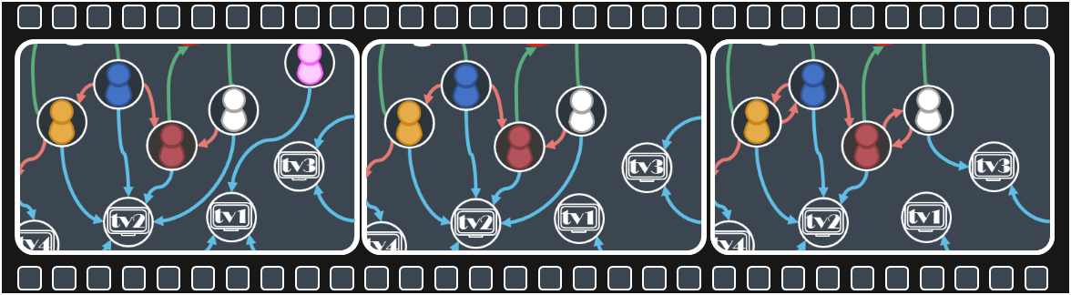
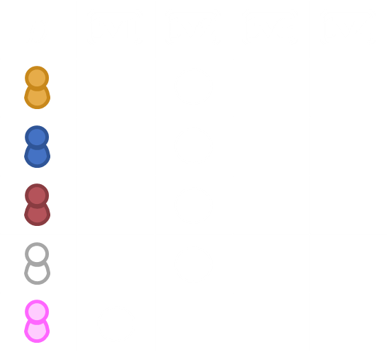
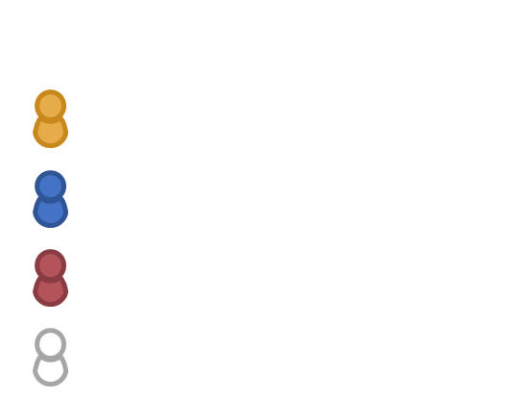
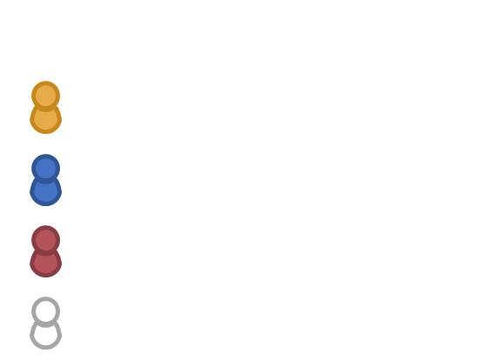






SihlQL
SihlQL is a continuous query language to compute differentially-private statistics from streams knowledge graph streams
It adapts w-event privacy for knowledge graphs, with a focus on web scenarios
Implemented in SihlMill, a query engine based on Apache Flink
$$Ω_{6}$$
$$Ω_{7}$$
$$Ω_{5}$$
$$D_{6}$$
$$D_{7}$$
$$D_{5}$$
[Dell’Aglio and Bernstein: Differentially private stream processing for the semantic web. WWW 2020]
tv1
tv2
tv3
tv4
tv1
tv2
tv3
tv4
tv1
tv2
tv3
tv4
13
Notes:
To sum up, a SihlQL query is a continuous query. The FORM clauses differ from the SPARQL ones as they indicate if the inputs come from a stream or some background data.
The privacy clause indicates that the query answer should be differentially private
As output, a SihlQL query releases histograms, using the items as bins.
The query should ensure that each user relates at most to one item at a time.
The background data is required to load the list of items
To guarantee that they appear in every histogram, background data left joins with the the streaming data
The language expressiveness is limited by the constraints introduced by differential privacy.
We could write more WHERE clauses, for example with FILTERS in the GRAPH and OPTIONAL clauses. However, a SihlQL query requires the elements in the red blocks.
It is natural to ask ourselves: can improve the expressiveness of the query language?
I believe that the most critical constraints are the ones in the WHERE clause.
In the following we will study if we can remove the constraints on the OPTIONAL and GRAPH clauses

Slide 14


Limitations of the w-event privacy framework
The privacy framework requires that items are known a priori
$$h$$
tv1
tv2
tv3
tv4
$$h$$
tv1
tv2
tv5
tv1
tv2
tv3
tv4
tv5
tv3
tv4
Notes:
We need to better understand those two requirements.
When we left join the background data with the streaming data, the query outputs histograms like this one
If we replace the left join with a join, the output is slightly different.
The items that are not appearing in the solution mappings from the stream will not be part of the output histogram
When we apply differential privacy, in the left join case the items with bin size 0 gets some noise.
An analyst looking at the query answer will not know if the true size of such a bin was 0 or 1 for example.
In the join case, the items with bin size 0 are missing, and the analyst will know for sure that the bin size was 0.
This means that with the join we are losing part of the uncertainty that differential privacy introduces, and this may potentially expose privacy information.
The same happens when the query does not have the join with the static data, and it just considers the mappings from the streaming data.

Slide 15


The bin removal mechanism
Intuition: remove also the items with a few elements
x
tv1
tv2
tv3
tv4
tv5
$$h_{0}$$
$$k$$
keep ~ Be( · ), for each item
k
tv4
tv1

Slide 16
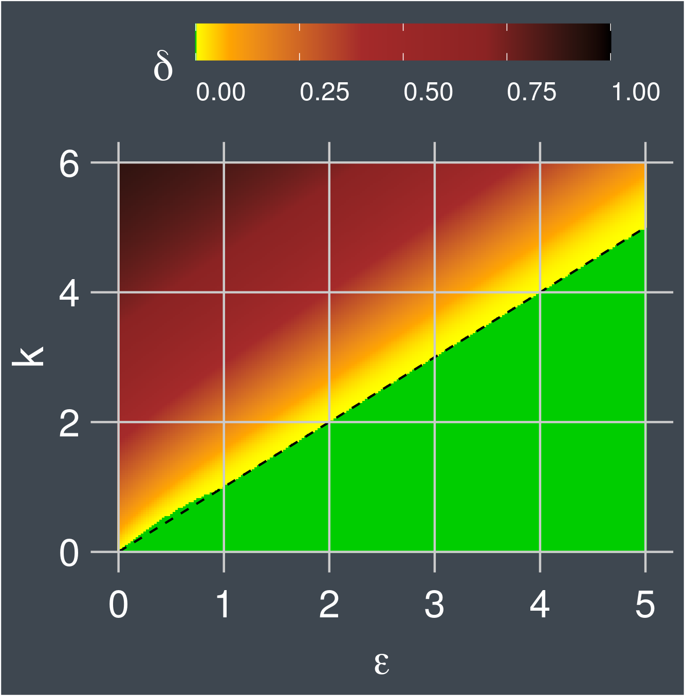
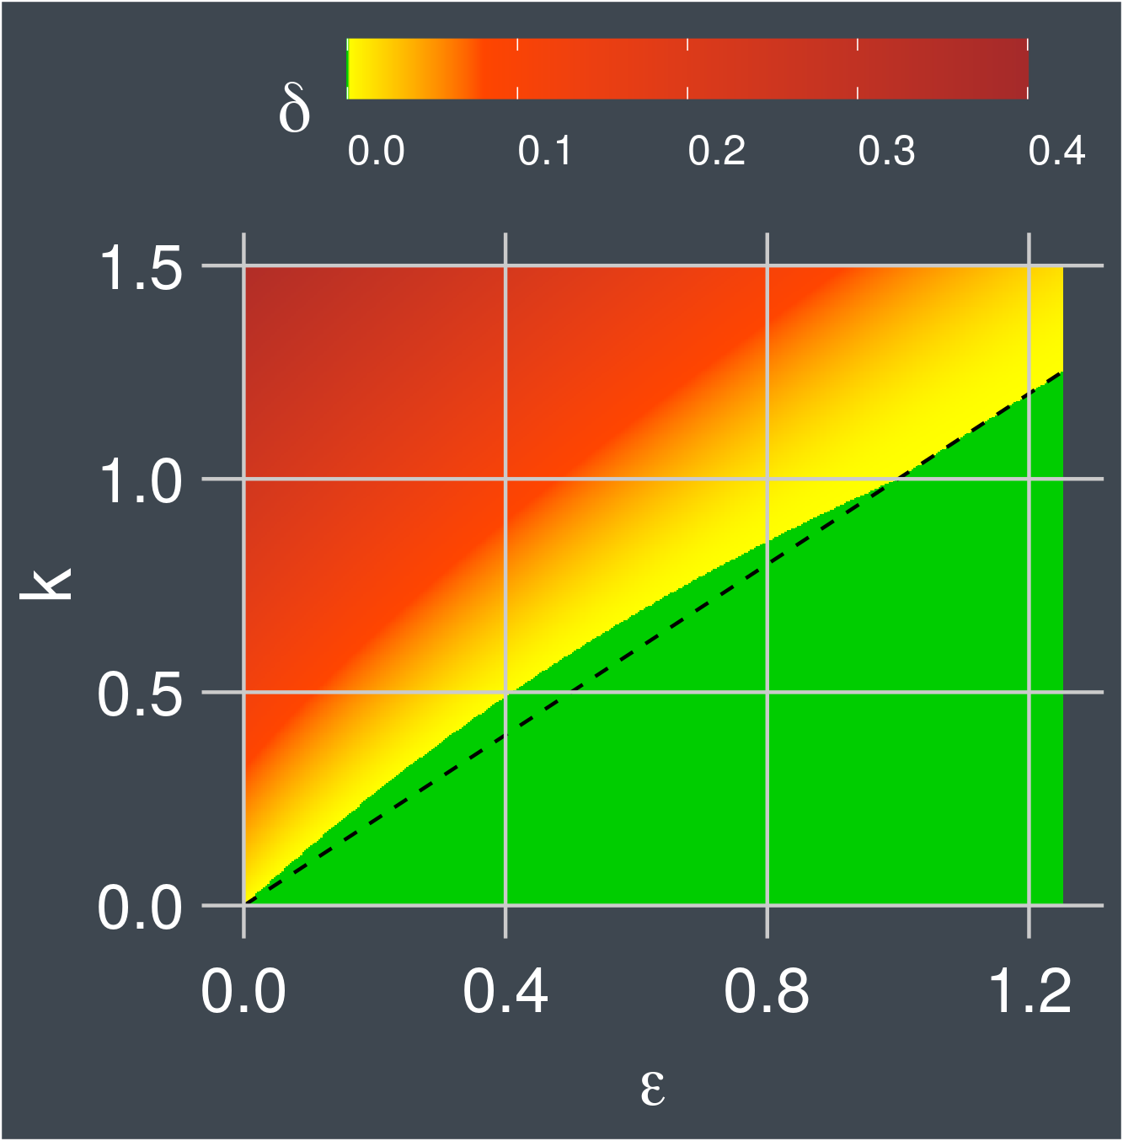
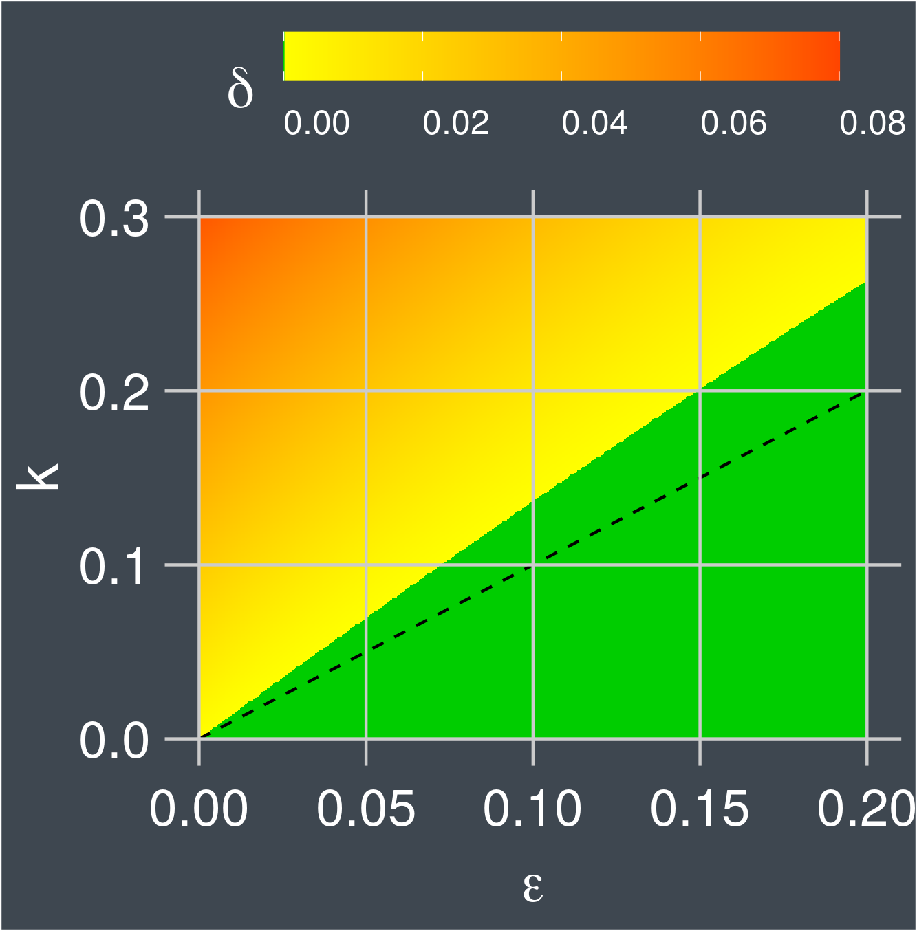
Analysis of the privacy parameters
$k=ε$ is a sufficient condition for $(\text{ε}\text{,}0)$-differential privacy
For small $ε$, there are values of $k≥ε$ that give $(\text{ε}\text{,}0)$-differential privacy
Notes:
To better understand the relation between epsilon, delta and k let’s have a look at the following plot
The plot shows the values of delta for different values of epsilon and k.
The large area in green is the one where delta = 0, which guarantees a strong notion of differential privacy
By an utility point of view, we should prefer high values of k, because they increase the steepness of the logistic function.
The black dashed line represents k = epsilon. We prove in the paper that this is a sufficient condition for having delta = 0.
When epsilon is lower than 1, there is an area where k > epsilon and delta = 0, as the mid and right plots show
This means that for low epsilons, one may want to fine tune k to gain better utility.

Slide 17
Experiments
SihlMill
SihlQL prototype engine
Implemented on top of Apache Flink and Apache Jena
Translates SihlQL queries in Flink topologies
Privacy operators as Flink functions
Open source at: https://gitlab.ifi.uzh.ch/DDIS-Public/sihlql
Data
Queries:
w-event privacy: a query with background data and left join
w-event privacy with bin removal: a query without background data
Dataset | Stream items | # of items | # of events
IPTV viewership | 49 035 | 450 | ~950 000 000
Amazon reviews [1] | 1 266 | 112 | 758 745
[1] Ni, Li and McAuley: Justifying recommendations using distantly-labeled reviews and fined-grained aspects. EMNLP 2019
Notes:
To experimentally study SihlQL and the bin removal mechanism, we implemented a prototype engine of SihlQL, called SihlMill
It is built on top of Apache Flink, a big data stream processing framework and of Apache Jena to parse SihlQL queries and rewrite them in Flink topologies
The privacy operators are implemented as Flink functions, and the same holds for the SPARQL operators available in SihlQL
The project is open source under Apache licence and available at this web site
As data, we consider two datasets: one with viewership information about IP TV data, and one with a selection of amazon product reviews extracted from the dataset of the study in the footnote.
As queries, we consider the query with background data and left join for w-event privacy, and the query without background data for the solution with the bin removal mechanism.

Slide 18
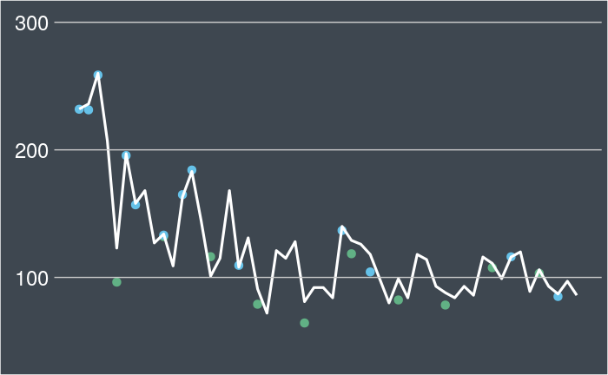
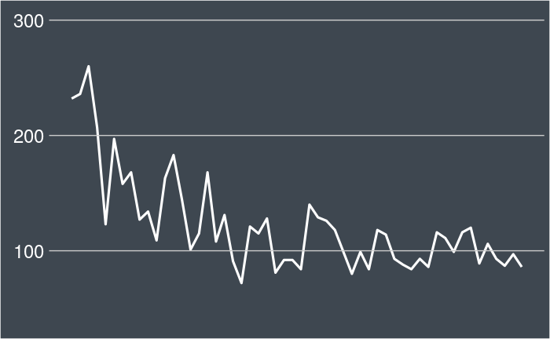


SihlQL: results
The bin removal mechanism:
manages dynamics sets of items in in the answers
is differentially private
may have a positive impact on the answer utility
SihlQL to declare continuous queries over knowledge graphs streams
$$h$$
$$time$$

Slide 19
Conclusions
We have technologies for publishing and exchanging data using the web as a platform
Data exchange can create new opportunities, improve personalised services and enhance our life quality
Remembering that data is a valuable resource, we need instruments to
Keep the ownership of our data
Share our data in controlled ways
Control the amount of information we share
Notes:
To wrap up, in this talk I presented our experience on extending semantic web technologies to integrate differential privacy.
SihlQL is built on a fragment of SPARQL compatible with the w-event privacy framework and can be used to publish noisy histograms
To improve its expressiveness, we designed the bin removal mechanism, a differential privacy algorithm to manage dynamic set of bins
This may be useful in several settings where data curators are adding or removing items, such as tv channels or products
Our experiments investigated the impact of introducing the bin removal mechanism in the w-event privacy framework, showing that there are cases where it has a beneficial impact on the answer utility.
I would like to thank you all for you attention, and if you have questions and comments, do not hesitate in getting in touch!

Slide 20
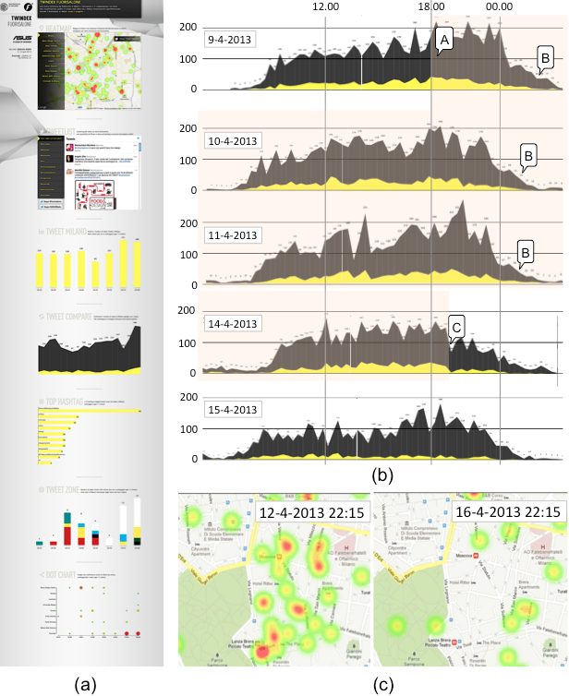
My research interests
I am interested in managing knowledge graphs evolving over time
Data models and vocabularies
Stream reasoning engines
Query languages
Applications
Query

Slide 21
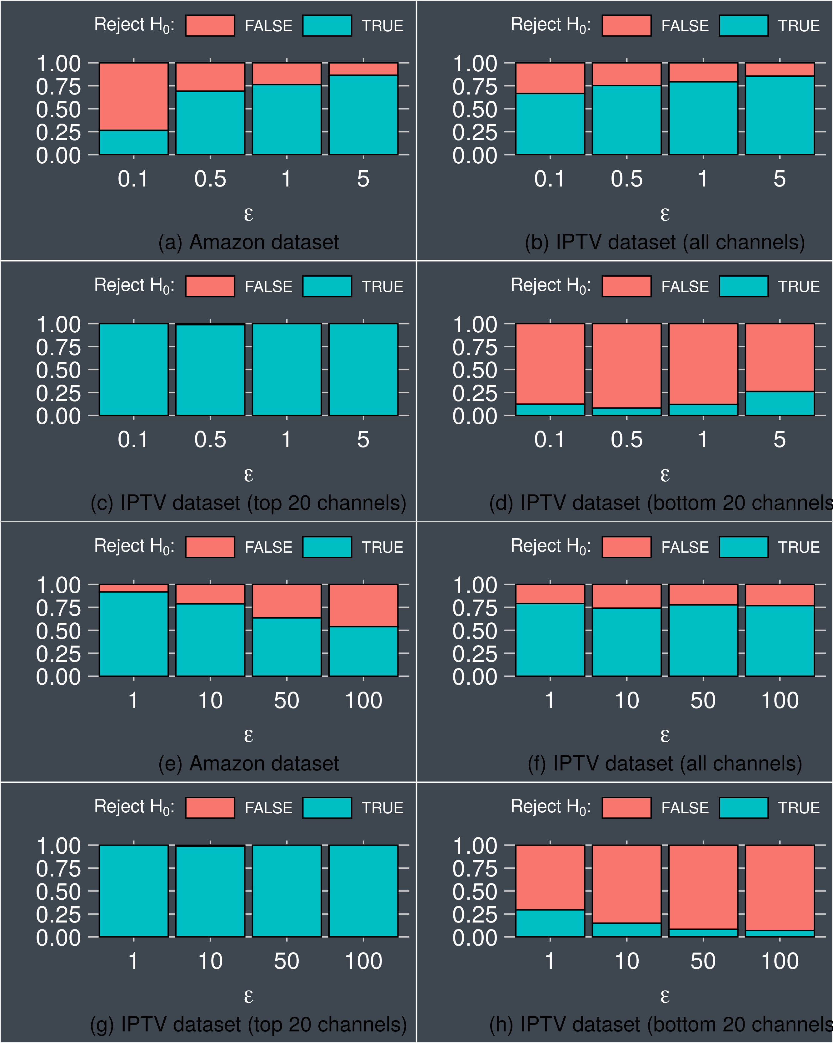


Hypothesis testing
Mann Whitney U test for each item to check the impact of the privacy algorithms
$H_{0}$: the distances are indistinguishable
$H_{a}$: the distances are distinguishable
Findings:
The lower the epsilon, the more indistinguishable the impact
The impact on items with large bin size are is often distinguishable
The impact on items with small bin size are is often indistinguishable
$ε$:
Amazon reviews
IPTV viewership
Top 20 channels
Bottom 20 channels
Notes:
To compare the distances we use a Mann Whitney U test.
For each item, we check if the distances associated to the two algorithms significantly differ.
We count for how many items the test is satisfied, showing the aggregations in the plot on the right.
Blue indicates that H0 is rejected, so the results are distinguishable, while red indicates that the bin removal mechanism does not impact the utility of the answer.
When we look into the results of the experiments on the Amazon dataset, we observe that when epsilon increases, the distances of the noisy time series wrt the real data are distinguishable for more items
This indicates an increasing impact of the br mechanism on the query answering process.
We observe a similar trend if we look into the IP TV viewership data
We repeated the analysis restricting on the 20 TV channels with the highest average number of viewers and the 20 channels with the lowest one.
This suggests that the main impact of the bin removal mechanism is on items with the large bin sizes
The main reason is that the introduction of the bin removal mechanism in the w-event privacy framework introduces a third mechanism.
The privacy budget needs to be redistributed among three mechanisms, leading to inject more noise when data is published.
It is easier to observe this effect when the noise is added to large bins.

Slide 22
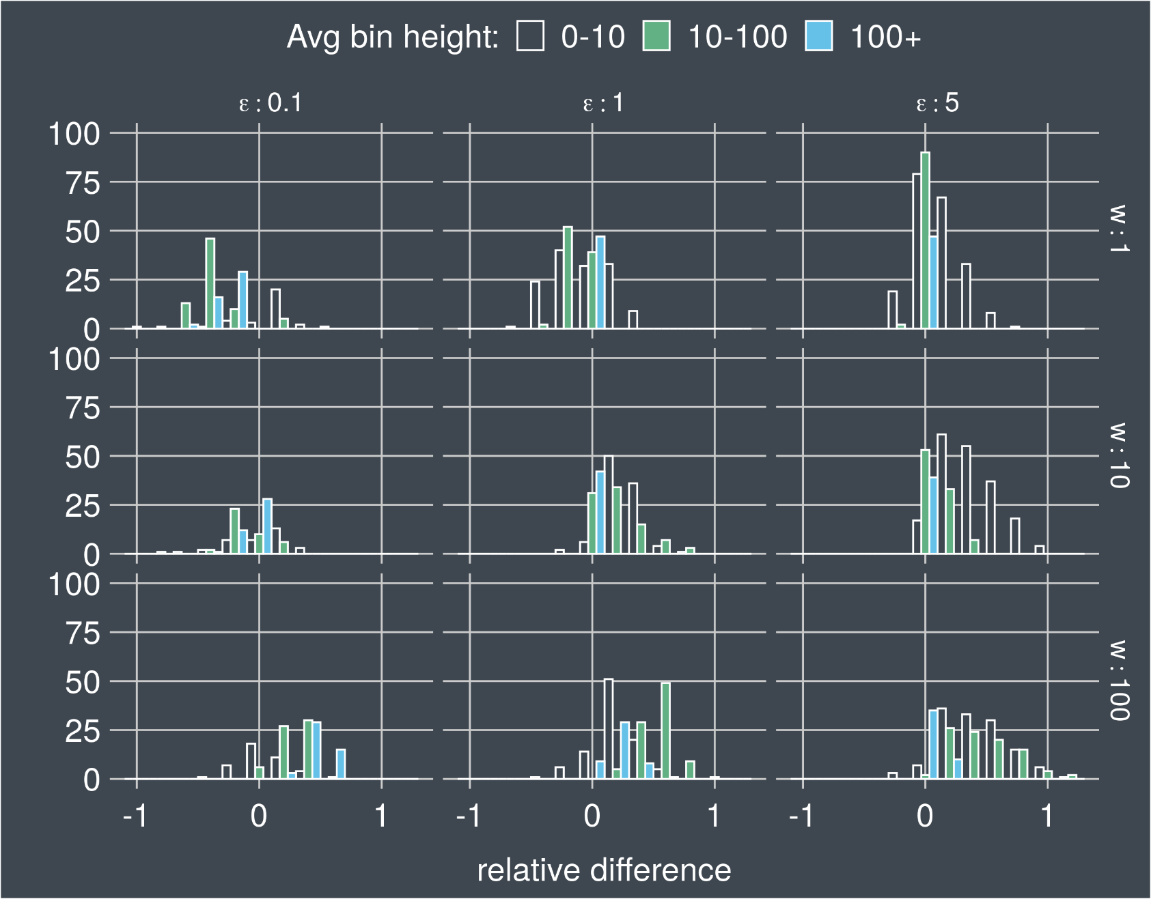
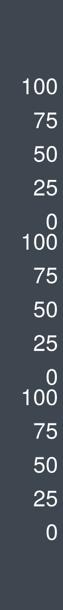
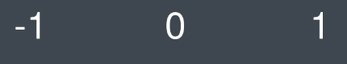

Analysis of distinguishable results
The plot shows relative distances
Negative distances: algorithm with the bin removal mechanism have higher utility than the one without it
Findings:
The algorithm without bin removal mechanism performs better when w increases
The algorithm with bin removal mechanism performs better when $ε$ decreases
Notes:
As a final insight, I want to spend a few words on what happens when results are distinguishable.
Here, we split the items with distinguishable distances in three sets, and we show the relative difference.
Negative values indicates that w-event privacy with bin removal mechanism produces results closer to the real one.
When w increases, the budget available at each time instant reduces, and this penalises more w-event privacy with bin removal mechanism, since bins with small and average bin size move to the right.
When epsilon decreases, we observer a shift to the left.
We hypothesise that in such cases, removing the bins reduces the number of releases, saving more budget to be used for more accurate releases. This, however, require more investigation.
All in all, this is a desirable behaviour, because the algorithm with bin removal mechanism shows good performance when epsilon is small.

