Slide 1
Highly-Efficient Reasoning via Trigger Graphs
Efi Tsamoura
SAIC-Cambridge
Dec 6, 2022
SAIC-Cambridge

Slide 2
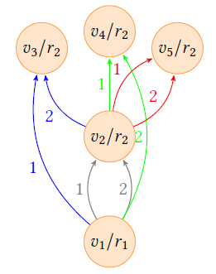
Disclaimer
This talk is not about stream reasoning…
…however, it presents a reasoning technique that can be naturally extended to reasoning in an incremental fashion.
The reasoning technique is based on a notion called Trigger Graphs (TGs).
𝑝(𝑋,𝑌) ← 𝑒(𝑋,𝑌) (𝑟₁)
𝑝(𝑋,𝑌) ← 𝑝(𝑋,𝑍) ∧ 𝑝(𝑍,𝑌) (𝑟₂)
“Materializing Knowledge Bases via Trigger Graphs”, VLDB 2021
“Probabilistic Reasoning at Scale: Trigger Graphs to the Rescue”, SIGMOD 2023

Slide 3
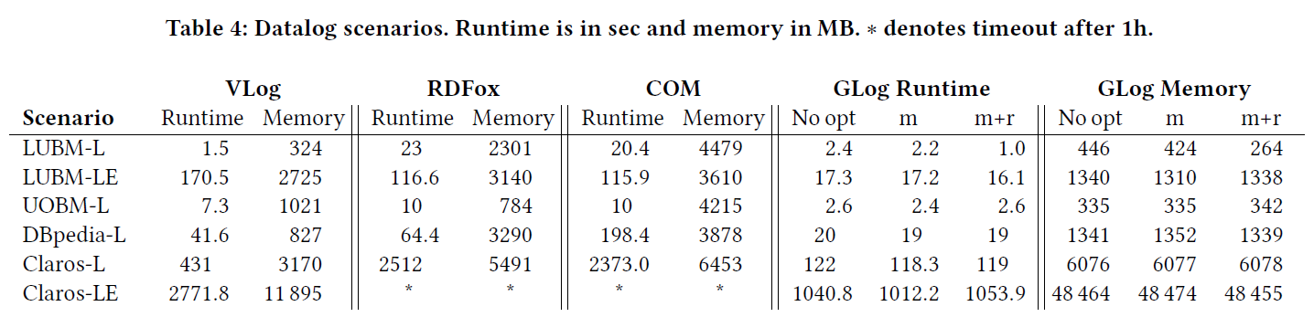
Performance benefits of Trigger Graphs: non-probabilistic reasoning

Slide 4
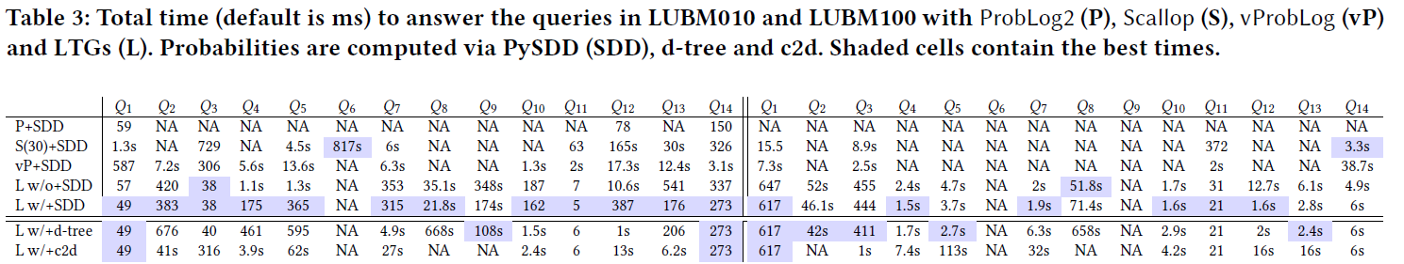
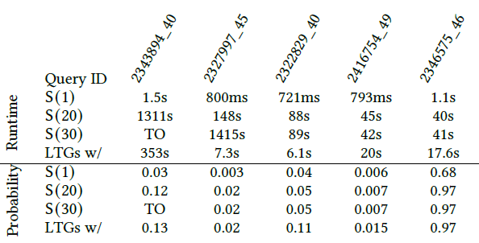
Performance benefits of Trigger Graphs: probabilistic reasoning
Table. Results over the VQAR benchmark (NeurIPS 2021).

Slide 5
Overview
TGs: non-probabilistic case
TGs: probabilistic case

Slide 6
Motivation
𝑟(𝑐₁, 𝑐₂)
Standard bottom-up seminaive evaluation
cannot prevent the derivation of logically redundant facts
cannot prevent redundant homomorphism checks
𝑟₄
𝑟₁
𝑇(𝑐₂, 𝑐₁, n₁)
𝑅(𝑐₁, 𝑐₂)
𝑟₃
𝑟₂
𝑇(𝑐₂, 𝑐₁, 𝑐₂)
𝑟₃
𝑅(𝑐₁, 𝑐₂)
𝑟(𝑋,𝑌) → 𝑅(𝑋,𝑌) (𝑟₁)
𝑅(𝑋,𝑌) → 𝑇(𝑌,𝑋,𝑌) (𝑟₂)
𝑇(𝑌,𝑋,𝑌) → 𝑅(𝑋,𝑌) (𝑟₃)
𝑟(𝑋,𝑌) → ∃𝑍. 𝑇(𝑌,𝑋, 𝑍) (𝑟₄)
𝐵 = {𝑟(𝑐₁, 𝑐₂)}

Slide 7
TG Construction for Linear Rules: Intuition
𝑟(𝑐₁, 𝑐₂)
Reason over an instance B* that captures *all* possible rule execution patterns.
Build a TG that captures the derivations over B*.
Eliminate nodes producing logically redundant facts:
preserving homomorphisms
𝑟₄
𝑟₁
v₂
v₁
𝑇(𝑐₂, 𝑐₁, n₁)
𝑅(𝑐₁, 𝑐₂)
1
𝑟₂
v₃
𝑇(𝑐₂, 𝑐₁, 𝑐₂)
𝑟(𝑋,𝑌) → 𝑅(𝑋,𝑌) (𝑟₁)
𝑅(𝑋,𝑌) → 𝑇(𝑌,𝑋,𝑌) (𝑟₂)
𝑇(𝑌,𝑋,𝑌) → 𝑅(𝑋,𝑌) (𝑟₃)
𝑟(𝑋,𝑌) → ∃𝑍. 𝑇(𝑌,𝑋, 𝑍) (𝑟₄)

Slide 8
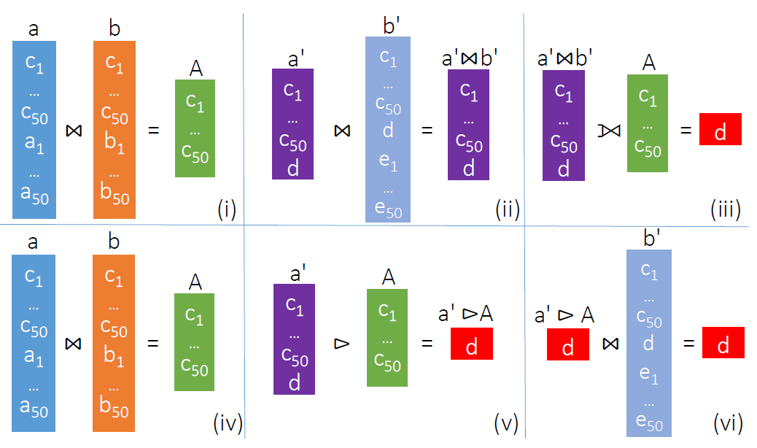
TG-Based Reasoning: Datalog Rules
No time to cover. Read our VLDB 2021 paper!
TG minimization
TG-based rule execution strategy
Computing rewritings over the TG.
Reduce to query containment (decidable as the check does not consider the rules).
Theoretical results:
Produce a minimal (all instance guarantees) TG.
Decision problem is co-NP-complete.

Slide 9
Overview
TGs: non-probabilistic case
TGs: probabilistic case (actually Datalog reasoning over tuple-independent PDBs)

Slide 10
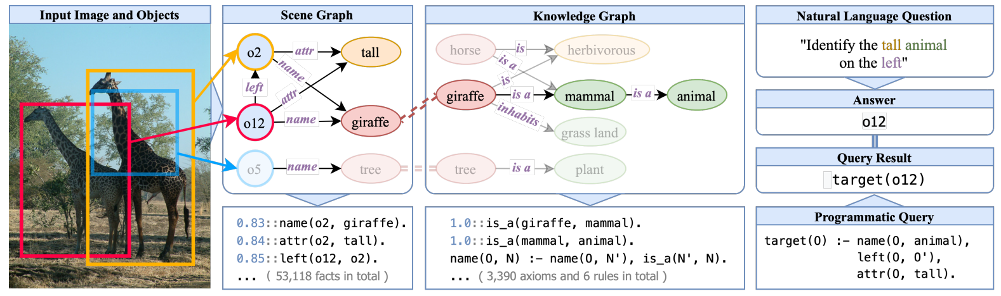
Probabilities into the game
Auto-mined KGs
Google’s Knowledge Vault
Microsoft’s Concept Graph
Visual Question Answering

Slide 11
TG extensions to account for probabilities
Why TGs should be extended?
We need to account for all possible non-redundant ways to derive each fact
Then, the derivations are compiled in a formula to compute the probability a derived fact is true.

Slide 12
TG-Based Probabilistic Reasoning: Intuition
𝑝(𝑎,𝑏)
𝑝(𝑎,𝑏)
𝑝(𝑎,𝑐)
𝑝(𝑏,𝑐)
Keep the provenance at reasoning-time within the nodes of the TG (this can be done efficiently).
Stop when the derivation of a fact depends on itself.
𝑝(𝑎,𝑐)
𝑝(𝑏,𝑏)
𝑝(𝑎,𝑏)
𝑝(𝑎,𝑏)
𝑝(𝑏,𝑐)
𝑝(𝑎,𝑐)
𝑝(𝑐,𝑏)
𝑒(𝑎,𝑏)
𝑒(𝑏,𝑐)
𝑒(𝑎,𝑐)
𝑒(𝑐,𝑏)
𝑝(𝑋,𝑌) ← 𝑒(𝑋,𝑌) (𝑟₁)
𝑝(𝑋,𝑌) ← 𝑝(𝑋, 𝑍) ∧ 𝑝(𝑍,𝑌) (𝑟₂)
𝑒(𝑎,𝑏), 𝑒(𝑏,𝑐), 𝑒(𝑎,𝑐), 𝑒(𝑐,𝑏)

Slide 13
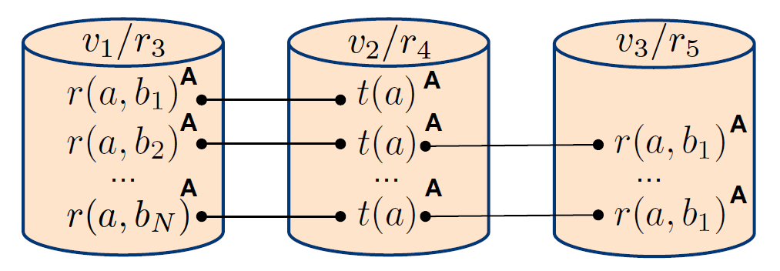
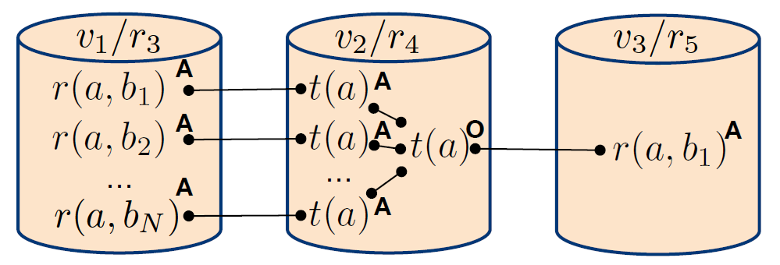
TG-Based Probabilistic Reasoning: Collapsing
The previous technique is sound… however, it can explode space-wise.
Keep only one derivation per fact within each node.
Extends the notion of absorptive provenance circuits [D. Deutch, ICDT 2014], but we decide when to collapse or not.
𝑟(𝑋,𝑌) ← 𝑞(𝑋,𝑌) (𝑟₃)
𝑡(𝑋) ← 𝑟(𝑋,𝑌) (𝑟₄)
𝑟(𝑋,𝑌) ← 𝑡(𝑋) ∧ 𝑠(𝑋,𝑌) (𝑟₅)
𝑞(𝑎,𝑏_{𝑖}), for 1≤ 𝑖 ≤𝑁, and 𝑠(𝑎,𝑏₁)

Slide 14
Probabilistic reasoning: prior art
How prior art [Tsamoura et al., AAAI 2020] works? Read our SIGMOD 2023 where we explain via an example!
They are based on provenance semirings [T.J. Green, PODS 2007] and have exponential space complexity [D. Deutch, ICDT 2014].

Slide 15
Connections to incremental reasoning
???

Slide 16

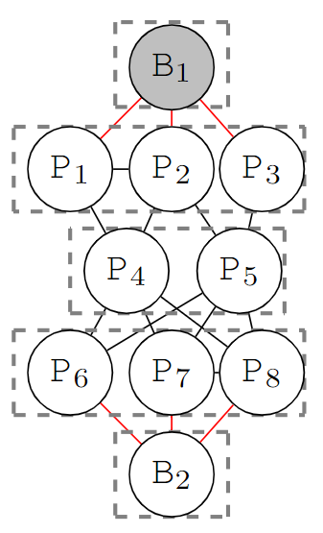
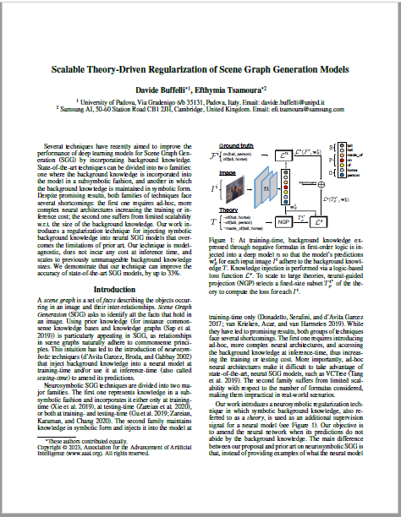
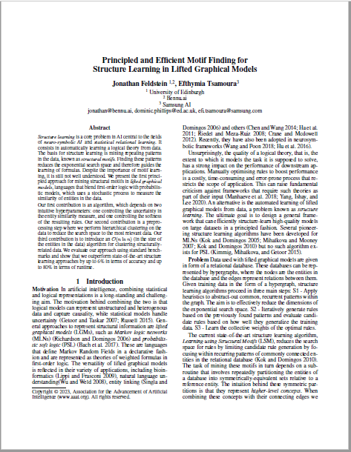
A few last things about my research
Scene graph generation
Structural motifs mining for lifted graphical models under (ε,α)-guarantees ...and some nice complexity results.
person
person
mixing
cutting
pan
tomatoes
AAAI 2023
AAAI 2023

Slide 17
Thanks!
Please feel free to reach out if
you want to visit me in Cambridge, UK, or
you have a nice idea to work on, or
you want to learn more about my projects including TGs!

