Slide 1
TensAIR: Online Learning from Data Streams via Asynchronous Iterative Routing
Mauro Dalle Lucca Tosi
Prof. Dr. Martin Theobald
University of Luxembourg
December 05, 2022

Slide 2
Index
Background: Online Learning
Current solutions to train NN from data-streams
TensAIR
Experiments & Results
Summary
Demo

Slide 3
1. Background Online Learning
Online Learning Characteristics
- Data streams
- Time-sensitive
- Simple Solutions
- Concept Drift
Streaming Processing Frameworks:
- Apache Spark
- Apache Flink
- Apache Kafka
- AIR

Slide 4
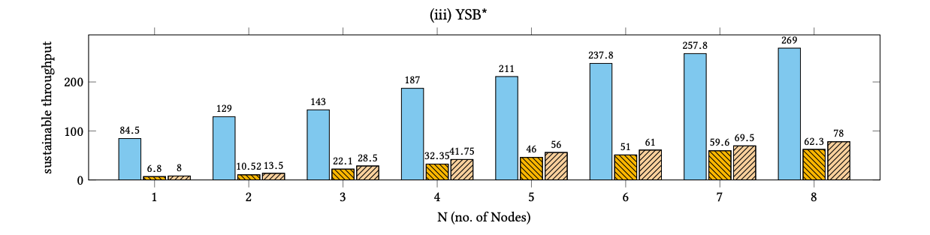

1. Background Online Learning: AIR
Distributed
Asynchronous message passing
Decentralised
Figure 3: “ST values (in 10⁶ events/sec.) of AIR, Spark and Flink over multiple nodes: SWA, YSB and YSB*” [1]
High-Performance (up to 36.58 Gb/s on 8 nodes and 224 cores)
[1] V. E. Venugopal, M. Theobald, S. Chaychi, and A. Tawakuli, “AIR: A light-weight yet high-performance dataflow engine based on asynchronous iterative routing,” in 2020 IEEE 32nd International Symposium on Computer Architecture and High Performance Computing (SBACPAD), 2020, pp. 51–58

Slide 5
2. Current solutions to train NN from data streams
Current Solutions:
dl-on-flink
Kafka and Tensorflow-IO
TensorFlowOnSpark
Limitations:
Rely on the availability of the whole training data at once.
Decreased performance under OL setting (real-time training).

Slide 6
3. TensAIR
TensAIR is a framework that implements TensorFlow in an AIR Dataflow.
C++
MPI
Distributed, asynchronous, and decentralized
Tensorflow C API
Tensorflow models imported from Python

Slide 7
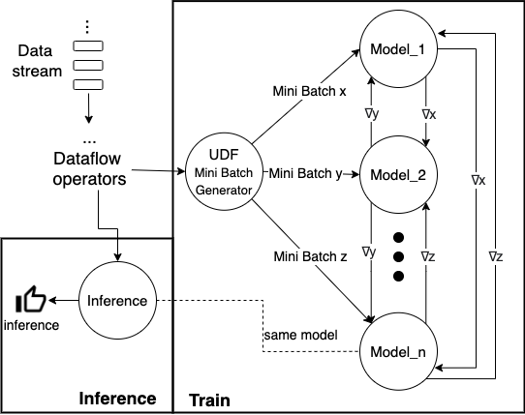
3. TensAIR: Dataflow
Figure 4: TensAIR general usecase dataflow.

Slide 8
3. TensAIR: Model Convergence
Special Characteristics:
Asynchronous
Decentralized
Convergence considerations:
Training is performed between significant concept drifts.
Theoretical convergence: Stale-Synchronous Parallellism (SSP).
Practical convergence: not impacted by asynchronous training.

Slide 9
4. Experiments & Results: Configurations
Problem | Dataset | Characteristic
Word2Vec | 1% English Wikipidea | Sparse
Image classification | CIFAR-10 | Dense
Table 3: Problems characteristics.
ULHPC
Nodes | Up to 16
Ranks per node (on CPU) | 4
CPUs per node | 28
GPUs per node | 4
Ranks per GPU | 1
Table 4: ULHPC configuration.

Slide 10
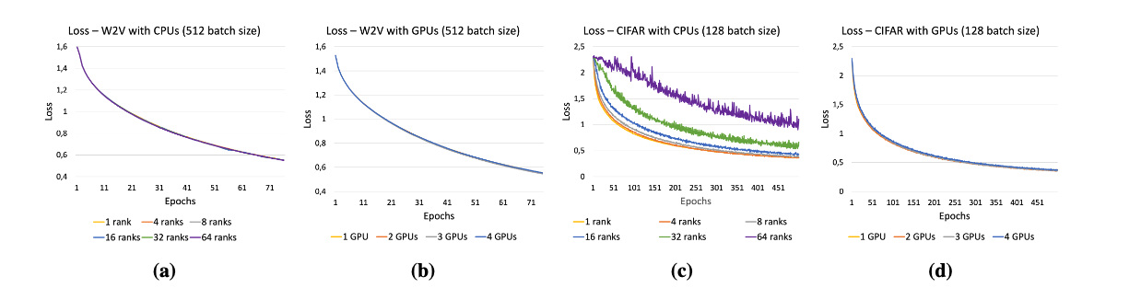
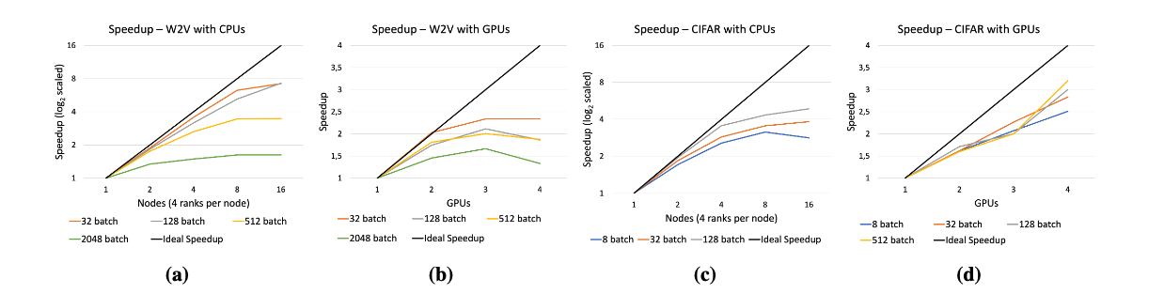
4. Experiments & Results: Convergence & Speed-up Analysis
Figure 6: Convergence Analysis of TensAIR on the Word2Vec and CIFAR-10 usecases.
Figure 7: Speedup Analysis of TensAIR on the Word2Vec and CIFAR-10 usecases.

Slide 11
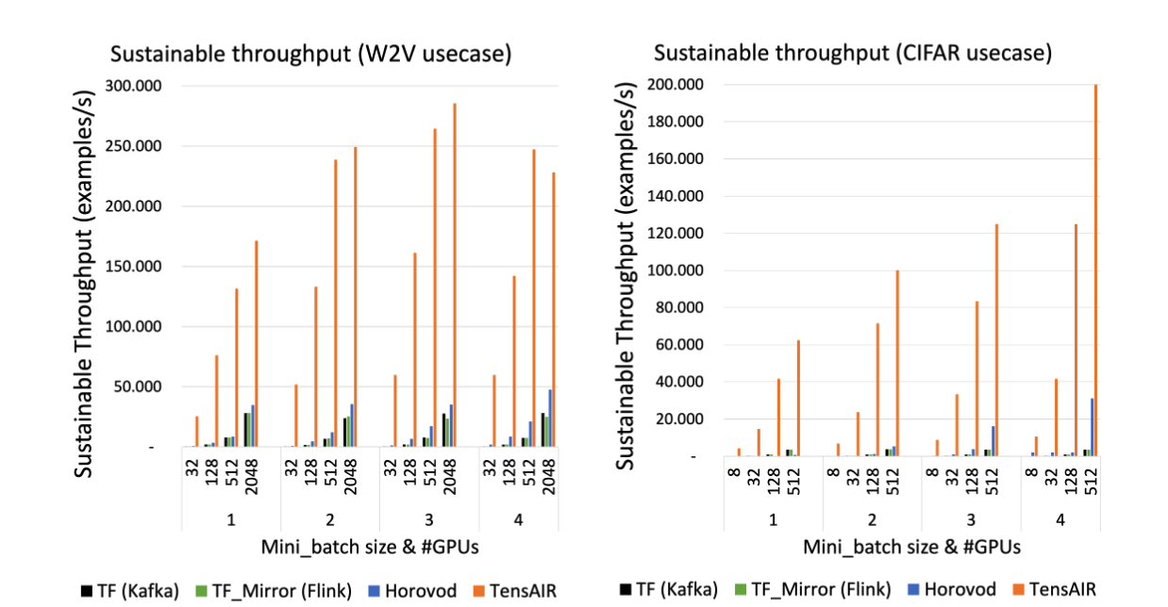
4. Experiments & Results: Baseline comparison
Figure 8: Throughput comparison between TensAIR, TensorFlow, and Horovod.

Slide 12
5. Summary
TensAIR:
Real-time train from multiple data-streams simultaneously.
Train NN models using CPUs, GPUs, or both.
Asynchronous and decentralized training.
Incorporate users pre and pos-defined pipelines.
Future works:
Implement active drift detection strategy.
Investigate convergence guarantees for decentralized ASGD.
Audio / Video usecases.

Slide 13
6. Demo

Slide 14


7. Acknowledgement
The Doctoral Training Unit Data-driven computational modelling and applications (DRIVEN) is funded by the Luxembourg National Research Fund under the PRIDE programme (PRIDE17/12252781).
https://driven.uni.lu

Slide 15

Thank you!
Gitlab: https://gitlab.uni.lu/mdalle/TensAIR
TensAIR dataflow.

