Slide 1
How can we increase revenue from Catch the Pink Flamingo?
Rahul Vishwakarma

Slide 2
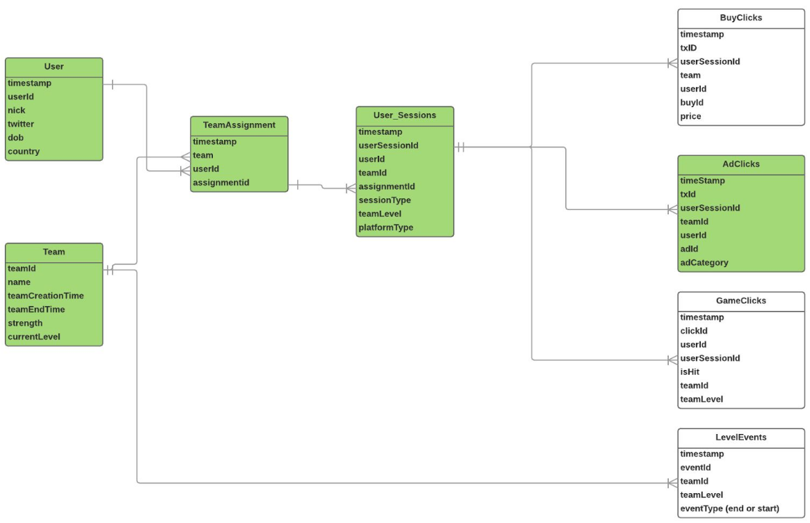
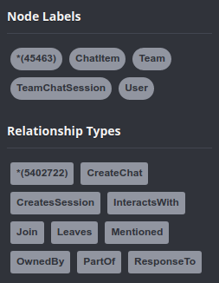
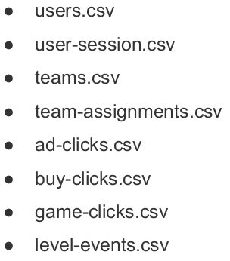
Problem Statement
How can we use the following data sets to understand options for increasing revenue from game players?
Notes:
Data set descriptions:
Two types of datasets are available to solve our problems
1. Flamingo-data
Users, teams and team levels in csv files
Game, Ad and Buy clicks in game dumped into csv files
2. Chat-data
User, team and chat sessions with relations like Join, Leaves, CreateSession
Chat message item with user relations like Mentioned, PartOf and ResponseTo
Data Science Story:
Eglence needs a focused analytics driven campaign to generate revenue from game players
Analytics will focus on the two types of game related data for patterns and translate them to actionable strategies
Flamingo data and chat data are the two data sources available to drive our analysis
Data about platform, users and revenue will help us understand the demography and high-stake individuals
Data about chat and message patters will provide information about active communities and teams

Slide 3
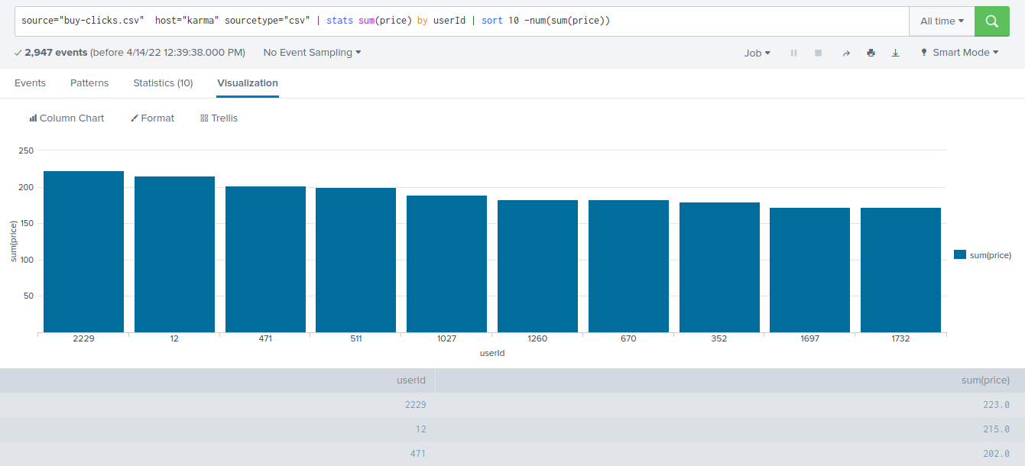
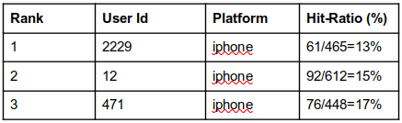
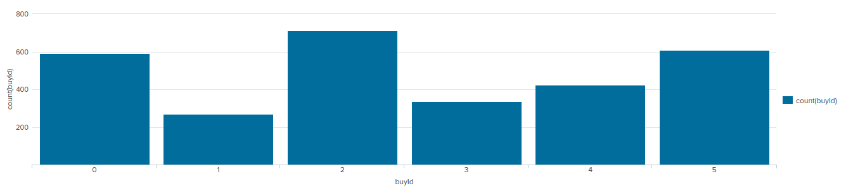
Data Exploration Overview
We see that the top buyers or spenders are using iphone and dont follow a consistent Hit-ratio in game play
We also see a great demand for product with buyId 2,5 & 0 when compared to 4,3,1 in that order of purchase counts respectively
Notes:
We look at the Flamingo-data using Splunk data exploration platform
iPhone is identified as the platform used by top ranking revenue generators
We also separate out the products most sought after and identify the products low in demand

Slide 4
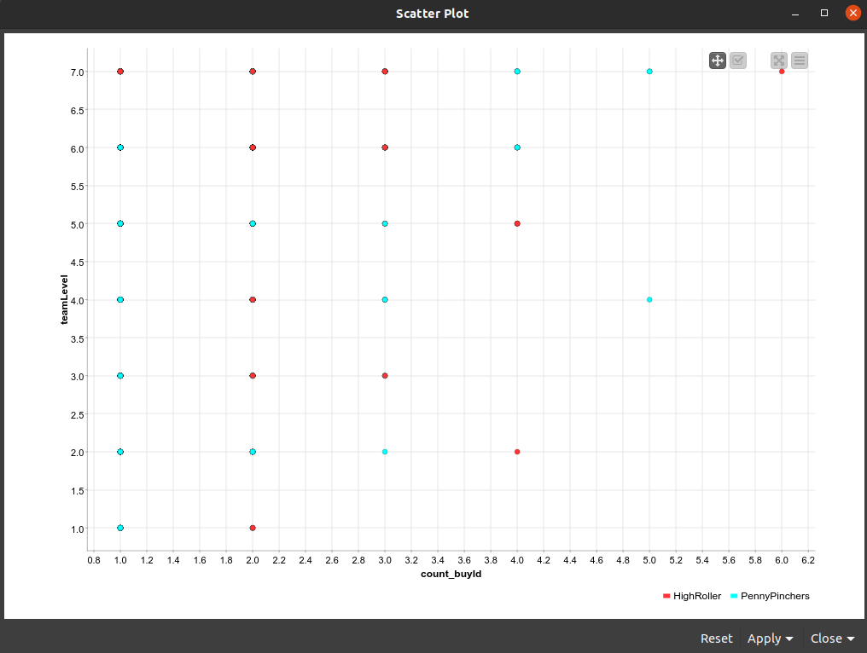
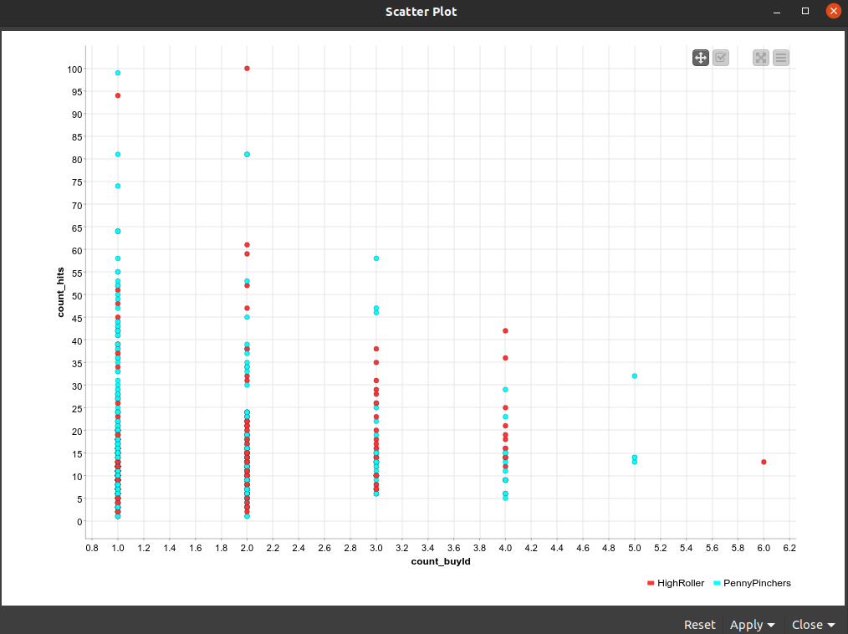
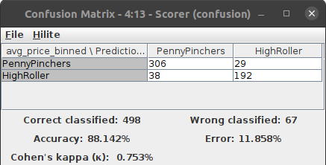
What have we learned from classification?
Looks like until teamLevel 7 is achieved product count_buyId 1 is not purchased at all.
Only PennyPinchers on count_buyId=5. We will need to apply what is learnt from 3 or 2 which are doing better
iPhone users are the money-making audience and do consider the errors in model
Notes:
KNIME is used to classify the revenue based on thresholded revenue categories
We use the Flamingo-data with revenue as our nominal feature in a DecisionTree workflow
Classification result Scatter charts have HighRoller in red & PennyPinchers in blue color
We will need to promote product id 5 since that is the money making item including the iOS iphone platform
The accuracy of this result is around 88% and should be considered in all claims

Slide 5
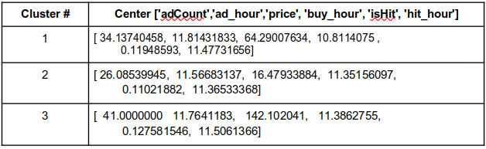
What have we learned from clustering?
Features from "timestamp", ”price”, “isHit”, “adCount”
Action recommendations
Propose ads right after a winning streak, level up or good hit rate
Select the high hit and revenue generating customer and show them ads later when compared to others
Selectively offer training and for low hit rate players so that they can engage and generate more revenue
Cluster 3 is different from the others in that the users with maximum adCount also have the highest hit and average price leading to higher revenue.
Cluster 2 is different from the others in that the users with minimum adCount and average price also have minimum average hit rate
Notes:
We use PySpark and built in packages for clustering
Features used is timestamp broken into hour of the day, price, hit, and ad_count
K-means cluster analysis with k=3 is done with 6 feature dimensions and 543 data rows
Actions are recommended in slide

Slide 6
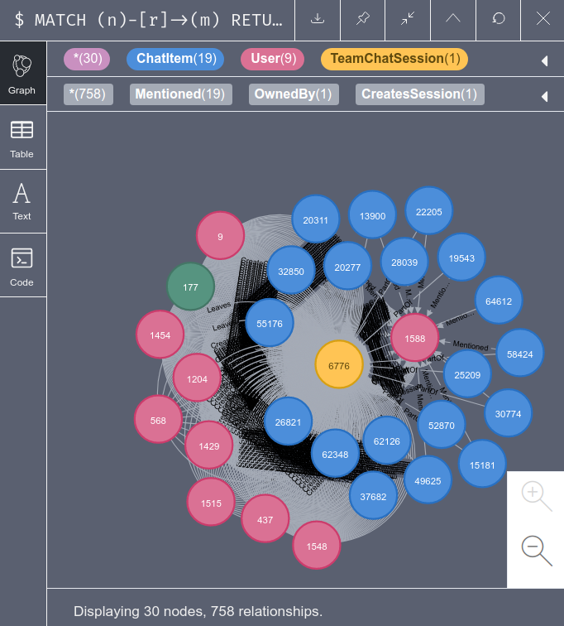
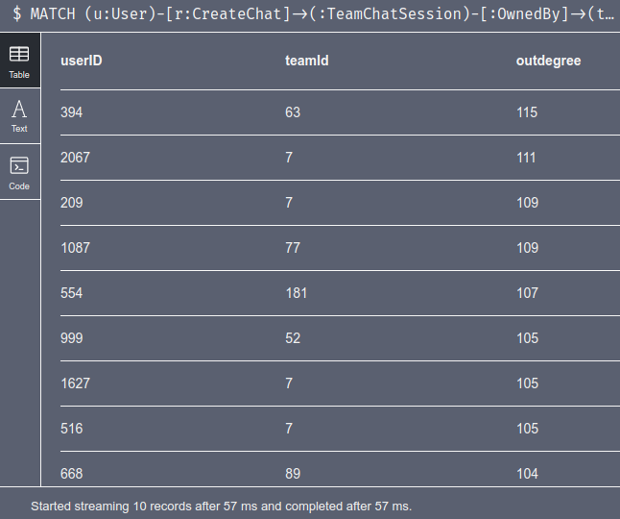
From our chat graph analysis, what further exploration should we undertake?
Looks like all except User:Id:999 shown here is the chattiest. We need to understand how this user performs on buy or hit rates compared to others
Similar comparison should be done for team:Id:52 and other chatty teams
Correlation between Cluster coefficient and buy revenue or hit rates can be useful
Marketing costs for ad buys and clicks for the various clusters can inform about the habits of the community & neighbors
Notes:
We load the Chat-data for analysis in Neo4j graph database
Chatty users may not be associated with chatty teams
Clustering coefficient is a measure of closeness amongst node’s neighbors and can be used to identify strong cliques
Rely on social proximity to target advertisements for better reach

Slide 7
Recommendation
Market more to the iPhone platform type and assess/survey the android user base for low sales.
Promote the purchase of buy item 4,3,1 by its order of revenue
Propose ads right after a winning streak, level up or good hit rate
Selectively offer training and for low hit rate players so that they can engage, share content and generate more revenue
Promote products based on its availability or make it a prize. (Until Level 7 is achieved product count_buyId 1 is not purchased at all)
Reward the chatty communities to share their purchases for reach
Notes:
Rationale/Explanation
Shift marketing efforts to iOS/iPhone platforms
Incentives to players for review on platforms of promotion (iOS > Android Play store)
Promote items that are low revenue generating like product id 4,3,1
Understand player behavior and show ads right after a winning streak
Gain a deeper understanding and develop contingency for error in the system (considering accuracy is 88% we are likely to see 12% error rate)

