Slide 1
How can we increase revenue from Catch the Pink Flamingo?
Rahul

Slide 2
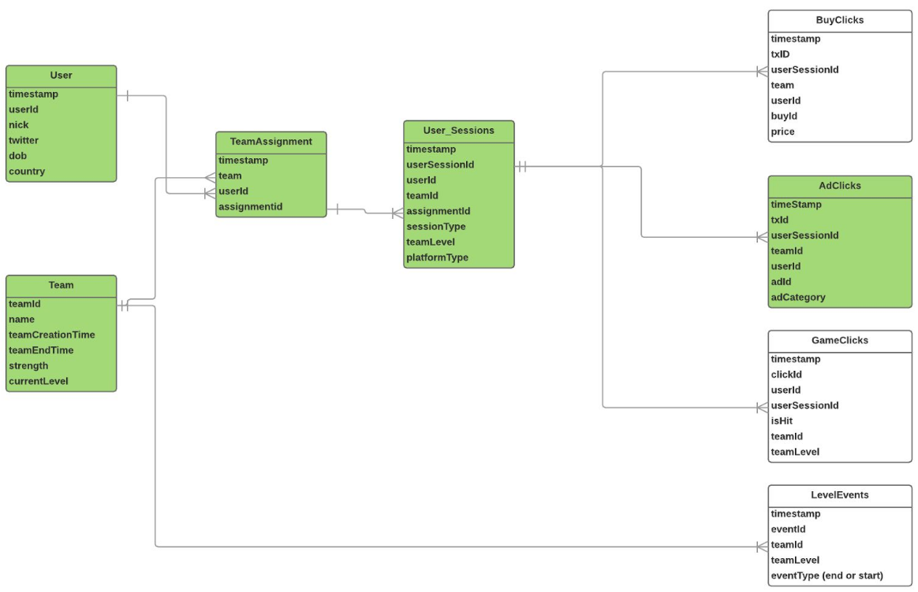
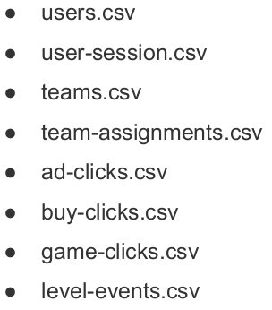
Problem Statement
How can we use the following data sets to understand options for increasing revenue from game players?
Notes:
Fill in appropriate data set descriptions.
In your script, be sure to make clear how this is a data science story. State in your own words YOUR opinion of why the different kinds and sources of data are so important for Eglence to be able to identify new revenue opportunities.

Slide 3
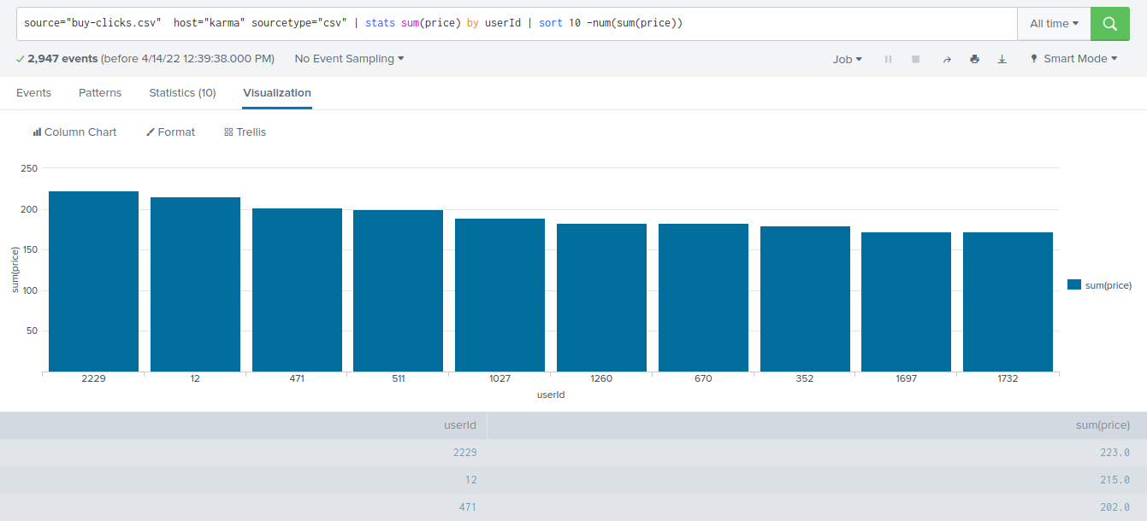
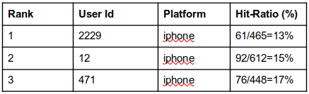
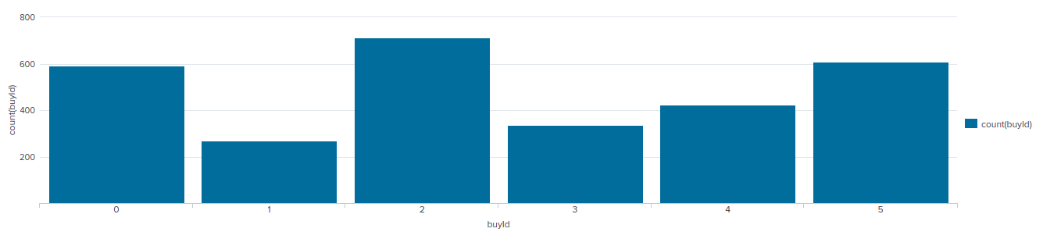
Data Exploration Overview
We see that the top buyers or spenders are using iphone and dont follow a consistent Hit-ratio in game play
We also see a great demand for product with buyId 2,5 & 0 when compared to 4,3,1 in that order of purchase counts respectively
Notes:
Assuming you have <2 minutes for this slide, what is the most important thing(s) to convey from your experience with exploring the data?

Slide 4
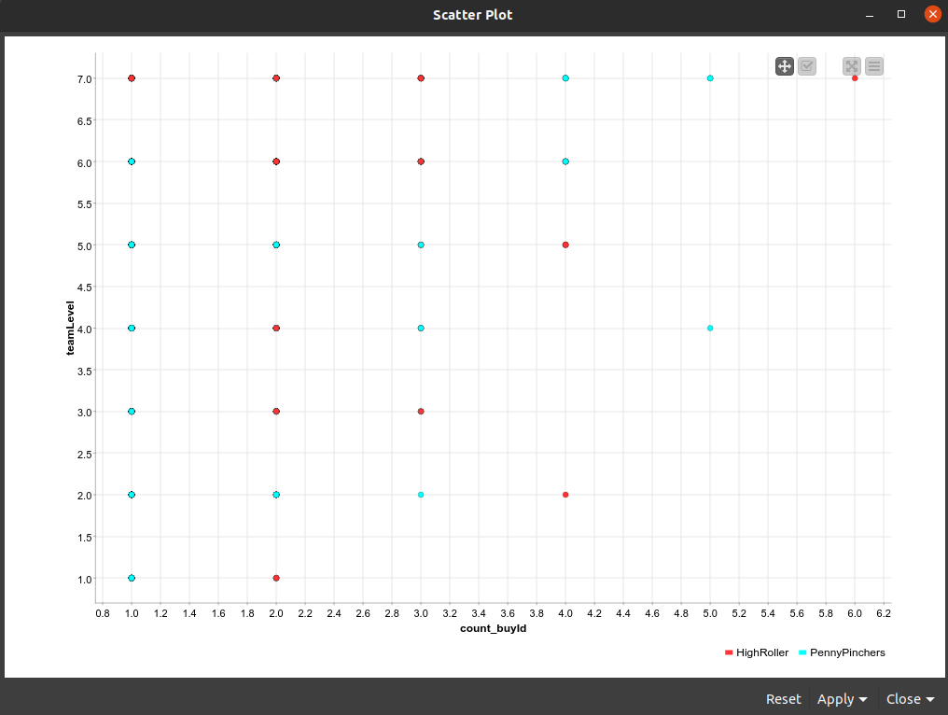
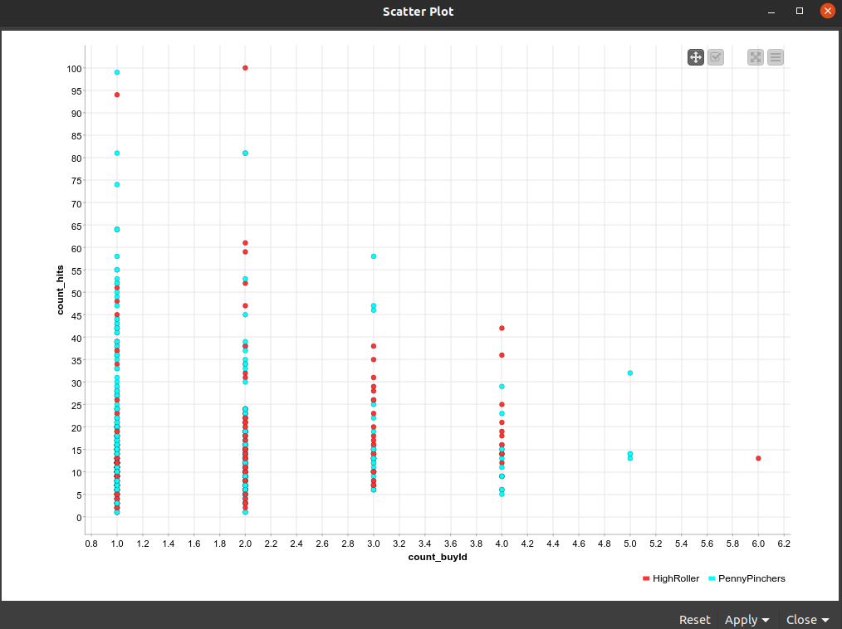
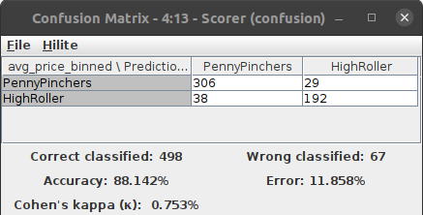
What have we learned from classification?
Looks like until teamLevel 7 is achieved product count_buyId 1 is not purchased at all.
Only PennyPinchers on count_buyId=5. We will need to apply what is learnt from 3 or 2 which are doing better
iPhone users are the money making audience and do consider the errors in model
Notes:
Assume you have 2 minutes to present what you perceive to be the most important or remarkable points from your classification analysis.

Slide 5
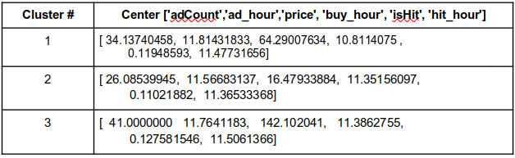
What have we learned from clustering?
Features from "timestamp", ”price”, “isHit”, “adCount”
Action recommendations
Propose ads right after a winning streak, level up or good hit rate
Select the high hit and revenue generating customer and show them ads later when compared to others
Selectively offer training and for low hit rate players so that they can engage and generate more revenue
Cluster 3 is different from the others in that the users with maximum adCount also have the highest hit and average price leading to higher revenue.
Cluster 2 is different from the others in that the users with minimum adCount and average price also have minimum average hit rate
Notes:
Assume you have 2 minutes to present what you perceive to be the most important or remarkable points from your classification analysis.

Slide 6
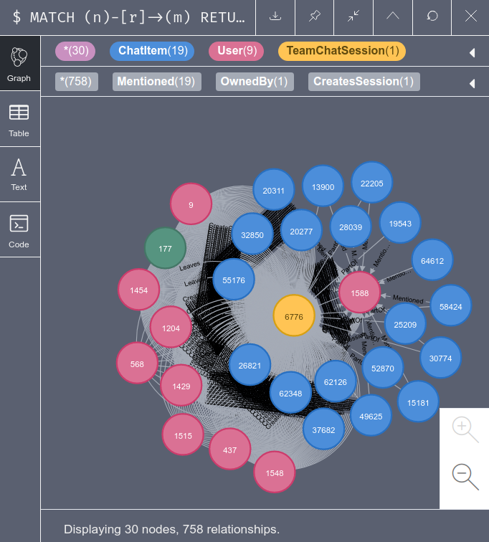
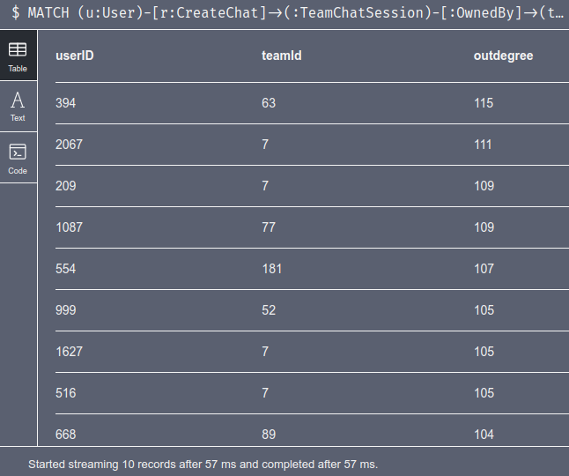
From our chat graph analysis, what further exploration should we undertake?
Looks like all except User:Id:999 shown here is the chattiest. We need to understand how this user performs on buy or hit rates compared to others
Similar comparison should be done for team:Id:52 and other chatty teams
Correlation between Cluster coefficient and buy revenue or hit rates can be useful
Marketing costs for ad buys and clicks for the various clusters can inform about the habits of the community & neighbors
Notes:
Assume you have 2 minutes to present what you perceive to be the most important or remarkable points from your graph analysis

Slide 7
Recommendation
Market more to the iPhone platform type and assess/survey the android user base for low sales.
Promote the purchase of buy item 4,3,1 by its order of revenue
Propose ads right after a winning streak, level up or good hit rate
Selectively offer training and for low hit rate players so that they can engage, share content and generate more revenue
Promote products based on its availability or make it a prize. (Until Level 7 is achieved product count_buyId 1 is not purchased at all)
Reward the chatty communities to share their purchases for reach
Notes:
From your own viewpoint, make one recommendation/action the Eglence should follow to improve their business. Be sure to explain your rationale.

