Slide 1

STREAMING ANALYTICS USING CMCD AND CMSD
First Milestone Presentation
Daniel Yermakov, Maximilian Roschlau, Neha Shrestha
Open Distributed System | SS 22

Slide 2
Content
Motivation
MPEG-DASH
How does MPEG-DASH works?
CMCD
CMSD
Further steps

Slide 3
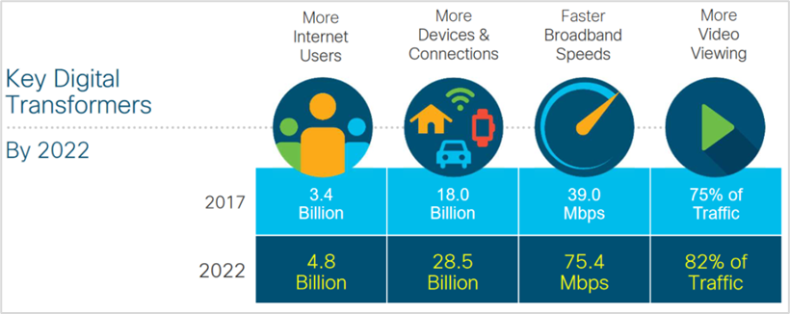
Motivation
Streaming content as a large part of internet traffic
Rising user expectations e.g. for video quality and buffer times

Slide 4
Motivation
Content Delivery Networks (CDNs) try to address user expectations
Limitations: efficient use of shared bandwidth by multiple clients
Specific informations are required to address limitations
One approach: Server and Network Assisted DASH Standard (SAND)
Open question: “What information is relevant and actionable?“

Slide 5
MPEG-DASH
Technology developed by Moving Picture Expert Group
Deliver media via Video on Demand (VOD) or Live Streaming
Dynamic Adaptive Streaming over HTTP (DASH)
Open Source option, dash.js
Use Media Source Extensions (MSE) and Encrypted Media Extensions (EME) to
enable playback directly in the browser
The media content is divided into small segments, which are available with different bitrate
Adaptive bitrate streaming

Slide 6
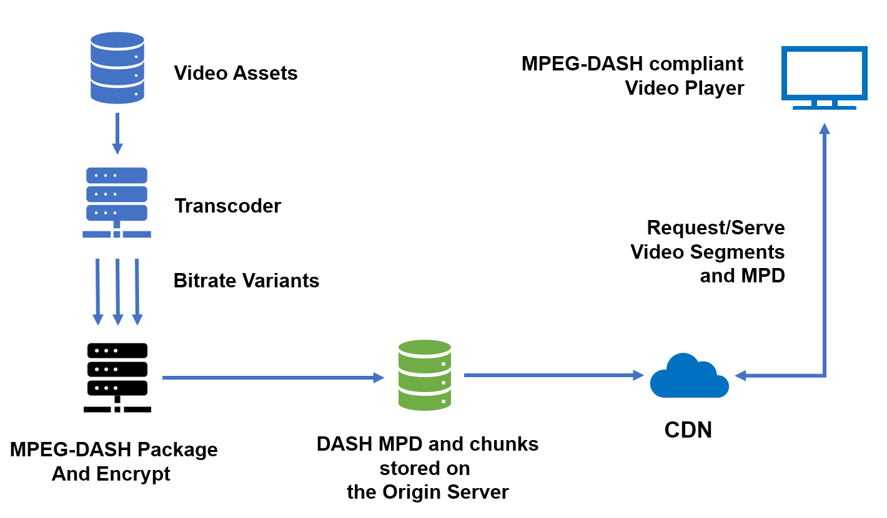
How does MPEG-DASH works?

Slide 7
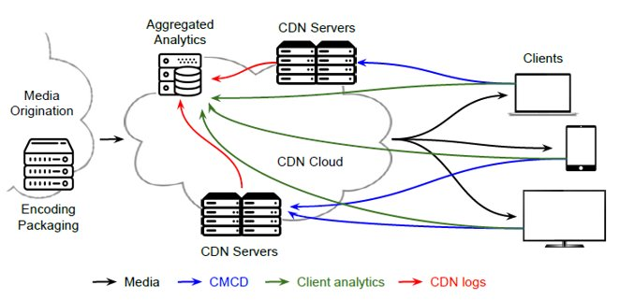
CMCD (Common-Media-Client-Data)
Published Sept. 2020 by Consumer Technology Association (CTA)
Defines technique to send metrics from client to CDN
The data is used to improve the communication performance and user experience
Data such as encoded bit rate, buffer rate or maximal throughput is exchanged
Issue: possibility of sending meta information and hints from the CDN to the streaming clients

Slide 8
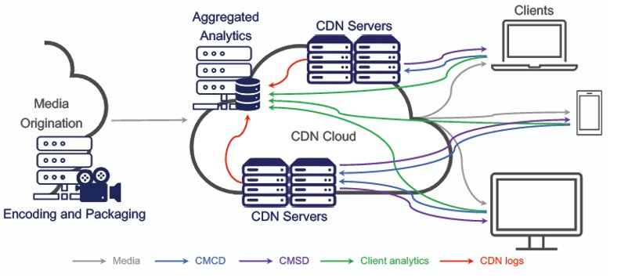
CMSD (Common-Media-Server-Data)
Not published yet - available only as a draft
Enables server-side communication to clients (intermediate servers and players)
Data is placed within HTTP-Headers (static and dynamic)
Improve the efficiency and performance of streaming services provided by CDNs to enhance the user experience

Slide 9
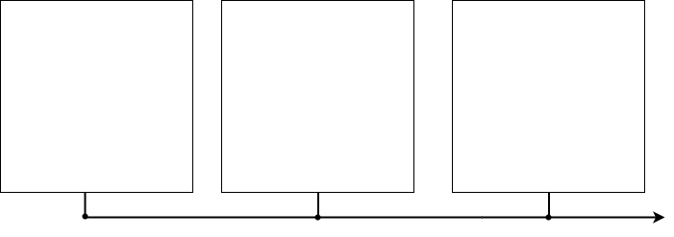
Schedule and Next Steps
Problem Statement
Paper Review
Understand Standards
Use the CMCD implementation in dash.js
Prototype CMSD endpoints in dash.js
Experiment with CMSD implementations and use cases
Implement a backend to receive and persist metrics
Build an analytics UI using Grafana
Workshop 1
Workshop 2
Workshop 3

Slide 10
References
Barnett, T., Jain, S., Andra, U., & Khurana, T. (2018). Cisco visual networking index (vni) complete forecast update, 2017–2022. Americas/EMEAR Cisco Knowledge Network (CKN) Presentation.
Begen, A. C. (2021, July). Manus manum lavat: media clients and servers cooperating with common media client/server data. In Proceedings of the Applied Networking Research Workshop (pp. 82-84).
Bentaleb, A., Lim, M., Akcay, M. N., Begen, A. C., & Zimmermann, R. (2021, July). Common media client data (CMCD) initial findings. In Proceedings of the 31st ACM Workshop on Network and Operating Systems Support for Digital Audio and Video (pp. 25-33).
E. Thomas, M. O. van Deventer, T. Stockhammer, A. C. Begen and J. Famaey, "Enhancing MPEG DASH Performance via Server and Network Assistance," in SMPTE Motion Imaging Journal, vol. 126, no. 1, pp. 22-27, Jan.-Feb. 2017, doi: 10.5594/JMI.2016.2632338.

Slide 11
References
Silhavy, D. (2022). dash.js - Common-Media-Client-Data - Video-Dev. Retrieved 16 May 2022, from https://websites.fraunhofer.de/video-dev/dash-js-common-media-client-data-cmcd/
Sodagar, "The MPEG-DASH Standard for Multimedia Streaming Over the Internet," in IEEE MultiMedia, vol. 18, no. 4, pp. 62-67, April 2011, doi: 10.1109/MMUL.2011.71.
Unpublished Working Draft. Common Media Server Data (CMSD). Retrieved 16 May 2022, from https://docs.google.com/document/d/1BlTHfbF2VGSlA4vLx1fMssWqiGWYuzhmTfQ8VeyxF8g/edit#heading=h.w4dwbs4gi4x
Vijayanagar, K. (2022). What is MPEG-DASH Video Streaming Protocol? How Does MPEG-DASH Work? - OTTVerse. Retrieved 16 May 2022, from https://ottverse.com/mpeg-dash-video-streaming-the-complete-guide/

