Slide 1
BANK CUSTOMER ANALYTICS
Customer Churn Prediction
Using demographic and financial signals to identify customers at risk of leaving the bank
10,000
14
86.8%
Customer records
Features tracked
Best model accuracy

Slide 2
The Business Problem
Why predicting churn matters for the bank
Acquiring a new customer costs far more than retaining an existing one. By analyzing customer demographics and financial behavior, the bank can flag at-risk customers early and act before they leave.
Target Variable
Exited (renamed Churn)
1 = customer closed account | 0 = customer retained
Identify drivers
Predictor Features
Pinpoint which customer attributes most strongly predict churn.
Credit Score
Geography & Gender
Age & Tenure
Balance
Number of Products
Has Credit Card
Is Active Member
Estimated Salary
Build a classifier
Train models that flag customers likely to exit the bank.
Enable action
Give the bank a data-backed retention target list.
Bank Customer Churn Prediction
2

Slide 3
How Many Customers Are Churning?
Overall churn rate across the 10,000-customer dataset
1 in 5 customers
left the bank during the period studied — a meaningful share of the customer base, and one the bank can work to reduce.
20.37%
79.63%
customers churned
customers retained
This imbalance is why model recall on churners matters as much as overall accuracy.
Bank Customer Churn Prediction
3

Slide 4
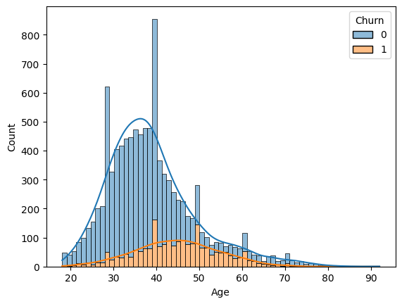
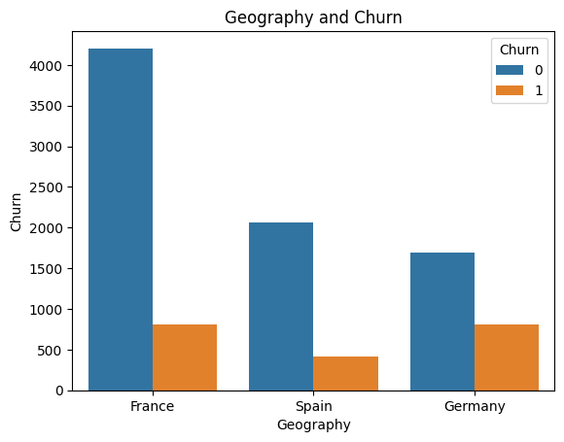
Who Is Churning: Age & Geography
Older customers and German customers churn at disproportionate rates
Most customers are 30-40 yrs old, but churn is highest for the 45-60 age band.
Germany churns at a far higher rate than France or Spain, despite having fewer customers.
Bank Customer Churn Prediction
4

Slide 5
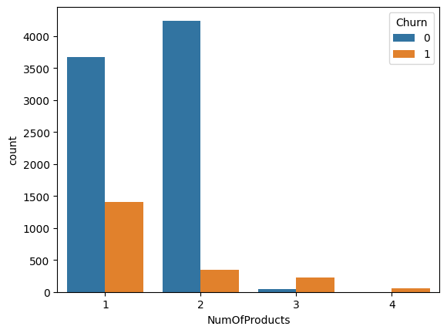
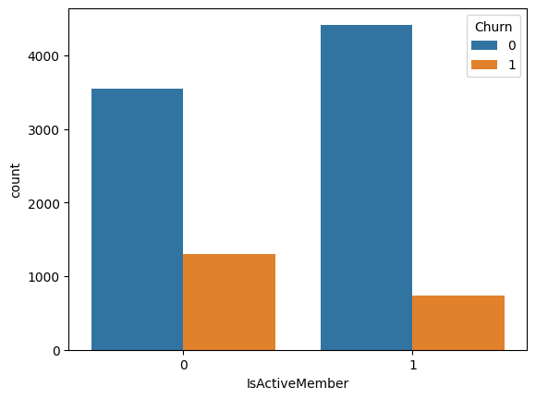
Engagement Signals: Products & Activity
Product count and active membership are strong churn signals
Customers with 1 product churn far more than those with 2 — and 3-4 products churn almost entirely.
Inactive members churn at roughly double the rate of active members.
Bank Customer Churn Prediction
5

Slide 6
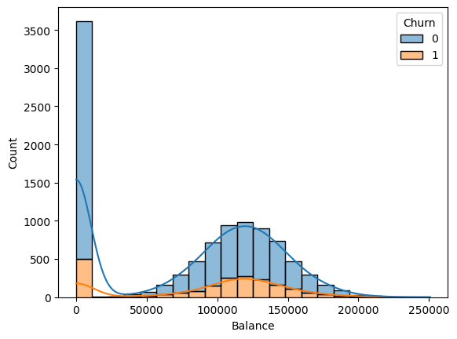
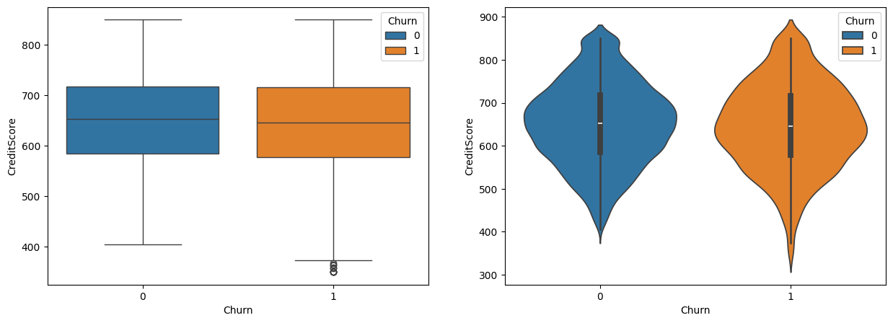
Financial Profile: Balance & Credit Score
Zero-balance customers churn least; credit score shows little separation
Customers holding 100K-150K in balance are more likely to churn than those near zero balance.
Credit score distributions for churned vs retained customers largely overlap — a weak standalone predictor.
Bank Customer Churn Prediction
6

Slide 7
Building the Prediction Models
From clean data to tuned classifiers
1
2
3
4
Preprocess
Split
Tune
Compare
Dropped IDs, encoded categoricals, normalized numeric features, checked for nulls and duplicates.
70/30 train-test split to evaluate models on unseen customers.
GridSearchCV used to find the best hyperparameters for each model.
Decision Tree and Random Forest classifiers evaluated head-to-head.
Bank Customer Churn Prediction
7

Slide 8
Model Performance: Decision Tree vs Random Forest
Random Forest edges out Decision Tree on every key metric
Bank Customer Churn Prediction
8

Slide 9
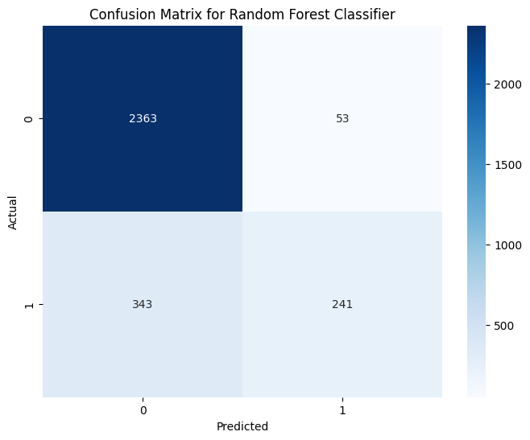
Random Forest: Where It Gets It Right (and Wrong)
Confusion matrix on the 3,000-customer test set
2,363
Retained customers correctly identified
241
Churners correctly caught
343
Churners missed (false negatives)
53
Retained customers wrongly flagged
Recall on churners (41%) is the model's main weak point — the bank still misses more churners than it catches.
Bank Customer Churn Prediction
9

Slide 10
Conclusions & Recommendations
Top churn drivers
Age
Geography
Tenure
Balance
Number of products
Credit card status
Active membership
Recommended model: Random Forest
Both models were hyperparameter-tuned with GridSearchCV and perform similarly, but Random Forest delivers better accuracy and precision than the Decision Tree — making it the stronger choice for flagging at-risk customers.
86.8%
0.82
test accuracy
churn precision
Next step: target outreach to customers with low product counts, low activity, and high balances in Germany and the 45-60 age band.
Bank Customer Churn Prediction
10

