Slide 1
Getting Started with the Mobile Toilet Competition
Detailed Design
Technical drawings: Floor plan, elevations, sections, detail drawings
3D visualization: Rendered views showing the unit in context
Material selection: Durable, weather-resistant, locally available
Systems design: Water supply, waste management, ventilation, lighting
Accessibility features: Ramps, handrails, adequate space for wheelchair use ( Can wheelchair be accommodate??, space is the issue)
complementary skills:
Designer
Engineer
Architect
WASH specialist
cost estimator
Research & Site Analysis
High-footfall areas in Dhaka
potential users
Focus Group Discussion (FGD)
Key Informant Interview (KII)
Identify Core Factors
Sketch multiple concept variations
Select 1-2 strongest concepts to develop further
Deliverables
Poster creation (A0, portrait)
Report writing (max 1000 words)
Budget preparation (itemized, under BDT 5 lakh)
Deadline: 22 Oct

Slide 2
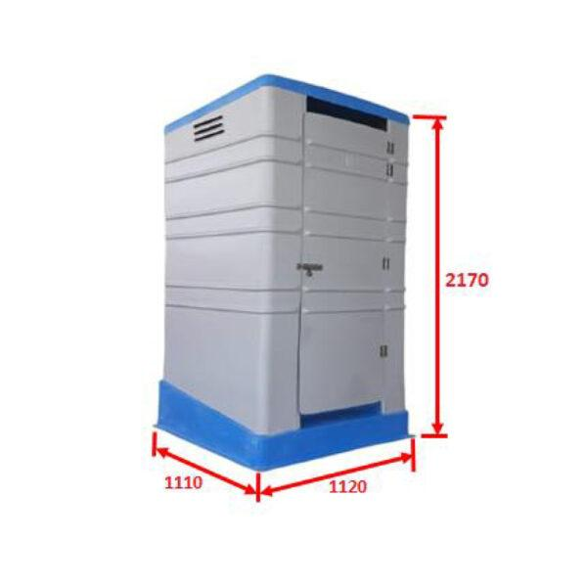
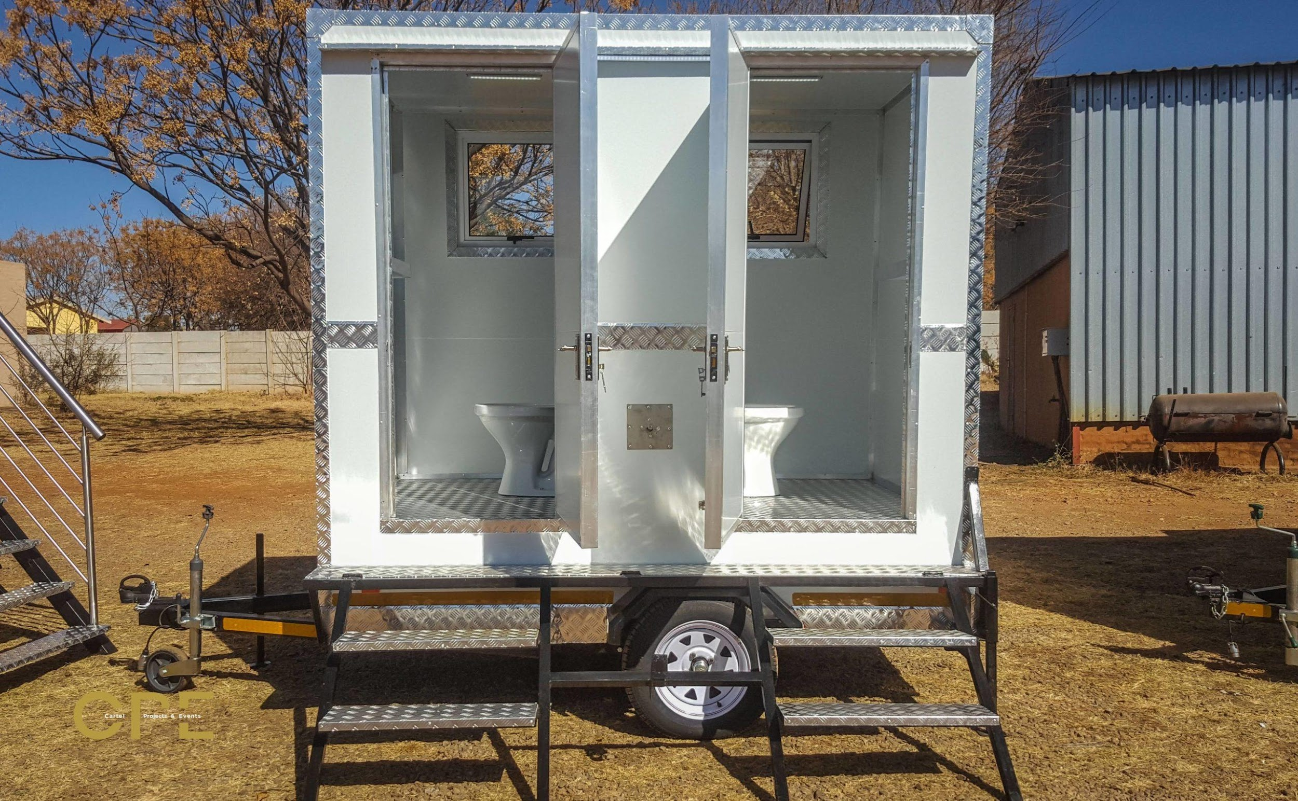
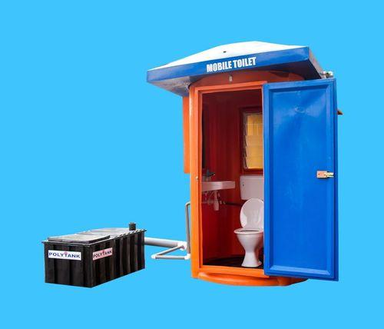
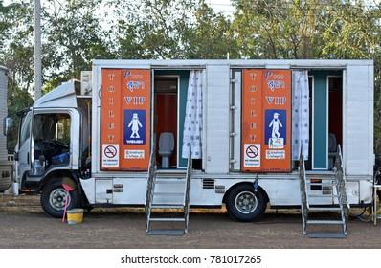
Consideration:
Narrow Dhaka Roads
Overcrowded place Like Kawran Bazar Where no space left for new toilet installation
Overhead Water Tank, Proper Solar Based Lights, Durable Build and Modular Design.
For Inclusive Sanitation, I have Doubt over Squatting style and Commode Style
Material: FRP or TIN or Modified Pickup
Room For Innovative Idea
Like Bhumijo, A place to get the ticket or vending machine

Slide 3
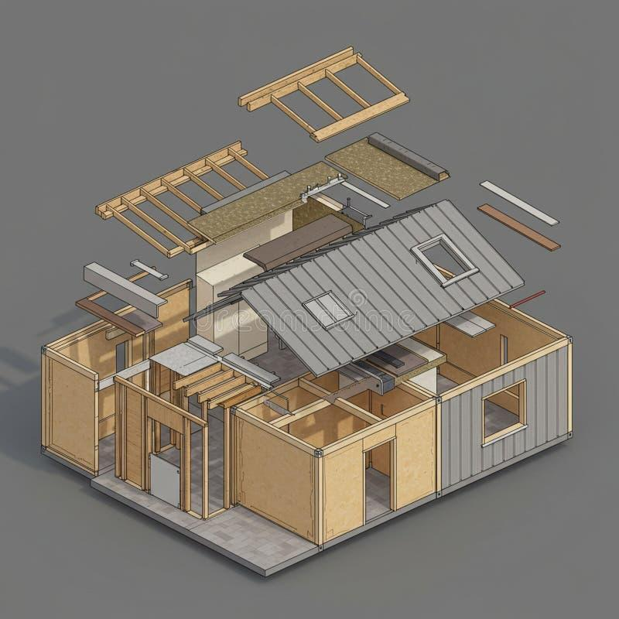
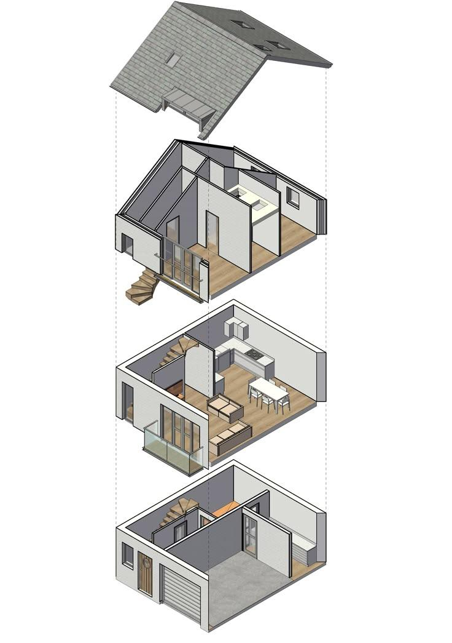

Slide 4
