Slide 1
SecureVault Access & MFA — Common Issues
How to handle ERR-ACL-002 and ERR-MFA-009 quickly

Slide 2
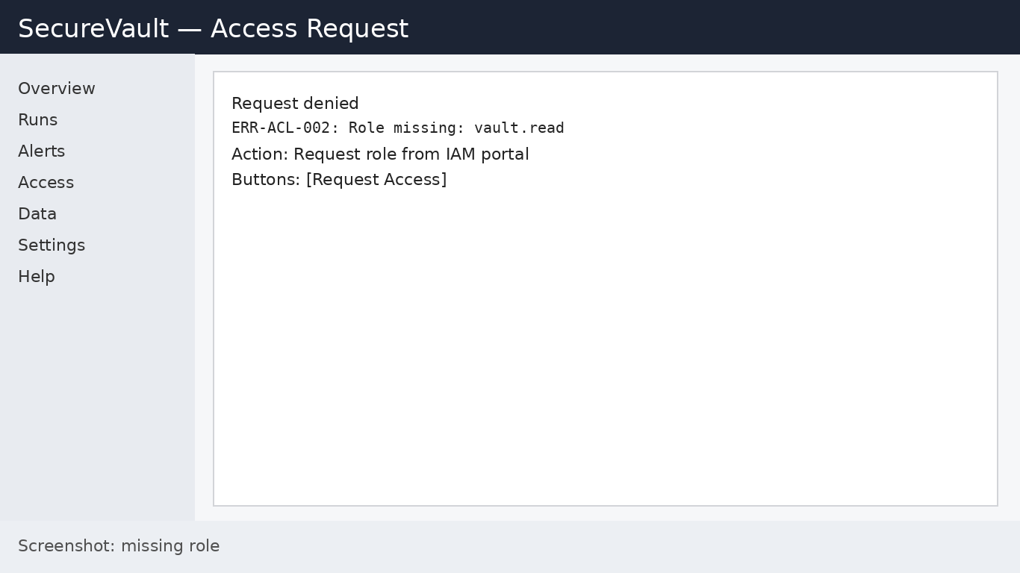
ERR-ACL-002: Role missing

Slide 3
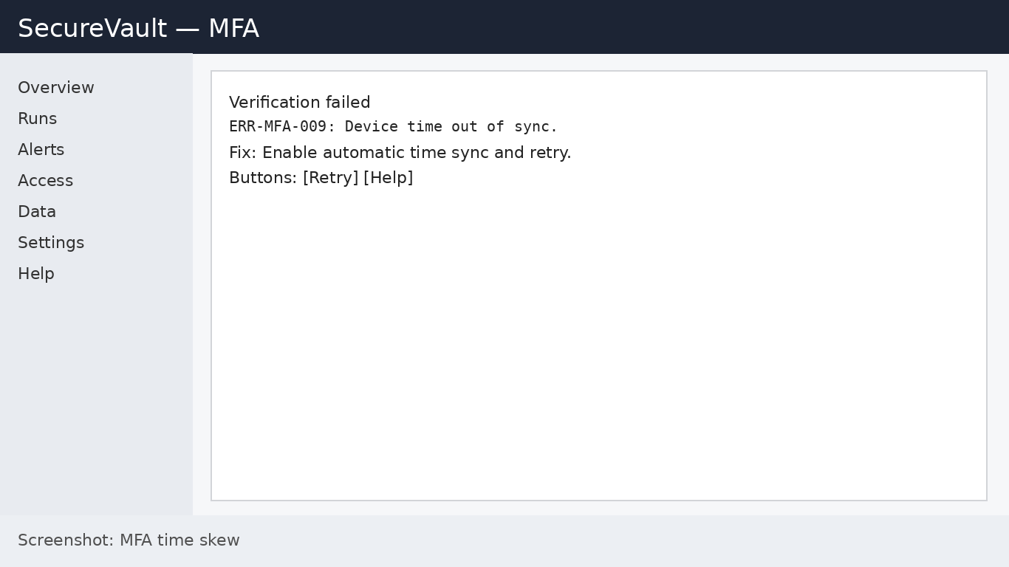
ERR-MFA-009: Device time skew

