Slide 1
ToolY Upload Policy — Common Failures
How to interpret ERR-UPL-013 and resolve it quickly

Slide 2
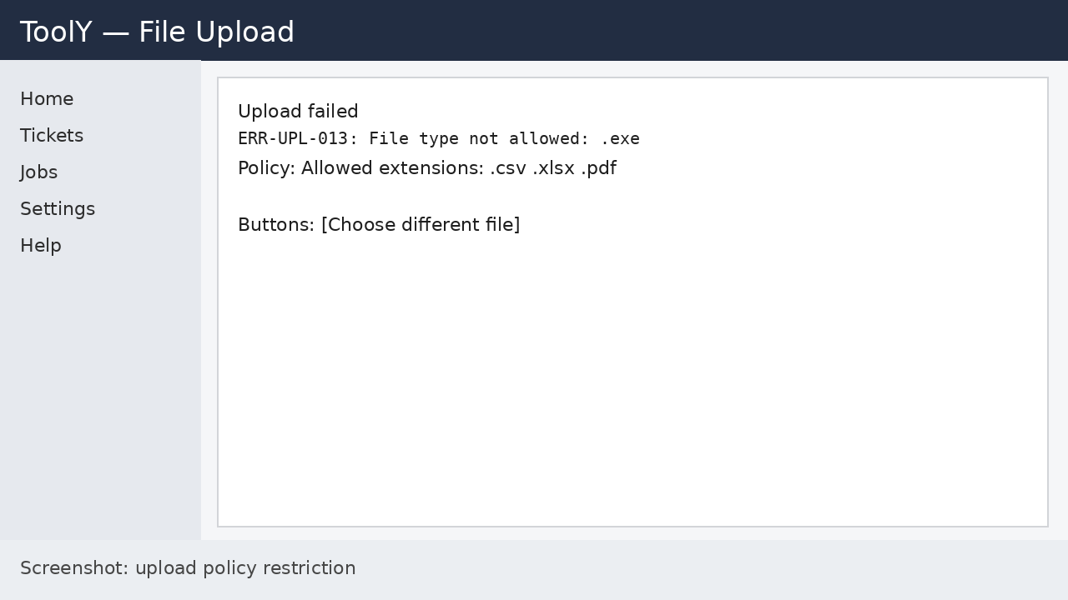
ERR-UPL-013: File type not allowed
Resolution: upload only allowed extensions (.csv .xlsx .pdf); request policy change for new types.

