Slide 1

Fine-tuning a transformer model based on a text corpus
Petteri Ranta, Dr. Tech.
Senior Data Scientist
Tietoevry

Slide 2
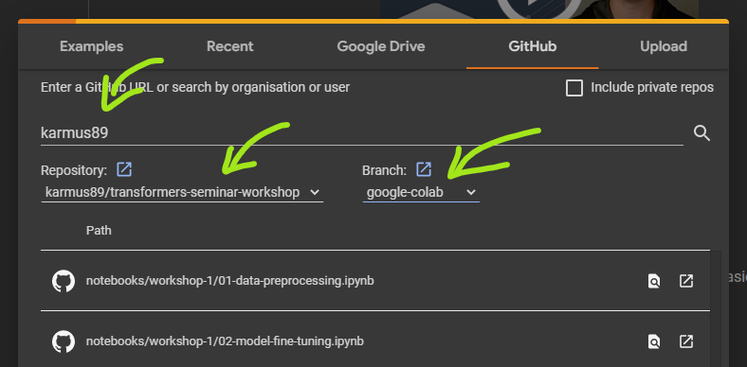
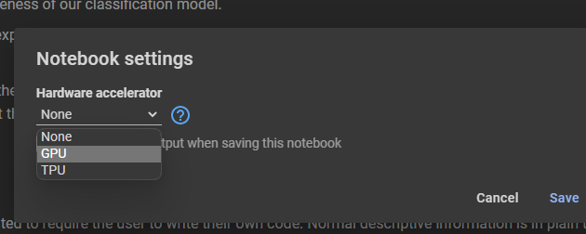
Hands-on instructions
Go to Google Colaboratory
> https://colab.research.google.com or search “colab”
Open a notebook from the designated Github repository
> File > Open Notebook > Github
> User: karmus89 (hit Enter to load)
> Repo: transformers-seminar-workshop
> Branch: google-colab
> Notebook: workshop-1/01-data-preprocessing
Change notebook runtime
> Runtime > Change runtime type > GPU
When done with the notebook
> Runtime > Disconnect and delete runtime

Slide 3
Thank you

