Slide 1
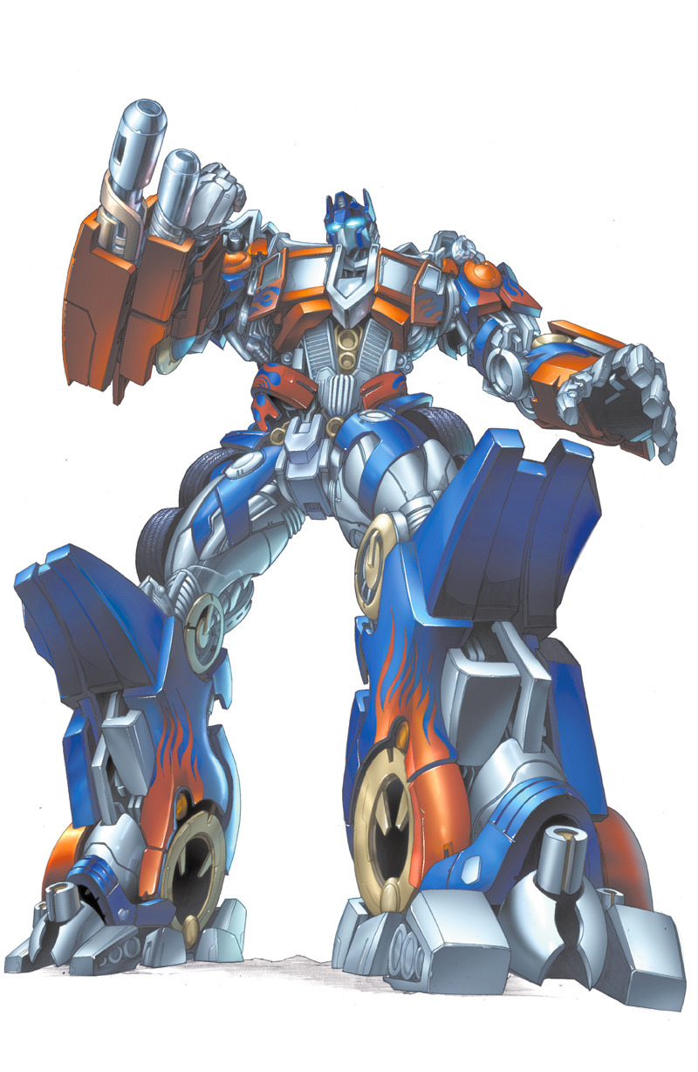
Developing custom transformer architecture
AI Roundtable in Cooperation with INFORTE PhD Seminar on
AI-Assisted Software Engineering
Petteri Ranta

Slide 2
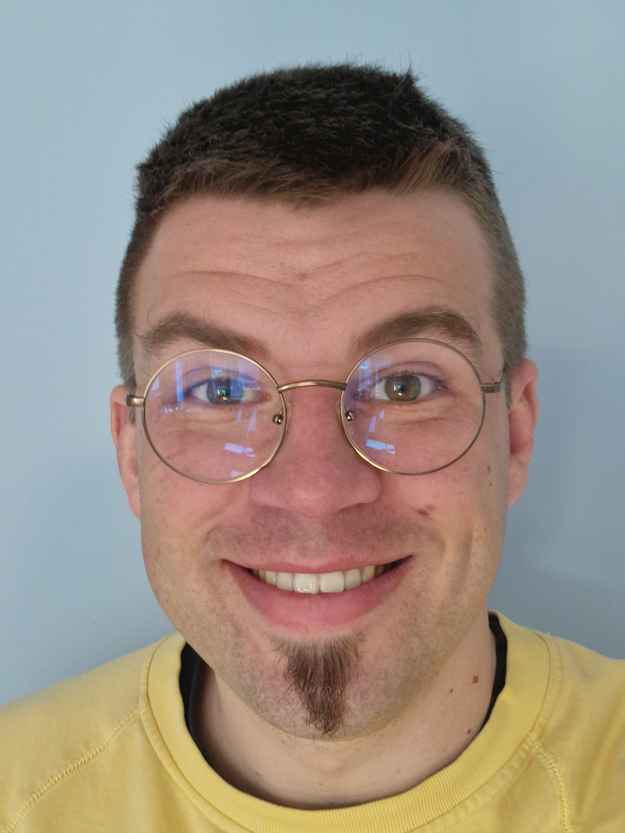
Petteri Ranta
Dr. Tech.
Senior Data Scientist
Tietoevry Care
linkedin.com/in/petteriranta

Slide 3
Hugging Face
A company focused on NLP and building open-source tools
Hosts trained models and datasets for NLP
Provides Python libraries such as Transformers, Datasets, Tokenizers, and Trainer to fine-tune pre-trained models
huggingface.co
The most popular NLP library
Over 2,000 contributors on GitHub
Provides state-of-the-art pre-trained models such as BERT, GPT, and T5
Allows for easy fine-tuning and transfer learning on custom datasets
The Trainer module allows training custom models too

Slide 4
Structure of the Workshop
Today we’ll cover the following topics:
Preparing raw text data for NLP
Fine-tuning a pre-trained BERT model
Using the fine-tuned model with a custom classification head for document classification
All resources (notebooks, data, presentation) are available in Github
github.com/karmus89/transformers-seminar-workshop
Using Google Colab is highly advised
Local use is also OK, but not everything is provided as click-and-go

Slide 5
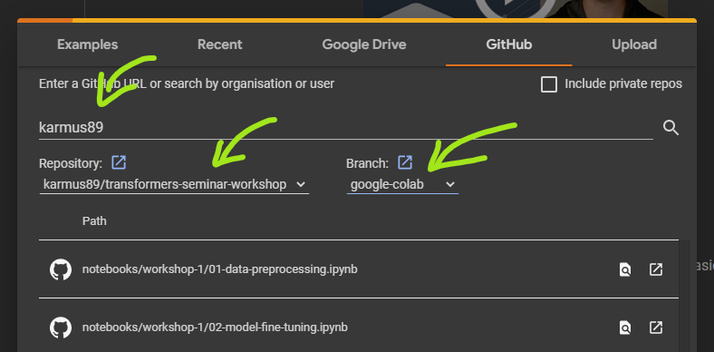
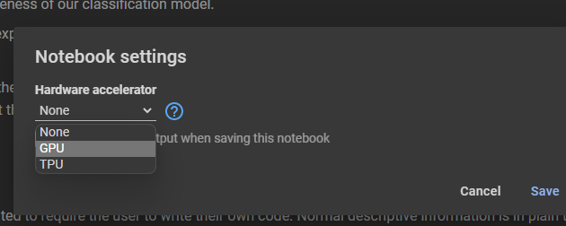
Hands-on Instructions
Go to Google Colaboratory
https://colab.research.google.com or search “colab”
Open a notebook from the designated Github repository
File > Open Notebook > Github
User: karmus89 (hit Enter to load)
Repo: transformers-seminar-workshop
Branch: google-colab
Notebook: workshop-2/01-transformer-concepts
Change notebook runtime
Runtime > Change runtime type > GPU
When done with the notebook
Runtime > Disconnect and delete runtime

