Slide 1

Fine-tuning a BERT model based on a text corpus
AI Roundtable in Cooperation with INFORTE PhD Seminar on
AI-Assisted Software Engineering
Petteri Ranta,

Slide 2
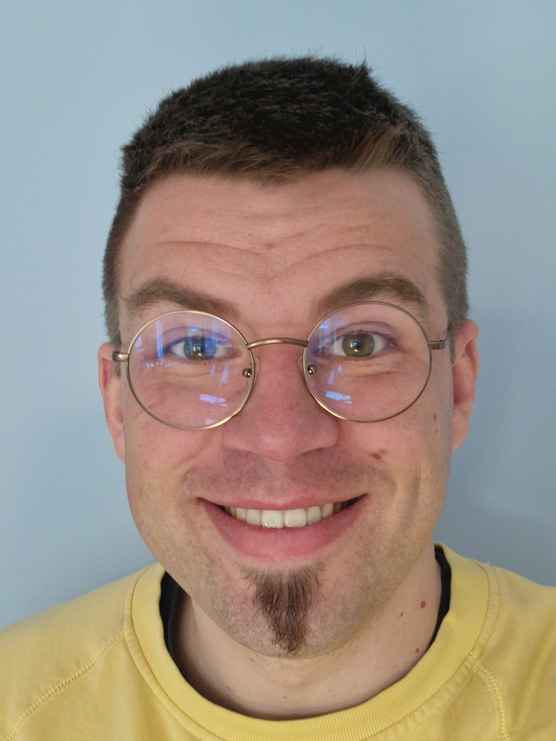
Petteri Ranta
Dr. Tech.
Senior Data Scientist
Tietoevry Care
linkedin.com/in/petteriranta

Slide 3
What is Natural Language Processing?
NLP focuses on interactions between humans and computers using natural language
Speech recognition, language translation, sentiment analysis, and question-answering
Significant progress in recent years due to advancements in deep learning
Particularly with the development of transformer-based models
Key concepts
Language
Context
Words-as-vectors (embedding)

Slide 4
Sequence to Sequence Models
Type of neural network that can be used for a variety of tasks involving sequential data
Typically consist of an encoder and a decoder
Recurrent neural networks (RNNs) the go-to architectures before transformers
Particularly well-suited for processing sequential data
RNNs have notable shortcomings for NLP
Limitations in handling long sequences (vanishing gradient, memory)
Struggle with out-of-vocabulary words
Have difficulties in generating diverse outputs

Slide 5
Transformer Architecture
A neural network architecture utilizing the attention mechanism
Sequence-to-sequence model that is designed to process input and output sequences in parallel (contra sequentially)
State-of-the-art results in a wide range of natural language processing tasks
The key innovation is the attention mechanism
Selectively focus on different parts of the input sequence
Advantages of Transformers over RNNs
Attention captures long-range dependencies more effectively than traditional RNNs (no vanishing gradient)
Can be trained more efficiently than RNNs, because they do not require backpropagation through time

Slide 6
From Transfomers to BERT
Bidirectional Encoder Representations from Transformers (BERT)
A transformer model for natural language processing tasks pre-trained on a large corpus of unlabeled text data to learn general language representations
Developed by Google in 2018
After the initial training, the model has been fine-tuned and retrained for multiple NLP tasks
Enabled transfer learning in NLP, reducing need for task-specific models
Enabled researchers to achieve near-human-level performance on some tasks, such as question answering and sentiment analysis
BERT has also paved the way for a new era of pre-trained language models that have since surpassed its performance, such as GPT-3

Slide 7
Hugging Face
A company focused on NLP and building open-source tools
Hosts trained models and datasets for NLP
Provides Python libraries such as Transformers, Datasets, Tokenizers, and Trainer to fine-tune pre-trained models
huggingface.co
The most popular NLP library
Over 2,000 contributors on GitHub
Provides state-of-the-art pre-trained models such as BERT, GPT, and T5
Allows for easy fine-tuning and transfer learning on custom datasets
The Trainer module allows training custom models too

Slide 8
Structure of the Workshop
Today we’ll cover the following topics:
Preparing raw text data for NLP
Fine-tuning a pre-trained BERT model
Using the fine-tuned model with a custom classification head for document classification
All resources (notebooks, data, presentation) are available in Github
github.com/karmus89/transformers-seminar-workshop
Using Google Colab is highly advised
Local use is also OK, but not everything is provided as click-and-go

Slide 9
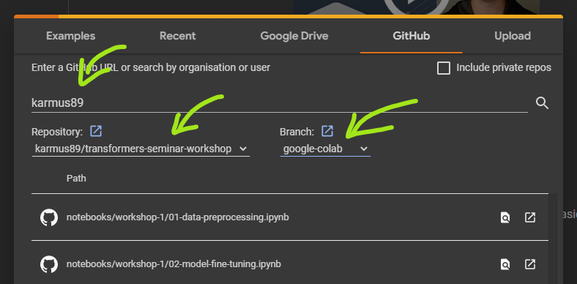
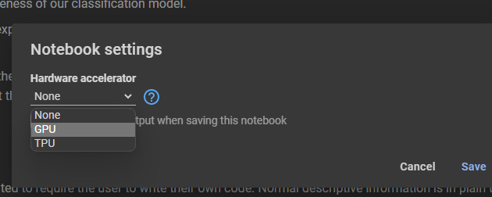
Hands-on Instructions
Go to Google Colaboratory
https://colab.research.google.com or search “colab”
Open a notebook from the designated Github repository
File > Open Notebook > Github
User: karmus89 (hit Enter to load)
Repo: transformers-seminar-workshop
Branch: google-colab
Notebook: workshop-1/01-data-preprocessing
Change notebook runtime
Runtime > Change runtime type > GPU
When done with the notebook
Runtime > Disconnect and delete runtime

Slide 10
Hands-on instructions
Go to Google Colaboratory
> https://colab.research.google.com or search “colab”
Open a notebook from the designated Github repository
> File > Open Notebook > Github
> User: karmus89 (hit Enter to load)
> Repo: transformers-seminar-workshop
> Branch: google-colab
> Notebook: workshop-1/01-data-preprocessing
Change notebook runtime
> Runtime > Change runtime type > GPU
When done with the notebook
> Runtime > Disconnect and delete runtime

Slide 11
Thank you

