Slide 1
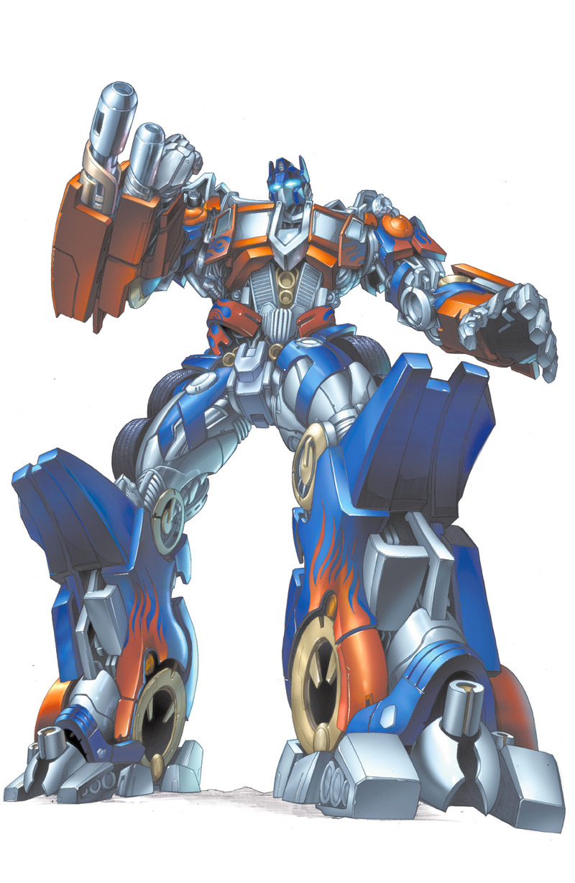
Developing custom transformer architecture
AI Roundtable in Cooperation with INFORTE PhD Seminar on
AI-Assisted Software Engineering
Petteri Ranta

Slide 2
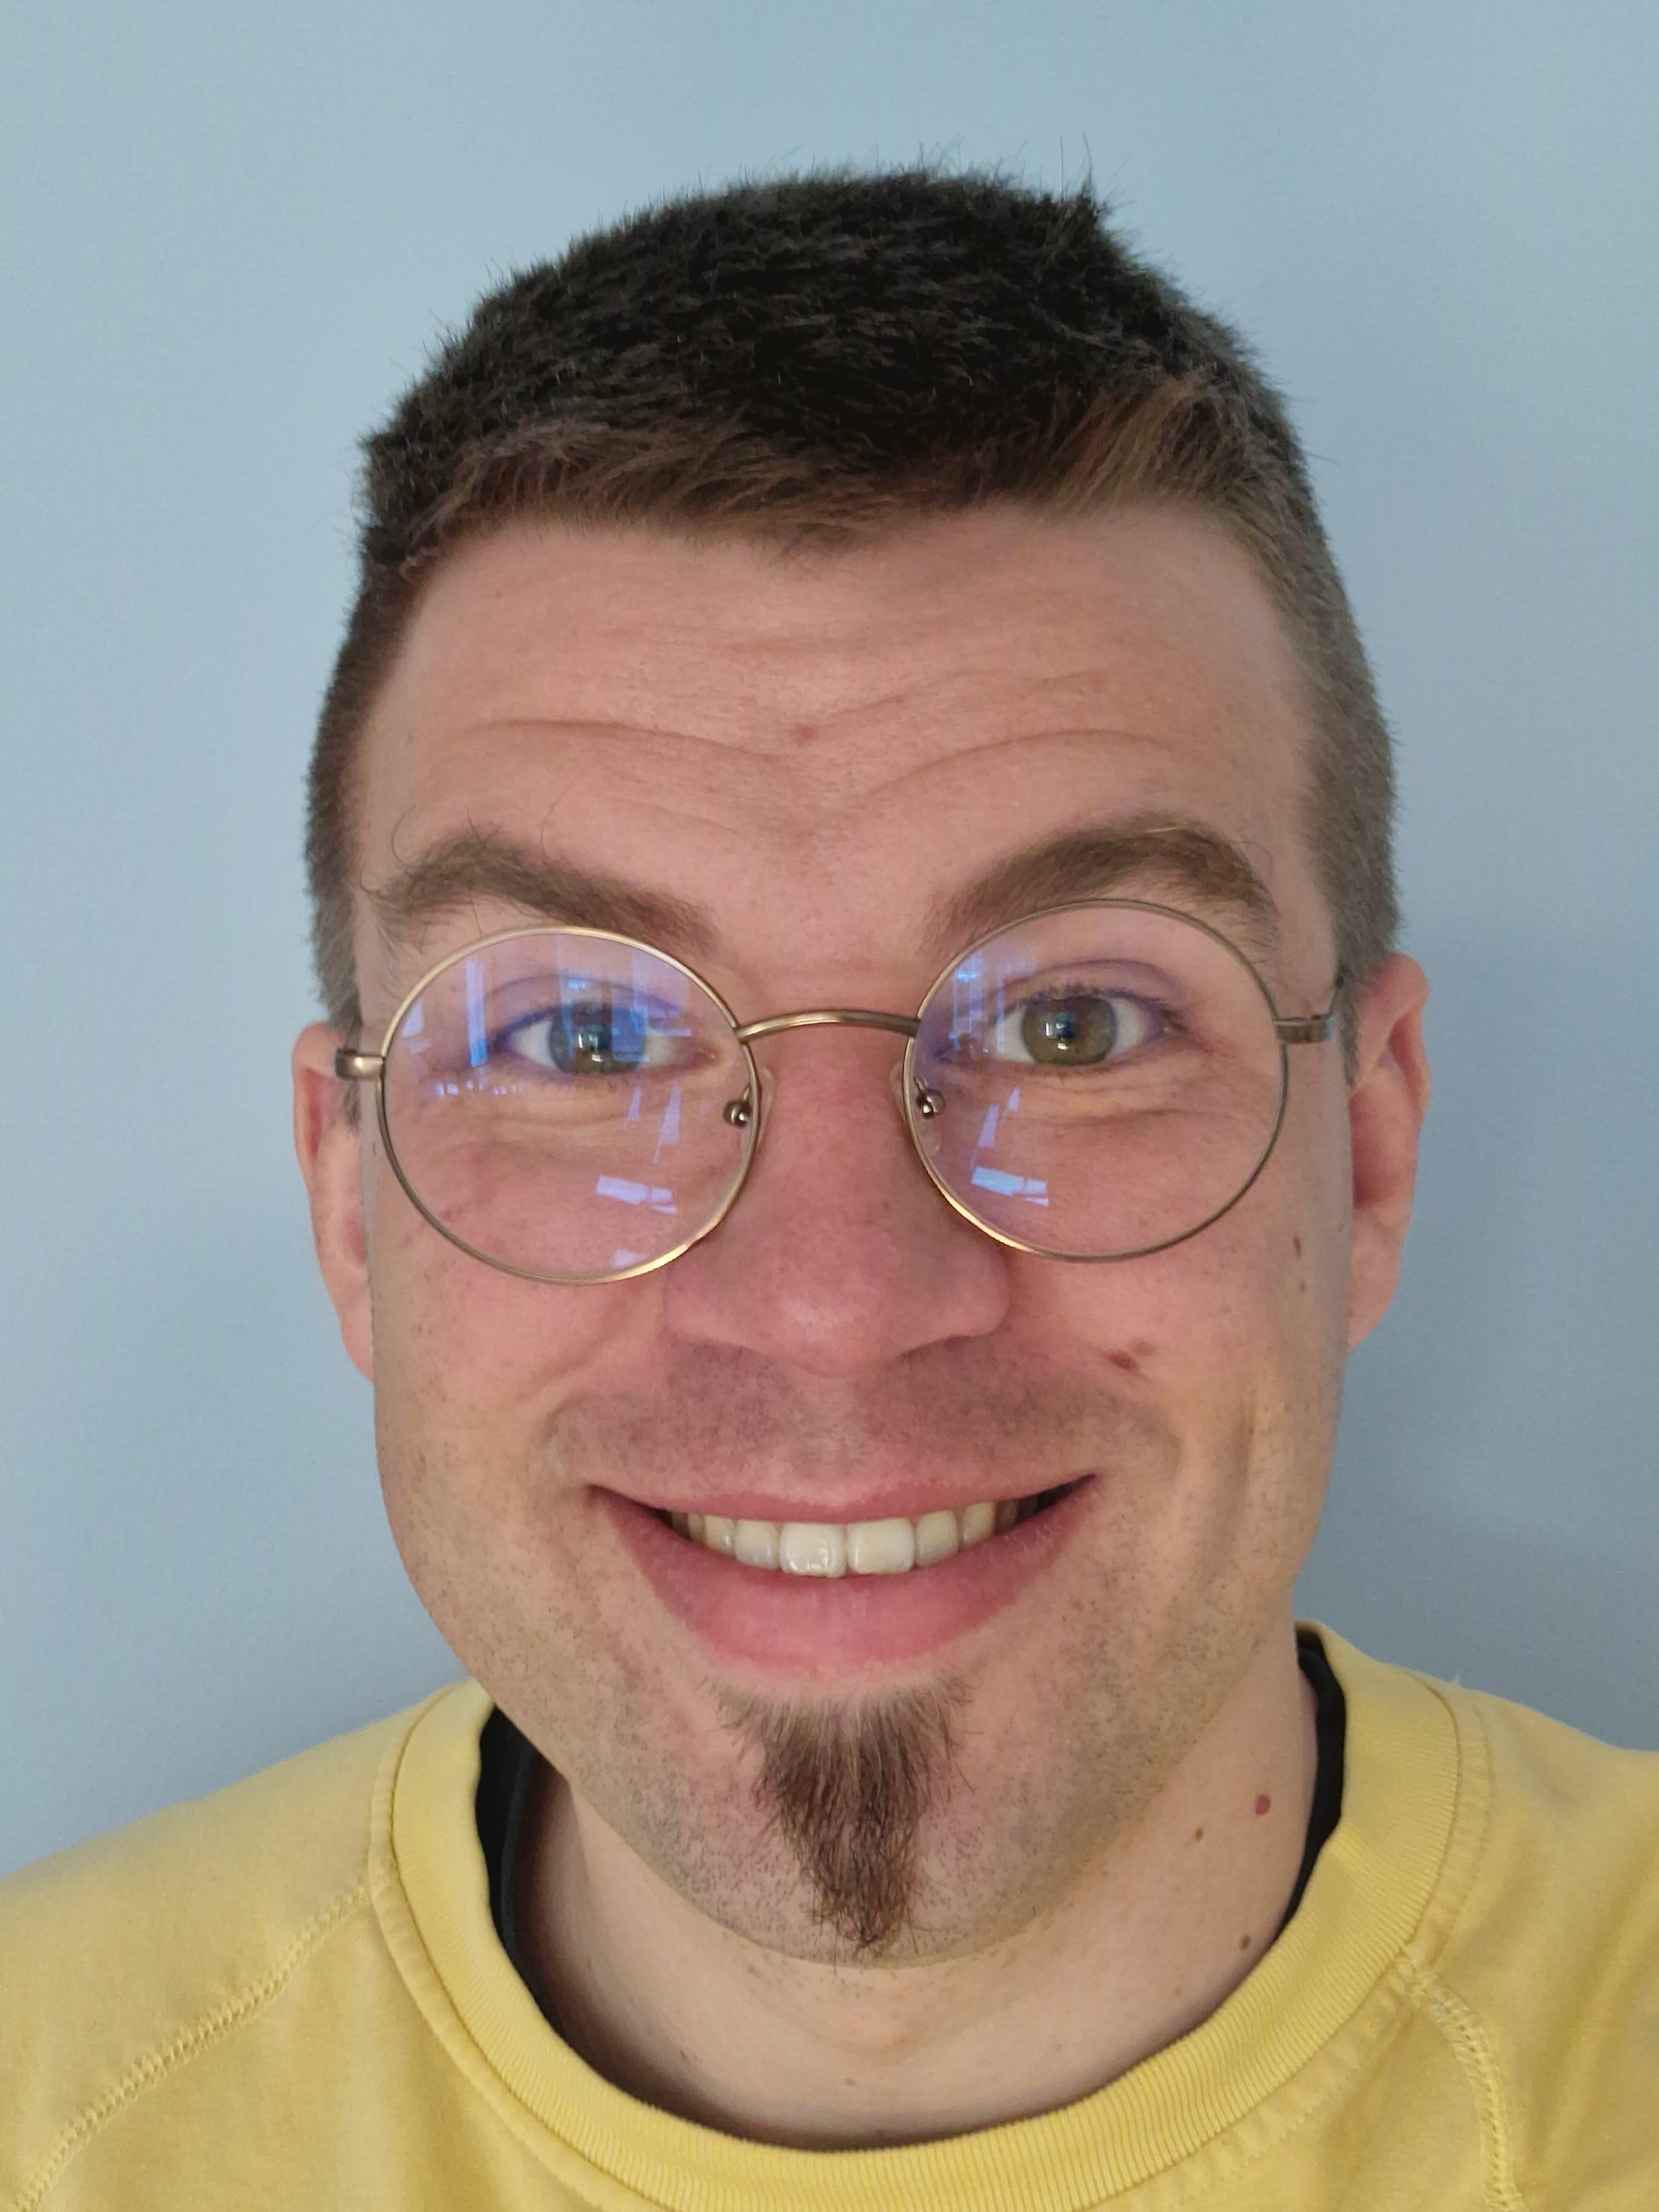
Petteri Ranta
Dr. Tech.
Senior Data Scientist
Tietoevry Care
linkedin.com/in/petteriranta

Slide 3
Let’s Get Straight to Hands-on Learning!

Slide 4
Structure of the Workshop
Today we’ll cover the following topics:
Transformer core concepts
BERT and differences to the Transformer
Creating BERT-like embeddings
Creating BERT-like a transformer
Training embedding and transformer layers in one go
All resources (notebooks, data, presentation) are available in Github
github.com/karmus89/transformers-seminar-workshop
Using Google Colab is highly advised
Local use is also OK, but not everything is provided as click-and-go

Slide 5
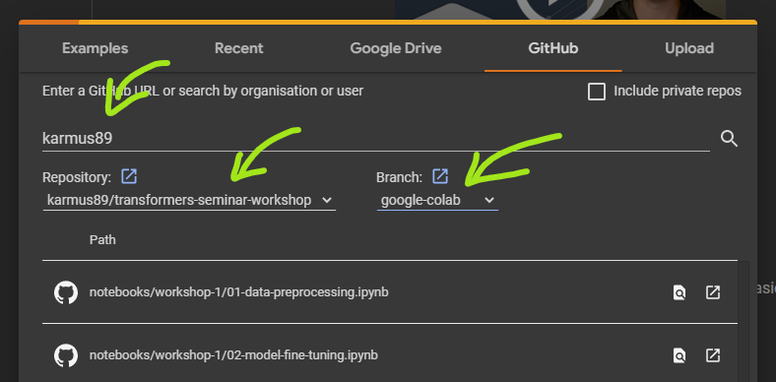
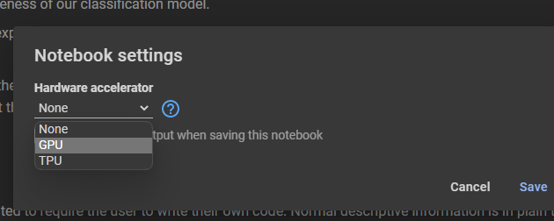
Hands-on Instructions
Go to Google Colaboratory
https://colab.research.google.com or search “colab”
Open a notebook from the designated Github repository
File > Open Notebook > Github
User: karmus89 (hit Enter to load)
Repo: transformers-seminar-workshop
Branch: google-colab
Notebook: workshop-2/01-transformer-concepts
Change notebook runtime
Runtime > Change runtime type > GPU
When done with the notebook
Runtime > Disconnect and delete runtime

