Slide 1




⚠
This deck may contain links or images from external sources. Please review them before opening.
UNIT II: Planning & Decision Making
Nature & purpose of planning, planning processes, MBO framework, decision-making environments, and analytical tools.
MODULE 1
MODULE 2
MODULE 3
Planning Foundations & Types
MBO Framework & Steps
Decision Making & Analytical Tools
Vivekananda Global University | Course Handout & Lecture Deck
Slide 1 of 12

Slide 2
UNIT II • PLANNING FUNDAMENTALS
Nature and Purpose of Planning
Definition of Planning
Essential Characteristics of Planning
Planning is the primary management function that involves defining organizational goals, establishing an overall strategy, and developing a comprehensive set of plans to integrate and coordinate activities.
Primacy of Planning:
Precedes all other managerial functions (Organizing, Staffing, Directing, Controlling).
Pervasive Function:
Required at top, middle, and operational levels of management.
Continuous & Future-Oriented:
Primary Purposes of Planning
An ongoing intellectual exercise that forecasts future trends and contingencies.
1. Direction
2. Risk Reduction
Efficiency & Flexibility:
Provides clear focus for managers & employees.
Minimizes uncertainty & anticipates changes.
Aims to achieve maximum goal achievement at minimum cost while adapting to changes.
3. Waste Control
4. Standards
Reduces overlapping & wasteful activities.
Establishes benchmarks for controlling.
Primacy & Perperpetual Nature of Planning
Planning & Decision Making • Unit II
Slide 2 of 12

Slide 3
UNIT II • PLAN TAXONOMY
Types of Plans and Hierarchy of Planning
1. By Operational Level & Horizon
2. Standing Plans vs. Single-Use Plans
Strategic Plans
Long-Term (3-5+ yrs)
Standing Plans
Single-Use Plans
Org-wide goals, competitive positioning, driven by Top Management.
Ongoing plans providing guidance for recurring activities.
Designed to meet the needs of a unique, non-recurring situation.
Tactical Plans
Medium-Term (1-3 yrs)
• Policies: General guidelines
• Programs: Comprehensive plans
Departmental goals translating strategy into action, driven by Middle Management.
• Procedures: Sequential steps
• Projects: Specific scope plans
• Rules: Explicit do's & don'ts
• Budgets: Financial plans
Operational Plans
Short-Term (<1 yr)
Daily/weekly task execution, schedules, driven by First-Line Supervisors.
Time Horizon & Management Hierarchy
Frequency & Frequency of Execution
Planning & Decision Making • Unit II
Slide 3 of 12

Slide 4
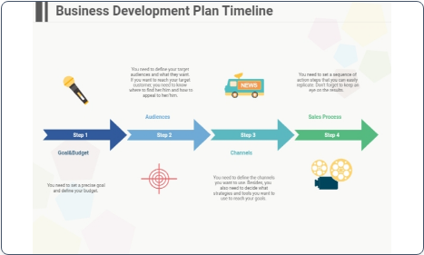
UNIT II • EXECUTION CYCLE
Systematic Steps in the Planning Process
Step 1: Environmental Scanning
Step 2: Establishing Objectives
SWOT analysis & assessing future premises/trends.
Setting SMART organizational & unit goals.
Step 3: Developing Premises
Step 4: Identifying Alternatives
Forecasting economic, market, & tech conditions.
Brainstorming feasible paths to objectives.
Step 5: Evaluating Alternatives
Step 6: Selecting Optimal Plan
Weighing cost, risk, ROI, & feasibility.
Choosing best alternative or strategy combo.
Step 7: Formulating Derivative Plans
Step 8: Budgeting & Monitoring
Sub-plans for purchasing, hiring, & tech.
Quantifying into budgets & tracking KPIs.
Figure 1: Business Planning Flowchart & Timeline
Logical 8-Step Planning Cycle
Planning & Decision Making • Unit II
Slide 4 of 12

Slide 5
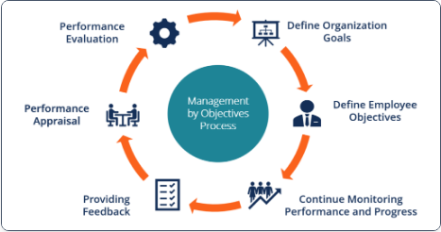





UNIT II • GOAL ALIGNMENT
Management by Objectives (MBO)
Peter Drucker's Concept (1954)
MBO is a strategic management model that aims to improve organizational performance by clearly defining objectives that are agreed to by both management and employees.
SMART Goals Criteria
Figure 2: MBO Collaborative Objective Cycle
Key Steps in MBO Process:
1. Set Org Goals → 2. Cascade Sub-Goals → 3. Joint Goal Setting → 4. Progress Monitoring → 5. Performance Appraisal.
Planning & Decision Making • Unit II
Slide 5 of 12

Slide 6
UNIT II • EVALUATION OF MBO
Benefits, Limitations, & Success Factors of MBO
Key Benefits of MBO
Potential Limitations
Goal Clarity & Focus: Every employee understands exactly what is expected.
Excessive Paperwork & Bureaucracy: Focus on administrative tracking instead of action.
Increased Employee Motivation: Participative goal setting boosts commitment and ownership.
Short-Term Bias: Over-emphasis on short-term measurable targets at expense of long-term innovation.
Objective Performance Evaluation: Appraisals based on actual results rather than personal bias.
Inflexible Goals: Difficulty adapting goals quickly in volatile market environments.
Performance & Alignment Driver
Prerequisites: Top management support & continuous feedback
Planning & Decision Making • Unit II
Slide 6 of 12

Slide 7
UNIT II • DECISION FUNDAMENTALS
Nature and Types of Decision Making
Programmed vs. Non-Programmed Decisions
Decision-Making Environments
Programmed Decisions
1. Certainty
Routine, repetitive decisions handled through standard operating procedures (SOPs), rules, or policies.
Manager knows exact outcome of every alternative (100% accurate data).
Example: Reordering inventory when stock reaches safety level.
2. Risk
Manager can estimate probabilities of various outcomes based on historical data.
Non-Programmed Decisions
3. Uncertainty
Unique, poorly structured, strategic decisions requiring custom problem solving and manager judgment.
Outcomes unpredictable; no historical data or probability estimates available.
Example: Entering a new international market or launching a new product line.
Routine vs Strategic Choice Mechanics
Environmental Predictability Continuum
Planning & Decision Making • Unit II
Slide 7 of 12

Slide 8
UNIT II • RATIONAL CHOICE MODEL
The Rational Decision-Making Process
Step 1
Step 2
Step 3
Step 4
Identify & Define Problem
Identify Decision Criteria
Weight Criteria
Develop Alternatives
Recognize gap between current state & desired state.
Determine factors relevant to resolving problem (cost, quality, time).
Assign relative priority weights to each decision criterion.
List all viable alternative options without premature evaluation.
Step 5
Step 6
Step 7
Analyze Alternatives
Select & Implement
Evaluate Decision Effect
Critically evaluate each option against weighted decision criteria.
Choose optimal alternative and execute through action plans.
Monitor results; take corrective feedback action if gap persists.
Planning & Decision Making • Unit II
Slide 8 of 12

Slide 9
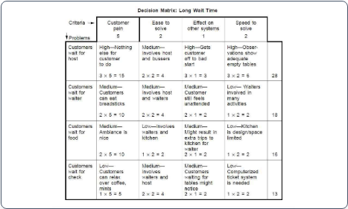
UNIT II • ANALYTICAL METHODS
Tools and Techniques for Decision Making
1. Decision Matrix (Grid Analysis)
Evaluates and ranks multiple options against weighted criteria to make objective choices.
2. Decision Trees
Diagram mapping probabilistic outcomes, costs, and expected monetary values (EMV) for sequential decisions.
3. Payoff Matrix
Table illustrating payoff combinations across different states of nature (Maximax, Maximin criteria).
Figure 3: Multi-Criteria Decision Matrix Model
4. Pareto Analysis (80/20 Rule)
Identifies the top 20% of causes that drive 80% of problems or results.
Planning & Decision Making • Unit II
Slide 9 of 12

Slide 10
UNIT II • GROUP DYNAMICS
Group Decision-Making & Strategic Analysis
Group Decision-Making Techniques
SWOT Analysis Framework
Brainstorming:
Strengths (Internal)
Weaknesses (Internal)
Free-flowing idea generation encouraging creative volume without immediate criticism.
Internal capabilities & competitive advantages.
Internal limitations & resource gaps.
Delphi Technique:
Opportunities (External)
Threats (External)
Anonymously soliciting expert opinions through iterative questionnaires to achieve consensus.
Favorable external environmental trends.
External risks & competitive challenges.
Nominal Group Technique (NGT):
Structured group meeting combining silent individual idea writing, discussion, and silent voting.
Consensus & Creative Problem Solving
Strategic Environmental Scanning
Planning & Decision Making • Unit II
Slide 10 of 12

Slide 11
UNIT II • ASSESSMENT & SYNTHESIS
Unit Summary & Review Questions
Key Takeaways Summary
Discussion & Review Questions
• Planning is the primary managerial function that sets standards and reduces uncertainty.
Q1 (Understand):
• Plans range from strategic long-term goals to standing policies and single-use budgets.
• MBO aligns individual performance with organizational SMART goals.
• Decision making uses rational models, decision matrices, and group consensus tools.
Q2 (Apply):
Q3 (Analyze):
Core Unit II Knowledge
Bloom's Taxonomy Levels: Remember → Apply → Analyze
Planning & Decision Making • Unit II
Slide 11 of 12

Slide 12



REFERENCES
Image Sources
Source:
Source:
Source:
Business Plan Flowchart Complete Guide | EdrawMax
Management by Objectives (MBO) - Overview, Steps, Benefits - Corporate Finance Institute
What is a Decision Matrix? Pugh, Problem, or Selection Grid - ASQ
https://images.edrawsoft.com/articles/business-plan-flowchart/business-plan-timeline-flowchart.jpg
https://cdn.corporatefinanceinstitute.com/assets/management-by-objectives-mbo1-1024x535.png
https://asq.org/-/media/Images/Learn-About-Quality/edmt_matrix_cropped.jpg
Planning & Decision Making • Unit II
Slide 12 of 12

