Slide 1
LEGAL-AID RAG
MLOps Milestone 1
Model, API, MLflow, and GenAI evaluation
A reproducible inference pipeline for grounded legal-inheritance answers
Karam Hussain - Aadesh Panjwani - Muhammad Rayyan Khan
Branch 8-m1-submission

Slide 2
Pipeline and milestone coverage
02
Legal PDFs
Preparation + validation
Fixed / recursive chunks
BM25 + Pinecone
Semantic / hybrid retrieval
HF generation + Groq fallback
MLflow + API + Gradio
Requirement | Status | Evidence
README and architecture | Complete | Setup, corpus, commands
Preparation and validation | Complete | 46/50 PDFs; two chunk strategies
Inference evaluation | Complete | 8 + 8 + 4 tracked runs
MLflow GenAI | Complete | Dataset, six judges, nested traces
FastAPI | Complete | /predict, /health, /docs
Tests and contributions | Complete | 91 passing; named task ownership
RAG training exemption: pretrained components are evaluated through held-out inference rather than unrelated supervised training.
Legal-Aid RAG MLOps - Milestone 1

Slide 3
Eight retrieval configurations
03
Legacy champion
Fixed hybrid top-3
Faithfulness 1.000
Relevancy 0.770
Latency 17,530 ms
Why it wins
Faithfulness has first priority. It ties fixed semantic top-3, then wins on relevancy.
Challenger: recursive hybrid top-3 has the highest relevancy, 0.786, with lower latency of 11,799 ms.
24/24 successful queries - same three held-out questions

Slide 4
Managed GenAI champion and challengers
04
The six-judge rubric ranks correctness and sufficiency before broader retrieval metrics.
Profile | Correct | Sufficient | Legal | Grounded | Relevant | Latency
Fixed hybrid top-5 | 0.333 | 0.333 | 1.000 | 0.667 | 0.667 | 29,517 ms
Fixed semantic top-5 | 0.000 | 0.333 | 0.667 | 1.000 | 0.467 | 3,808 ms
Fixed hybrid top-3 | 0.000 | 0.333 | 0.333 | 1.000 | 0.778 | 13,512 ms
Recursive hybrid top-3 | 0.000 | 0.000 | 1.000 | 1.000 | 0.889 | 9,424 ms
Champion
Trade-off
Fixed hybrid top-5 is the only profile with non-zero correctness and reaches 1.000 legal quality.
It has the highest latency. Recursive hybrid top-3 is the strongest relevance and speed challenger.
Different champion, different rubric: the legacy evaluator optimizes faithfulness first; the managed evaluator prioritizes reviewed facts.
Legal-Aid RAG MLOps - Milestone 1

Slide 5
Prompt, model, and temperature ablation
05
Run | Changed variable | Latency
Baseline | Control | 28,756 ms
Structured prompt | Prompt | 21,272 ms
GPT-OSS-120B | Model | 20,145 ms
High temperature | 0.1 to 0.7 | 16,698 ms
Generation champion
Structured legal prompt
Qwen 3.8-27B - temperature 0.1
+0.333 correctness - +0.333 legal quality - 7,484 ms faster than baseline
Higher temperature is fastest but cuts retrieval sufficiency from 0.667 to 0.333.
Retrieval frozen to fixed hybrid top-5 for causal comparison

Slide 6
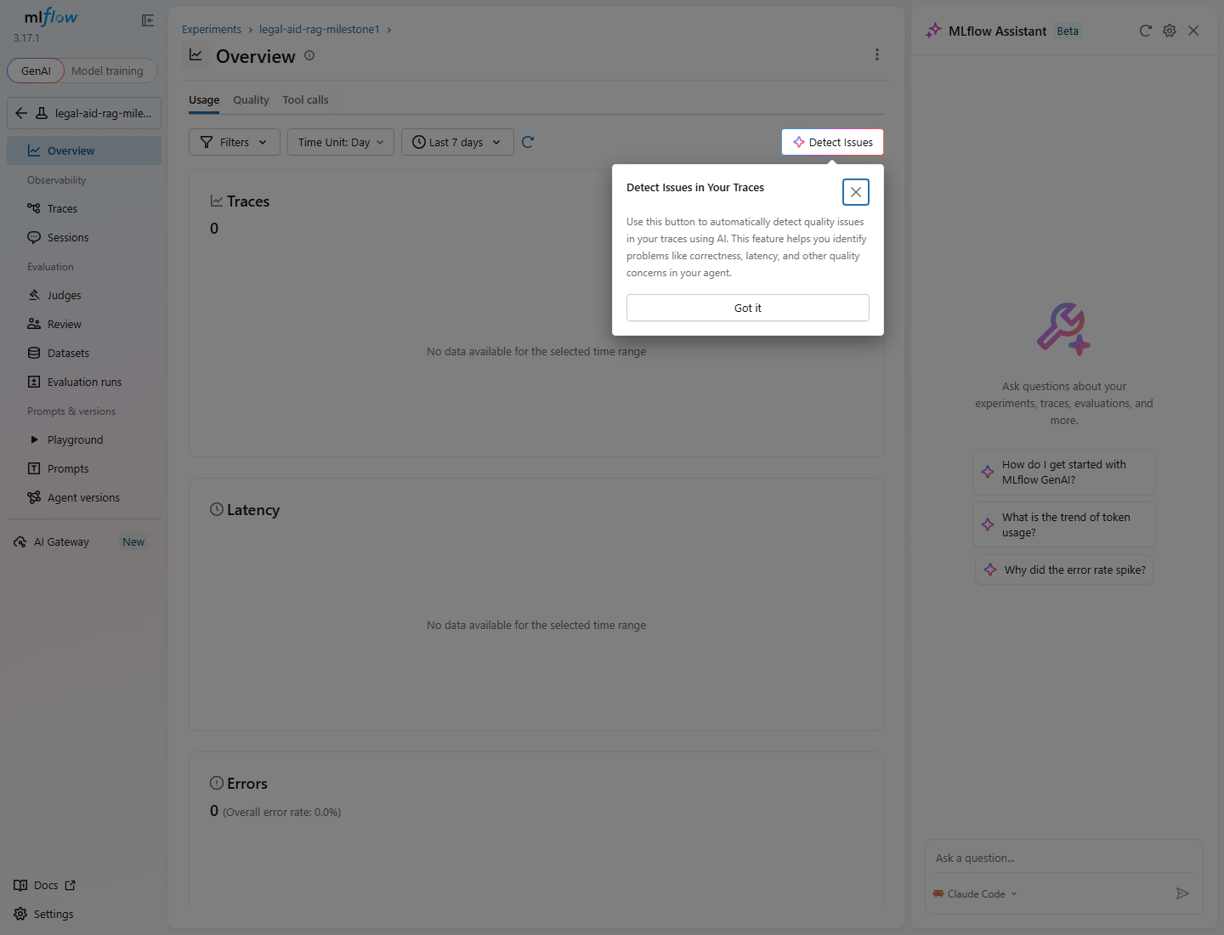
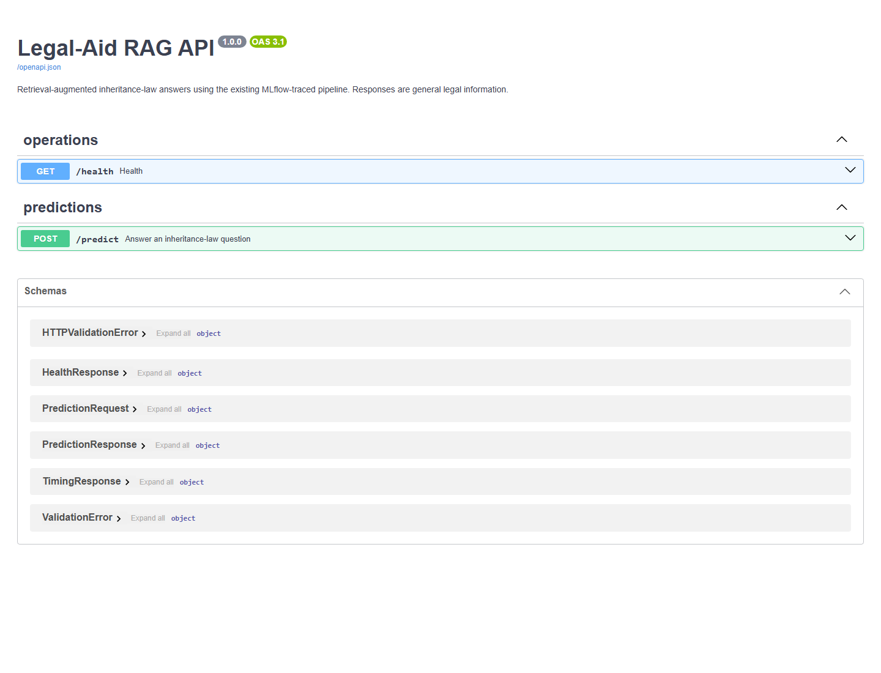
Serving and observability evidence
06
MLflow
FastAPI
Eight retrieval runs, managed dataset, six judges, and nested RAG traces
Validated /predict, health check, generated /docs, and cached components
91 passing tests - 14 focused evaluation tests - secrets excluded from traces and version control
Legal-Aid RAG MLOps - Milestone 1

Slide 7
FINAL SELECTION
Fixed hybrid top-5 retrieval
structured_legal_v2 - Qwen 3.8-27B - temperature 0.1
Why
The managed rubric favors its non-zero correctness and perfect legal quality. The structured prompt then gives the best controlled generation result.
Limitation
Three reviewed questions demonstrate reproducibility, not statistical generalization.
Next milestone: expand the evaluation dataset, automate CI evaluation, and deploy shared MLflow storage.
Karam Hussain - Aadesh Panjwani - Muhammad Rayyan Khan

