Slide 1
LEGAL-AID RAG
MLOps Milestone 1
Model, API, MLflow, and GenAI evaluation
A reproducible inference pipeline for grounded legal-inheritance answers
Karam Hussain - Aadesh Panjwani - Muhammad Rayyan Khan
Branch 9-post-m1-fixes

Slide 2
Pipeline and milestone coverage
02
Legal PDFs
Preparation + validation
Fixed / recursive chunks
BM25 + Pinecone
Semantic / hybrid retrieval
Direct Groq generation
MLflow + API + Gradio
Requirement | Status | Evidence
README and architecture | Complete | Setup, corpus, commands
Preparation and validation | Complete | 46/50 PDFs; two chunk strategies
Inference evaluation | Complete | 8 core-v2 + 4 ablation runs
MLflow GenAI | Complete | Dataset, judges, nested traces
FastAPI | Complete | /predict, /health, /docs
Tests and contributions | Complete | 108 passing; named task ownership
RAG training exemption: pretrained components are evaluated through held-out inference rather than unrelated supervised training.
Legal-Aid RAG MLOps - Milestone 1

Slide 3
Corrected eight-profile evaluation
03
Quality champion
Fixed hybrid top-5
Fact coverage 0.7222
Groundedness 0.6000
RAG latency 7,509 ms
Why it wins
Fractional expected-fact coverage ranks answer completeness without collapsing partial answers to zero.
Speed challenger: fixed semantic top-3 retains 0.5833 fact coverage and leads groundedness at 0.8833.
8/8 valid profiles - same three reviewed questions - four pinned core judges

Slide 4
Champion-challenger latency validation
04
Matching warm benchmarks use 15 questions across five repeats, with generation and judges disabled.
Profile | Fact coverage | Mean | Median | P95 | Role
Fixed hybrid top-5 | 0.7222 | 6,975 ms | 6,754 ms | 12,211 ms | Quality champion
Fixed semantic top-3 | 0.5833 | 528 ms | 394 ms | 1,341 ms | Speed challenger
92.4%
94.2%
0.1389
lower mean retrieval latency
lower median retrieval latency
absolute fact-coverage trade-off
Hybrid reranking consumes 5,304 ms on average. Semantic top-3 is the recommended interactive profile when latency matters more than maximum expected-fact coverage.
Legal-Aid RAG MLOps - Milestone 1

Slide 5
Prompt, model, and temperature ablation
05
Run | Changed variable | Latency
Baseline | Control | 28,756 ms
Structured prompt | Prompt | 21,272 ms
GPT-OSS-120B | Model | 20,145 ms
High temperature | 0.1 to 0.7 | 16,698 ms
Generation champion
Structured legal prompt
Qwen 3.8-27B - temperature 0.1
+0.333 correctness - +0.333 legal quality - 7,484 ms faster than baseline
Higher temperature is fastest but cuts retrieval sufficiency from 0.667 to 0.333.
Retrieval frozen to fixed hybrid top-5 for causal comparison

Slide 6
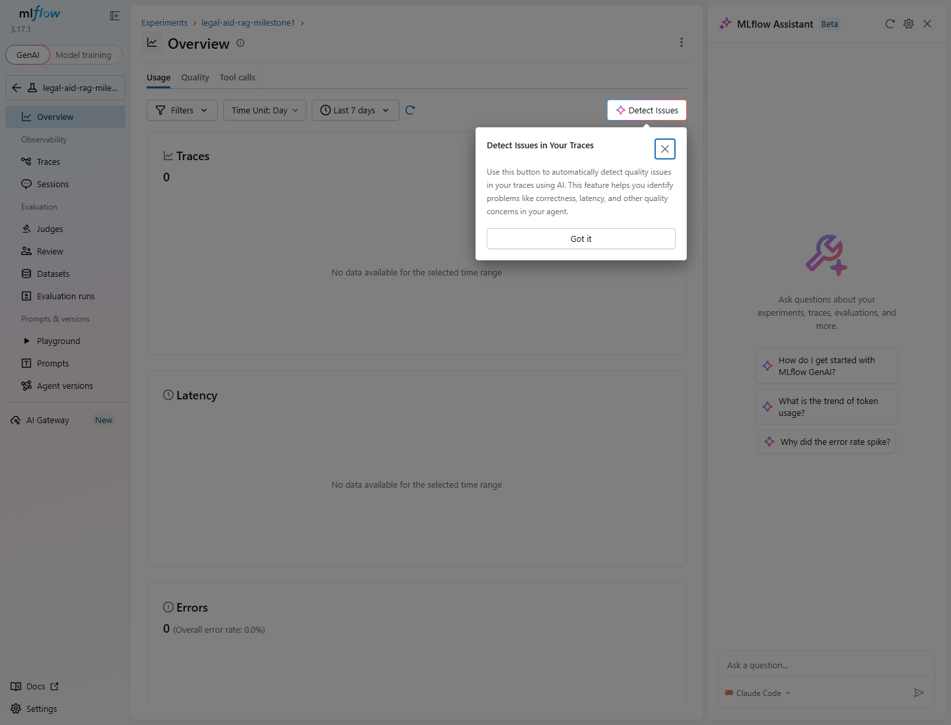
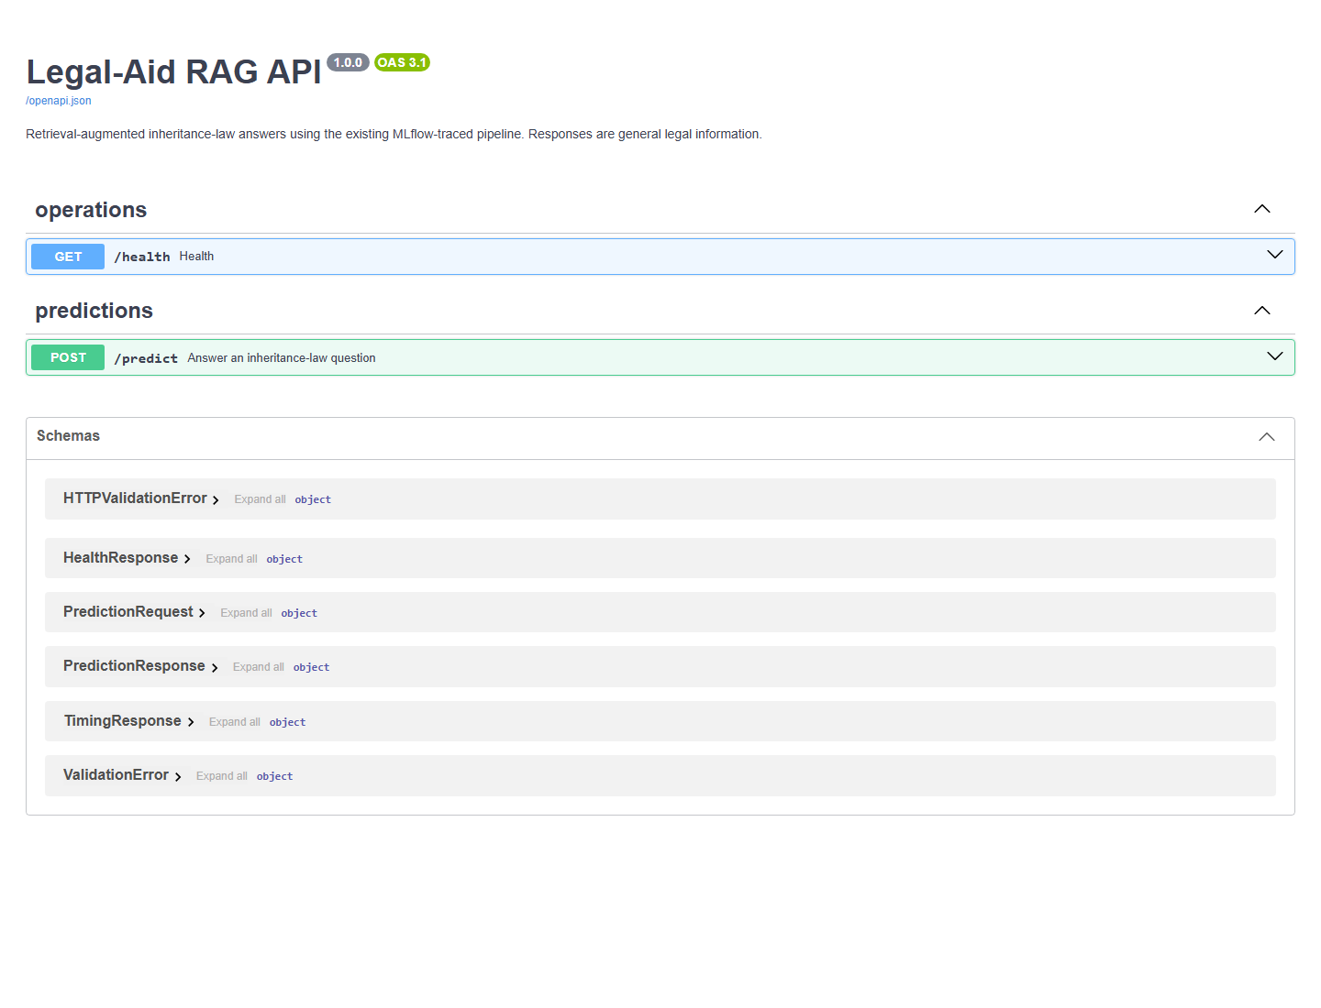
Serving and observability evidence
06
MLflow
FastAPI
Eight core-v2 runs, 150 benchmark requests, managed judges, and nested RAG traces
Validated /predict, health check, generated /docs, and cached components
108 passing tests - live Gradio request completed in 10.699 s - secrets excluded from traces and version control
Legal-Aid RAG MLOps - Milestone 1

Slide 7
FINAL SELECTION
Quality champion and speed challenger
structured_legal_v2 - Qwen 3.8-27B - temperature 0.1
Why
Fixed hybrid top-5 leads fact coverage at 0.7222. Fixed semantic top-3 cuts median retrieval latency by 94.2% and remains the interactive deployment option.
Decision rule
Use hybrid top-5 for maximum answer coverage. Use semantic top-3 when response time has priority.
Next milestone: expand the evaluation dataset, automate CI evaluation, and deploy shared MLflow storage.
Karam Hussain - Aadesh Panjwani - Muhammad Rayyan Khan

