Slide 1
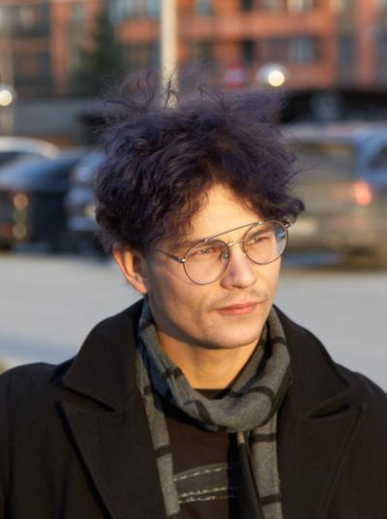
PORTFOLIO / 2026
Denis
Irinyakov
Data Engineer
Reliable pipelines, streaming systems, analytical data layers, and ML project work.
Moscow / Remote
github.com/karnaksp
Notes:
[Sources]
- https://www.datascienceportfol.io/karnaksp
- https://www.datascienceportfol.io/static/profile_pics/pr0_E3153937B96DB3A35FB6.jpg

Slide 2
01
I build data systems across the full lifecycle
From ingestion to product use, with reliability and documentation in view.
I am a data engineer with experience in analytics, backend development, and ML projects. My focus is reliable ETL/ELT, event streaming, analytical DWH/lakehouse layers, data quality, observability, and clear operational documentation.
1
2
3
4
5
6
Ingest
Transform
Validate
Store
Monitor
Serve
A complete data path, not an isolated task
The projects show more than code: data contracts, run scenarios, checks, architecture, and constraints.
DENIS IRINYAKOV / DATA ENGINEER
02
Notes:
[Sources]
- https://www.datascienceportfol.io/karnaksp

Slide 3
02
The toolkit spans data systems and delivery
Grouped from the skills listed in the source portfolio.
Pipelines & orchestration
Streaming & processing
Data platforms
Engineering & delivery
Airflow
Dagster
dbt
SQLMesh
ETL / ELT
Kafka
Redpanda
Spark
Debezium
CDC
PostgreSQL
ClickHouse
Greenplum
BigQuery
MinIO / S3
Python + SQL
Bash + PL/pgSQL
Docker + CI
FastAPI + CLI
Data quality + observability
DENIS IRINYAKOV / DATA ENGINEER
03
Notes:
[Sources]
- https://www.datascienceportfol.io/karnaksp

Slide 4
03
Four engineering projects anchor the portfolio
Each covers a distinct point in the path from events to usable data.
01
investment-signals
Real-time market data collection, validation, storage, API, and Telegram delivery.
02
data-forge
Retail CDC pipeline from PostgreSQL through streaming processing to analytical layers.
03
streamify
Music-service event analytics with Kafka, Spark Streaming, Airflow, dbt, and BigQuery.
04
dbt-af
A reproducible and testable path for running dbt models from Airflow.
Six additional projects extend the story into market visualizations, ML hackathons, C/C++, and document automation.
DENIS IRINYAKOV / DATA ENGINEER
04
Notes:
[Sources]
- https://www.datascienceportfol.io/karnaksp

Slide 5
04
investment-signals observes market data
Collection, validation, history, and delivery in one service.
01
02
03
04
Broker API
Kafka / Redpanda
ClickHouse + PostgreSQL
API + Telegram
PURPOSE
PRACTICAL VALUE
Collect and validate quotes and events in real time.
Notice market deviations and ingestion failures sooner while retaining calculation history.
Python / Kafka / Redpanda / ClickHouse / PostgreSQL / FastAPI / Dagster / Grafana / Docker
github.com/karnaksp/investment-signals
DENIS IRINYAKOV / DATA ENGINEER
05
Notes:
[Sources]
- https://www.datascienceportfol.io/karnaksp/projects/11
- https://github.com/karnaksp/investment-signals

Slide 6
05
data-forge builds a complete retail CDC path
An applied learning environment for a complete CDC pipeline.
01
02
03
04
PostgreSQL
Debezium + Kafka
Spark + Trino
ClickHouse + BI
PURPOSE
PRACTICAL VALUE
Stream changes from a retail transactional database into processing and analytical layers.
Show the full path from source transactions to validated data marts and reports.
PostgreSQL / Debezium / Kafka / Spark / Trino / MinIO / ClickHouse / Airflow / Superset / Docker Compose
github.com/karnaksp/data-forge
DENIS IRINYAKOV / DATA ENGINEER
06
Notes:
[Sources]
- https://www.datascienceportfol.io/karnaksp/projects/13
- https://github.com/karnaksp/data-forge

Slide 7
06
streamify turns listening events into analytics
Streaming, scheduled transformation, and data-mart checks.
01
02
03
04
05
Listening events
Kafka
Spark Streaming
Airflow + dbt
BigQuery
PURPOSE
PRACTICAL VALUE
Build an analytics pipeline for music-service listening events.
Demonstrate event analytics where streaming, scheduling, and data-mart quality control all matter.
Kafka / Spark Streaming / Airflow / dbt / BigQuery / Docker Compose / GitHub Actions
github.com/karnaksp/streamify
DENIS IRINYAKOV / DATA ENGINEER
07
Notes:
[Sources]
- https://www.datascienceportfol.io/karnaksp/projects/16
- https://github.com/karnaksp/streamify

Slide 8
07
dbt-af makes orchestration reliable
A focused project on repeatable, testable dbt execution from Airflow.
01
02
03
04
Airflow DAG
dbt models
Regression tests
Docker Compose + CI
WHAT CHANGED
PRACTICAL VALUE
The manual-run scenario was corrected, checks were added, and the root cause was documented.
Bring orchestration to a state that can be checked, repeated, and maintained.
Python / Airflow / dbt / Docker Compose / GitHub Actions / pytest
github.com/karnaksp/dbt-af
DENIS IRINYAKOV / DATA ENGINEER
08
Notes:
[Sources]
- https://www.datascienceportfol.io/karnaksp/projects/14
- https://github.com/karnaksp/dbt-af

Slide 9
08
stock-prices automates market visualizations
A CLI and Telegram workflow for ready-to-share animated price reviews.
01
02
03
04
Ticker + period + market
Quote loading
Charts + animation
Video output
INTERACTION
PRACTICAL VALUE
Run from the command line or through a Telegram bot.
Prepare a clear price overview without assembling charts manually.
Python / Telegram Bot API / CLI / Docker / MkDocs / GitHub Actions
github.com/karnaksp/stock-prices
DENIS IRINYAKOV / DATA ENGINEER
09
Notes:
[Sources]
- https://www.datascienceportfol.io/karnaksp/projects/12
- https://github.com/karnaksp/stock-prices
- https://karnaksp.github.io/stock-prices/

Slide 10

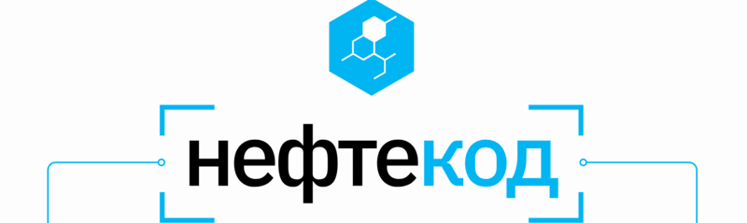
09
Three hackathons show applied ML range
Forecasting tasks across agriculture, industry, and lubricants.
AgroCode Data Science Cup 2023
Sibur Challenge 2023
Neftekod 2024
Animal productivity forecasting using feature preparation, gradient-boosting ensembles, feature selection, and regression evaluation.
Industrial mixture parameter prediction with data cleaning, LSTM/ML models, blending, and reproducible experiment packaging.
Lubricating-oil parameter prediction for a variable number of components using SMILES and anonymized experimental parameters.
CatBoost / XGBoost / LightGBM / stacking / blending
LSTM / deep learning / tabular data / Docker
Deep learning / preprocessing / OOP / teamwork
DENIS IRINYAKOV / DATA ENGINEER
10
Notes:
[Sources]
- https://www.datascienceportfol.io/karnaksp/projects/0
- https://www.datascienceportfol.io/karnaksp/projects/1
- https://www.datascienceportfol.io/karnaksp/projects/10
- https://github.com/akscent/Hacks/tree/main/AgroCodeDS2023
- https://github.com/akscent/Hacks/tree/main/Sibur-Challenge
- https://github.com/Neftekod/Oil-code/tree/main

Slide 11
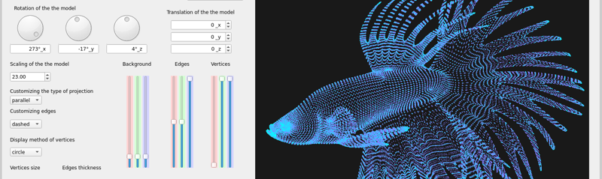
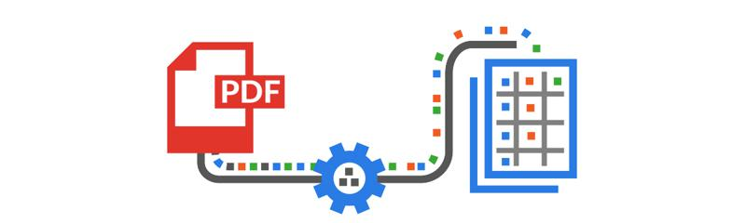
10
Engineering foundations reach beyond data
Two earlier projects document systems programming and practical automation.
School 21 programming projects
PDF Parser
C/C++, structured and object-oriented programming, algorithms, memory, containers, GUI/QT, and team development.
A small Python automation project for text extraction, regular expressions, procedural processing, and structured output.
DENIS IRINYAKOV / DATA ENGINEER
11
Notes:
[Sources]
- https://www.datascienceportfol.io/karnaksp/projects/7
- https://www.datascienceportfol.io/karnaksp/projects/8
- https://github.com/karnaksp/Educational-projects
- https://github.com/akscent/internships/tree/main/CoalCompany

Slide 12
11
Experience spans data and LLM work
Two listed roles connect analytics, warehousing, and LLM-based chatbots.
2023-2024
Data Analyst / DirectService
Loyalty-program analysis; ETL pipeline and PostgreSQL data warehouse setup; migration from ClickHouse and Greenplum; BI reporting visualization.
SQL / Python / Analytics
2024
Data Scientist / Spacecode
Development of chatbots based on large language models.
Machine learning / Data analysis / LLM
DENIS IRINYAKOV / DATA ENGINEER
12
Notes:
[Sources]
- https://www.datascienceportfol.io/karnaksp

Slide 13
12
Explore the code, architecture, and constraints
Repositories and contact details are available directly from the portfolio.
Education
Portfolio
karnaksp.github.io/karnaksp
2023-2024
Programmer, School 21 - project-based programming education from Sber.
GitHub
2019-2023
github.com/karnaksp
PhD, FSC of Biodiversity - fundamental ecology.
Email
2023-2024
irinyakov2016@yandex.ru
Sapiens Solutions - course: Working with Greenplum Database.
DENIS IRINYAKOV / DATA ENGINEER
13
Notes:
[Sources]
- https://www.datascienceportfol.io/karnaksp
- https://github.com/karnaksp
- https://karnaksp.github.io/karnaksp/

