Slide 1



Sustainable Supply Chain Management Dashboard
Name : Karna Patel
Internship ID : INTERNSHIP_1736246007677d02f700dbe

Slide 2

Learning Objectives
During this internship, I aimed to:
Develop expertise in Power BI for data visualization.
Create an interactive SCM dashboard to analyze real-world business data.
Improve decision-making in logistics, supplier management, and inventory tracking.
Learn to use slicers, filters, and KPIs for interactive insights.
Present data in a way that helps businesses reduce costs and improve efficiency.
GOAL
Source :
www.freepik.com/

Slide 3
Tools and Technology used
During this project, I worked with:
Power BI – For interactive data visualization and dashboard creation.
Excel/CSV – Used for data import and storage.
Data Modeling – Established relationships between tables (Orders, Suppliers, Inventory, Logistics).
Slicers & Filters – Enabled dynamic data exploration for better decision-making.
Conditional Formatting & KPIs – Highlighted key trends and performance indicators.
Key Learning: The importance of data visualization in business intelligence.

Slide 4
Methodology
How I Built the Dashboard – Step-by-Step
Data Import – Loaded the pre-cleaned dataset into Power BI.
Dashboard Design – Chose appropriate charts, KPIs, and slicers for analysis.
Customization & Formatting – Applied consistent color schemes, tooltips, and labels.
Testing & Optimization – Ensured slicers, filters, and interactivity worked properly.
Final Refinement – Adjusted layout, added insights, and ensured usability.
Why This Approach ? : This method ensures that data is structured, visualized effectively, and provides clear business insights.

Slide 5
Problem Statement:
Challenges in Supply Chain Management
Many companies face challenges in supply chain efficiency, such as : High transportation costs due to poor route selection.
Delayed shipments leading to customer dissatisfaction.
Supplier quality issues affecting production timelines.
Lack of real-time inventory tracking, causing stock shortages.
Why is this a problem? Without real-time insights, businesses struggle to optimize costs, improve logistics, and manage supplier performance.
Solution Needed: A data-driven dashboard that provides clear insights into logistics, supplier performance, and inventory trends.

Slide 6
Solution:
I built a 5-page interactive dashboard that:
Tracks sales, revenue, and lead time with key performance indicators (KPIs).
Optimizes logistics by analyzing shipping costs & carrier performance.
Evaluates supplier performance based on defect rates & lead times.
Monitors inventory levels to prevent stockouts and overstocking.
Ensures quality control by analyzing product inspection results.

Slide 7
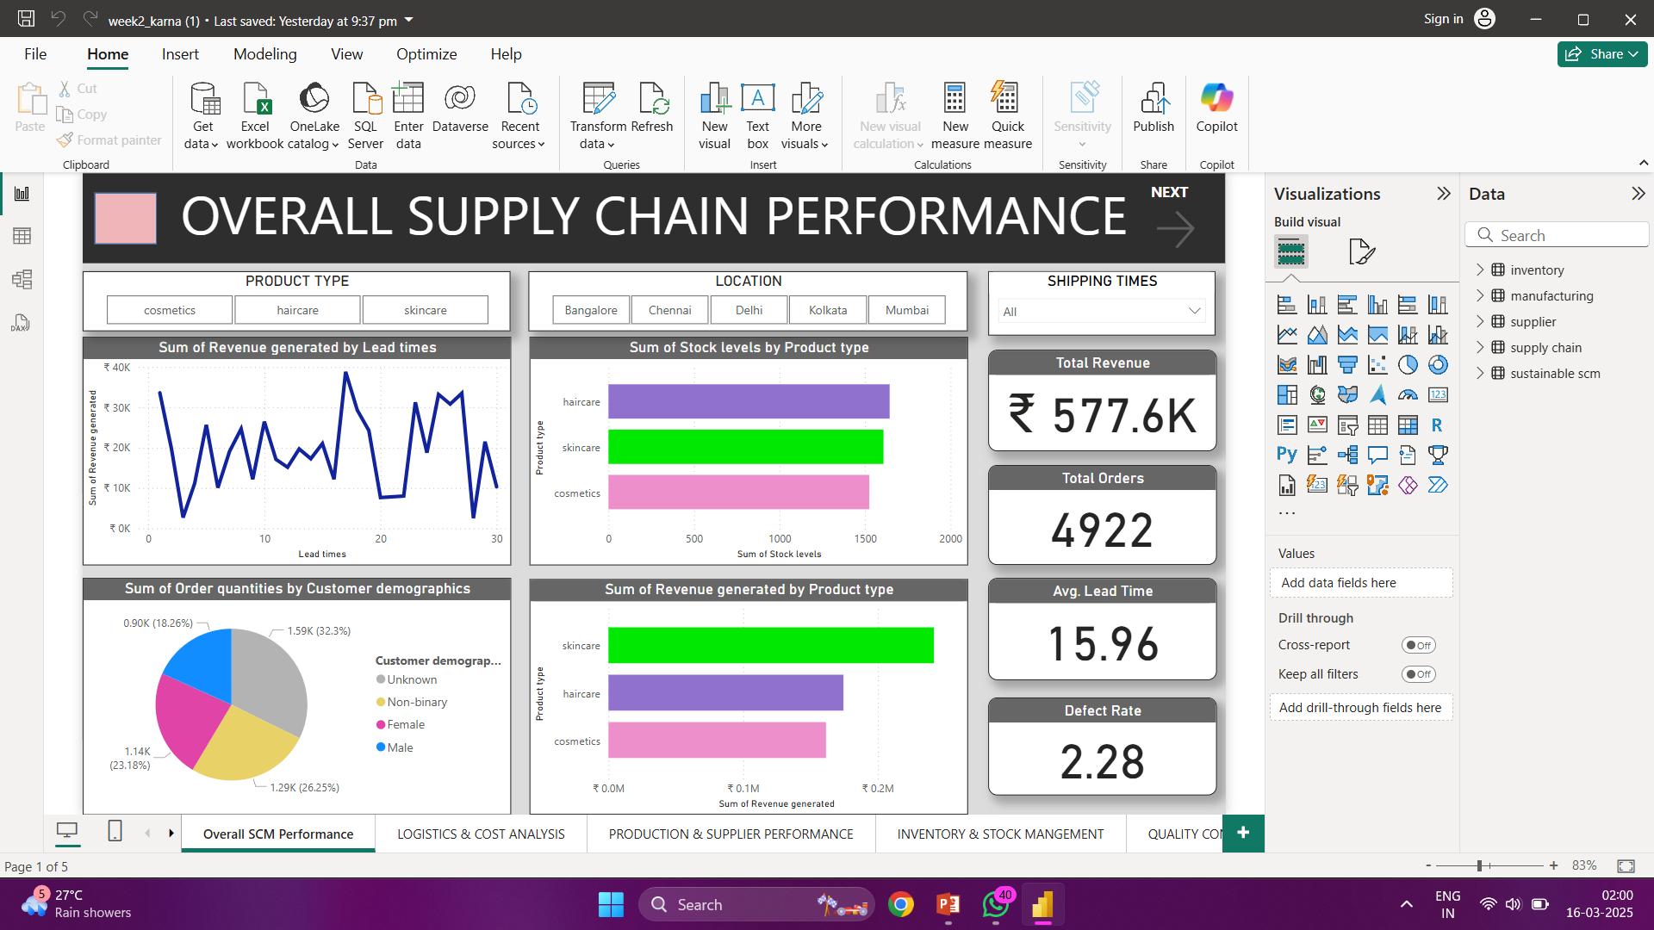
Screenshot of Output:

Slide 8
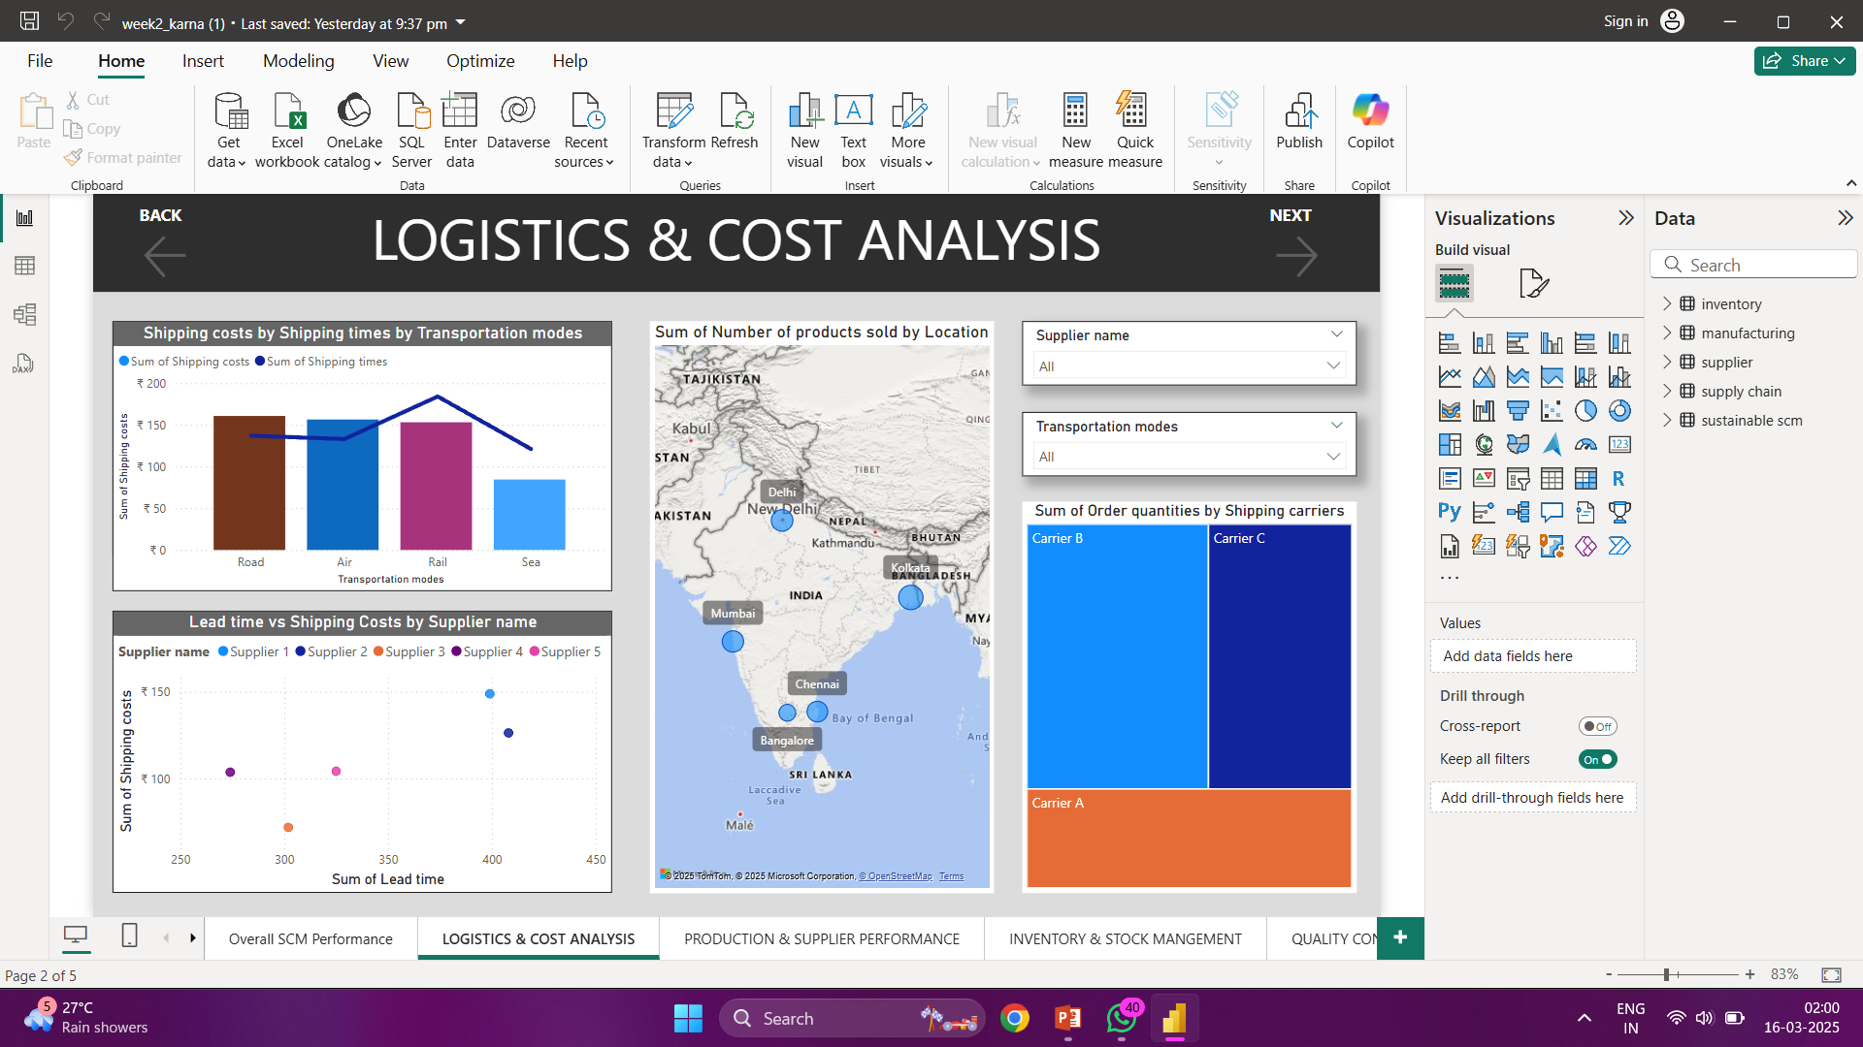
Screenshot of Output:

Slide 9
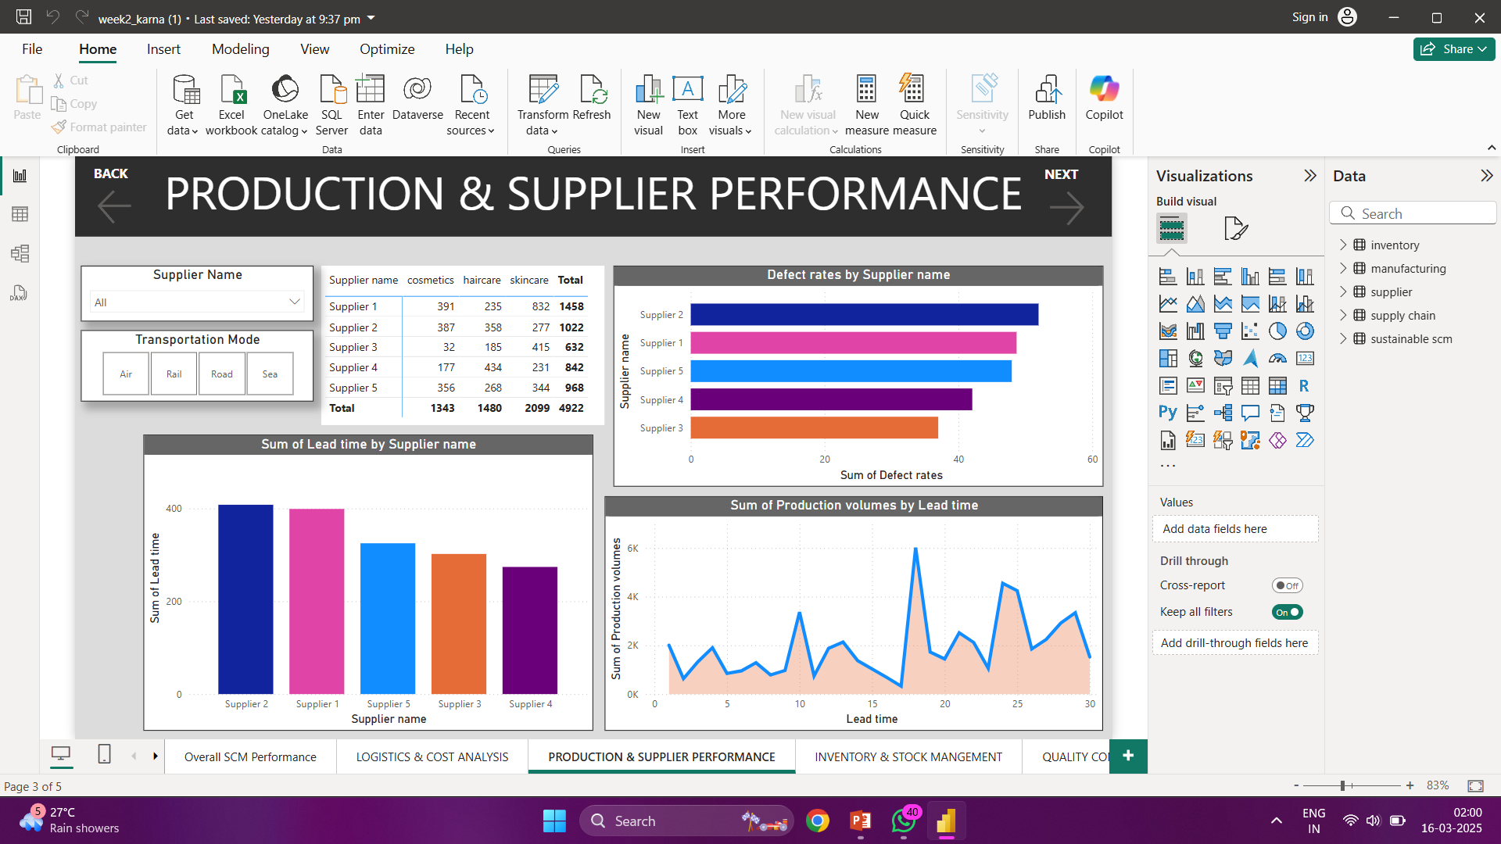
Screenshot of Output:

Slide 10
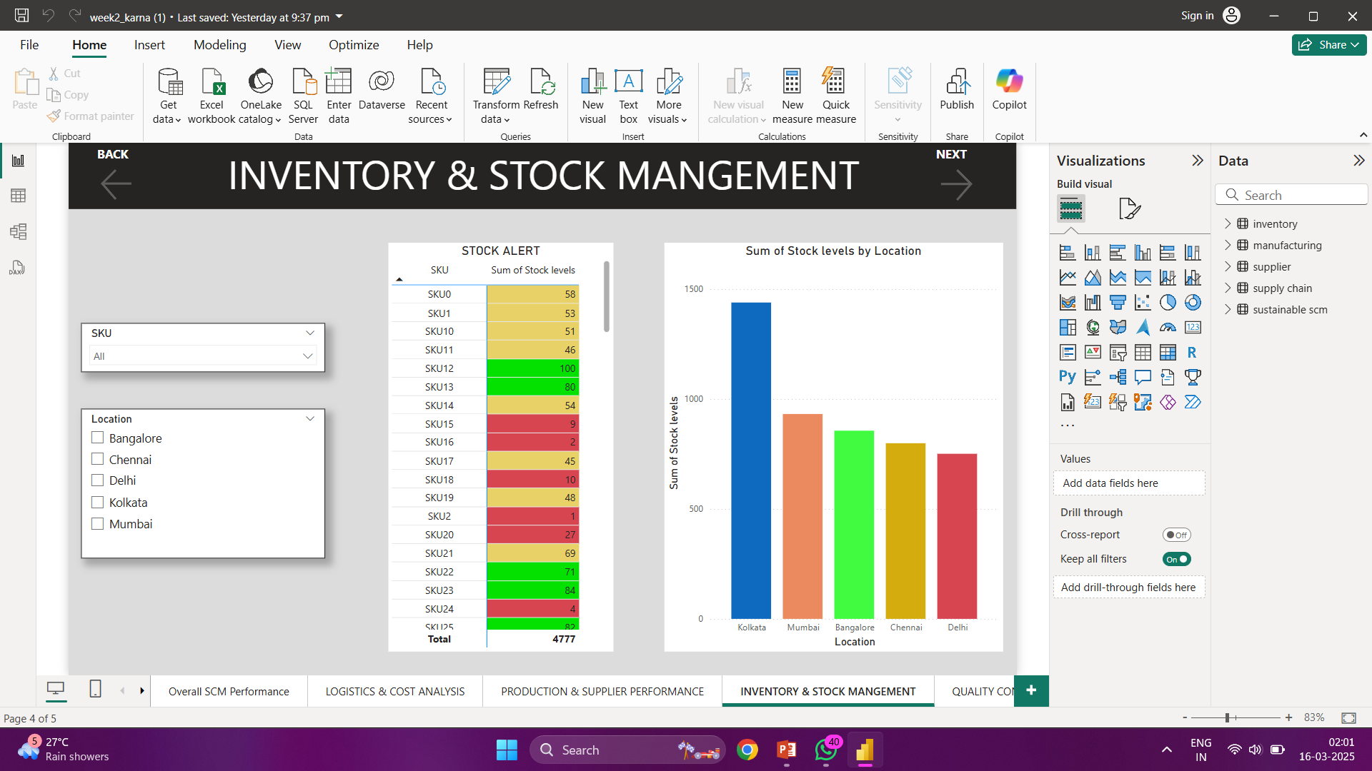
Screenshot of Output:

Slide 11
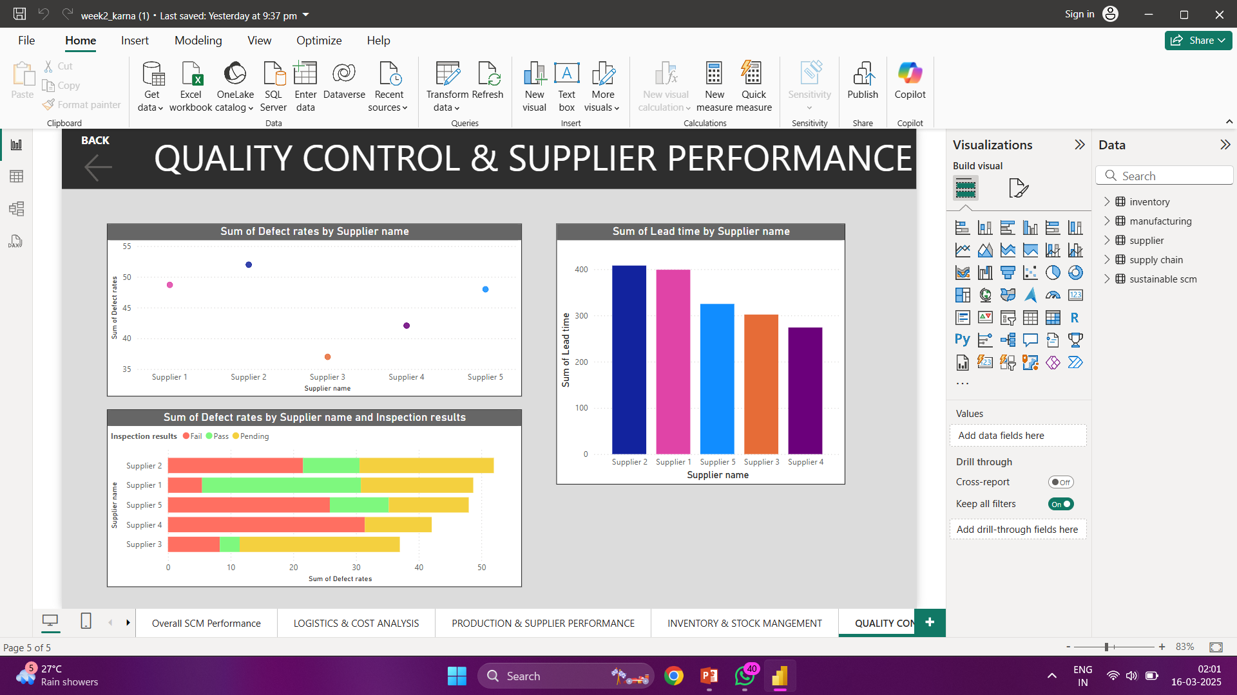
Screenshot of Output:

Slide 12
Conclusion:
Final Takeaways :
Built a fully interactive Power BI dashboard.
Provided real-time insights into revenue, logistics, and supplier performance.
Helped businesses reduce costs, track inventory, and optimize supplier selection.

