Slide 1
Building and Investigating a Small Transformer Language Model
CS 5370 Group Project, Fall 2026
[Member 1] | [Member 2] | [Member 3] | [Member 4]
Notes:
Introduce the group. We built a small GPT-style language model from scratch, trained it on a fictional corpus that we generated, fine-tuned it for question answering, and studied how reliably it reproduces facts.

Slide 2
The project at a glance
28
392K
0.93M
27 min
facts about one fictional department
training tokens in 4,000 documents
parameters, built from scratch in PyTorch
pretraining time on a laptop CPU
Research question
How reliably can a small Transformer reproduce the facts of its training corpus, how does this develop during training, and does it depend on the wording of the prompt?
Notes:
Four numbers summarize the project. The pipeline is: generate data, tokenize, pretrain with next-token prediction, evaluate, fine-tune on question-answer pairs, then run our research experiment. Read the research question aloud.

Slide 3
Fictional domain: the Laptop Loan Desk
Cedar Ridge University
Fact | Value
Location | room 114, Hollis Library
Weekday hours | 8 am to 6 pm
Manager | Dana Whitfield
Loan period | 14 days
Late fee | $5 per day (max $75)
Lost laptop | $900
Reservation portal | LoanPort
Report damage within | 48 hours
A fictional university. We model only one department: the desk that lends laptops to students.
Why so narrow?
A small model learns a small set of facts well when each fact is repeated many times in different words. More facts would mean weaker learning.
Notes:
Our fictional organization is Cedar Ridge University, and we limited the project to its Laptop Loan Desk. The knowledge base has 28 facts in total: location, hours, staff, loan rules, fees, and procedures. The table shows 8 of them.

Slide 4
Generating the corpus
Knowledge base
28 facts
→
8 wordings per fact
(written with AI)
→
5 document types
openings, closings
→
4,000 documents
random combinations
The same fact in different words
Partition | Documents | Tokens
Training | 4,000 | 392,149
Validation | 250 | 25,026
Test | 250 | 25,827
Policy: “The late fee for an overdue laptop is $5 per day.”
Staff email: “Please remember that each overdue day costs the student $5.”
Student notice: “Late returns are charged at a rate of $5 per day.”
One wording per fact is held out: it appears only in validation and test.
Notes:
We used a generative AI tool to write the knowledge base and eight different sentences for every fact, plus openings, closings and starter phrases for five document types. A script then builds each document from a random type, four to eight random facts, and a random wording for each. No new facts can appear. For separation, no document is shared between partitions, and one of the eight wordings of every fact is never used in training.

Slide 5
Word-level tokenizer
“The fee is $5.”
→
the
fee
is
$
5
.
Lowercase, then split into words, numbers and punctuation
Vocabulary built from training text only
Special tokens: <pad>, <unk>, <eos>
Chosen because a whole document fits into 128 tokens, which keeps CPU training fast
Weakness: any new word becomes <unk>
483
tokens in the vocabulary
Embedding matrix: 483 × 128
LM head: 128 → 483 logits
Notes:
We chose a word-level tokenizer. Text is lowercased and split into words, numbers and punctuation marks. The vocabulary has 483 tokens including three special ones. The vocabulary size directly sets two parts of the model: the embedding matrix has one row per token, 483 by 128, and the LM head has one output per token, so 483 logits. The weakness is that a word outside the vocabulary becomes the unknown token.

Slide 6
Decoder-only Transformer
Token embedding + position embedding
Setting | Value
Decoder blocks | 4
Attention heads | 4 (32 dims each)
Embedding size | 128
Feed-forward size | 512
Context length | 128 tokens
Dropout | 0.1
Parameters | 931,811
Decoder block × 4
LayerNorm → causal multi-head attention
W_Q, W_K, W_V, W_O + causal mask
+ residual connection
LayerNorm → feed-forward → + residual
Final LayerNorm → LM head (483 logits)
Sized to train in under 30 minutes on a CPU.
Notes:
The model is a GPT-style decoder-only Transformer that we implemented ourselves in slm.py. Token and position embeddings are added. Each of the four blocks applies layer normalization, causal multi-head self-attention with the learned projections W_Q, W_K, W_V and W_O, a residual connection, then layer normalization, a feed-forward network, and another residual. The causal mask is a lower-triangular matrix: future positions get minus infinity before the softmax, so a token can only attend to earlier tokens. The LM head gives 483 logits.

Slide 7
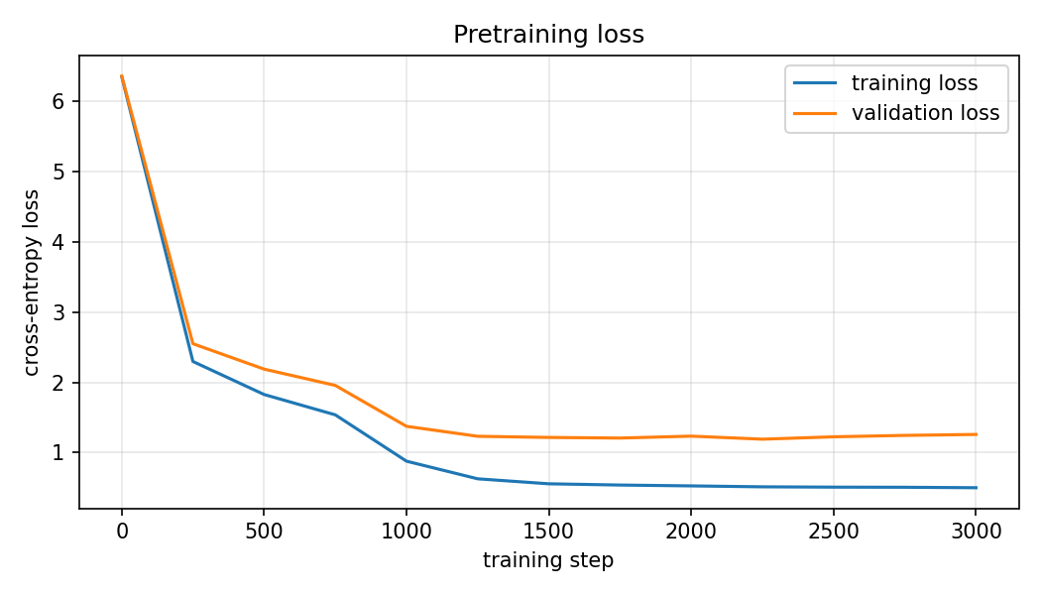
Pretraining: next-token prediction
Random weights at the start
Cross-entropy loss on the next token
AdamW, learning rate 3e-4
3,000 steps, batch of 32 × 128 tokens
Checkpoint every 250 steps
Training loss 6.35 → 0.50
Validation loss 1.26
Test perplexity 3.53
Loss starts at 6.35, close to ln(483) = 6.18 for uniform guessing.
Notes:
We trained from random weights. The input is a window of 128 tokens and the target is the same window shifted by one token. Training loss falls from 6.35 to 0.50. It cannot reach zero because the order of facts in a document is random. Validation loss is higher, 1.26, because validation documents contain the held-out wordings and some unknown words. It is lowest at step 2250 and rises slightly afterwards, which is mild overfitting.

Slide 8
What the pretrained model writes
Prompt: “Notice to all students.” (temperature 0.8)
28 / 28
we would like to remind you that the loan desk operates out of room 114, hollis library. [...] thank you for using the laptop loan desk.
facts completed correctly with familiar wording
11 / 28
Where it fails
Greedy decoding repeats one sentence five times
“The library is” → “overdue by 30 days”: fluent nonsense
New wordings of a fact are often completed wrongly
facts completed correctly with new wording
Notes:
The pretrained model writes fluent documents in the style of the corpus: an opening, facts, a closing, and then it stops. It even matches the starter phrases to the document type. For fact completion we give the beginning of a sentence cut just before the value. With familiar wording it gets all 28 facts. With the held-out wording only 11. We also saw repetition with greedy decoding and nonsense for prompts outside the corpus.

Slide 9
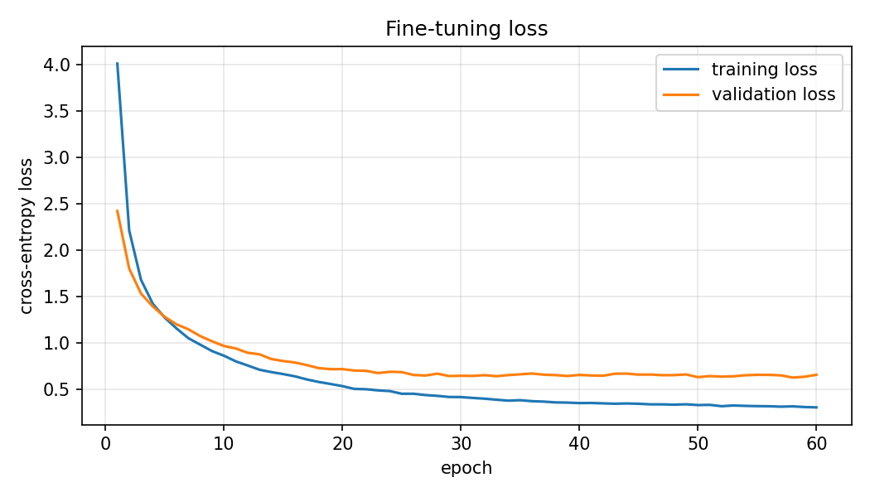
Fine-tuning for question answering
question: Who manages the Laptop Loan Desk? answer: The loan desk is managed by Dana Whitfield. <eos>
224 training pairs: 28 facts × 4 questions × 2 answers
56 held-out questions with wordings never used in training
Starts from the pretrained weights; all weights are updated
60 epochs, about one minute
First try (20 epochs, lower learning rate) was too short: only 3 of 56 correct.
Notes:
For fine-tuning we wrote question-answer pairs from the same knowledge base, in the format question, answer, end-of-sequence. The pretraining corpus contains no text in this format. There are 224 training pairs. For evaluation we reserved two other question wordings per fact, 56 questions that are never used in fine-tuning. The loss is the same next-token loss. Our first attempt was too short, so we trained for 60 epochs.

Slide 10
Before and after fine-tuning
Q: Who runs the loan program?
Before: the desk does not open on sundays and remains closed all day
After: the manager of the loan desk is dana whitfield
2 / 56 → 25 / 56 on held-out questions
110 / 112 on trained question wordings
Wrong answers are fluent sentences about the wrong fact
Notes:
Both models received the same 56 held-out questions with greedy decoding. An answer counts as correct if its first sentence contains the fact value. The pretrained model ignores the question and writes a random corpus sentence: 2 of 56, both by luck. The fine-tuned model always answers with one well-formed sentence and gets 25 of 56. On the question wordings it was trained on it gets 110 of 112. So it learned the answer format well, but it generalizes only partly to new wordings. Typical error: asked for the highest late fee, it answers with the daily late fee of 5 dollars.

Slide 11
Method: seen and unseen wording
For each of the 13 pretraining checkpoints and each of the 28 facts, we give the model the start of a sentence and check if it continues with the correct value.
Seen wording
Unseen wording
A sentence start that occurs in the training documents
The start of the held-out sentence, never in training
“the late fee for an overdue laptop is ___”
“if you return your laptop late, you will be charged ___”
No extra training: we reuse the saved checkpoints. Greedy decoding makes every result repeatable.
Notes:
To answer our research question we did not train any extra models. We loaded the 13 checkpoints saved during pretraining and ran a fact completion test on each. For every fact there are two prompts: one with a wording from the training documents and one from the held-out wording that the model has never seen. We check whether the next 8 generated tokens contain the correct value.

Slide 12
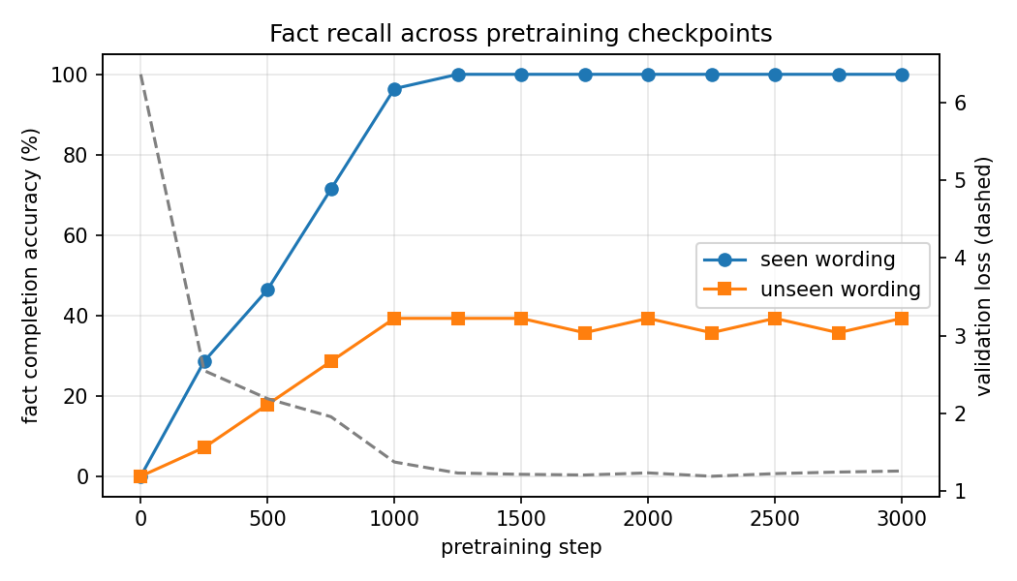
Recall depends on the wording
100%
seen wording, reached at step 1250
39%
unseen wording, flat after step 1000
Dashed line: validation loss
More training steps do not close the gap.
Notes:
This is our main result. Accuracy with seen wording rises steadily and reaches 28 of 28 at step 1250, at the same time as the validation loss levels off. Accuracy with unseen wording reaches 11 of 28 at step 1000 and then stays between 10 and 11 for the remaining 2,000 steps. A low loss does not mean the model knows the facts in a general way.

Slide 13
What the model actually learned
Form before facts
Prompt: “the late fee for an overdue laptop is”
Step 0
Step 250
Step 500
random words
$75 (wrong value)
$5 per day
Facts are tied to local word patterns
Works: prompt ends with familiar words
Fails: the last words are new
“...you can call extension” → 4410
“...you will have to pay” → “a staff member in person”
Notes:
Two observations explain the result. First, the model learns form before facts. At step 250 it already knows that a dollar amount follows the late fee prompt, but it gives 75 dollars, the maximum late fee. At step 500 it gives the correct 5 dollars. Second, the unseen prompts that succeed end with words that also come right before the value in training sentences, like 'call extension'. The ones that fail end with new words, like 'you will have to pay'. So the model stores a fact as a link between a short word pattern and a value, not as knowledge about an entity. Fine-tuning showed the same effect: 98 percent on trained question wordings, 45 percent on new ones.

Slide 14
Conclusions and limitations
What we found
Limitations
A model with under 1M parameters learns fluent domain text and all 28 facts in 27 minutes on a CPU
Fine-tuning turns it into a question answerer: 4% → 45% on new questions
Its knowledge is tied to the wordings it was trained on
Corpus built from a fixed set of sentences, less varied than real text
Unknown words become <unk>
The model never says “I don’t know”
One training run, 28 facts, one prompt pair per fact
Next step: more varied wordings, not more training steps.
Notes:
To conclude: a very small Transformer can learn the language and facts of a narrow domain quickly, and a short fine-tuning stage teaches it to answer questions. But both experiments show that what it learned is tied to the wordings it saw. The most useful improvement would be more varied wordings and questions in the data, and a subword tokenizer to avoid unknown words. We used AI tools substantially in this project and describe this in the AI Use Statement of our report. Thank you, we are happy to take questions.

