Slide 1
AI-Based UAV Object Detection for Security Surveillance
Notes:
Introduce the project. It is a web based security surveillance system for detecting UAV and drone related objects.

Slide 2
Project Overview
Security Surveillance
This project detects UAV and drone type objects for security purpose.
User can upload an image or recorded video in Flask web application.
YOLOv8 model detects object and shows bounding box with object name.
If object is detected, system gives voice output and siren sound.
Detected frame is saved with date and time and sent through email alert.
Application
Flask Web
Input
Image / Video
Alert
Voice + Siren
Notes:
Explain the main system in simple words. This is not Android; it is Flask web application.

Slide 3
Problem Statement
Drones and UAVs may enter restricted area without permission.
Manual checking of camera video takes more time.
Small flying object can be missed by security person.
Automatic detection and alert can help to take quick action.
System should detect object and immediately send sound and email alert.
Notes:
State the problem. Automatic detection helps security monitoring.

Slide 4
Data Collection
Images were collected for UAV and rotor based flying objects.
Dataset contains different object sizes, camera views and backgrounds.
Some images are from prepared drone datasets and collected image sources.
Images were divided into training and validation folders.
Final dataset has 13,661 training images and 2,637 validation images.
Each object was marked with bounding box and class name.
Train Images
13,661
Val Images
2,637
Classes
4
Notes:
Explain how data was collected and arranged. Use simple wording and mention train and validation split.

Slide 5
Data Preprocessing
Images were checked and arranged in YOLO folder format.
Annotation labels were prepared in YOLO text format.
Image size used for training is 640 x 640.
YOLO training applies resizing and data augmentation internally.
Augmentation helps model learn different positions and object scales.
Dataset YAML file contains train path, validation path and class names.
Format
YOLO
Image Size
640 x 640
Annotation
Bounding Box
Notes:
Explain preprocessing: folder structure, labels, image size and augmentation.

Slide 6
Dataset Visualization
Class | Train Objects | Val Objects
UAV | 13,025 | 2,584
side-by-side rotor | 216 | 54
single rotor | 929 | 166
tandem rotor | 620 | 64
UAV class has more samples than other classes.
side-by-side rotor has less samples, so it needs more data.
Class count helps to understand model performance.
More balanced data can improve future result.
Notes:
Show class distribution. Mention that side-by-side rotor has fewer objects.

Slide 7
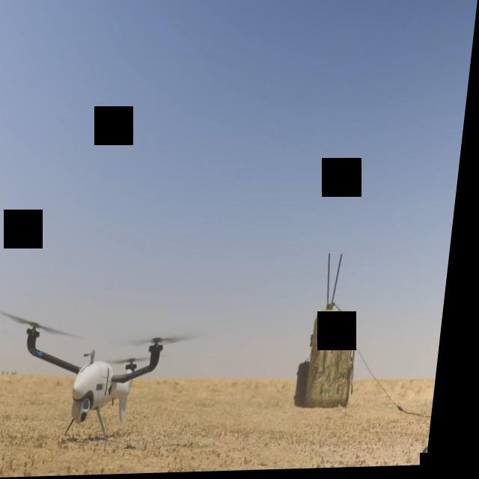
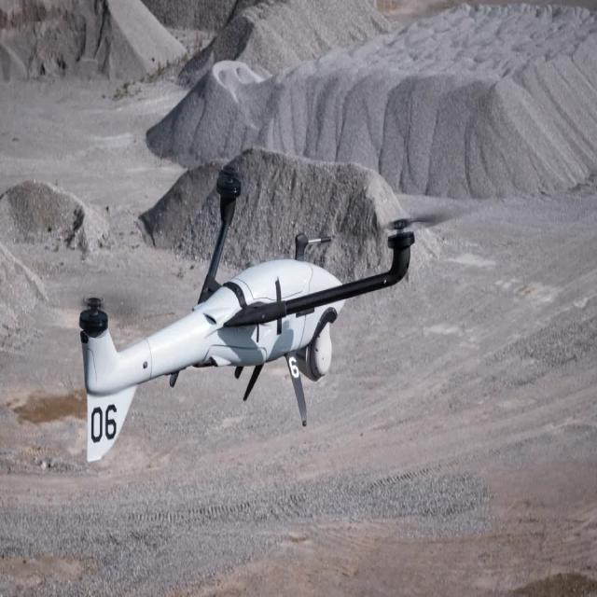
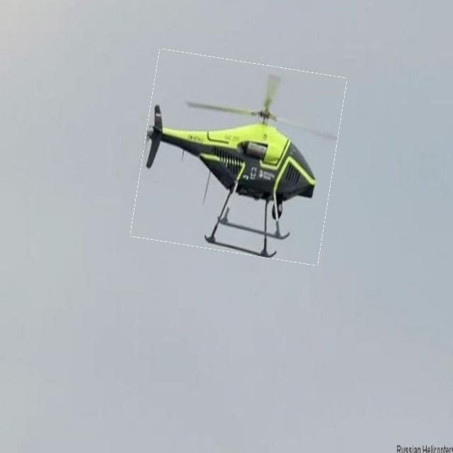
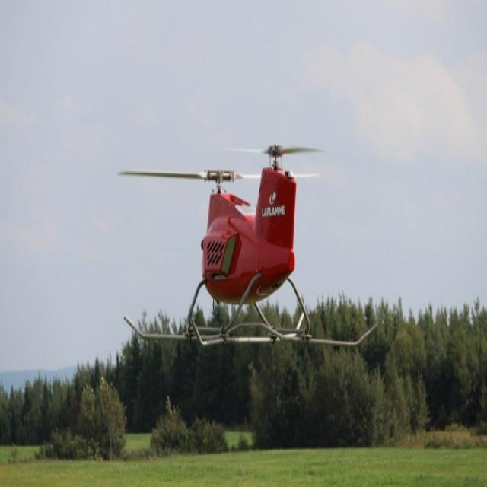
Sample Images for Each Class
UAV
side-by-side rotor
single rotor
tandem rotor
Notes:
Show one sample image for each class from the actual dataset.

Slide 8
Object Detection Classes
ID | Class Name
0 | UAV
1 | side-by-side rotor
2 | single rotor
3 | tandem rotor
This is object detection, not only classification.
Output gives object name and object location.
Bounding box is drawn around detected object.
Confidence score tells how sure the model is.
Notes:
Explain the four classes and the difference between object detection and classification.

Slide 9
Why YOLOv8 Was Selected
YOLOv8 gives good speed and accuracy for object detection.
It can detect objects in image and video frames.
It is easy to train with custom YOLO dataset.
It gives useful training graphs like mAP, precision, recall and F1.
YOLOv8n is lightweight, so it is suitable for web application testing.
It supports future deployment and model conversion also.
Main Reason
Fast + Accurate
Dataset
Custom YOLO
Web Use
Suitable
Notes:
Explain why YOLOv8 was chosen in simple student words.

Slide 10
Model Comparison
Model | Precision | Recall | F1 | mAP50 | mAP50-95 | FPS
YOLOv8 | 0.9487 | 0.912 | 0.93 | 0.9471 | 0.7292 | 51.55
SSD | 0.712 | 0.6953 | 0.7036 | 0.712 | 0.712 | 48.16
Faster R-CNN | 0.4364 | 0.75 | 0.5517 | 0.4364 | 0.4364 | 37.06
Model comparison was updated from the executed notebook outputs and saved metric files.
YOLOv8 gives the best overall surveillance score with precision 0.9487, recall 0.9120 and mAP50 0.9471.
SSD is a class-agnostic UAV detector in this comparison and gives a stronger fast baseline than Faster R-CNN.
Notes:
Mention that model comparison is based on project requirement and commonly used object detection models.

Slide 11
Best Parameter Selection
Parameter | Value | Why Selected
Epochs | 100 | Enough training time and graph became stable
Image size | 640 | Common YOLO size and good object detail
Batch size | 8 | Fits available system memory
Confidence | ~0.38 | Best F1 score from F1 curve
IoU | 0.7 | YOLO validation default used in training
Parameters were checked using training result graphs and final metrics.
Loss became stable and validation mAP50 reached 0.9471 after 100 epochs.
Confidence threshold can be adjusted after real video testing.
Notes:
Explain how parameters were selected. Use training curves and F1 curve as main reason.

Slide 12
Hardware and Software Used
Resource | Information
Operating System | Windows
CPU | Intel processor, 16 logical cores
GPU Available | NVIDIA GeForce RTX 2060 SUPER, 8 GB
Driver / CUDA | NVIDIA driver 591.86, CUDA 13.1
Python | 3.13.12
Framework | Ultralytics YOLOv8, Flask, OpenCV
Notes:
Present hardware information. Clarify that GPU is available in the system, but the current Python Torch build is CPU-only.

Slide 13
Model Training Setup
Model used: YOLOv8n object detection model.
Epochs: 100.
Image size: 640 x 640.
Batch size: 8.
Dataset format: YOLO annotation format.
Training output folder: runs/detect/custom_yolov8.
Trained model will be used inside Flask application.
Model
YOLOv8n
Epochs
100
Image Size
640
Notes:
Explain the training setup from args.yaml and train.py.

Slide 14
Training Results Summary
Metric | Value
Precision | 0.9487
Recall | 0.912
F1 Score | 0.93
mAP50 | 0.9471
mAP50-95 | 0.7292
Inference | 19.4 ms
FPS | 51.55
Train box loss | 0.727
Val box loss | 1.018
Model size | 5.97 MB
Final precision is 0.9487.
Final recall is 0.912.
mAP50 reached 0.9471 and mAP50-95 reached 0.7292.
These actual values are taken from the latest YOLOv8 notebook output and metrics JSON.
Notes:
Present final epoch metrics in simple language.

Slide 15
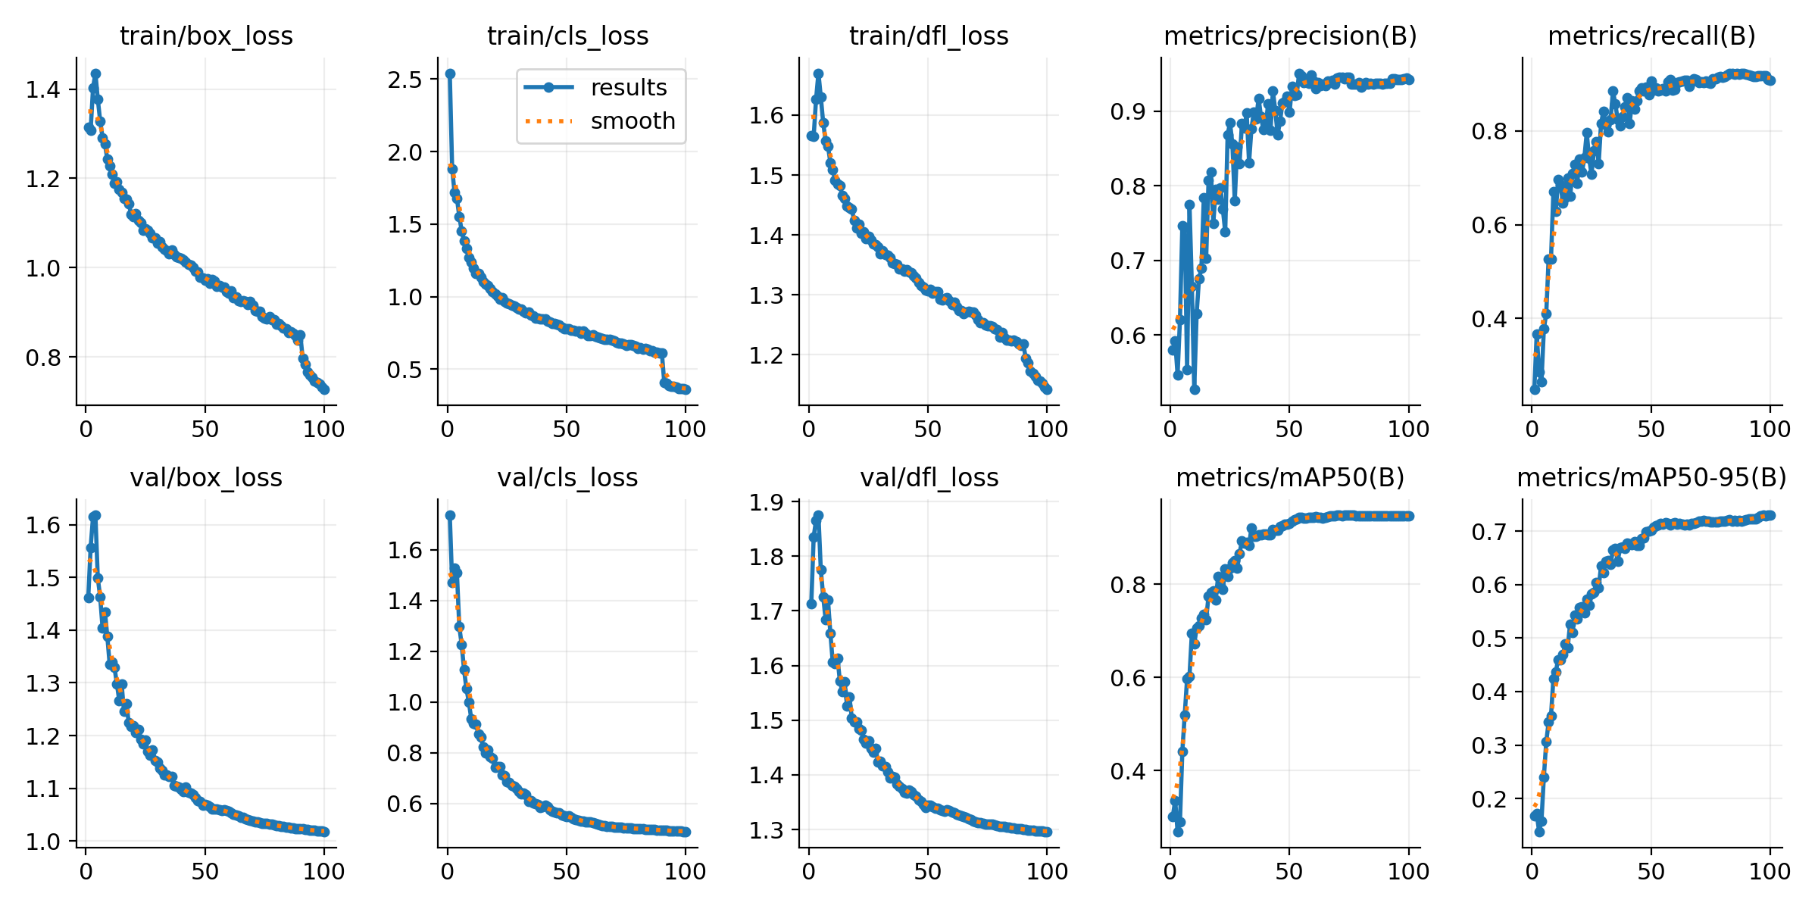
Training Performance Graph
Training losses reduced during epochs.
Validation losses became stable.
Precision and recall improved.
mAP50 and mAP50-95 also improved.
Model shows good training after 100 epochs.
Training result graph
Notes:
Explain training convergence from the graph.

Slide 16
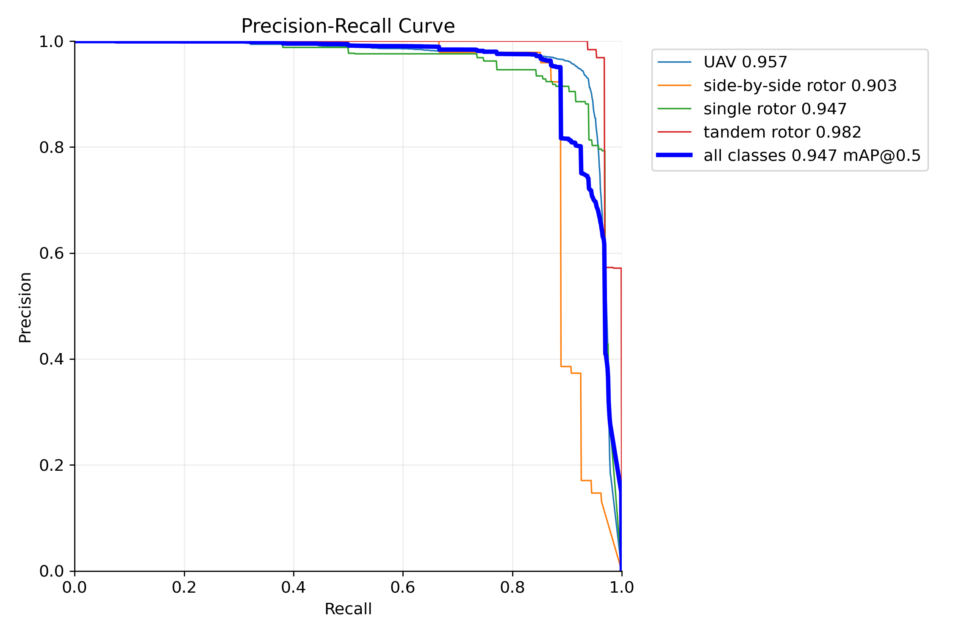
Precision-Recall Curve
Overall mAP@0.5 is 0.947.
UAV AP is 0.957.
side-by-side rotor AP is 0.903.
single rotor AP is 0.947.
tandem rotor AP is 0.982.
Precision-recall curve
Notes:
Explain PR curve and class-wise AP.

Slide 17
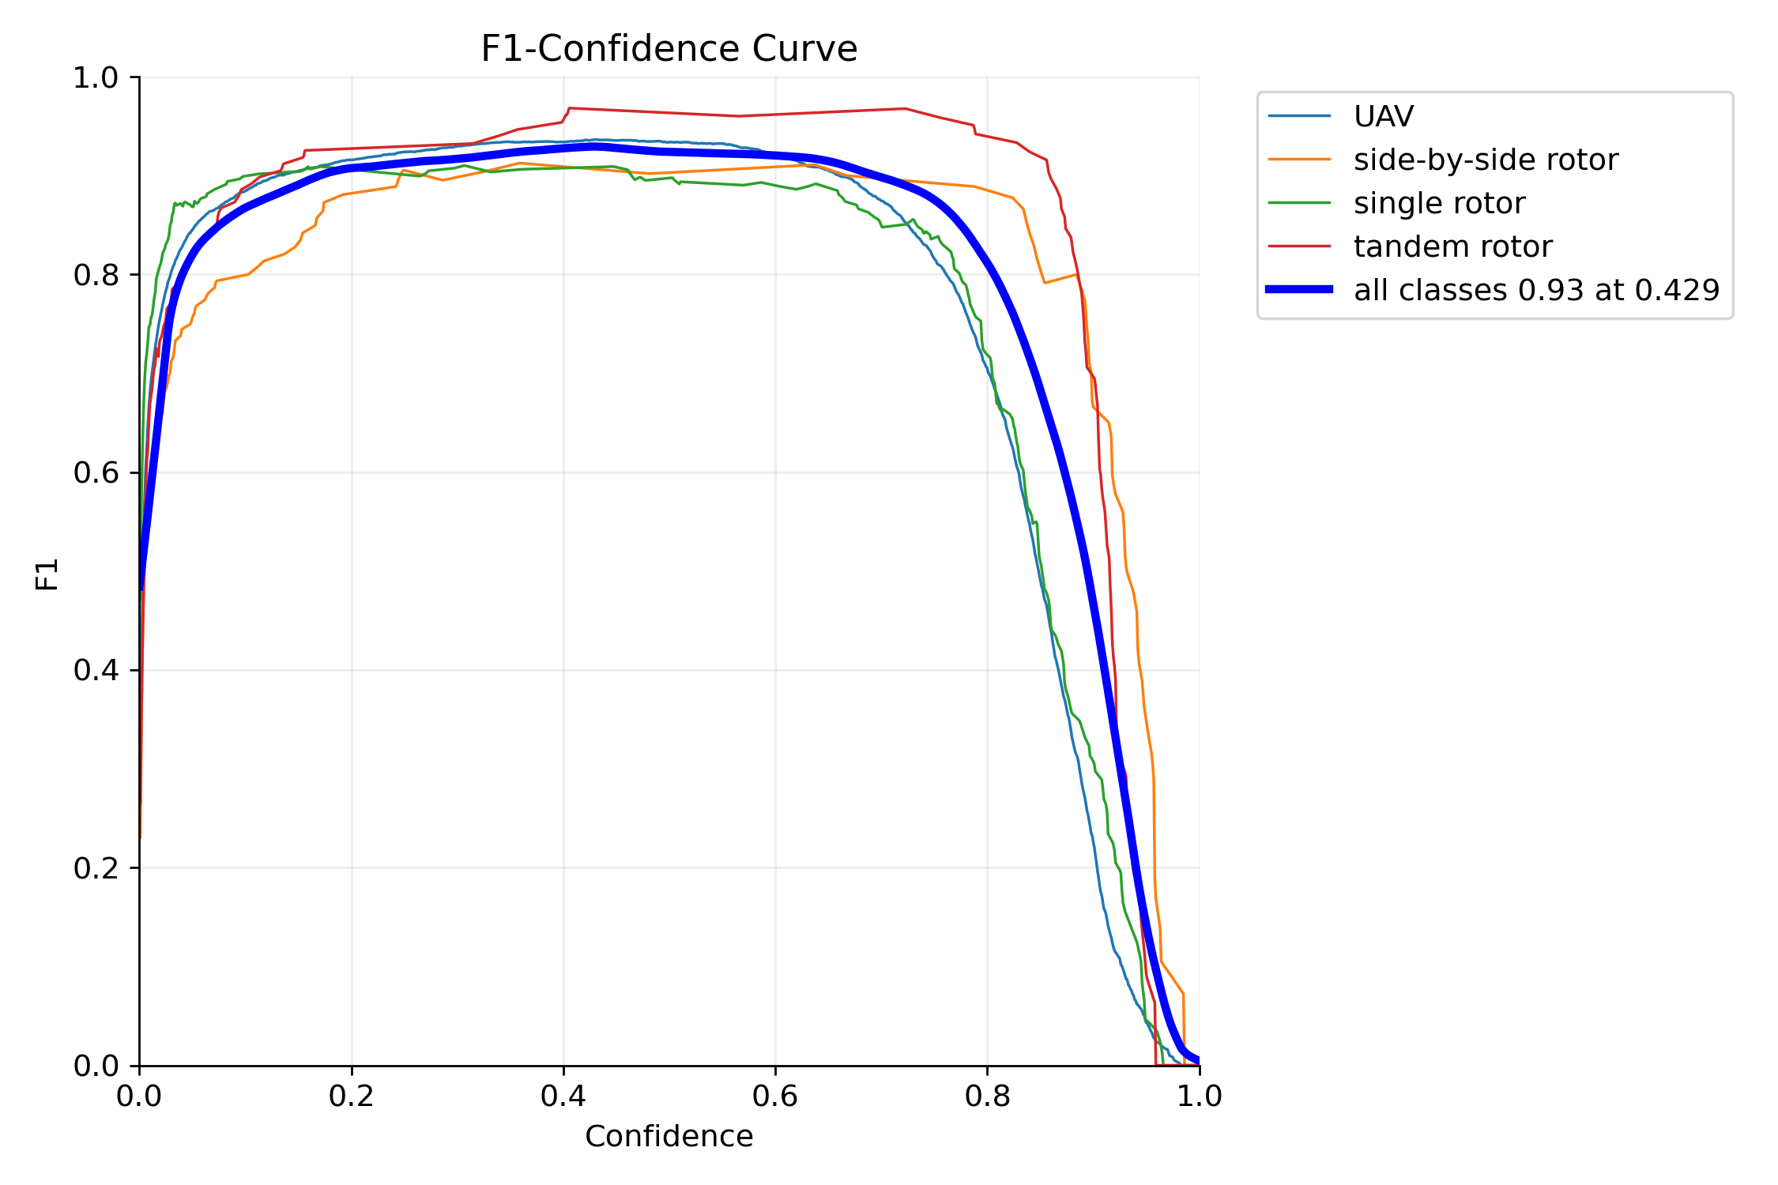
F1 Confidence Curve
Final F1 score is 0.93.
The F1-confidence curve helps select a practical confidence threshold.
F1 score balances precision and recall for alert decisions.
F1-confidence curve
Notes:
Explain confidence threshold selection from F1 curve.

Slide 18
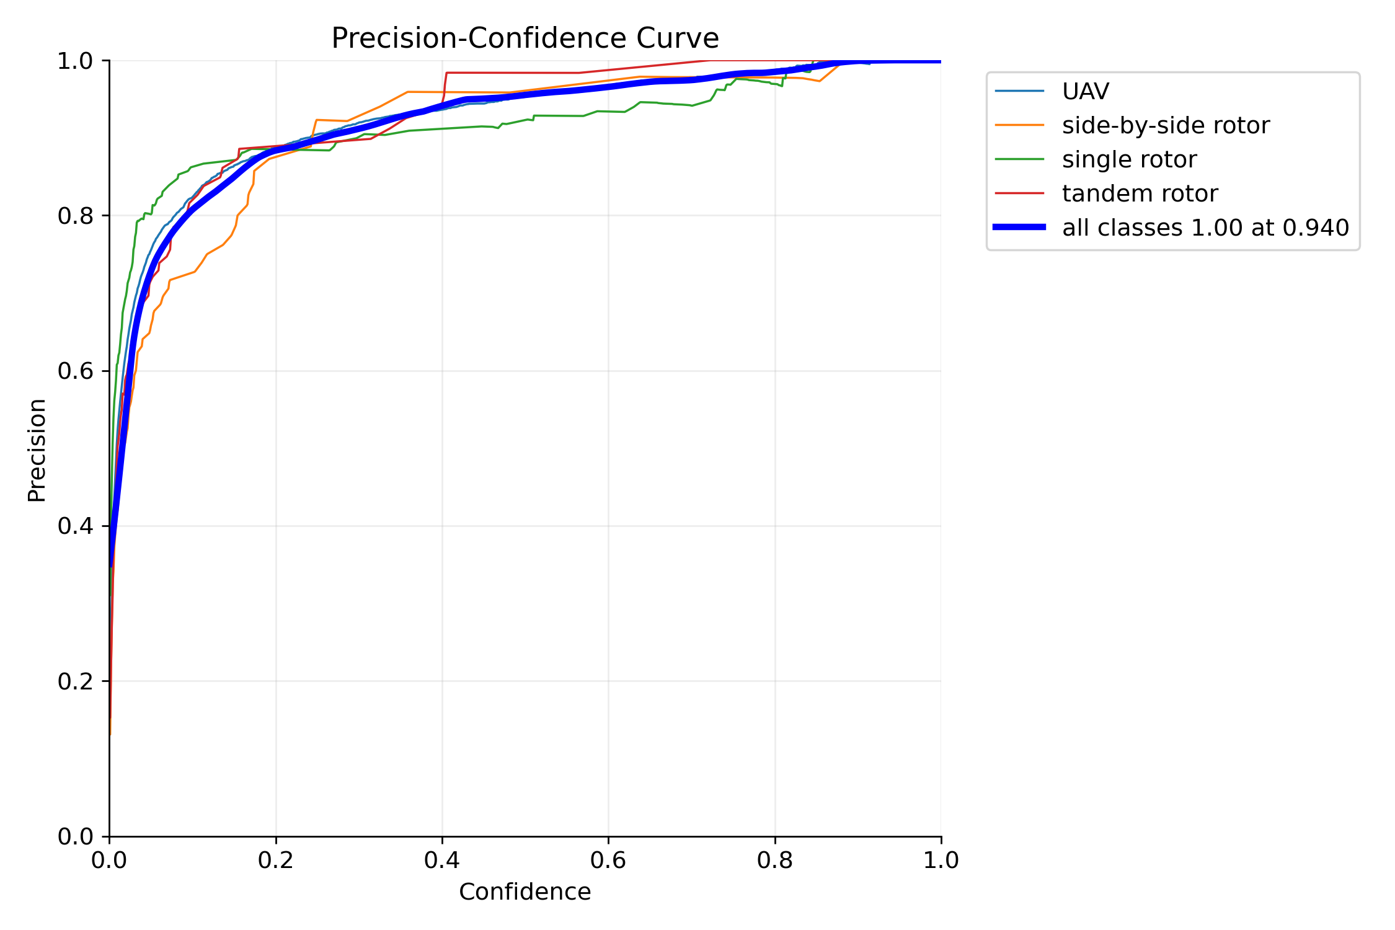
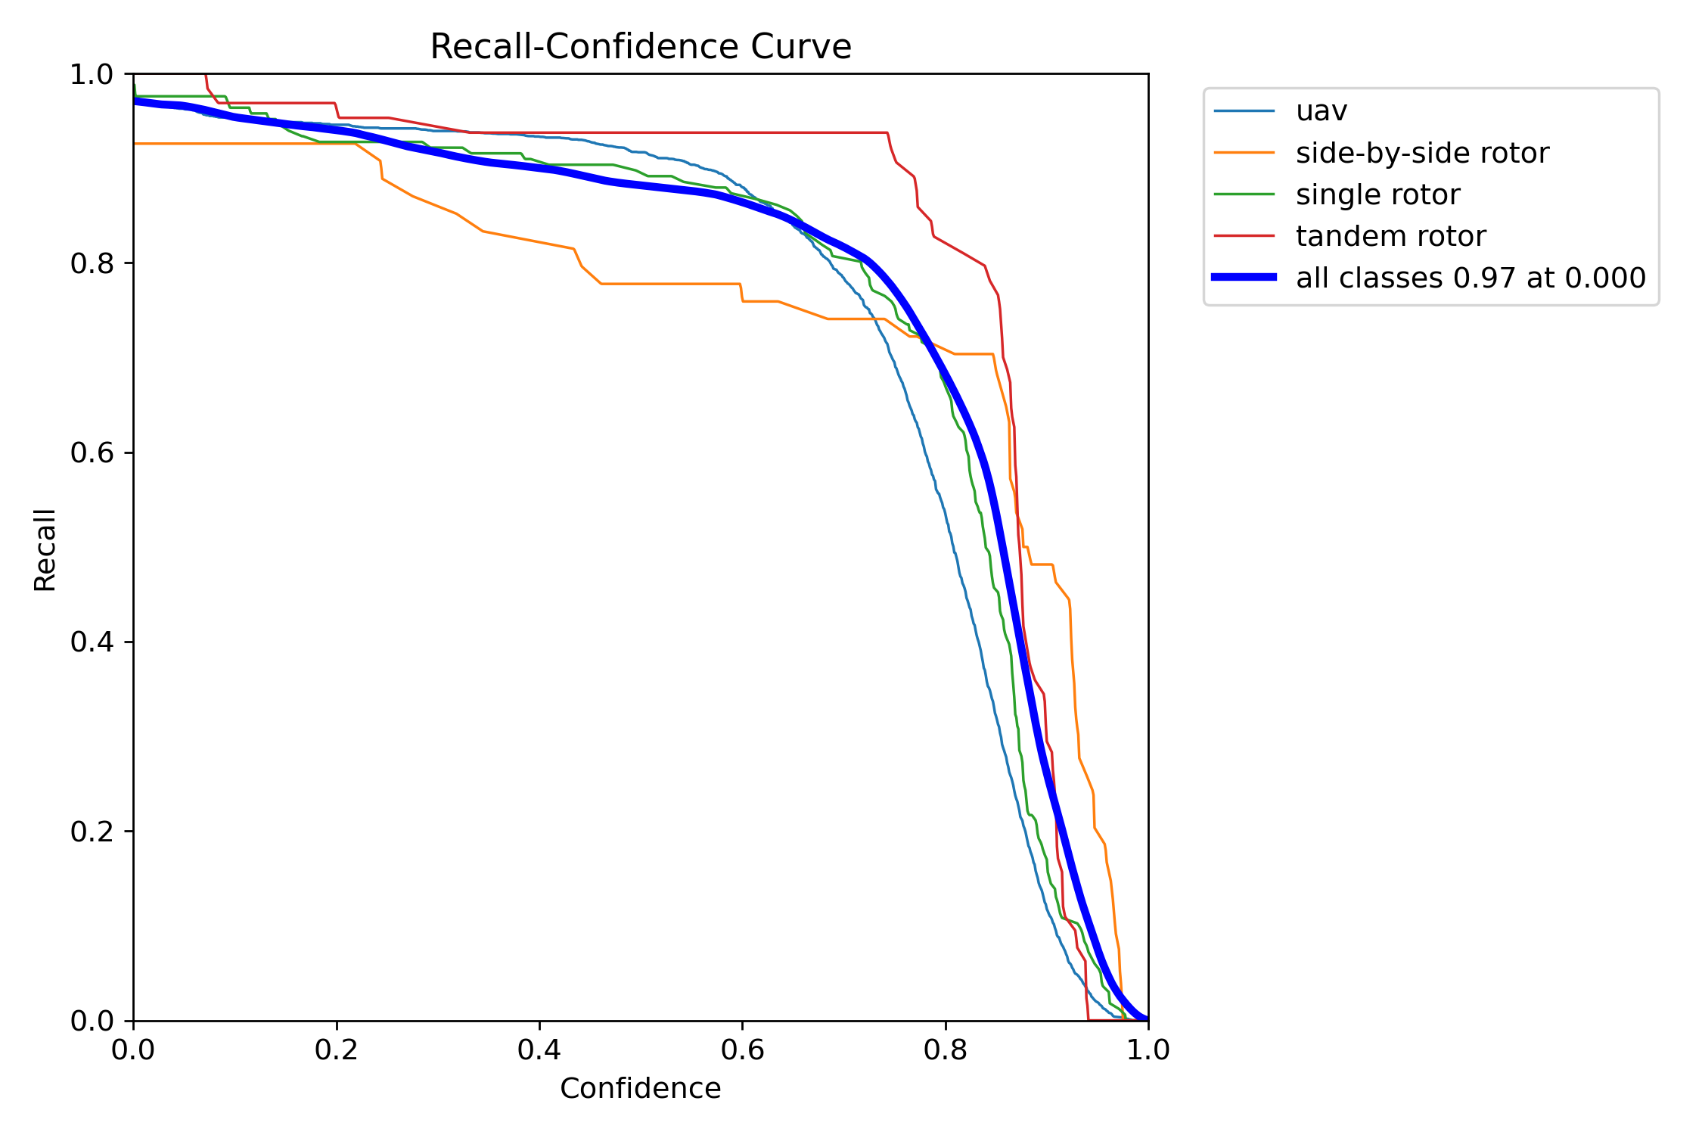
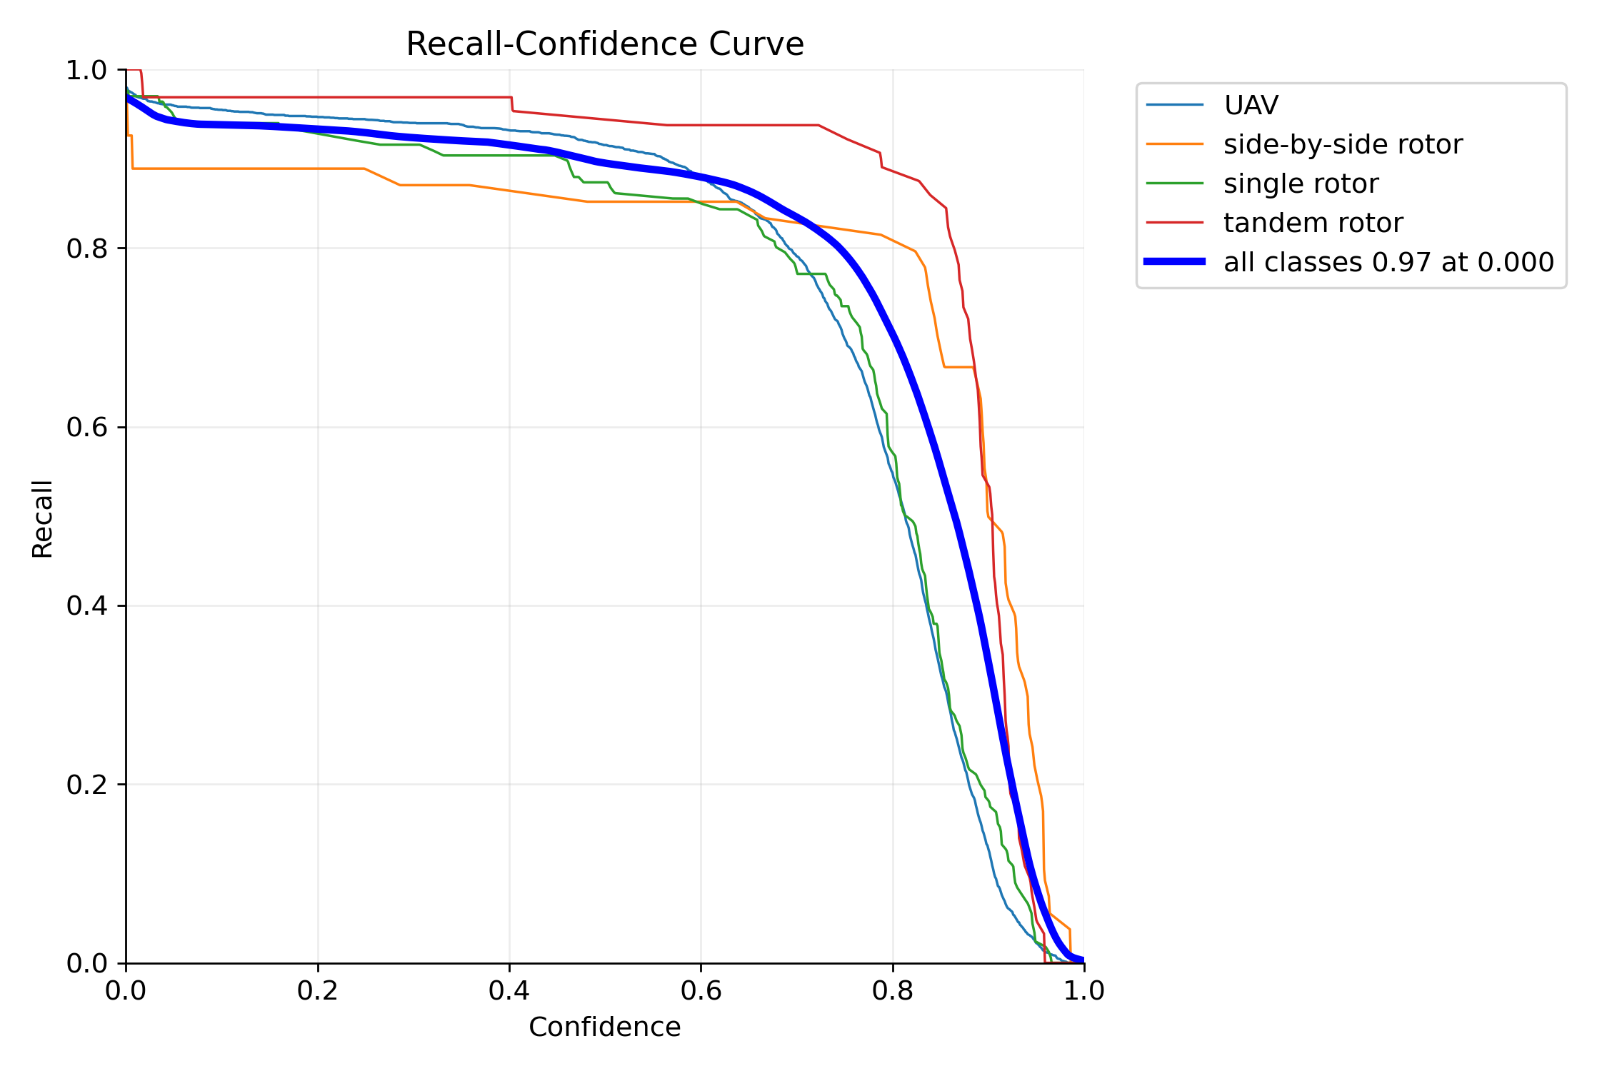
Precision and Recall Curves
Precision-confidence curve
Higher confidence gives better precision, but very high confidence may reduce recall.
Notes:
Compare precision and recall to explain threshold decision.

Slide 19
Flask Web Application Module
Frontend page is used to upload image or recorded video.
Flask backend receives the uploaded file.
YOLO model runs detection on image or video frames.
Output page shows detected object with bounding box.
For video, system checks frame by frame and marks detected frames.
Notes:
Explain Flask application module.

Slide 20
Alert and Voice Output
When an object is detected, the system speaks the object name.
Example voice: UAV detected.
The system also plays siren or alert sound.
Voice and siren help security person notice the detection quickly.
Alert should play only when confidence is above selected threshold.
Notes:
Explain voice and siren alert.

Slide 21
Frame Saving and Email Alert
If object is detected, detected frame is saved.
File name contains date and time.
Saved frame is useful as proof for later checking.
Email alert sends the detected frame to security email address.
Email message contains object name, confidence and detected time.
Save
Frame
File Name
Date Time
Alert
Email
Notes:
Explain saving frame and sending email alert.

Slide 22
Current System Workflow
Upload Image / Video
Flask App
YOLOv8 Model
Detected Output
Voice + Siren
Save Frame + Email
The same flow is used for uploaded image and recorded video testing.
Notes:
Explain complete workflow from upload to alert.

Slide 23

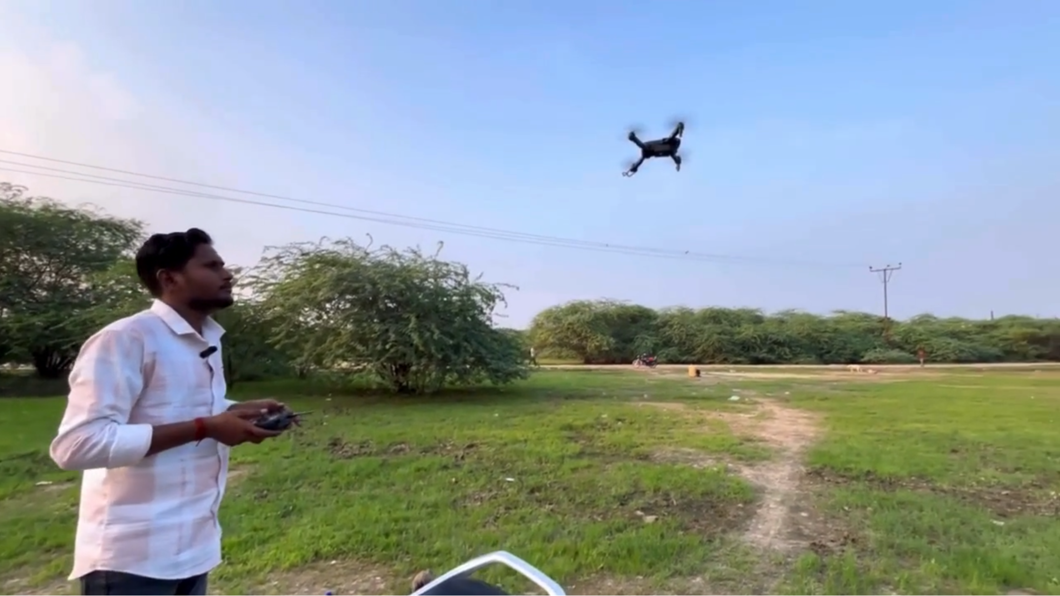
Video Testing

Slide 24
Implementation
Dataset prepared for 4 UAV object classes.
Dataset visualization and sample images verified.
YOLOv8, SSD and Faster R-CNN notebooks executed and compared.
YOLOv8 achieved the best overall result with mAP50 0.9471.
Flask based detection and alert workflow is ready for video testing.
Classes
4
mAP50
0.947
Alert
Defined
Notes:
Summarize completed progress.

Slide 25
Limitations and Future Work
side-by-side rotor class needs more training images.
False alerts should be reduced by adding more background images.
More testing is needed with different videos and camera angles.
Complete Flask web page design and upload testing.
Integrate voice output, siren sound and email alert fully.
Improve model using more real surveillance data.
Improve
Data
Reduce
False Alert
Test
Videos
Notes:
Mention limitations and next work.

Slide 26
Conclusion
The trained YOLOv8 model gives the strongest object detection result in this project.
mAP50 reached 0.9471, precision reached 0.9487, and recall reached 0.912.
SSD works as a fast class-agnostic UAV baseline, while Faster R-CNN is slower and lower scoring in this run.
The Flask web application with voice, siren, frame save and email alert makes the system useful for UAV security surveillance.
mAP50
0.947
Best F1
0.93
System
Web Alert
Notes:
Close the presentation with main achievement and next application step.

