Slide 1
PROJECT PRESENTATION
KubeEdgeInfer
A closed-loop, eBPF-driven Kubernetes framework for heterogeneous distributed LLM inference on consumer edge clusters
Karnati Praveen
Repository: github.com/karnati-praveen/ebpf-
August 2026

Slide 2
1 · INTRODUCTION
Introduction: why this is a scheduling problem
▪ A 7B model at FP16 needs ~14 GB of weights. No laptop GPU, Jetson or single rented L4 holds the models users actually want.
▪ Pipeline parallelism is the standard answer: cut the layer stack into contiguous shards, one per machine. Activations, not weights, cross the network.
▪ Running it at the edge rather than the cloud buys privacy (prompts stay local), latency (no WAN hop per token) and cost (hardware you already own).
▪ Kubernetes is already there - k3s runs on laptops, Jetsons and mini-PCs - so this is built as a Kubernetes controller, not beside one.
THE EDGE IS NOT A DATACENTER
THERMAL
Devices derate under load
NETWORK
Links wander by orders of magnitude
AVAILABILITY
Nodes are laptops - they disappear
THE CONSEQUENCE
A partition that is optimal at deployment time is not optimal sixty seconds later. Every system surveyed computes it once, from an offline profile, and never revisits it.
Node A
layers 0-3
Node B
layers 4-7
Node C
layers 8-11
12 blocks 3 machines
KubeEdgeInfer · eBPF-driven distributed LLM inference
2

Slide 3
2 · LITERATURE REVIEW
Literature review (1 / 2): edge LLM serving
Work (venue, year) | Core idea | Gap this project addresses
[1] EdgeShard IEEE IoT Journal, 2024 | DP joint device-selection + layer partition for LLMs on 15 heterogeneous edge devices (Jetson AGX/NX, RTX 3090); Llama2-7B/13B/70B. | The DP runs once, offline, from a one-time profiling pass. No mechanism to revisit the split after deployment - by design.
[2] Galaxy IEEE INFOCOM, 2024 | Hybrid tensor + sequence parallelism for in-situ transformer inference, with tile-based compute/communication overlap. | Placement fixed at planning time; no runtime telemetry loop, no response to thermal derating or node loss.
[3] Petals ACL 2023 (Demo) | BitTorrent-style volunteer pipeline over the WAN; clients rent transformer blocks from peers. | Peer selection by application-level latency probing only - no kernel telemetry, no thermal signal, no orchestration API.
[4] Helix ACM ASPLOS, 2025 | Max-flow formulation for serving LLMs across heterogeneous GPUs and a heterogeneous network topology. | Solves placement offline per configuration; measured drift is never fed back into the solver while serving.
[5] vLLM / PagedAttention ACM SOSP, 2023 | Paged KV-cache memory manager removing fragmentation, enabling continuous batching at high throughput. | Single-node memory management. Orthogonal and complementary - assumes the model already fits the node set it is given.
KubeEdgeInfer · eBPF-driven distributed LLM inference
3

Slide 4
2 · LITERATURE REVIEW
Literature review (2 / 2): serving and kernel telemetry
Work (venue, year) | Core idea | Gap this project addresses
[6] DistServe USENIX OSDI, 2024 | Disaggregates prefill and decode onto separate GPUs so each phase meets its own latency SLO. | Datacenter GPUs on a stable fabric; no notion of thermal derating or of a node leaving the cluster.
[7] Splitwise ACM/IEEE ISCA, 2024 | Splits prompt and token phases across two machine pools, moving KV cache over a fast interconnect. | Depends on InfiniBand-class bandwidth that does not exist on a consumer edge LAN.
[8] Llumnix USENIX OSDI, 2024 | Reschedules inference requests across model instances at runtime using live KV-cache migration. | Migrates requests between whole replicas, not layers within one model, and the mechanism is stateful migration.
[9] ServerlessLLM USENIX OSDI, 2024 | Locality-aware checkpoint loading and live migration to cut cold-start cost for serverless LLM inference. | Focused on load/start latency; the partition of a model across nodes is never revisited during serving.
[10] Electrode USENIX NSDI, 2023 | Offloads distributed-protocol fast paths (Paxos) into eBPF, approaching kernel-bypass performance. | Establishes eBPF for datapath acceleration, not as a measured cost signal driving a scheduling optimiser.
SYNTHESIS
Across all ten: the layer partition is solved once, and the systems that do act at runtime act on requests, by migrating state.
KubeEdgeInfer · eBPF-driven distributed LLM inference
4

Slide 5
3 · PROBLEM STATEMENT
Problem statement
WHY THE GAP EXISTS - THE POSITIONING GRID
FORMALLY
KV-cache
migration
Stateless replay
(no migration)
Given L layers and K heterogeneous workers in pipeline order, where worker k has time-varying effective speed sₖ(t) ∈ (0,1] and the hop feeding it has time-varying cost rₖ(t): find the contiguous partition minimising the bottleneck stage cost - and keep it minimal continuously, while the pipeline is serving, without restarting a single process.
Existing systems solve this at t = 0 only. The variables that make it hard, sₖ(t) and rₖ(t), are exactly the ones they treat as constants.
Static /
one-time
not applicable
EdgeShard · PipeEdge Galaxy · Alpa · Petals
solved once, offline
Dynamic /
continuous
Llumnix ServerlessLLM · AnchorTP
dynamic, but stateful
KubeEdgeInfer (this work)
continuous, stateless
RQ1
Can kernel measurements be the optimiser's cost input, not an operator dashboard?
RQ2
Can a partition change on a live pipeline with no pod restart and no KV migration?
RQ3
Can one hysteresis-gated trigger cover thermal, network and failure uniformly?
WHY NOBODY IS HERE
The dynamic + stateless cell is empty because dynamic repartitioning was assumed to need KV-cache migration. Making workers stateless removes that assumption - and the reason the cell was empty.
RQ4
Does closing the loop beat a static split - and what does it cost when nothing is wrong?
KubeEdgeInfer · eBPF-driven distributed LLM inference
5

Slide 6
4 · CONTRIBUTIONS / NOVELTY
Contributions: four narrow, defensible claims
C1
Kernel-verified telemetry as an optimiser input
CO-RE eBPF (tp_btf/tcp_probe, fentry/tcp_sendmsg) feeds per-flow sRTT straight into the partition cost function, every control tick.
vs. Cilium/Hubble/Pixie collect eBPF data for humans; EdgeShard/Galaxy feed their DP from an offline profile.
C2
Live, generation-fenced repartition with no migration
Layer ranges reassigned over gRPC on a serving pipeline. Workers are stateless, so correctness needs only full-context replay - verified token-identical to HuggingFace GPT-2.
vs. Llumnix and AnchorTP repartition at runtime too, but by migrating KV state.
C3
One hysteresis-gated trigger, three fault classes
Thermal derating, network RTT growth and heartbeat loss all resolve to the same decision: recompute, apply if >15% better after a 30 s cooldown.
vs. TAPAS handles thermal; Tarragon/LUMEN failure; Kinitos network. None unifies all three.
C4
The partition is a first-class Kubernetes resource
An InferencePipeline CRD holds the desired model and layer count; the controller reconciles telemetry into a published assignment + generation.
vs. KServe, Volcano and Ray Serve orchestrate model replicas, not intra-model layer assignment.
“EdgeShard solves where to place each layer once, from an offline profile. We solve when to move it - continuously, from live kernel telemetry - while the pipeline keeps serving requests, without restarting a single pod.”
KubeEdgeInfer · eBPF-driven distributed LLM inference
6

Slide 7
5 · PROPOSED WORK
Proposed work: a control loop, not a planner
01
02
03
04
WATCH
DECIDE
ACT
HEAL
eBPF CO-RE on every node
tp_btf/tcp_probe → sRTT
fentry/tcp_sendmsg → bytes
GPU/thermal via gpu.Reader:
sim | cputherm | nvml
Exact linear-partition DP
O(L²K), minimises bottleneck
Hysteresis gate:
≥15% better AND
≥30 s since last change
New layer ranges pushed
over gRPC - no pod restart,
no model reload
Every assignment carries
a monotonic generation
3 s stale heartbeat ⇒
node declared gone
Forced repartition across
survivors; router replays
in-flight context
loop repeats every 2 s
Component | Language | Role in the loop
internal/ebpf + cmd/nodeagent | Go + C (CO-RE BPF) | WATCH - loads BPF objects with cilium/ebpf from a privileged DaemonSet; exports flow sRTT and GPU/thermal state
internal/partition | Go | DECIDE - exact DP plus the hysteresis Decider; unit-tested against brute force on 200 randomised instances
cmd/controller + internal/controller | Go | ACT / HEAL - reassigns ranges over gRPC, reconciles the InferencePipeline CRD, re-asserts the layout every 10 s
worker/ (server.py, router.py) | Python | Stateless shard workers (sim, gpt2 backends) plus the router driving stages hub-and-spoke
KubeEdgeInfer · eBPF-driven distributed LLM inference
7

Slide 8
5 · PROPOSED WORK
The optimiser, and what makes a live repartition safe
▪ Generation fencing. Every assignment carries a monotonic generation. Workers reject stale-generation forwards; the router refetches the layout and replays.
▪ Replay is trivially correct because workers are stateless. Each recomputes from the full accumulated context, so there is no KV cache to migrate, invalidate or reconcile - the bug class that makes migration-based repartitioning hard does not exist here.
▪ Healing. A heartbeat older than 3 s marks a node gone; the worker-set change forces a repartition past the gate.
▪ Re-assertion. The controller re-pushes the layout every 10 s, so a restarted router is reconciled back in rather than left empty.
▪ Declarative. The split lives in an InferencePipeline CRD - `kubectl get ipl` shows the live layout, bottleneck and generation.
COST MODEL
Tₖ = (bₖ − aₖ) · c / sₖ(t) + rₖ₋₁(t)
c is the base per-layer cost, sₖ(t) the live effective speed (throttling included), rₖ₋₁(t) the measured sRTT of the hop feeding the stage. An empty stage costs zero - not even its hop - so a worker whose link collapsed can be bypassed entirely.
internal/partition/partition.go
// f[j][w] = minimal bottleneck assigning the first
// j layers to the first w workers. Exact, O(L^2 K).
for w := 1; w <= k; w++ {
for j := 0; j <= n; j++ {
for split := 0; split <= j; split++ {
cost := max(f[split][w-1], stageCost(w-1, j-split))
if cost < f[j][w] { f[j][w] = cost }
} } }
HYSTERESIS GATE - WHY THE LOOP DOES NOT THRASH
THE WHOLE POINT
No pod is restarted, no model reloaded and no KV cache moved. The entire repartition mechanism is a gRPC call plus a version check.
δ = 15%
apply only if the new bottleneck beats the current one by >15%
τ = 30 s
and only after 30 s; both tunable live at runtime
force
a worker joining or dying bypasses both gates - healing must not wait
KubeEdgeInfer · eBPF-driven distributed LLM inference
8

Slide 9
6 · RESULTS
Experimental setup: VM, Docker, cluster and workload
Read off the machine the reported runs executed on.
Layer | Configuration
Host / VM | GitHub Codespaces VM (Azure), Ubuntu 24.04.4 LTS
Kernel | 6.8.0-1052-azure, x86_64 · BTF at /sys/kernel/btf/vmlinux (6.02 MB) · cgroup v2
CPU / memory | AMD EPYC 7763 64-Core - 2 vCPU · 7.76 GiB
Container runtime | Docker 29.3.0-1 · storage driver overlayfs · cgroup driver cgroupfs, v2
Cluster | kind v0.29.0 · kubectl v1.35.2 · 1 control-plane + 3 workers labeled kubeedgeinfer.io/worker=true
Toolchain | Go 1.26.1 · Python 3.12.1 · cilium/ebpf v0.22.0 · grpc-go v1.82.0 · client-go v0.36.2
Image | Base → runtime, contents
worker:dev | python:3.12-slim; grpcio≥1.60, protobuf≥4.25, numpy≥1.26; torch + transformers only with WITH_GPT2=1 (WITH_CUDA=1 → cu121 wheel)
controller:dev | golang:1.26 → distroless/static-debian12; CGO_ENABLED=0 static binary
nodeagent:dev | golang:1.26 → distroless/base-debian12; glibc base because the -tags gpu NVML build needs cgo
Workload / control | Value
Model, layers | GPT-2, totalLayers = 12, perLayerMs = 30, 3 shards
Load | 3 concurrent threads, prompt_len 16, max_new_tokens 8
Control loop | 2 s tick · re-assert 10 s · δ=0.15, τ=30 s · heartbeat 3 s
Scenario | Injection method
netem | tc qdisc add dev eth0 root netem delay 80ms on worker2
thermal | POST /gpu/override {"temp_c": 92} → speed derated to 0.4×
failure | docker stop kubeedgeinfer-worker3 (last stage), then restart
combo | netem + thermal simultaneously - the joint-fault test for C3
KubeEdgeInfer · eBPF-driven distributed LLM inference
9

Slide 10
6 · RESULTS
Results: the loop matters exactly when it should
−0%
−2%
+57%
+41%
+357%
BASELINE
no fault - cost of running the loop
NETEM
80 ms on one link - below the gate
THERMAL
node at 0.4× - layers migrate off
COMBO
netem + thermal - 2 repartitions
FAILURE
node stopped - 18 lost vs 0
Scenario | Mode | Req OK | Req err | Throughput (tok/s) | TTFT mean (ms) | TTFT p95 (ms) | Repart.
baseline | dynamic | 63 | 0 | 8.038 | 377.2 | 392.3 | –
baseline | static | 63 | 0 | 8.060 | 377.0 | 389.0 | –
netem | dynamic | 90 | 0 | 7.074 | 418.0 | 453.6 | –
netem | static | 93 | 0 | 7.254 | 416.0 | 452.4 | –
netem | profileonly | 93 | 0 | 7.239 | 416.9 | 452.6 | 0
thermal | dynamic | 84 | 0 | 6.647 | 457.7 | 476.9 | –
thermal | static | 54 | 0 | 4.245 | 701.9 | 903.5 | –
failure | dynamic | 126 | 0 | 6.548 | 452.1 | 537.8 | –
failure | static | 30 | 18 | 1.434 | 382.3 | 386.4 | –
combo | dynamic | 78 | 0 | 6.021 | 495.7 | 547.4 | 2
combo | static | 54 | 0 | 4.261 | 679.4 | 900.5 | 0
▪ Thermal +57% throughput, TTFT p95 904 → 477 ms.
▪ Failure 4.6×, and 18 failed requests → 0.
▪ Baseline 0.3% - the loop is free when nothing is wrong.
▪ netem is an honest negative. 80 ms on one link never crosses the 15% gate, so no repartition fires. The gate is behaving correctly - a fault layer movement cannot fix should not move layers.
▪ failure/static's *better* TTFT p95 (386 ms) is an artefact: it completed only 30 requests; the 18 that hit the dead node never produced a latency sample.
KubeEdgeInfer · eBPF-driven distributed LLM inference
10

Slide 11
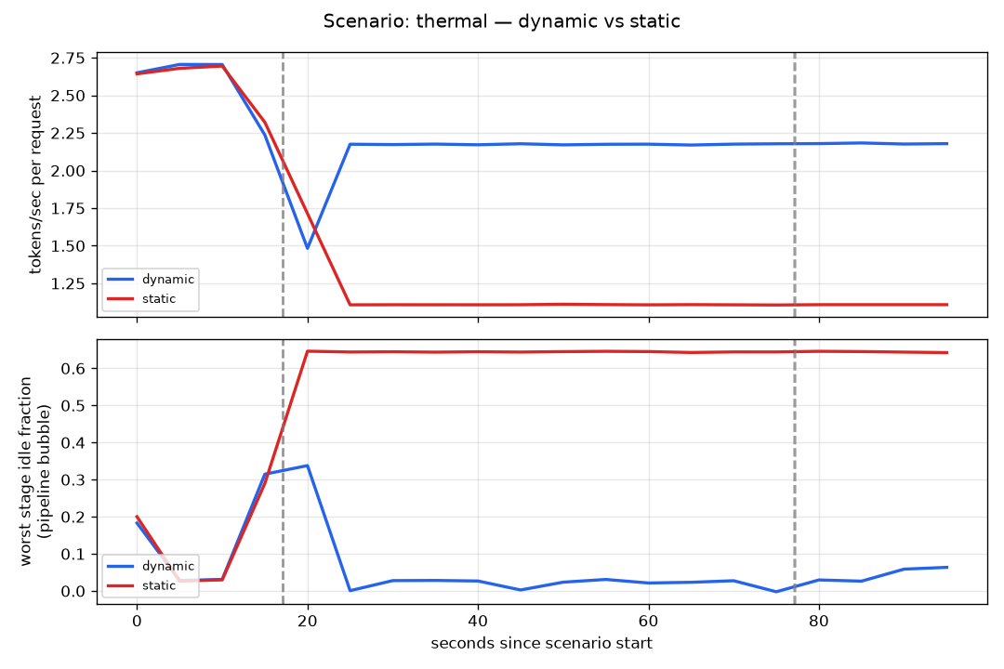
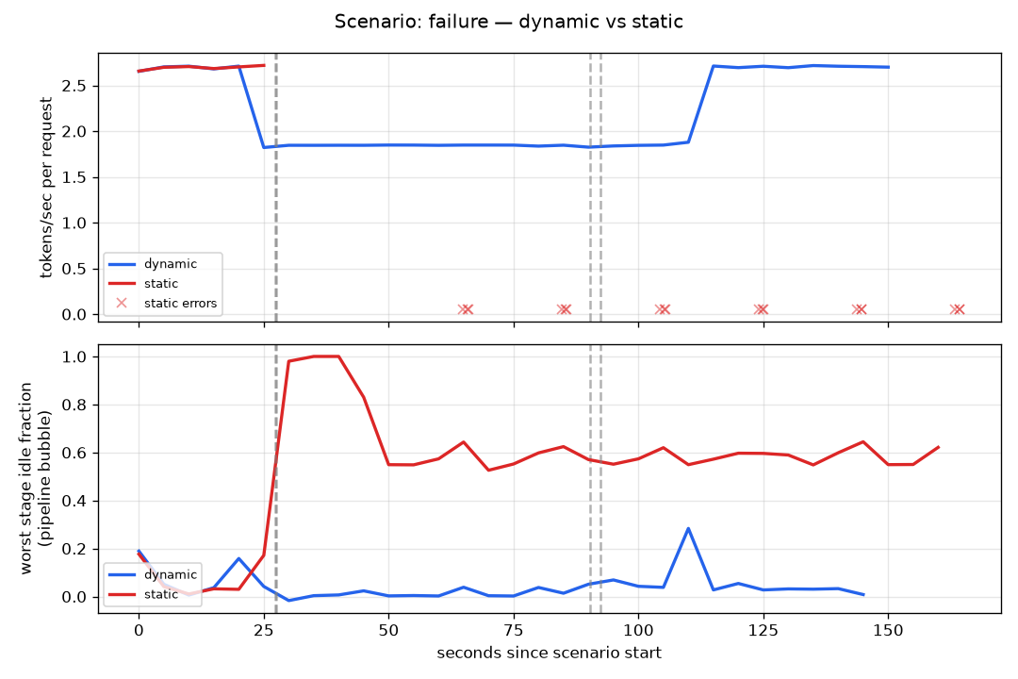
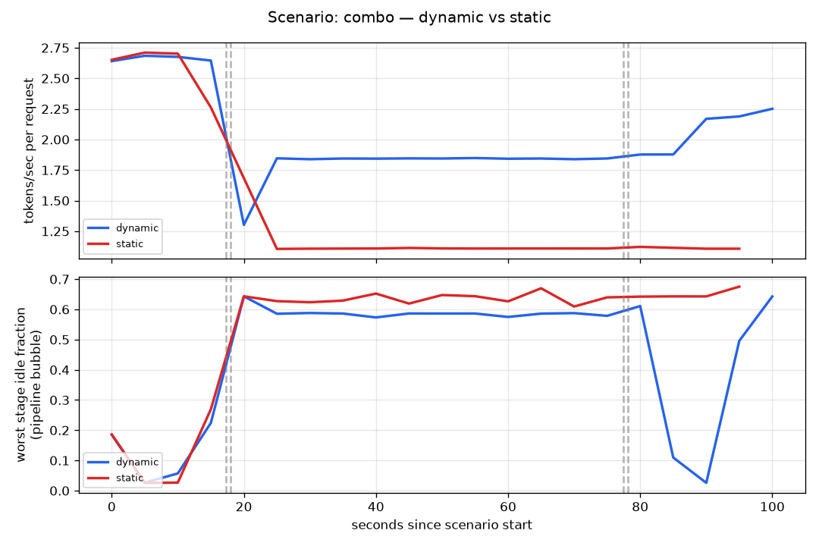
6 · RESULTS
Results: dynamic vs static under each fault
THERMAL
NODE FAILURE
JOINT FAULT
worker2 forced to 92 °C (0.4×). Layers migrate off the hot node within one tick: 6.65 vs 4.25 tok/s.
worker3 stopped. 3 s heartbeat forces a repartition past the gate: 126 requests / 0 errors vs 30 / 18.
netem + thermal together - the test for C3. 2 repartitions vs 0; TTFT p95 547 vs 900 ms.
ONE TRIGGER, THREE FAULT CLASSES
The controller never learns *which* fault it is reacting to. Thermal derating, link degradation and a missing heartbeat all reduce to the same statement - the cost terms changed - and the same response: recompute the split, apply it if the gate allows.
KubeEdgeInfer · eBPF-driven distributed LLM inference
11

Slide 12
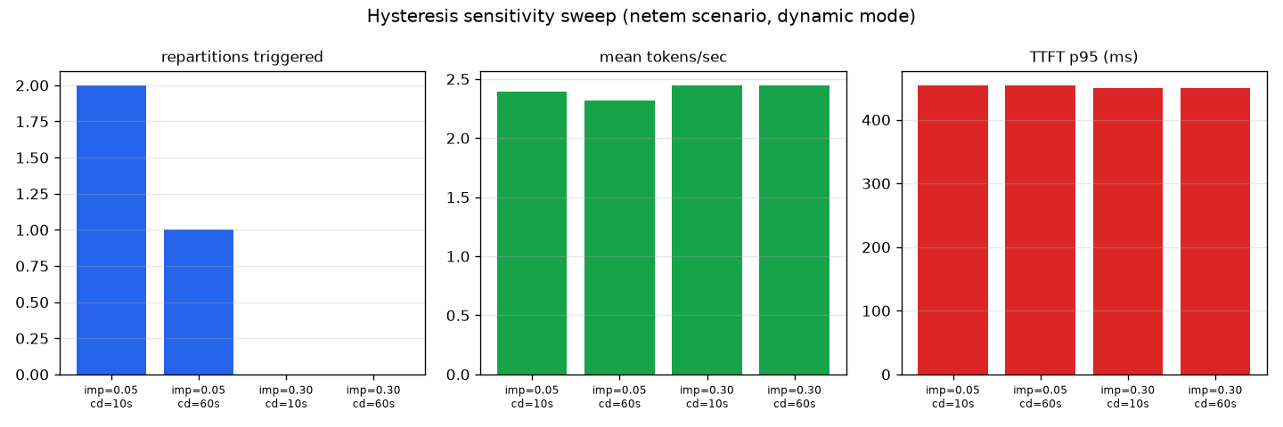
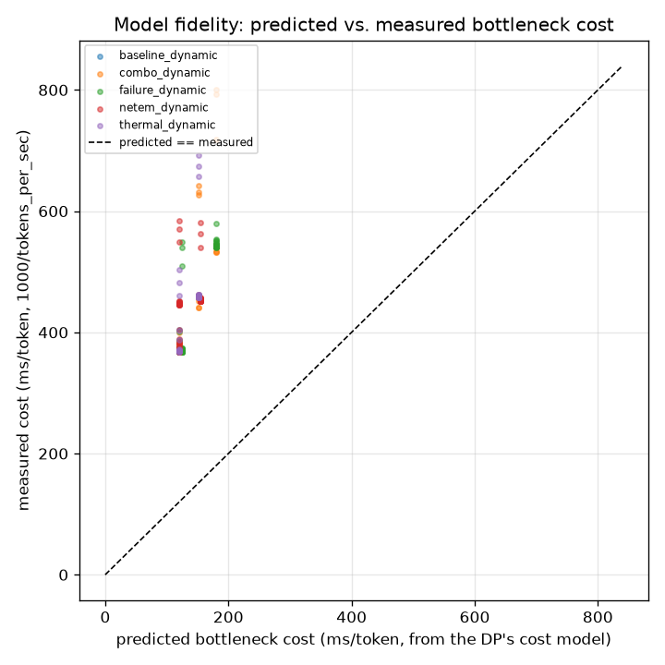
6 · RESULTS
Results: stability, cost-model fidelity, correctness
DOES IT THRASH?
IS THE COST MODEL TRUSTWORTHY?
DOES THE ANSWER CHANGE?
$ python3 bench/verify_gpt2.py
distributed : [11, 314, 716, 257, 1263]
single-proc : [11, 314, 716, 257, 1263]
MATCH
▪ δ ∈ {0.05, 0.30} × τ ∈ {10 s, 60 s} under netem.
▪ Monotonic and stable: lower threshold and cooldown give more repartitions (max 2); δ = 0.30 never triggers.
▪ No thrashing at any setting.
▪ Predicted per-token bottleneck vs measured 1000/tokens_per_sec.
▪ Prediction underestimates by a stable 3.0-3.24× in every scenario.
▪ A stable ratio means the DP ranks stages correctly - all it needs to pick the right split - but misses a near-constant gRPC/interpreter overhead. Reported as a calibration caveat, not a bug.
$ make test
ok internal/partition
TestOptimalMatchesBruteForce
(200 randomised cases)
▪ Distributed output is token-identical to single-process HuggingFace GPT-2 under greedy decoding.
▪ The DP is checked against brute-force enumeration - it returns the exact optimum, not a heuristic.
KubeEdgeInfer · eBPF-driven distributed LLM inference
12

Slide 13
7 · COMPARISON
Comparison: against prior systems, and against static
Capability | Petals | vLLM | EdgeShard | Llumnix | Ours
Heterogeneous edge support | partial | ✗ | ✓ | ✗ | ✓
Kernel-level telemetry (eBPF) | ✗ | ✗ | ✗ | ✗ | ✓
Runtime-continuous repartition | ✗ | ✗ | ✗ once | ✓ req. | ✓ layers
Requires no KV-cache migration | ✓ | n/a | ✓ | ✗ | ✓
Thermal-aware scheduling | ✗ | ✗ | ✗ | ✗ | ✓
Autonomous healing on node loss | ✗ | ✗ | ✗ | partial | ✓
Declarative Kubernetes API | ✗ | ✗ | ✗ | ✗ | ✓
Real heterogeneous-hardware eval | partial | ✓ | ✓ 15 dev. | ✓ | ✗ our gap
Scenario | Metric | Static | Dynamic | Change
baseline | throughput (tok/s) | 8.060 | 8.038 | −0.3%
baseline | TTFT p95 (ms) | 389.0 | 392.3 | +0.8%
netem | throughput (tok/s) | 7.254 | 7.074 | −2.5%
netem | TTFT p95 (ms) | 452.4 | 453.6 | +0.3%
thermal | throughput (tok/s) | 4.245 | 6.647 | +56.6%
thermal | TTFT p95 (ms) | 903.5 | 476.9 | −47.2%
combo | throughput (tok/s) | 4.261 | 6.021 | +41.3%
combo | TTFT p95 (ms) | 900.5 | 547.4 | −39.2%
failure | throughput (tok/s) | 1.434 | 6.548 | +356.6%
failure | TTFT p95 (ms) | 386.4 | 537.8 | +39.2%
failure | failed requests | 18 | 0 | 18 → 0
THE ROW THAT IS NOT IN OUR FAVOUR
The last row is included deliberately. EdgeShard evaluates on 15 physical devices with Llama2-70B; this project on a single-host kind cluster with GPT-2. That is a real gap in evaluation rigour, stated rather than omitted.
Same controller, same load, same hardware - STATIC_MODE=1 is the only difference. It wins on thermal, combo and failure; it is neutral on baseline and netem, which is the correct behaviour there.
KubeEdgeInfer · eBPF-driven distributed LLM inference
13

Slide 14
8-9 · LIMITATIONS & CONCLUSION
Limitations, conclusion and future work
LIMITATIONS - STATED OPENLY
CONCLUSION
▪ Evaluation runs on a single-host kind cluster: loopback network, simulated GPU by default. The real-hardware paths exist and are documented, but the reported numbers are from kind.
▪ No empirical EdgeShard/Petals comparison - different testbeds. Stated rather than approximated with an unfair reimplementation.
▪ GPT-2 scale. The crossover where stateless replay costs more than KV migration is not yet measured.
▪ Cost model is ~3× low in absolute terms - stable ratio, so ranking is correct; a calibration caveat.
▪ The netem ablation was neutral, and the profileonly ablation inconclusive under that fault.
▪ A working system, not a simulation. Real CO-RE eBPF, a real Kubernetes controller and CRD, real gRPC workers, and a harness that injects real faults into a real cluster.
▪ The one-time partition assumption is removable. Stateless workers turn repartitioning from a KV-migration problem into a gRPC call plus a version check - so it can run continuously, at 2 s granularity, on a live pipeline.
▪ It pays off under exactly the faults that motivate it - thermal +57%, joint +41%, node loss 4.6× with zero dropped requests - and costs under 0.5% when nothing is wrong.
▪ Correctness is proved, not assumed - token-identical output, and a partitioner checked against brute force.
FUTURE WORK
1
Measure the replay-vs-migration crossover as context length grows - the experiment that bounds C2.
2
Re-run the telemetry-source ablation under a larger perturbation to isolate C1.
3
Deploy on physical hardware: multi-laptop k3s with GPU_MODE=cputherm, plus an NVIDIA node with real NVML.
4
Scale past GPT-2 to a small Llama variant, narrowing the evaluation gap against EdgeShard.
5
Multi-tenant operation: concurrent InferencePipeline resources sharing one node set.
KubeEdgeInfer · eBPF-driven distributed LLM inference
14

Slide 15
10 · REFERENCES
References
[1] M. Zhang, J. Cao, X. Shen and Z. Cui, “EdgeShard: Efficient LLM Inference via Collaborative Edge Computing,” IEEE Internet of Things Journal, 2024. (arXiv:2405.14371)
[2] S. Ye et al., “Galaxy: A Resource-Efficient Collaborative Edge AI System for In-situ Transformer Inference,” Proc. IEEE INFOCOM, 2024.
[3] A. Borzunov et al., “Petals: Collaborative Inference and Fine-tuning of Large Models,” Proc. ACL 2023 System Demonstrations, 2023.
[4] Y. Mei et al., “Helix: Serving Large Language Models over Heterogeneous GPUs and Network via Max-Flow,” Proc. ACM ASPLOS, 2025.
[5] W. Kwon et al., “Efficient Memory Management for Large Language Model Serving with PagedAttention,” Proc. 29th ACM SOSP, 2023.
[6] Y. Zhong et al., “DistServe: Disaggregating Prefill and Decoding for Goodput-optimized LLM Serving,” Proc. 18th USENIX OSDI, 2024.
[7] P. Patel et al., “Splitwise: Efficient Generative LLM Inference Using Phase Splitting,” Proc. 51st ACM/IEEE ISCA, 2024.
[8] B. Sun et al., “Llumnix: Dynamic Scheduling for Large Language Model Serving,” Proc. 18th USENIX OSDI, 2024.
[9] Y. Fu et al., “ServerlessLLM: Low-Latency Serverless Inference for Large Language Models,” Proc. 18th USENIX OSDI, 2024.
[10] Y. Zhou et al., “Electrode: Accelerating Distributed Protocols with eBPF,” Proc. 20th USENIX NSDI, 2023.
[11] A. Agrawal et al., “Taming Throughput-Latency Tradeoff in LLM Inference with Sarathi-Serve,” Proc. 18th USENIX OSDI, 2024.
[12] Y. Hu et al., “PipeEdge: Pipeline Parallelism for Large-Scale Model Inference on Heterogeneous Edge Devices,” Proc. 25th Euromicro DSD, 2022.
[13] L. Zheng et al., “Alpa: Automating Inter- and Intra-Operator Parallelism for Distributed Deep Learning,” Proc. 16th USENIX OSDI, 2022.
[14] A. Pınar and C. Aykanat, “Fast optimal load balancing algorithms for 1D partitioning,” J. Parallel Distrib. Comput., vol. 64, no. 8, 2004.
[15] S. S. Skiena, The Algorithm Design Manual, 2nd ed. Springer, 2008. (linear partition problem)
[16] A. Radford et al., “Language Models are Unsupervised Multitask Learners,” OpenAI Technical Report, 2019. (GPT-2)
[17] Cilium project, “cilium/ebpf: eBPF library for Go.” github.com/cilium/ebpf
[18] SUSE / Rancher, “k3s: Lightweight Kubernetes.” k3s.io
[19] Kubernetes SIG Testing, “kind: Kubernetes in Docker.” kind.sigs.k8s.io
Section 11 (proposed-work code, Docker/VM configuration and the live demo) is in the companion deck: KubeEdgeInfer_Code_Demo.pptx
KubeEdgeInfer · eBPF-driven distributed LLM inference
15

