Slide 1
PROJECT PRESENTATION
KubeEdgeInfer
A closed-loop, eBPF-driven Kubernetes framework for heterogeneous distributed LLM inference on consumer edge clusters
Karnati Praveen
Repository: github.com/karnati-praveen/ebpf-
August 2026

Slide 2
Agenda
1
Introduction
Why LLM inference must move to the edge
6
Results
Testbed, configuration and 11 measured runs
2
Literature Review
10 systems, 2023-2025
7
Comparison
Against static partitioning and prior systems
3
Problem Statement
The one-time-partition assumption
8
Limitations
Stated openly, not buried
4
Contributions
Four claims, each narrow and defensible
9
Conclusion
What was built and what it demonstrates
5
Proposed Work
WATCH - DECIDE - ACT - HEAL
10
References
Plus a separate live-code demo deck
KubeEdgeInfer · eBPF-driven distributed LLM inference
2

Slide 3
SECTION 1
Introduction
Why distributed inference at the edge is a scheduling problem, not just a placement problem.
KubeEdgeInfer · eBPF-driven distributed LLM inference
3

Slide 4
INTRODUCTION
Large models do not fit on one edge device
▪ A 7B-parameter model at FP16 needs roughly 14 GB of weights alone. A laptop GPU, a Jetson Orin NX or a single rented L4 cannot hold the large models users actually want.
▪ Pipeline parallelism is the standard answer: cut the layer stack into contiguous shards and place each shard on a different machine. The activations, not the weights, cross the network.
▪ Running it at the edge instead of the cloud buys three things that matter in practice:
– Privacy - prompts never leave the local network.
– Latency - no WAN round trip on every token.
– Cost - reuse hardware already owned, with no per-token billing.
▪ Kubernetes is already there. k3s runs on laptops, Jetsons and mini-PCs, and gives scheduling, health checking and a declarative API for free - so the framework is built as a Kubernetes controller rather than beside one.
THE SETUP
Split a 12-block GPT-2 across three commodity machines and each one holds four blocks. The model runs. The question this project asks is what happens next.
PIPELINE PARALLELISM
Node A
layers 0-3
Node B
layers 4-7
Node C
layers 8-11
Activations flow left to right, one hop per token step. The cost of a stage is its compute plus the network hop feeding it.
KubeEdgeInfer · eBPF-driven distributed LLM inference
4

Slide 5
INTRODUCTION
The edge is not a datacenter
Three properties of consumer hardware that break the assumptions every existing pipeline-inference system is built on.
THERMAL
NETWORK
AVAILABILITY
Devices derate under load
Links wander
Nodes disappear
Consumer GPUs and laptop CPUs cannot sustain peak clocks. Under sustained inference they throttle, and a stage that was the fastest becomes the bottleneck - with no change in the workload at all.
WiFi and consumer LAN RTT moves by orders of magnitude with interference, distance and competing traffic. The hop cost in the partition model is not a constant.
Edge nodes are laptops. They get closed, unplugged, suspended and moved out of range. A node leaving is a normal event, not an exception.
THE CONSEQUENCE
A layer partition that is optimal at deployment time is not optimal sixty seconds later. Every system surveyed computes that partition once - from an offline profiling pass - and never revisits it.
KubeEdgeInfer · eBPF-driven distributed LLM inference
5

Slide 6
SECTION 2
Literature Review
Ten systems from 2023-2025 across three communities: edge LLM serving, datacenter LLM serving, and kernel-level telemetry.
KubeEdgeInfer · eBPF-driven distributed LLM inference
6

Slide 7
LITERATURE REVIEW
Related work (1 / 2)
Work (venue, year) | Core idea | Gap this project addresses
[1] EdgeShard IEEE IoT Journal, 2024 | Dynamic-programming joint device selection + layer partition for LLMs on 15 heterogeneous edge devices (Jetson AGX/NX, RTX 3090); Llama2-7B/13B/70B. | The DP runs once, offline, from a one-time profiling pass. No mechanism exists to revisit the split after deployment - by design.
[2] Galaxy IEEE INFOCOM, 2024 | Hybrid tensor + sequence parallelism for in-situ transformer inference across edge devices, with tile-based communication/compute overlap. | Placement is fixed at planning time; no runtime telemetry loop and no response to thermal derating or node loss.
[3] Petals ACL 2023 (Demo) | BitTorrent-style volunteer pipeline over the WAN; clients rent transformer blocks from peers and chain them into a pipeline. | Peer selection uses application-level latency probing only - no kernel telemetry, no thermal signal, no orchestration API.
[4] Helix ACM ASPLOS, 2025 | Max-flow formulation for serving LLMs across heterogeneous GPUs and a heterogeneous network topology. | Solves placement offline per configuration; measured network and thermal drift are not fed back into the solver while serving.
[5] vLLM / PagedAttention ACM SOSP, 2023 | Paged KV-cache memory manager that removes fragmentation and enables continuous batching at high throughput. | Single-node memory management. Orthogonal and complementary - it assumes the model already fits the node set it is given.
KubeEdgeInfer · eBPF-driven distributed LLM inference
7

Slide 8
LITERATURE REVIEW
Related work (2 / 2)
Work (venue, year) | Core idea | Gap this project addresses
[6] DistServe USENIX OSDI, 2024 | Disaggregates the prefill and decode phases onto separate GPUs so each phase can meet its own latency SLO. | Targets datacenter GPUs on a stable fabric; no notion of thermal derating or of a node leaving the cluster.
[7] Splitwise ACM/IEEE ISCA, 2024 | Splits prompt and token phases across two machine pools, transferring KV cache over a high-bandwidth interconnect. | Depends on InfiniBand-class bandwidth that does not exist on a consumer edge LAN.
[8] Llumnix USENIX OSDI, 2024 | Reschedules inference requests across model instances at runtime using live KV-cache migration. | Migrates requests between whole replicas, not layers within one model, and the mechanism is stateful migration.
[9] ServerlessLLM USENIX OSDI, 2024 | Locality-aware checkpoint loading and live migration to cut cold-start cost for serverless LLM inference. | Focused on load/start latency; the partition of a model across nodes is never revisited during serving.
[10] Electrode USENIX NSDI, 2023 | Offloads distributed-protocol fast paths (Paxos) into eBPF programs, approaching kernel-bypass performance. | Establishes eBPF for datapath acceleration, not as a measured cost signal driving a scheduling optimizer.
KubeEdgeInfer · eBPF-driven distributed LLM inference
8

Slide 9
LITERATURE REVIEW
Synthesis: where the gap actually is
Two axes separate the surveyed systems. One cell is empty.
KV-cache migration
Stateless replay (no migration)
not applicable
EdgeShard · PipeEdge · Galaxy Alpa · Petals
Partition solved once from an offline profile.
Static /
one-time partition
Llumnix · ServerlessLLM · AnchorTP
Dynamic, but pays a stateful migration cost.
KubeEdgeInfer (this work)
Continuous repartition made cheap by stateless workers.
Dynamic /
continuous repartition
WHY NOBODY IS HERE
The dynamic + stateless cell is empty because dynamic repartitioning was assumed to require KV-cache migration. Making workers stateless removes that assumption - and with it, the reason the cell was empty.
KubeEdgeInfer · eBPF-driven distributed LLM inference
9

Slide 10
SECTION 3
Problem Statement
KubeEdgeInfer · eBPF-driven distributed LLM inference
10

Slide 11
PROBLEM STATEMENT
Problem statement
RESEARCH QUESTIONS
FORMALLY
RQ1
Can kernel-level measurements be used directly as the cost input to a partition optimiser, rather than as an operator dashboard?
Given a model of L layers and K heterogeneous workers in pipeline order, where worker k has a time-varying effective speed sₖ(t) ∈ (0, 1] and the hop feeding it has a time-varying cost rₖ(t):
find the contiguous partition of layers that minimises the bottleneck stage cost - and keep it minimal continuously, while the pipeline is serving requests, without restarting a single process.
Existing systems solve this at t = 0 only. The variables that make it hard, sₖ(t) and rₖ(t), are exactly the ones they treat as constants.
RQ2
Can a layer partition be changed on a live, serving pipeline without restarting pods and without migrating KV state?
RQ3
Can one hysteresis-gated trigger handle thermal derating, network degradation and node failure uniformly?
RQ4
Does closing the loop actually beat a static partition under fault - and what does it cost when nothing is wrong?
SCOPE
The contribution is not the optimiser. It is re-invoking the optimiser continuously, from live kernel telemetry, on a pipeline that never stops serving.
KubeEdgeInfer · eBPF-driven distributed LLM inference
11

Slide 12
SECTION 4
Contributions
Four claims. Each is deliberately narrow, and each rules out a specific named prior system.
KubeEdgeInfer · eBPF-driven distributed LLM inference
12

Slide 13
NOVELTY
Contributions
C1
Kernel-verified telemetry as an optimiser input
CO-RE eBPF programs (tp_btf/tcp_probe, fentry/tcp_sendmsg) feed per-flow smoothed RTT straight into the partition cost function, evaluated every control tick.
vs. prior work: Cilium, Hubble and Pixie collect eBPF flow data for humans to read. EdgeShard, PipeEdge and Galaxy feed their DP from an offline profile. Neither wires the kernel signal into the optimiser.
C2
Live, generation-fenced repartition with no migration
Layer ranges are reassigned over gRPC on a serving pipeline. Workers are stateless, so correctness needs only full-context replay - verified token-identical to single-process HuggingFace GPT-2.
vs. prior work: Llumnix and AnchorTP also repartition at runtime, but by migrating KV state. This design removes the reason migration seemed necessary.
C3
One hysteresis-gated trigger, three fault classes
Thermal derating, network RTT growth and heartbeat loss all resolve to the same decision: recompute the split, apply it if it improves the bottleneck by >15% and the 30 s cooldown has elapsed.
vs. prior work: TAPAS handles thermal. Tarragon and LUMEN handle failure. Kinitos-style schedulers handle network. No surveyed system unifies all three.
C4
The partition is a first-class Kubernetes resource
An InferencePipeline CRD holds the desired model, backend and layer count; the controller reconciles observed telemetry into a published assignment and generation in .status.
vs. prior work: KServe, Volcano and Ray Serve orchestrate model replicas, not intra-model layer assignment. No equivalent CRD exists.
KubeEdgeInfer · eBPF-driven distributed LLM inference
13

Slide 14
NOVELTY
The novelty in one sentence
“EdgeShard solves where to place each layer once, from an offline profile. We solve when to move it - continuously, from live kernel telemetry - while the pipeline keeps serving requests, without restarting a single pod.”
dynamic
rules out EdgeShard, Galaxy, Alpa, PipeEdge
stateless
rules out Llumnix, AnchorTP, ServerlessLLM
eBPF-driven
rules out every offline-profiling partitioner
K8s-native
rules out Petals, KServe, Ray Serve
Each of the four words is doing real work: remove any one and a named prior system already occupies the position.
KubeEdgeInfer · eBPF-driven distributed LLM inference
14

Slide 15
SECTION 5
Proposed Work
System architecture, the optimiser, and the mechanisms that make a live repartition safe.
KubeEdgeInfer · eBPF-driven distributed LLM inference
15

Slide 16
PROPOSED WORK
System architecture: a control loop, not a planner
01
02
03
04
WATCH
DECIDE
ACT
HEAL
eBPF CO-RE programs on every node
tp_btf/tcp_probe → per-flow sRTT
fentry/tcp_sendmsg → bytes
GPU/thermal via gpu.Reader:
sim | cputherm | nvml
Exact linear-partition DP
O(L²K), minimises bottleneck
Hysteresis gate:
≥ 15% improvement AND
≥ 30 s since last change
Controller pushes new layer
ranges over gRPC - no pod
restart, no model reload
Every assignment carries a
monotonic generation
3 s stale heartbeat ⇒ node
declared gone
Forced repartition across
survivors; router replays
in-flight context
loop repeats every 2 s
Component | Language | Role in the loop
internal/ebpf + cmd/nodeagent | Go + C (CO-RE BPF) | WATCH - loads BPF objects with cilium/ebpf from a privileged DaemonSet; exports flow sRTT and GPU/thermal state over HTTP
internal/partition | Go | DECIDE - exact DP plus the hysteresis Decider; unit-tested against brute force on 200 randomised instances
cmd/controller + internal/controller | Go | ACT / HEAL - aggregates telemetry, reassigns ranges over gRPC, reconciles the InferencePipeline CRD, re-asserts every 10 s
worker/ (server.py, router.py) | Python | Stateless shard workers with sim and gpt2 backends, plus the router that drives stages hub-and-spoke
KubeEdgeInfer · eBPF-driven distributed LLM inference
16

Slide 17
PROPOSED WORK · STAGE 1
WATCH: telemetry from inside the kernel
▪ Two CO-RE BPF programs, compiled against the host BTF and attached from a privileged DaemonSet - one per node.
– tp_btf/tcp_probe reads tcp_sock->srtt_us via BPF_CORE_READ: the kernel's own smoothed RTT, not an application-level guess.
– fentry/tcp_sendmsg accumulates per-flow bytes for throughput.
▪ Flows are keyed by (saddr, daddr, sport, dport) and filtered to worker ports in-kernel, so userspace sees only pipeline traffic.
▪ GPU and thermal state comes from a pluggable gpu.Reader, selected at runtime:
internal/ebpf/bpf/tcpmon.c
SEC("tp_btf/tcp_probe")
int BPF_PROG(tcp_probe_hook, struct sock *sk,
struct sk_buff *skb)
{
struct flow_key key = {};
if (flow_from_sock(sk, &key))
return 0;
struct tcp_sock *tp = (struct tcp_sock *)sk;
// kernel stores srtt << 3 with a fraction
__u32 srtt = BPF_CORE_READ(tp, srtt_us) >> 3;
struct flow_val *val = flow_lookup_or_init(&key);
if (!val)
return 0;
val->srtt_us = srtt;
__sync_fetch_and_add(&val->srtt_samples, 1);
val->last_seen_ns = bpf_ktime_get_ns();
return 0;
}
sim
default; models temperature relaxing to ambient + k·load, driven by the worker's real busy fraction
WHY THIS MATTERS
This sRTT value is not logged for an operator. It becomes rₖ(t) - the hop cost term - in the partition optimiser on the very next tick. That path from kernel probe to scheduling decision is the first contribution.
cputherm
reads real /sys/class/thermal - genuine hardware throttling on any laptop, no discrete GPU needed
nvml
real NVIDIA temperature, VRAM and throttle reasons (-tags gpu, cgo + libnvidia-ml)
KubeEdgeInfer · eBPF-driven distributed LLM inference
17

Slide 18
PROPOSED WORK · STAGE 2
DECIDE: exact partition, gated by hysteresis
COST MODEL
internal/partition/partition.go · Optimal()
// f[j][w] = minimal bottleneck assigning the
// first j layers to the first w workers
f[0][0] = 0
for w in 1..K:
for j in 0..L:
for split in 0..j:
cost = max(f[split][w-1],
stageCost(w-1, j-split))
f[j][w] = min(f[j][w], cost)
// exact optimum in O(L^2 * K)
Stage k holding layers [aₖ, bₖ) costs
Tₖ = (bₖ − aₖ) · c / sₖ(t) + rₖ₋₁(t)
where c is the base per-layer cost, sₖ(t) the live effective speed (throttling included) and rₖ₋₁(t) the measured sRTT of the hop feeding the stage. An empty stage costs zero - not even its hop - so the optimiser can bypass a worker whose link degraded beyond the value of using it at all.
HYSTERESIS GATE - why the loop does not thrash
δ = 15%
A new split is applied only if its bottleneck beats the current split's re-evaluated bottleneck by more than 15%.
τ = 30 s
And only if at least 30 s has passed since the last change. Both tunable live via IMPROVEMENT_FRAC / COOLDOWN_S.
force
Worker-set changes (a node dying) bypass both gates - healing must not wait for a cooldown.
KubeEdgeInfer · eBPF-driven distributed LLM inference
18

Slide 19
PROPOSED WORK · STAGES 3-4
ACT and HEAL: changing a pipeline that is still serving
▪ Generation fencing. Every assignment carries a monotonically increasing generation number. Workers reject any forward stamped with a stale generation; the router then refetches the layout and replays.
▪ Replay is trivially correct because workers are stateless. Each worker recomputes from the full accumulated context, so there is no KV cache to migrate, invalidate or reconcile - the class of bug that makes migration-based repartitioning hard simply does not exist here.
▪ Verified, not asserted. bench/verify_gpt2.py runs the same prompt through the 3-stage distributed pipeline and through single-process HuggingFace GPT-2 and compares greedy output token by token.
▪ Healing. A heartbeat older than 3 s marks a node gone. The worker set changes, which forces a repartition past the hysteresis gate, and the surviving nodes absorb the orphaned layers.
▪ Re-assertion. The controller re-pushes the current layout every 10 s, so a router or worker that restarts is reconciled back into the pipeline instead of being left with an empty layout.
REPARTITION TIMELINE
t+0.0s
node agent reports temp 92 °C, speed derated to 0.4×
t+2.0s
controller tick: DP finds a split 40% better
t+2.0s
hysteresis gate passes (>15%, cooldown elapsed)
t+2.1s
gen++ ; new ranges pushed to every worker over gRPC
t+2.2s
in-flight requests fail the generation check, replay
t+2.3s
pipeline serving on the new split - no pod restarted
THE WHOLE POINT
No pod is restarted, no model is reloaded and no KV cache is moved. The entire mechanism is a gRPC call plus a version check.
KubeEdgeInfer · eBPF-driven distributed LLM inference
19

Slide 20
PROPOSED WORK · STAGE 4
The partition as a declarative Kubernetes resource
deploy/manifests/pipeline.yaml
▪ The user declares what to run. The controller decides how it is laid out, and writes the decision back to .status - assignments, predicted bottleneck and current generation.
▪ That makes the layer partition an observable, reconciled cluster object: kubectl get ipl shows the live split, and every repartition is a status transition rather than an opaque internal event.
▪ Additional printer columns expose Phase, Bottleneck and Generation directly in kubectl output.
▪ No other surveyed system exposes intra-model layer assignment as a Kubernetes API object - KServe, Volcano and Ray Serve all operate at the granularity of a whole model replica.
apiVersion: kubeedgeinfer.io/v1alpha1
kind: InferencePipeline
metadata:
name: demo
namespace: kubeedgeinfer
spec:
model: gpt2
backend: sim # sim | gpt2
totalLayers: 12
perLayerMs: 30 # base per-layer cost
workers: 3
routerAddr: router.kubeedgeinfer.svc:50052
observed state
$ kubectl -n kubeedgeinfer get ipl demo
NAME PHASE BOTTLENECK GENERATION
demo Serving 121.4 7
KubeEdgeInfer · eBPF-driven distributed LLM inference
20

Slide 21
SECTION 6
Results
Full testbed and container configuration, evaluation methodology, and eleven measured runs.
KubeEdgeInfer · eBPF-driven distributed LLM inference
21

Slide 22
RESULTS
Experimental setup: host, VM and containers
Every value below was read from the machine the reported runs executed on.
Layer | Configuration
Host / VM | GitHub Codespaces virtual machine (Microsoft Azure), Ubuntu 24.04.4 LTS
Kernel | 6.8.0-1052-azure, x86_64 · BTF exposed at /sys/kernel/btf/vmlinux (6.02 MB) · cgroup v2
CPU | AMD EPYC 7763 64-Core Processor - 2 vCPU allocated
Memory | 7.76 GiB total
Container runtime | Docker 29.3.0-1 (client and server) · storage driver overlayfs · cgroup driver cgroupfs, v2
Cluster | kind v0.29.0 · kubectl v1.35.2 · 1 control-plane + 3 worker nodes
Node labels | kubeedgeinfer.io/worker=true on all three workers; node-id w1 / w2 / w3
Image | Base → runtime | Contents
worker:dev | python:3.12-slim | grpcio≥1.60, protobuf≥4.25, numpy≥1.26; torch + transformers only when built with WITH_GPT2=1 (WITH_CUDA=1 selects the cu121 wheel)
controller:dev | golang:1.26 → distroless/static-debian12 | CGO_ENABLED=0 static binary; client-go v0.36.2, grpc-go v1.82.0
nodeagent:dev | golang:1.26 → distroless/base-debian12 | cilium/ebpf v0.22.0; glibc base because the -tags gpu NVML build needs cgo and dlopens libnvidia-ml.so
A NOTE ON EBPF UNDER KIND
kind nodes are containers sharing the host kernel, so eBPF tracepoints are kernel-global. Flow keys therefore carry the source IP and the controller attributes each flow to a pod - the same code path used on separate physical machines.
KubeEdgeInfer · eBPF-driven distributed LLM inference
22

Slide 23
RESULTS
Workload, control parameters and fault injection
Parameter | Value
Model | GPT-2 (12 transformer blocks) - totalLayers = 12
Backend | sim for the ablation matrix; gpt2 for the correctness proof
Base per-layer cost | perLayerMs = 30
Workers | 3 shards, one per kind worker node
Load | 3 concurrent client threads, prompt_len = 16, max_new_tokens = 8
Control loop | 2 s tick · re-assert every 10 s
Hysteresis | δ = 0.15 improvement, τ = 30 s cooldown
Heartbeat timeout | 3 s → node declared gone
Scenario | Injection method
baseline | none - steady load only
netem | tc qdisc add dev eth0 root netem delay 80ms inside the kubeedgeinfer-worker2 container
thermal | POST /gpu/override {"temp_c": 92} to the node agent on worker2 → speed derated to 0.4×
failure | docker stop kubeedgeinfer-worker3 (last stage), then restart
combo | netem and thermal injected simultaneously - the joint-fault test for contribution C3
Mode | What it isolates
dynamic | The full closed loop - telemetry, DP, hysteresis, healing.
static | Same controller with STATIC_MODE=1: one equal split at startup, no repartitioning, no healing. The baseline.
profileonly | Repartitions like dynamic but freezes telemetry at the first reading - an in-house approximation of an offline-profiling system (EdgeShard / PipeEdge / Galaxy).
KubeEdgeInfer · eBPF-driven distributed LLM inference
23

Slide 24
RESULTS
Headline result: the loop matters exactly when it should
Throughput of dynamic relative to the static baseline, by scenario. Higher is better; near zero is the correct answer for baseline.
−0%
−2%
+57%
+41%
+357%
BASELINE
no fault - measures the cost of running the loop
NETEM
80 ms on one link - below the 15% gate, no repartition fired
THERMAL
node derated to 0.4× - layers migrate off the hot node
COMBO
netem + thermal together - 2 repartitions
FAILURE
node stopped - static loses 18 requests, dynamic loses none
READING THE NUMBERS
Under thermal derating the closed loop delivers 57% more throughput than the static split; under node failure, 4.6×, with zero failed requests against 18. Under no fault it costs 0.3% - inside run-to-run noise.
AN HONEST NEGATIVE RESULT
The netem row is reported as measured, not as hoped. An 80 ms delay on a single link does not move the bottleneck enough to cross the 15% improvement gate, so no repartition fires and dynamic tracks static to within noise. The gate is behaving correctly - a fault that cannot be improved by moving layers should not cause layers to move.
KubeEdgeInfer · eBPF-driven distributed LLM inference
24

Slide 25
RESULTS
Complete measurement matrix
All 11 runs from bench/results/summary.json. Requests are 8-token completions at 3-way concurrency.
Scenario | Mode | Req OK | Req err | Throughput (tok/s) | TTFT mean (ms) | TTFT p95 (ms) | Repart.
baseline | dynamic | 63 | 0 | 8.038 | 377.2 | 392.3 | –
baseline | static | 63 | 0 | 8.060 | 377.0 | 389.0 | –
netem | dynamic | 90 | 0 | 7.074 | 418.0 | 453.6 | –
netem | static | 93 | 0 | 7.254 | 416.0 | 452.4 | –
netem | profileonly | 93 | 0 | 7.239 | 416.9 | 452.6 | 0
thermal | dynamic | 84 | 0 | 6.647 | 457.7 | 476.9 | –
thermal | static | 54 | 0 | 4.245 | 701.9 | 903.5 | –
failure | dynamic | 126 | 0 | 6.548 | 452.1 | 537.8 | –
failure | static | 30 | 18 | 1.434 | 382.3 | 386.4 | –
combo | dynamic | 78 | 0 | 6.021 | 495.7 | 547.4 | 2
combo | static | 54 | 0 | 4.261 | 679.4 | 900.5 | 0
DO NOT MISREAD THIS ROW
failure/static reports a better TTFT p95 (386 ms) than failure/dynamic (538 ms) purely because it only completed 30 of its requests - the 18 that hit the dead node errored out and never produced a latency sample at all.
KubeEdgeInfer · eBPF-driven distributed LLM inference
25

Slide 26
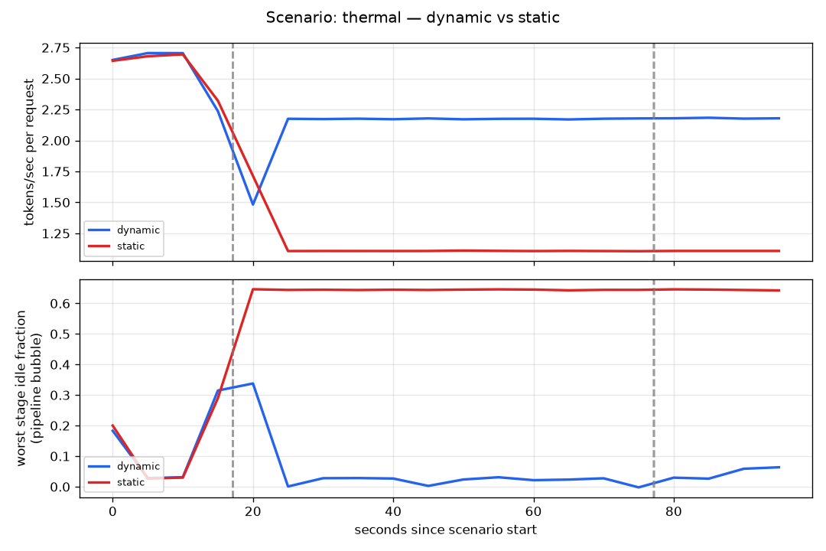
RESULTS
Thermal derating: layers migrate off the hot node
▪ The static split keeps four layers on a node running at 0.4× for the whole fault window; its bottleneck stage simply absorbs the derating.
▪ The dynamic loop detects the derated speed within one 2 s tick, recomputes, clears the 15% gate and moves layers onto the two healthy nodes.
▪ Throughput: 6.647 vs 4.245 tok/s (+57%).
▪ TTFT p95: 477 ms vs 904 ms (−47%).
▪ This is the cleanest demonstration of the loop: a fault that layer movement can genuinely fix, and it fixes it.
bench/results/thermal.png - worker2 forced to 92 °C (0.4× speed) during the shaded fault window.
KubeEdgeInfer · eBPF-driven distributed LLM inference
26

Slide 27
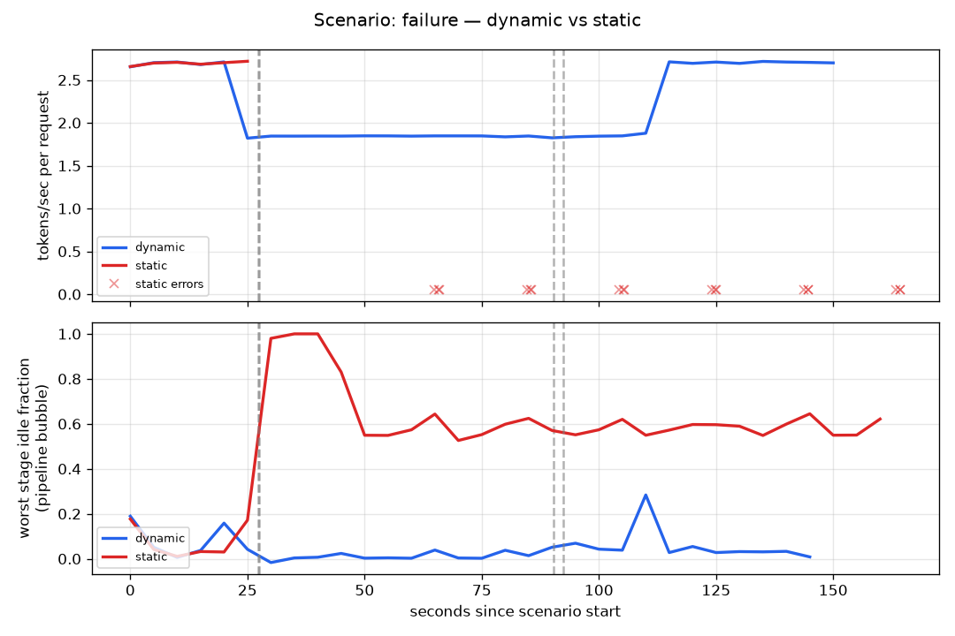
RESULTS
Node failure: healing without lost requests
▪ A heartbeat older than 3 s marks the node gone. The worker-set change forces a repartition past the hysteresis gate - healing does not wait for a cooldown.
▪ Dynamic: 126 requests completed, 0 errors.
▪ Static: 30 completed, 18 errors - it has no mechanism to notice the stage is gone.
▪ Throughput ratio 4.57×, but the error count is the result that actually matters: an edge cluster where a closed laptop drops requests is not deployable.
bench/results/failure.png - kubeedgeinfer-worker3 (last stage) stopped and later restarted.
KubeEdgeInfer · eBPF-driven distributed LLM inference
27

Slide 28
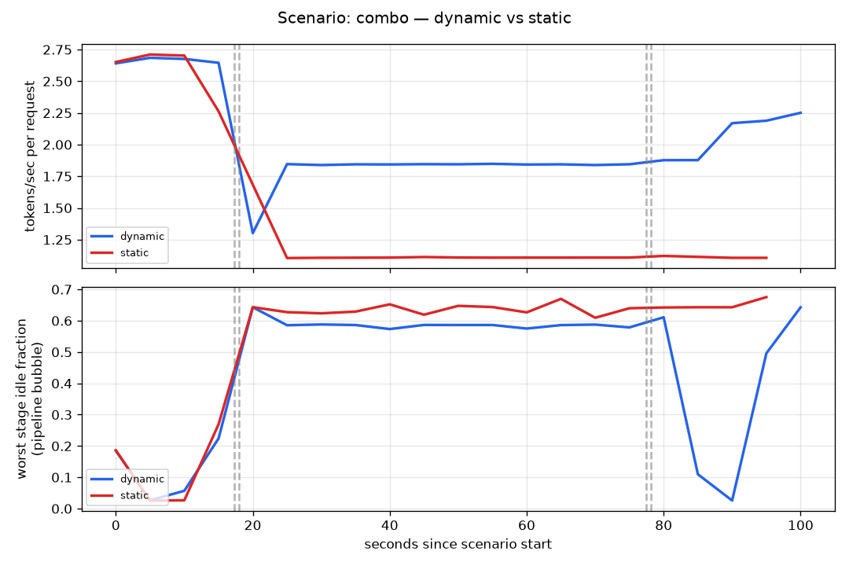
RESULTS
Joint fault: two fault classes, one trigger
▪ This run exists specifically to test contribution C3: that a single hysteresis-gated trigger handles multiple fault classes without special-casing them.
▪ Dynamic performed 2 repartitions; static performed 0.
▪ Throughput 6.021 vs 4.261 tok/s (+41%).
▪ TTFT p95 547 ms vs 900 ms.
▪ The controller does not know which fault it is reacting to. Both faults reduce to the same thing: the cost terms changed, so recompute the split.
bench/results/combo.png - 80 ms netem and a 92 °C thermal override injected simultaneously.
KubeEdgeInfer · eBPF-driven distributed LLM inference
28

Slide 29
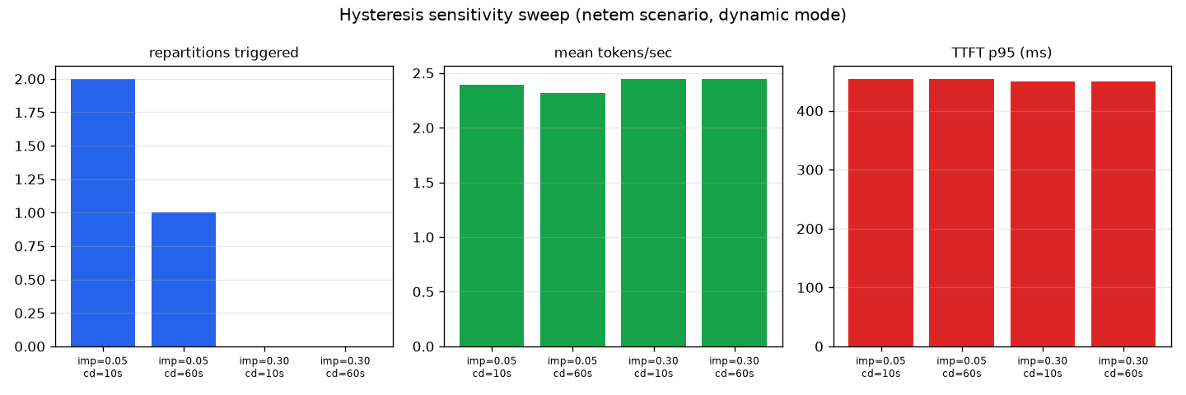
RESULTS
Sensitivity: does the loop thrash?
bench/results/hysteresis_sweep.png - improvement threshold δ ∈ {0.05, 0.30} × cooldown τ ∈ {10 s, 60 s}, under the netem fault.
HYSTERESIS SWEEP
Behaviour is monotonic and stable: a lower threshold and shorter cooldown produce more repartitions (up to 2), while δ = 0.30 never triggers at all. No thrashing was observed at any setting. Throughput and TTFT stay nearly flat across the grid, consistent with the netem fault being too small to be worth acting on.
KubeEdgeInfer · eBPF-driven distributed LLM inference
29

Slide 30
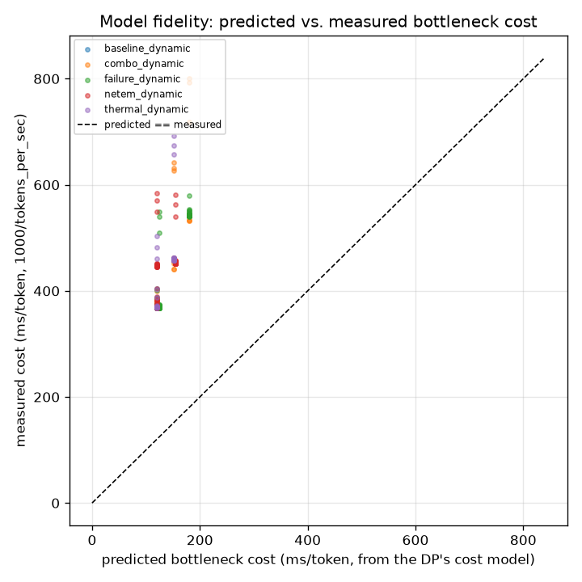
RESULTS
Model fidelity: is the DP's cost model trustworthy?
▪ The optimiser's predicted per-token bottleneck cost is correlated against measured 1000 / tokens_per_sec from data the dynamic runs already collected.
▪ Finding: prediction underestimates measurement by a stable 3.0-3.24× across every scenario.
▪ A stable ratio means the DP ranks stages correctly - which is all it needs to choose the right partition - but misses a roughly constant per-token overhead, most likely gRPC and interpreter cost not represented in the cost model.
▪ Reported as a calibration caveat, not a correctness bug: the bottleneck number is a ranking signal, not a calibrated latency prediction.
bench/results/fidelity.png
KubeEdgeInfer · eBPF-driven distributed LLM inference
30

Slide 31
RESULTS
Correctness: distributed output is token-identical
Repartitioning is only interesting if the answer does not change.
▪ Workers hold no KV cache. Each shard recomputes from the full accumulated context on every token step, so a mid-generation repartition is indistinguishable from having started with the new split.
▪ bench/verify_gpt2.py runs the identical prompt through:
– the 3-stage distributed pipeline (layers 0-3 / 4-7 / 8-11), and
– single-process HuggingFace GPT-2 with greedy decoding,
▪ then compares the emitted token IDs element by element. It prints MATCH only on an exact match.
▪ The optimiser is also verified. The DP is unit-tested against a brute-force enumeration of every contiguous partition on 200 randomised instances - it returns the exact optimum, not a heuristic approximation.
token-identical output
$ python3 bench/verify_gpt2.py
distributed : [11, 314, 716, 257, 1263, 4336]
single-proc : [11, 314, 716, 257, 1263, 4336]
MATCH
optimiser unit tests
$ make test
ok kubeedgeinfer/internal/partition
TestOptimalMatchesBruteForce (200 cases)
TestDeciderHysteresis
TestEmptyStageBypass
KubeEdgeInfer · eBPF-driven distributed LLM inference
31

Slide 32
SECTION 7
Comparison
Against the static baseline quantitatively, and against prior systems by capability.
KubeEdgeInfer · eBPF-driven distributed LLM inference
32

Slide 33
COMPARISON
Capability comparison against prior systems
Capability | Petals | vLLM | EdgeShard | Llumnix | KubeEdgeInfer
Heterogeneous edge support | partial | ✗ | ✓ | ✗ | ✓
Kernel-level telemetry (eBPF) | ✗ | ✗ | ✗ | ✗ | ✓
Runtime-continuous repartition | ✗ | ✗ | ✗ (offline, once) | ✓ (requests) | ✓ (layers)
Requires no KV-cache migration | ✓ | n/a | ✓ | ✗ | ✓
Thermal-aware scheduling | ✗ | ✗ | ✗ | ✗ | ✓
Autonomous healing on node loss | ✗ | ✗ | ✗ | partial | ✓
Declarative Kubernetes API | ✗ | ✗ | ✗ | ✗ | ✓
Real heterogeneous-hardware eval | partial | ✓ | ✓ (15 devices) | ✓ | ✗ (current gap)
THE ROW THAT IS NOT IN OUR FAVOUR
The last row is included deliberately. EdgeShard evaluates on 15 physical devices with Llama2-70B; this project evaluates on a single-host kind cluster with GPT-2. That is a real gap in evaluation rigour and is stated as one rather than omitted.
KubeEdgeInfer · eBPF-driven distributed LLM inference
33

Slide 34
COMPARISON
Quantitative comparison: dynamic vs static baseline
Same controller, same load, same hardware - STATIC_MODE=1 is the only difference.
Scenario | Metric | Static | Dynamic | Change
baseline | throughput (tok/s) | 8.060 | 8.038 | −0.3%
baseline | TTFT p95 (ms) | 389.0 | 392.3 | +0.8%
netem | throughput (tok/s) | 7.254 | 7.074 | −2.5%
netem | TTFT p95 (ms) | 452.4 | 453.6 | +0.3%
thermal | throughput (tok/s) | 4.245 | 6.647 | +56.6%
thermal | TTFT p95 (ms) | 903.5 | 476.9 | −47.2%
combo | throughput (tok/s) | 4.261 | 6.021 | +41.3%
combo | TTFT p95 (ms) | 900.5 | 547.4 | −39.2%
failure | throughput (tok/s) | 1.434 | 6.548 | +356.6%
failure | TTFT p95 (ms) | 386.4 | 537.8 | +39.2%
failure | failed requests | 18 | 0 | 18 → 0
▪ Where it wins: thermal, combo and failure - faults that moving layers can actually fix.
▪ Where it is neutral: baseline and netem - and neutral is the correct behaviour there.
▪ What it costs: under 0.5% throughput with no fault present. The loop is not paid for in the common case.
▪ profileonly - the offline-profile ablation - matched static to within noise under netem, so contribution C1 is not yet demonstrated by that specific experiment. Re-running it under thermal or combo is the next step.
KubeEdgeInfer · eBPF-driven distributed LLM inference
34

Slide 35
COMPARISON
Limitations, stated openly
What a reviewer would ask first, answered before they ask.
Limitation | Position taken
Evaluation runs on a single-host kind cluster, not physical machines | Network hops are loopback-speed and the GPU is simulated by default. The real-hardware code paths exist and are documented (k3s multi-node, GPU_MODE=cputherm for laptops, GPU_MODE=nvml for NVIDIA), but the reported numbers are from kind.
No empirical comparison against EdgeShard or Petals | Different testbeds - EdgeShard uses 15 physical Jetsons. Stated as a limitation rather than approximated with an unfair reimplementation. The profileonly mode is an in-house stand-in for the offline-profiling design, not for EdgeShard itself.
Model scale is GPT-2, not a modern 7B+ model | Stateless replay is cheap at this scale. The crossover point where replay becomes more expensive than KV migration is not yet measured - this is the single most important follow-up experiment.
Cost model underestimates absolute latency by ~3× | The ratio is stable across all scenarios, so relative ranking - which is what the DP needs - is correct. Treated as a calibration caveat.
The netem ablation produced a neutral result | An 80 ms single-link delay does not cross the improvement gate. Reported as measured; a larger perturbation is needed to isolate the value of continuous telemetry specifically.
KubeEdgeInfer · eBPF-driven distributed LLM inference
35

Slide 36
SECTION 8
Conclusion
KubeEdgeInfer · eBPF-driven distributed LLM inference
36

Slide 37
CONCLUSION
Conclusion
▪ A working system, not a simulation. Real CO-RE eBPF programs, a real Kubernetes controller with a real CRD, real gRPC workers, and an ablation harness that injects real faults into a real cluster.
▪ The one-time partition assumption is removable. Making workers stateless turns repartitioning from a KV-migration problem into a gRPC call plus a version check - so it can be done continuously, on a live pipeline, at 2-second granularity.
▪ Closing the loop pays off under exactly the faults that motivate it - thermal derating (+57%), joint faults (+41%) and node loss (4.6× with zero dropped requests) - and costs under 0.5% when nothing is wrong.
▪ Correctness is proved, not assumed. Distributed output is token-identical to single-process HuggingFace GPT-2, and the partitioner is checked against brute force.
▪ The honest gaps are named: single-host evaluation, GPT-2 scale, no direct EdgeShard comparison, and one ablation that returned a neutral result.
FUTURE WORK
1
Measure the replay-vs-migration crossover as context length grows - the experiment that bounds contribution C2.
2
Re-run the telemetry-source ablation under a larger perturbation to isolate contribution C1.
3
Deploy on physical hardware: multi-laptop k3s with GPU_MODE=cputherm, and an NVIDIA node with real NVML.
4
Scale past GPT-2 to a small Llama variant to narrow the evaluation gap against EdgeShard.
5
Multi-tenant operation: two or more concurrent InferencePipeline resources sharing one node set.
KubeEdgeInfer · eBPF-driven distributed LLM inference
37

Slide 38
SECTION 9
References
KubeEdgeInfer · eBPF-driven distributed LLM inference
38

Slide 39
REFERENCES
References (1 / 2)
[1] M. Zhang, J. Cao, X. Shen and Z. Cui, “EdgeShard: Efficient LLM Inference via Collaborative Edge Computing,” IEEE Internet of Things Journal, 2024. (arXiv:2405.14371)
[2] S. Ye et al., “Galaxy: A Resource-Efficient Collaborative Edge AI System for In-situ Transformer Inference,” in Proc. IEEE INFOCOM, 2024.
[3] A. Borzunov et al., “Petals: Collaborative Inference and Fine-tuning of Large Models,” in Proc. ACL 2023 System Demonstrations, 2023.
[4] Y. Mei et al., “Helix: Serving Large Language Models over Heterogeneous GPUs and Network via Max-Flow,” in Proc. ACM ASPLOS, 2025.
[5] W. Kwon et al., “Efficient Memory Management for Large Language Model Serving with PagedAttention,” in Proc. 29th ACM SOSP, 2023.
[6] Y. Zhong et al., “DistServe: Disaggregating Prefill and Decoding for Goodput-optimized Large Language Model Serving,” in Proc. 18th USENIX OSDI, 2024.
[7] P. Patel et al., “Splitwise: Efficient Generative LLM Inference Using Phase Splitting,” in Proc. 51st ACM/IEEE ISCA, 2024.
[8] B. Sun et al., “Llumnix: Dynamic Scheduling for Large Language Model Serving,” in Proc. 18th USENIX OSDI, 2024.
[9] Y. Fu et al., “ServerlessLLM: Low-Latency Serverless Inference for Large Language Models,” in Proc. 18th USENIX OSDI, 2024.
KubeEdgeInfer · eBPF-driven distributed LLM inference
39

Slide 40
REFERENCES
References (2 / 2)
[10] Y. Zhou et al., “Electrode: Accelerating Distributed Protocols with eBPF,” in Proc. 20th USENIX NSDI, 2023.
[11] A. Agrawal et al., “Taming Throughput-Latency Tradeoff in LLM Inference with Sarathi-Serve,” in Proc. 18th USENIX OSDI, 2024.
[12] Y. Hu et al., “PipeEdge: Pipeline Parallelism for Large-Scale Model Inference on Heterogeneous Edge Devices,” in Proc. 25th Euromicro DSD, 2022.
[13] L. Zheng et al., “Alpa: Automating Inter- and Intra-Operator Parallelism for Distributed Deep Learning,” in Proc. 16th USENIX OSDI, 2022.
[14] A. Pınar and C. Aykanat, “Fast optimal load balancing algorithms for 1D partitioning,” J. Parallel Distrib. Comput., vol. 64, no. 8, pp. 974-996, 2004.
[15] S. S. Skiena, The Algorithm Design Manual, 2nd ed. London: Springer, 2008. (linear partition problem)
[16] A. Radford et al., “Language Models are Unsupervised Multitask Learners,” OpenAI Technical Report, 2019. (GPT-2)
[17] Cilium project, “cilium/ebpf: eBPF library for Go.” https://github.com/cilium/ebpf
[18] SUSE / Rancher, “k3s: Lightweight Kubernetes.” https://k3s.io
[19] Kubernetes SIG Testing, “kind: Kubernetes in Docker.” https://kind.sigs.k8s.io
KubeEdgeInfer · eBPF-driven distributed LLM inference
40

Slide 41
Thank you
The live code walkthrough and demo continue in the companion deck:
KubeEdgeInfer_Code_Demo.pptx
github.com/karnati-praveen/ebpf- · ./run-demo.sh
KubeEdgeInfer · eBPF-driven distributed LLM inference
41

