Slide 1

Design and Implementation of a Computer Training Center Management System CSA0409-OPERATING SYSTEMS
Presented by:
K.Jaya Venkata sai (192525182)
K.Nikhil (192525307)
G.Koushik (192524238)
GUIDED BY:
Dr .S.Sundar Rajan

Slide 2


CONTENTS
Introduction
Objectives
Problem statement
Abstract
Literature review
Modules
System architecture
Result
Future scope
Conclusion
References

Slide 3

INTRODUCTION
A Computer Training Center Management System is designed to automate the daily operations of a computer training institute.
The system helps manage student records, course details, trainer information, fee payments, attendance, and examination details in a centralized database.
It reduces manual paperwork, improves accuracy, saves time, and provides quick access to information.
The project uses Operating System concepts such as file management, process management, user authentication, and resource management to efficiently handle multiple users and data simultaneously.
The system provides a secure and user-friendly environment for administrators, trainers, and students.

Slide 4
ABSTRACT
The Computer Training Center Management System is a software application developed to simplify the management of training institutes.
The system maintains information about students, trainers, courses, batches, attendance, fee payments, and examinations in a digital format.
It eliminates manual record keeping, minimizes errors, and improves operational efficiency.
The application provides secure login access for administrators and allows easy retrieval, updating, and storage of information.
By implementing this system, training centers can improve productivity, reduce administrative workload, and provide better services to students.

Slide 5
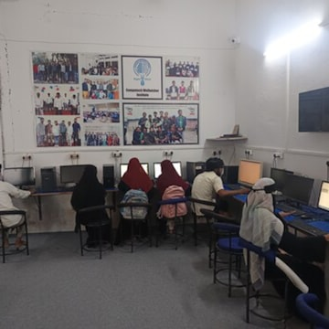
OBJECTIVES
To develop a computerized system for managing the daily operations of a computer training center.
To automate the student registration and admission process.
To maintain a centralized database for students, faculty, courses, and batches.
To simplify batch allocation and class scheduling.

Slide 6
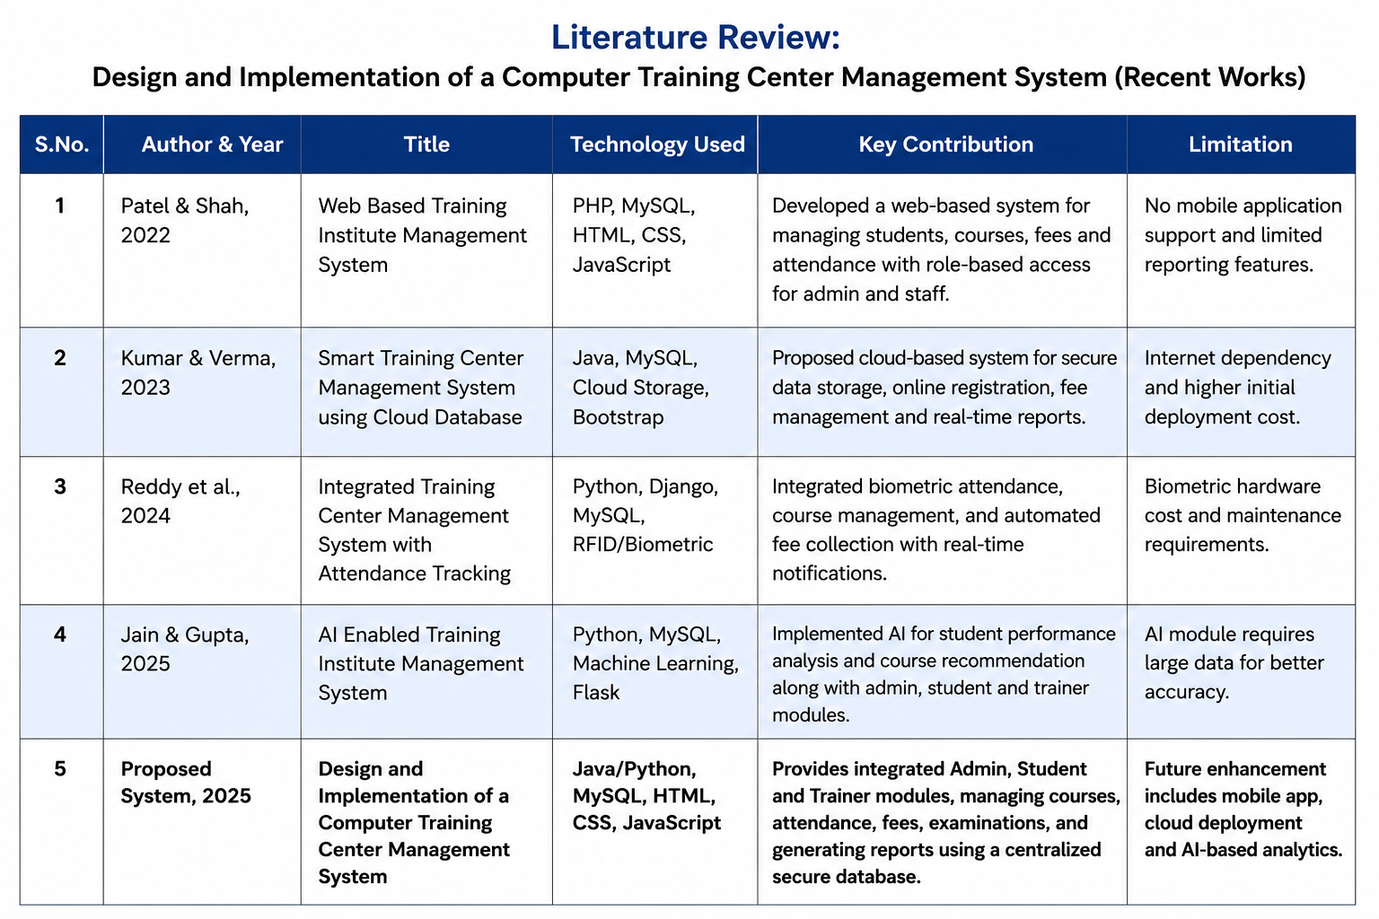
LITERATURE REVIEW

Slide 7
PROBLEM STATEMENT
Most computer training centers still rely on manual registers and paper-based records to manage student information, attendance, fees, and course details. Managing student admissions, batch allocation, and class schedules manually is time-consuming and often leads to errors.
Training center owners face difficulties in tracking student enrollment, attendance, fee payments, and overall center activities.
Faculty members do not have a centralized system to plan daily lessons, record completed topics, assign homework, and monitor student progress.
Students cannot easily view their attendance, completed topics, assignments, practice hours, and course progress in one place.
Manual record management increases the chances of data duplication, data loss, and inaccurate information.
Communication between the administrator, faculty, and students is often inefficient due to the lack of an integrated system.

Slide 8

MODULE-1
Admin Module
Responsibilities:
Secure admin login
Add, update, and delete student records
Add and manage trainers
Create and manage courses
Create training batches
Manage fee details
View attendance reports
Schedule examinations
Generate reports
Manage the overall system

Slide 9

MODULE-2
Student Module
Responsibilities:
Student login
View personal profile
Register for courses
View batch details
Check attendance
View fee payment status
View examination schedule
Check results
Download certificates (if available)
Update basic profile information

Slide 10
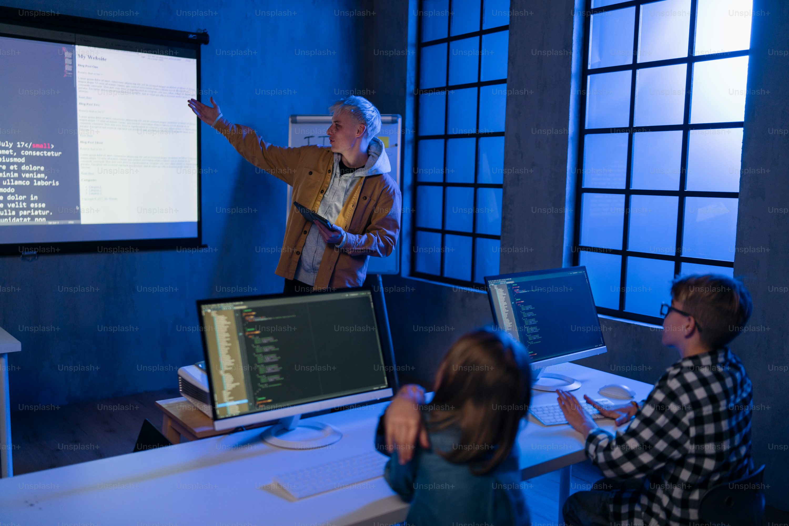
MODULE-3
Faculty Module
Responsibilities:
Faculty login
View assigned courses and batches
Mark student attendance
Upload study materials
Update class schedules
Conduct online/offline assessments
Enter student marks
View student progress
Send announcements to students

Slide 11
Tools Used
Programming Language: Java / Python
Frontend: HTML, CSS, JavaScript
Backend: Java (JSP/Servlets) or Python (Flask/Django)
Database: MySQL
Development Environment: Visual Studio Code / Eclipse / IntelliJ IDEA
Techniques Used
User Authentication – Secure login for Admin, Faculty, and Students.
Database Management – Store and manage student, faculty, batch, and course information.
Role-Based Access Control (RBAC) – Different access permissions for Admin, Faculty, and Students.

Slide 12
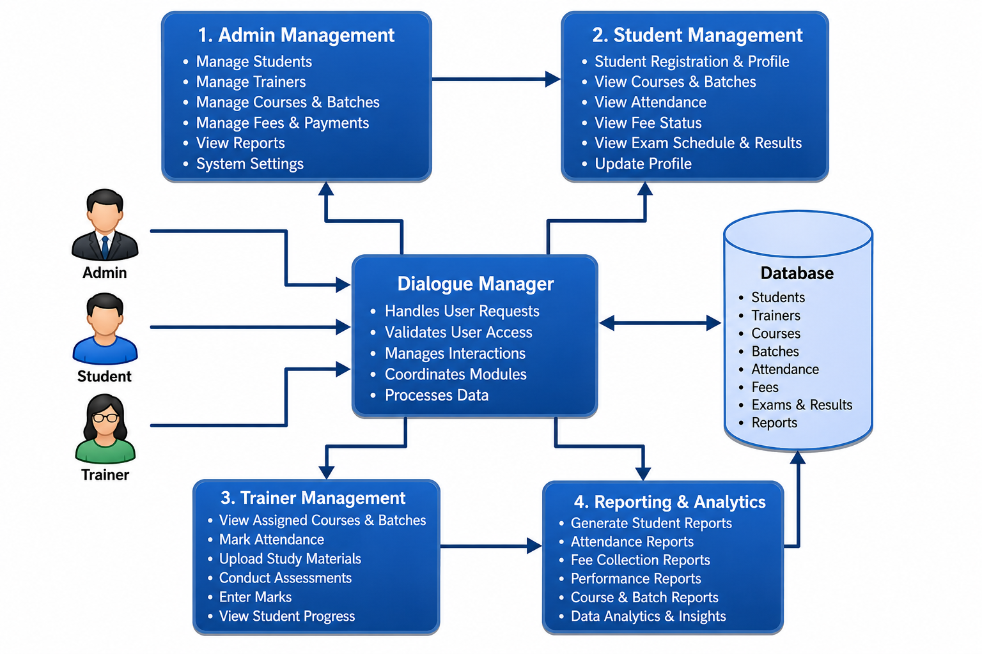
SYSTEM ARCHITECTURE

Slide 13
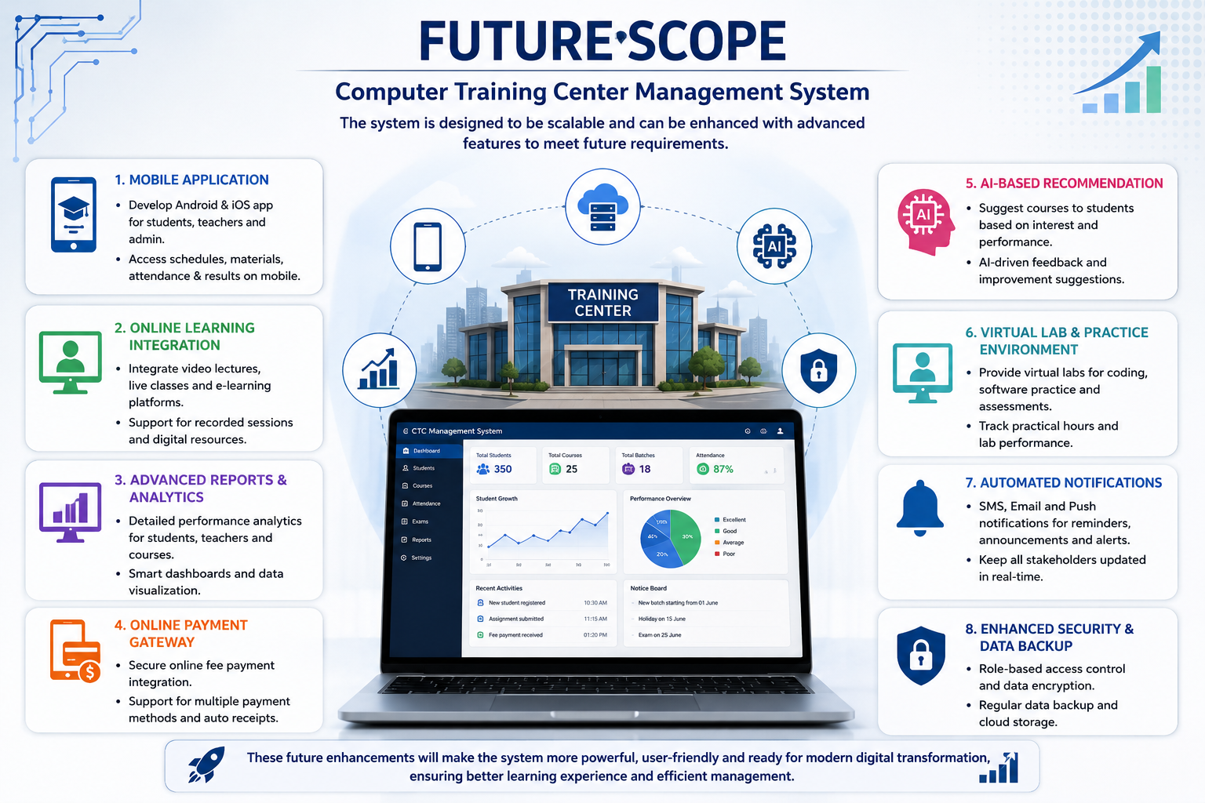
FUTURE SCOPE
Develop a mobile application for Android and iOS to access the system anytime.
Integrate online course registration and admission management.
Add online fee payment through UPI, credit/debit cards, and net banking.
Implement biometric or facial recognition attendance for accurate attendance tracking. Send SMS and email notifications for attendance, fee reminders, and examination updates.
Introduce an AI-based student performance analysis system to identify learning progress. Add online examination and certification features.
Store data on the cloud for secure backup and remote accessibility. Include role-based access control with enhanced security and encryption.

Slide 14
CONCLUSION
The Computer Training Center Management System successfully automates the day-to-day operations of a computer training institute.
It simplifies the management of students, trainers, courses, attendance, fees, and examination records.
The system reduces manual paperwork, minimizes human errors, and improves the accuracy of data management.
It provides secure access to users through authentication and maintains records in a centralized database.
The project demonstrates how software applications and Operating System concepts can be used to improve the efficiency and reliability of training center management.
Overall, the system saves time, increases productivity, and enhances the overall learning and administrative experience.

Slide 15
REFERENCES
H. Huang and B. Li, "Design and Implementation of Student Management System of Integrated Programmable Device Programming System," Scientific Reports, vol. 14, Art. no. 11873, May 2024.
F. Shwedeh and H. M. Alzoubi, "Applying Artificial Intelligence in Database Management Systems to Mitigate the Difficulties Encountered in Training Institutions' Systems," in Innovative Dynamics in Management and Engineering (IDME). Cham, Switzerland: Springer Nature, 2025.
X. Xu et al., "Research on Education Management System Based on Machine Learning and Multidimensional Data Modeling," Applied Mathematics and Nonlinear Sciences, 2023.
S. Kumar, S. Mangal, and A. Singh, "Supervision of College Management Using Database Management System," Journal of Advances in Database Management Systems, vol. 11, no. 2, 2024.
K. Shelke, Y. Khan, and A. S. Kapse, "Student Management System: A Web-Based Solution for Academic Administration," International Journal of Scientific Research in Science and Technology, vol. 12, no. 3, pp. 50–54, 2025.

Slide 16
THANK YOU

