Slide 1
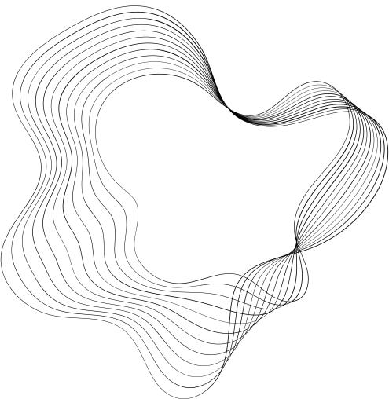

Clinical Natural Language Processing (NLP) in Healthcare
-SHASHANK REDDY KARNATI

Slide 2
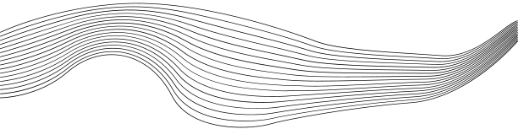
CONTENT
01
INTRODUCTION TO CLINICAL NLP
02
EVOLUTION OF NLP IN HEALTHCARE
03
CURRENT STATE OF THE ART
04
PROOF OF CONCEPT OVERVIEW
05
RELEVANT TRENDS
06
OPPORTUNITIES AND THREATS
07
CONCLUSION

Slide 3

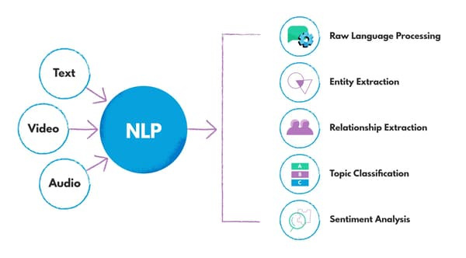


WHAT IS CLINICAL NLP?
Definition: Clinical Natural Language Processing (NLP) is the application of NLP techniques to healthcare data, particularly unstructured clinical text, to extract meaningful information.
CUSTOMERS

Slide 4


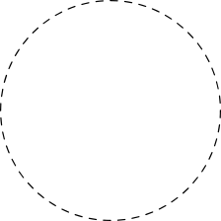


EVOLUTION OF NLP IN HEALTHCARE - PAST APPROACHES
Optical Character Recognition (OCR)
Computer Vision
Rule-Based Systems
Initial NLP applications in healthcare relied heavily on rule-based systems, using hand-crafted rules and lexicons to extract information from clinical texts. These systems were limited in scalability and adaptability to new terminologies.
Primarily used for digitizing printed medical documents, converting images of text into machine-encoded text. These systems struggled with complex layouts and handwritten notes.
Applied for image enhancement and basic analysis, such as edge detection and segmentation, with limited diagnostic capabilities.

Slide 5

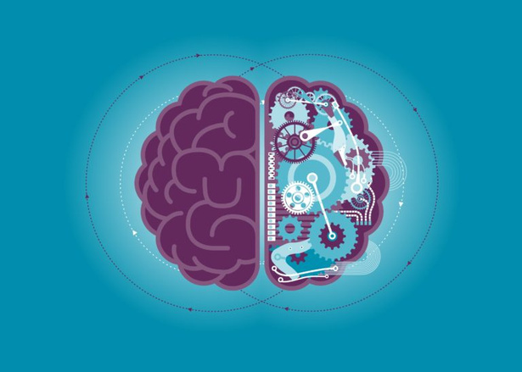
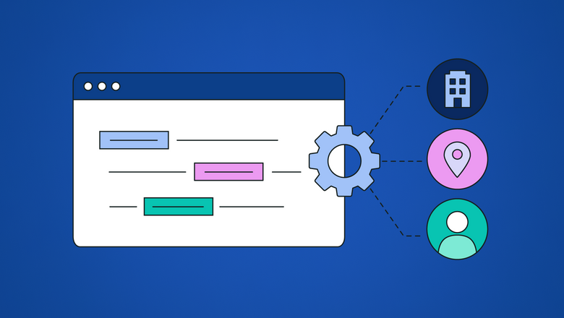
CURRENT STATE OF THE ART
Machine Learning-Based Models
Revolutionary impact on healthcare NLP
Utilization of models like BERT and BioBERT
Training on large medical text corpora
Enhanced context understanding and entity extraction
Named Entity Recognition (NER)
Advanced systems for identifying and classifying medical entities
Focuses on diseases, symptoms, and treatments in clinical notes
Improves data structuring and retrieval in healthcare settings

Slide 6
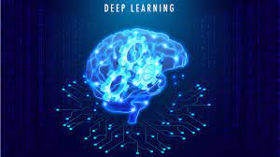
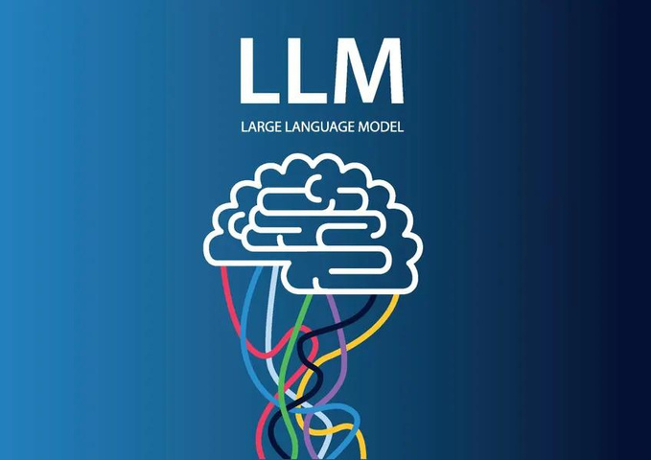
CURRENT STATE OF THE ART
Deep Learning Models
Extensively used for diagnostic imaging tasks
Applications include:
Tumor detection
Retinal image classification
Key advantages:
High accuracy
High specificity
LLM &LMM
Text Generation and Analysis
LLMs like GPT-4 and BioGPT employed for
Generating patient summaries
Extracting clinical insights
Supporting decision-making
Multimodal Integration
Enable comprehensive healthcare analysis
LMMs combine text and image data analysis

Slide 7
CLINICAL NLP PROOF OF CONCEPT
The Clinical NLP Proof of Concept (POC) aims to enhance the efficiency of healthcare professionals in processing and analyzing unstructured clinical data. By leveraging advanced technologies in Natural Language Processing (NLP) and Computer Vision, the POC provides automated insights from clinical documents and images, thereby improving patient care and operational workflows.

Slide 8
TECHNOLOGIES INVOLVED:
NATURAL LANGUAGE PROCESSING (NLP)
OPTICAL CHARACTER RECOGNITION (OCR)
COMPUTER VISION
LARGE LANGUAGE MODELS (LLMS)
FLASK (WEB FRAMEWORK)
TECH STACK:
PYTHON
FLASK
TRANSFORMERS (NLP TASKS)
PYTESSERACT (OCR)
OPENCV (IMAGE PROCESSING)
PYPDF2 (PDF HANDLING)
SPACY (NLP)

Slide 9
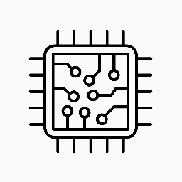
ARCHITECTURE
The architecture comprises several modules:
Data Ingestion Module: Handles text and file uploads.
NLP Processing Module: Extracts entities and analyzes sentiment.
Multimodal Integration Module: Processes images and combines text and image data.
Clinical Decision Support Module: Generates insights and summaries.
Web Interface: User-friendly interface built with Flask.

Slide 10
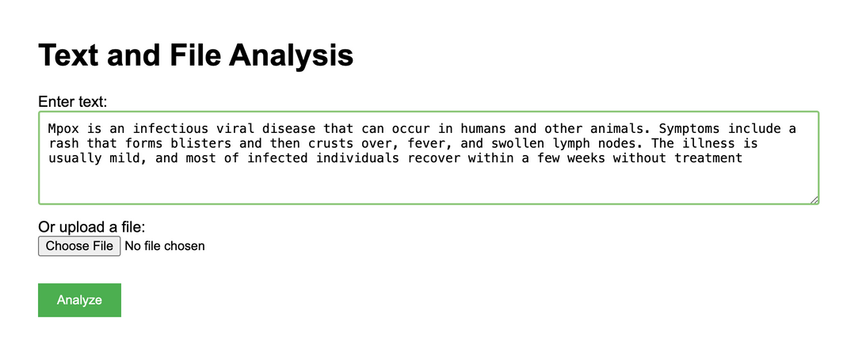
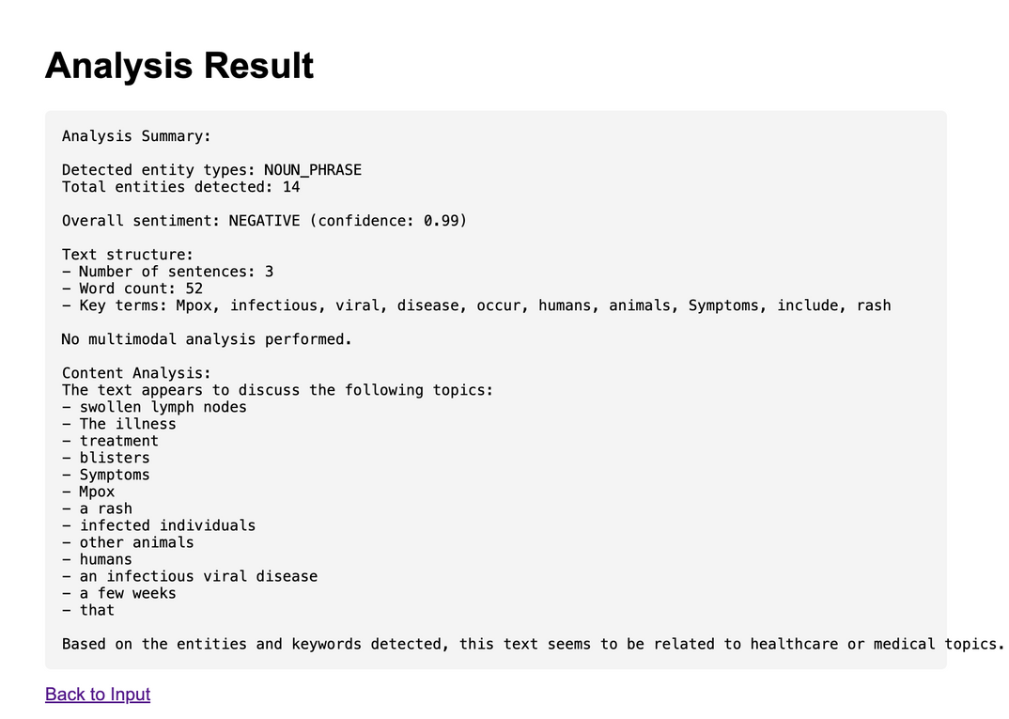
WORKING MODELS

Slide 11
IMPLEMENTATION FLOW
Python: Used as the primary programming language for implementing the POC.
Flask: Employed as the web framework to create the user interface and handle HTTP requests.
Transformers library: Utilized for NLP tasks such as entity recognition and sentiment analysis, leveraging pre-trained models.
PyTesseract: Implemented for Optical Character Recognition (OCR) to extract text from uploaded images.
OpenCV: Used for image processing tasks, potentially preprocessing images before OCR or further analysis.
PyPDF2: Employed to handle and extract text from PDF documents uploaded to the system.
spaCy: Utilized for additional NLP tasks such as tokenization, part-of-speech tagging, and possibly named entity recognition.
NLTK (Natural Language Toolkit): While not explicitly mentioned, it's commonly used alongside spaCy for various NLP tasks.
Scikit-learn: Likely used for any machine learning models that don't require deep learning, such as text classification or clustering.
TensorFlow or PyTorch: While not specified, one of these deep learning frameworks may be used for implementing more complex NLP models.

Slide 12



RELEVANT TRENDS
AI in healthcare market to reach $45.2 billion by 2026 (source: MarketsandMarkets)
The COVID-19 pandemic has accelerated telemedicine adoption, increasing the demand for NLP technologies to analyze patient interactions and support virtual consultations effectively.
NLP is used to extract actionable insights from EHR data, improving clinical workflows and patient outcomes.
AI AND ML IN HEALTHCARE
RISE OF TELEMEDICINE
EHR OPTIMIZATION

Slide 13
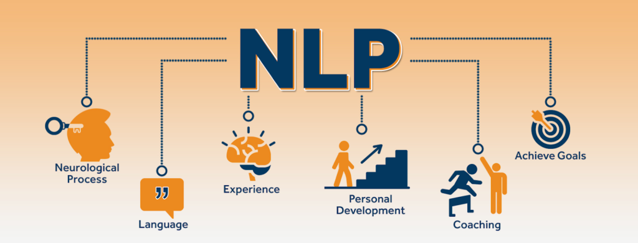
OPPORTUNITIES
IMPROVED CLINICAL DECISION SUPPORT
ENHANCED RESEARCH CAPABILITIES
STREAMLINED ADMINISTRATIVE PROCESSES
PERSONALIZED PATIENT CARE

Slide 14
THREATS
DATA PRIVACY CONCERNS: THE USE OF AI TECHNOLOGIES IN HEALTH CARE RAISES CONCERNS ABOUT DATA PRIVACY AND SECURITY, ESPECIALLY WHEN HANDLING SENSITIVE PATIENT INFORMATION.
BIAS IN AI MODELS: AI MODELS, INCLUDING NLP AND LMMS, MAY INHERIT BIASES FROM THE DATA THEY ARE TRAINED ON, POTENTIALLY LEADING TO BIASED DECISION-MAKING IN CLINICAL SETTINGS.
INTEGRATION CHALLENGES: INTEGRATING ADVANCED TECHNOLOGIES INTO EXISTING HEALTH CARE SYSTEMS CAN BE CHALLENGING, REQUIRING SIGNIFICANT INVESTMENT IN INFRASTRUCTURE AND TRAINING.
REGULATORY HURDLES: NAVIGATING THE REGULATORY LANDSCAPE FOR AI IN HEALTH CARE CAN BE COMPLEX, WITH EVOLVING STANDARDS AND REQUIREMENTS THAT MUST BE MET.

Slide 15
FUTURE PROSPECTS
CONTEXTUAL UNDERSTANDING IN NLP
ADVANCED DOCUMENT UNDERSTANDING IN OCR
PREDICTIVE ANALYTICS AND AR IN COMPUTER VISION
PERSONALIZED MEDICINE WITH LLMS AND LMMS
EXAMPLE: AR-GUIDED SURGERY WITH REAL-TIME NLP ASSISTANCE

Slide 16

THANK YOU

