Slide 1
Home Assignment 3
CSCE451: OS Principles

Slide 2
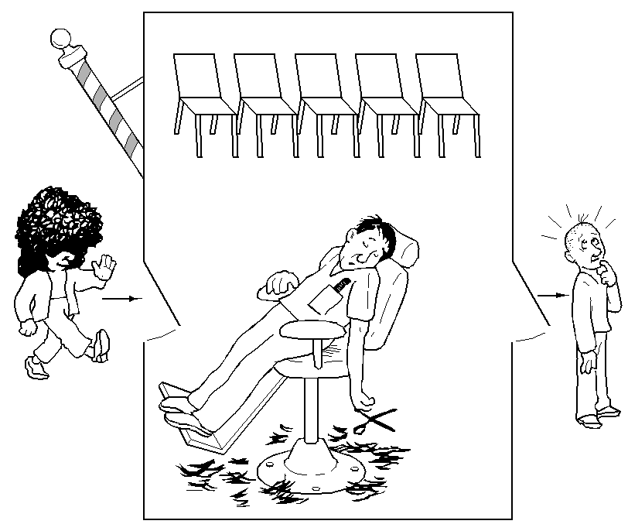
The Sleeping Barber Problem (1)
Barber is sleeping when there is no customer.
When a customer arrives, he/she sits on a waiting chair if at least one is available. Otherwise, the customer leaves.
If the customer is the first one, he/she wakes up the barber and continues to wait.
The barber gets ready then takes a customer from the chair.
The barber cuts the customer’s hair.
The barber checks for more customers. If none, go to sleep.

Slide 3
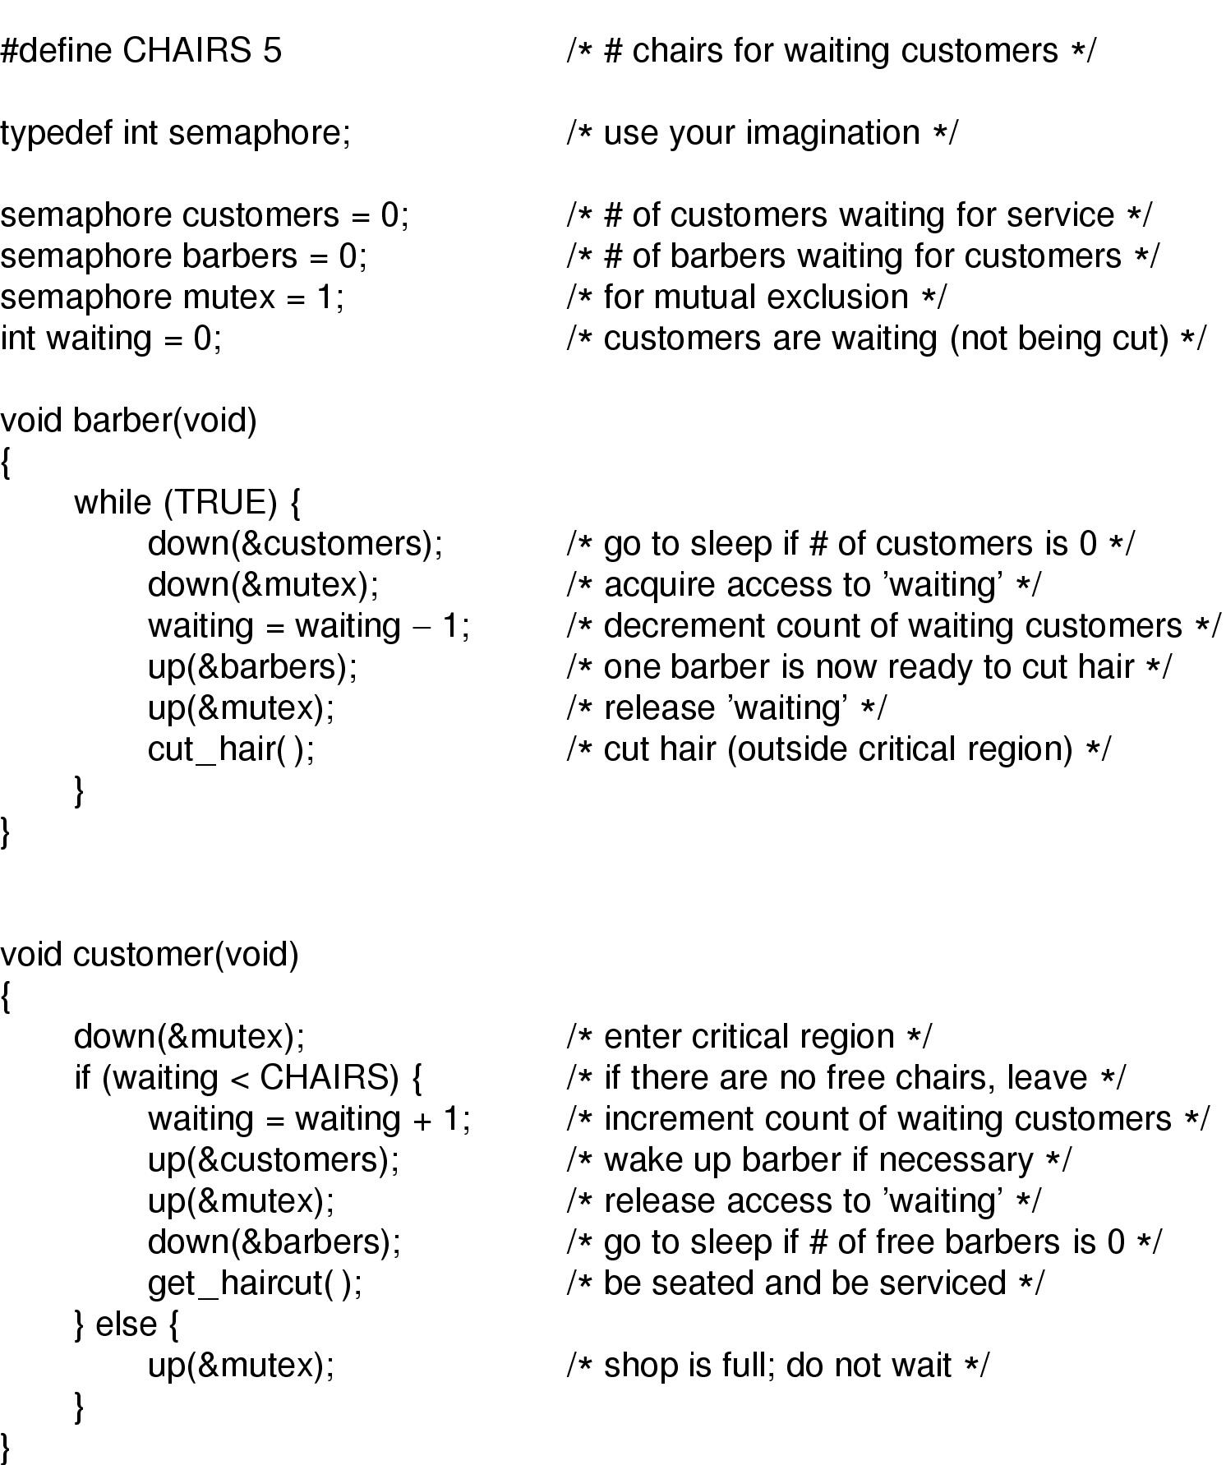
The Sleeping Barber Problem (2)

Slide 4
#DEFINE chairs 7
sem mutex = 1, cust =0, barber = 0
int waiting = 0
1.
Barber ()
down(cust)
3.
barber ()
down(mutex)
waiting = 0
up(barber)
//awake cust1
up(mutex)
cut_hair()
5.
Customer1 ()
get_haircut()
…
7.
Customer2 ()
get_haircut()
…
No customer, block
Out of quantum
Out of quantum
2.
Customer1 ()
down(mutex)
waiting = 1
up(cust)
//awake barber
up(mutex)
down(barber)
6.
barber ()
down(cust)
down(mutex)
waiting = 0
up(barber)
//awake cust2
up(mutex)
cut_hair()
8.
Barber ()
down(cust)
//back to sleep
Out of quantum
4.
Customer2 ()
down(mutex)
waiting = 1
up(cust)
up(mutex)
down(barber)
Block on barber
Out of quantum
Block on barber

