Slide 1

Streamline Dining
Karneet Arora, Pablo Hernandez, Justice Jubilee, Harman Kailey, Srinu Koritela , Talya Kornbluth, Max Lightman, Joel Usita, Eugene Langmer

Slide 2
Problem Description
Humans in Food services are prone to errors due to miscommunications.
Customers desire to be given a list of ingredients and Servers can only write down as well as they can hear.
Most food services rely on taking orders on a notepad and chefs being able to read the servers handwriting.
Food services need to have an inventory of fresh food.
Customers feedback, normally customers leave feedback by taking surveys or leaving a written note
For employees to know their schedules they must check with managers.

Slide 3
How We Solve These Issues
Having a mutual platform.
Having an inventory, where authorized personal can interact and be able to add or remove items based on the physical inventory.
Application which provides customers a way of leaving feedback that requires little effort, customers will be able to see a completed menu with all ingredients.
Taking orders will be done by selecting an item, which can be done by the customer or the server.
Having an employee page where they will be able to see their schedules.

Slide 4
Who Our Product Is For
Owners who want to have a more efficient way to run their business
Managers benefit from our platform by making it easier to keep track of the dynamic environment the restaurant is
Customers can have a quick and Streamlined Dining ;D experience
Employees can utilize the app for employee information as well as to make their jobs easier to complete
Chefs
Servers
Hosts

Slide 5
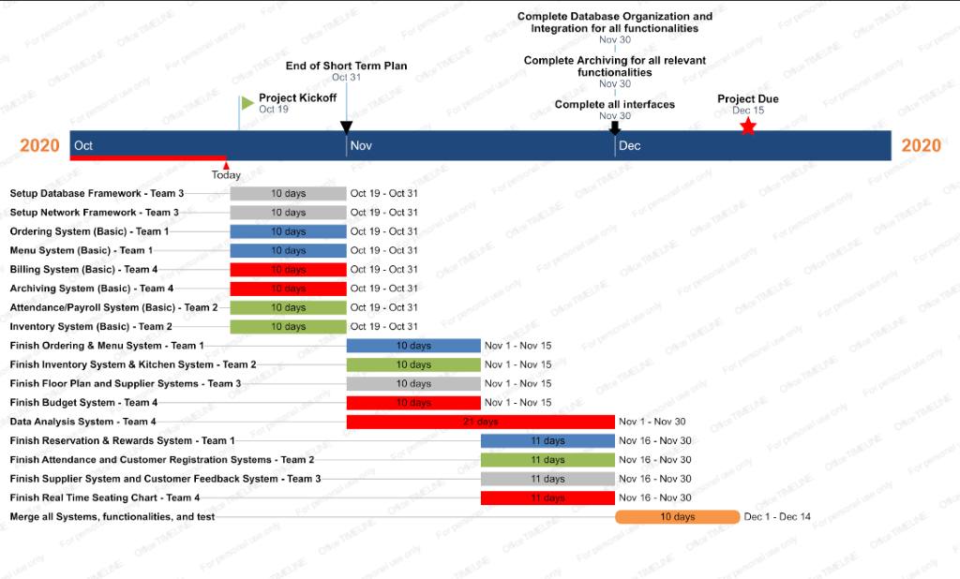
Project Roadmap

