Slide 1

Streamline Dining
Karneet Arora, Pablo Hernandez, Justice Jubilee, Harman Kailey, Srinu Koritela , Talya Kornbluth, Max Lightman, Joel Usita, Eugene Langmer

Slide 2
Who Our Product Is For
Owners who want to have a more efficient way to run their business
Managers benefit from our platform by making it easier to keep track of the dynamic environment the restaurant is
Customers can have a quick and Streamlined Dining experience
Employees can utilize the system for employee information as well as to make their jobs easier to complete
Chefs
Servers
Hosts

Slide 3
Features
Employees will be able to clock in/out.
Inventory
Menu with ingredients
Work schedule
Customers Feedback
Special request on food items

Slide 4
Updates from Demo 1
Inventory: Managers will have the ability to see and edit a Food inventory.
Kitchen interface - Chef screen with orders from Customers with any special request, will also have table number, or take-out in case it is not a dine-in meal.
Employees will see a real-time Floor plan.
Kitchen Display where Chefs see new orders, and information such as any special request from customer
Customers will have a Feedback screen.

Slide 5
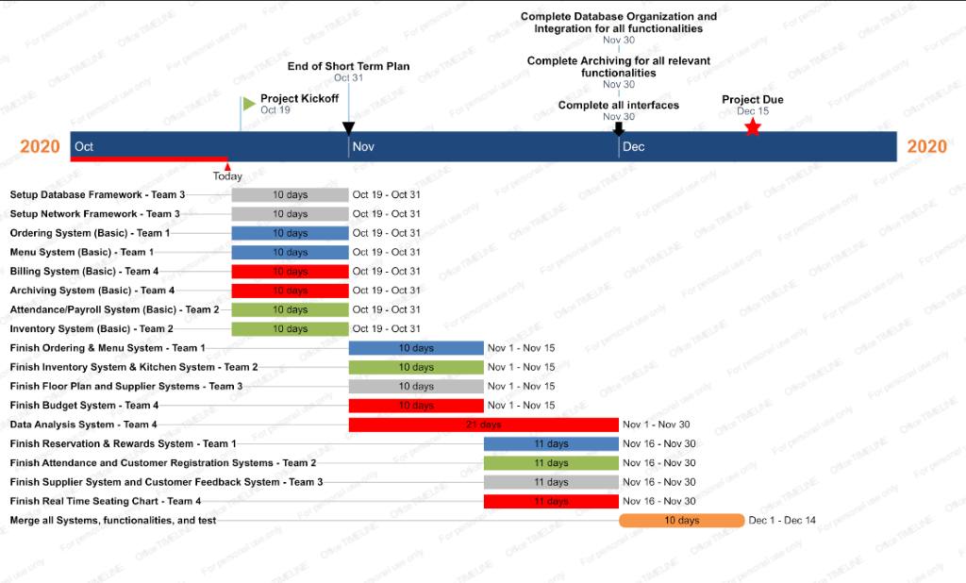
Project Roadmap

