Slide 1
Geometric Algebra in Haskell
Dr Chris Doran
Arm & Cambridge University
Haskell Exchange
2017

Slide 2

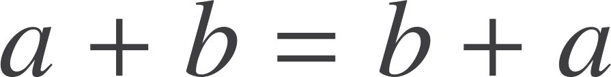
What is a vector?
A vector is a directed line segment (for now, at least)
This is not a vector:
This is a vector:
b
b
c
b+c
a
a+b
a
a+b
a
a+b+c
b

Slide 3
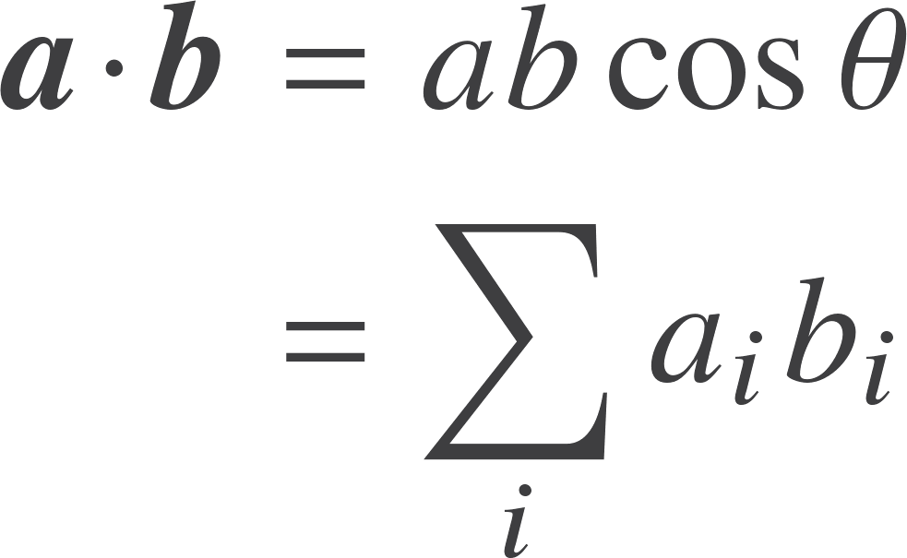
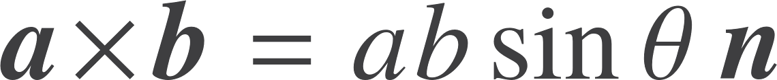
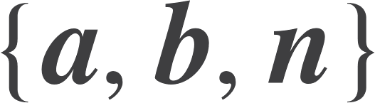
The problem
How do you multiply together two vectors?
Inner product
Cross product
Commutative
Returns a scalar
Anti-commutative
Returns a vector perpendicular to a plane
Right-handed set

Slide 4
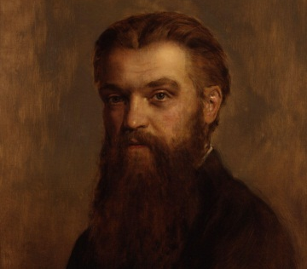

Geometric algebra
W.K. Clifford (1845-1879) introduced the geometric product of two vectors.
The product of two vectors is the sum of a scalar and a bivector.
Think of the sum as like the real and imaginary parts of a complex number.

Slide 5
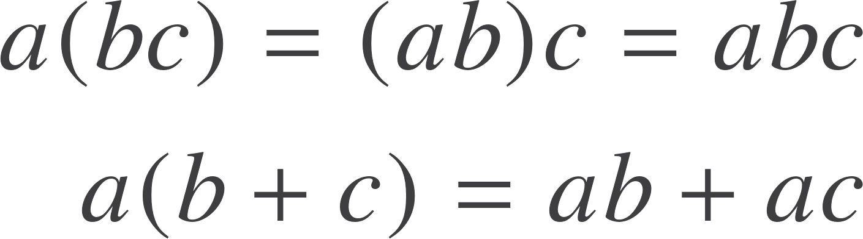
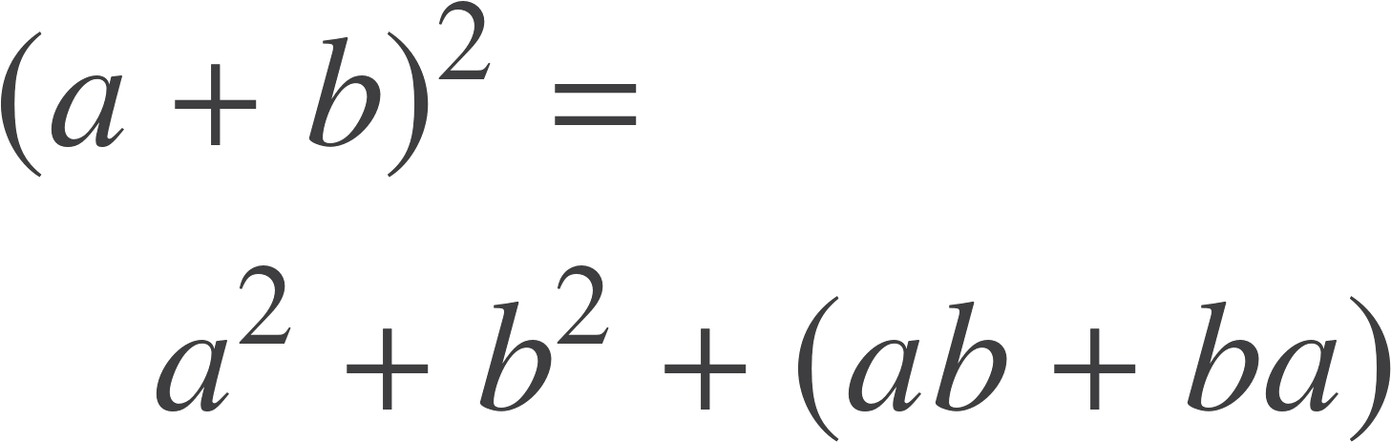
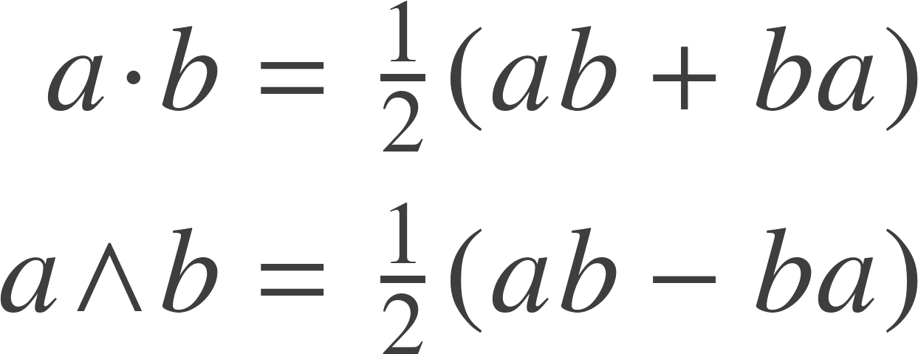
The rules
The geometric product
The geometric product is associative and distributive over addition.
The square of any vector is a scalar. This makes the product invertible.
Define the inner (scalar) and outer products in terms of the geometric product.
Guaranteed to be a scalar

Slide 6


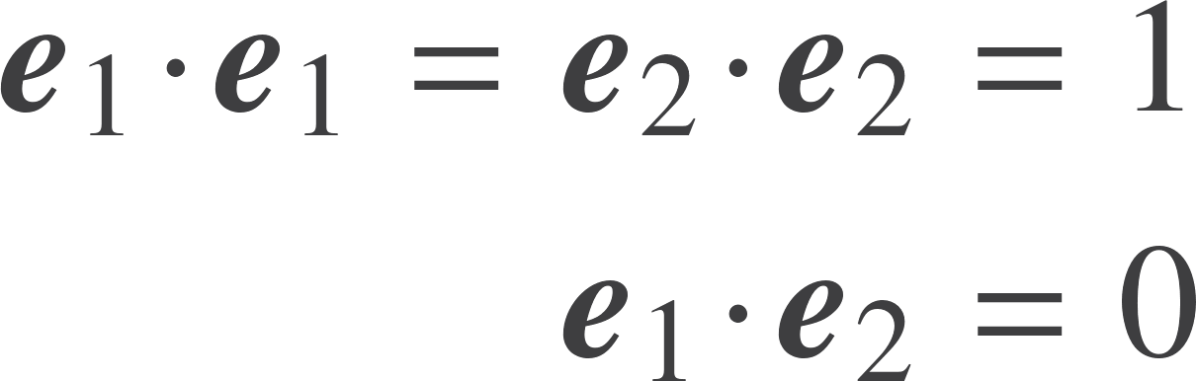
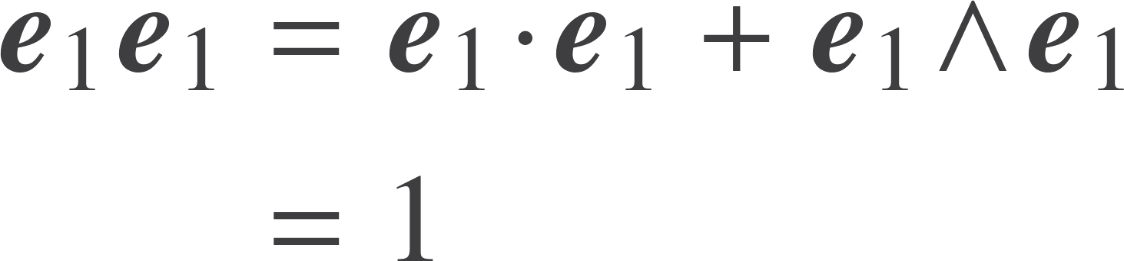
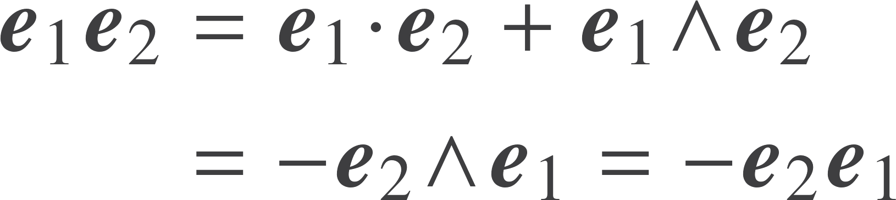
Two dimensions
2D sufficient to understand basic results. Construct an orthonormal basis.
Parallel vectors commute.
Orthogonal vectors anti-commute. This is the key property. We build everything up from this idea.

Slide 7
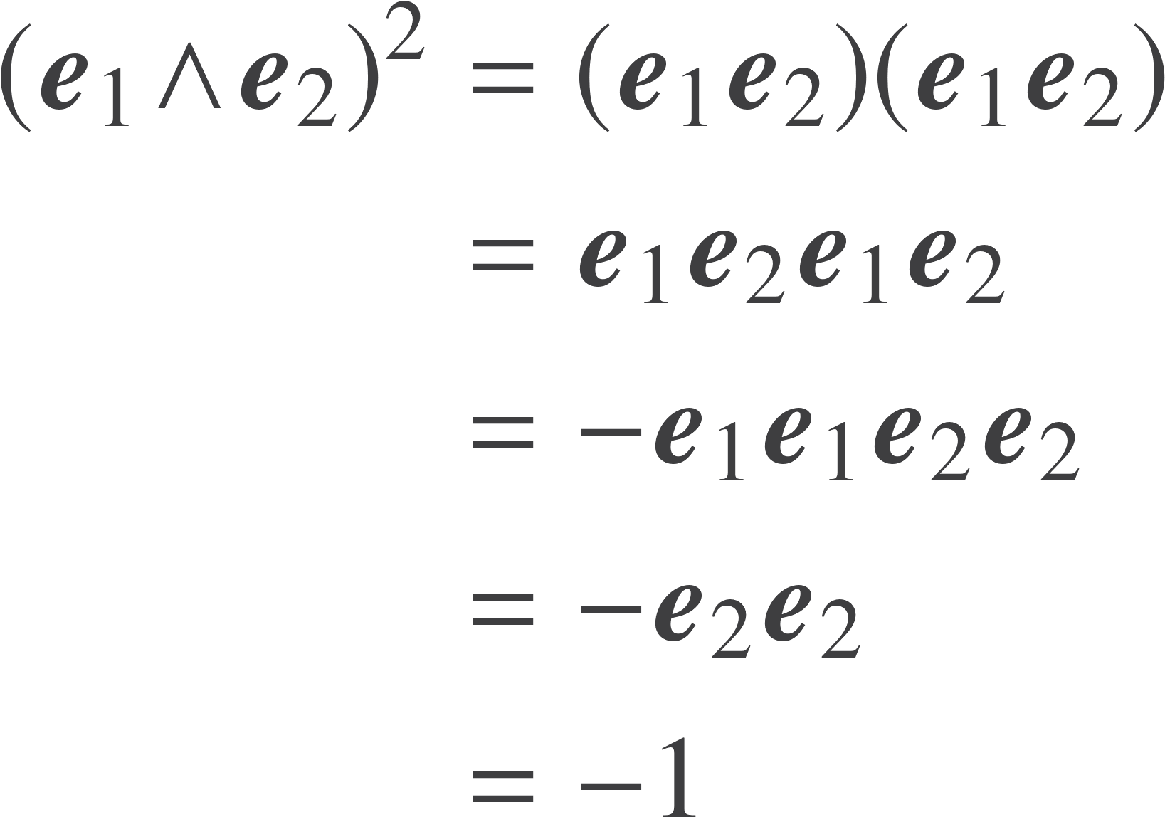
The bivector
The unit bivector has negative square.
Follows purely form the axioms of geometric algebra.
We have not said anything about complex numbers, or solving polynomial equations.
We have invented complex numbers!
They arise naturally in the geometric algebra of the plane.

Slide 8
A type for multivectors

Slide 9
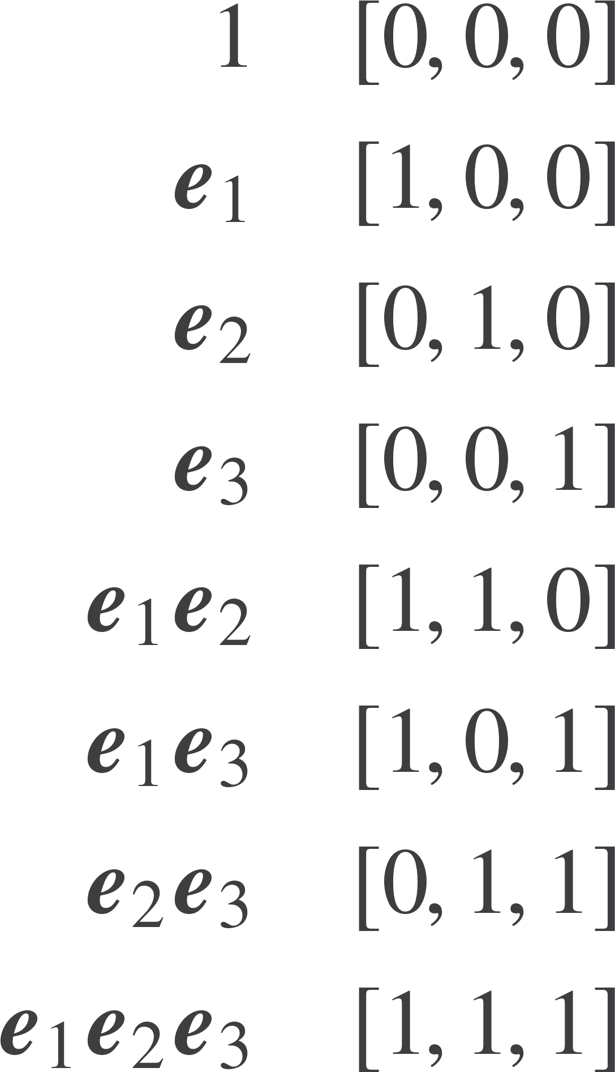
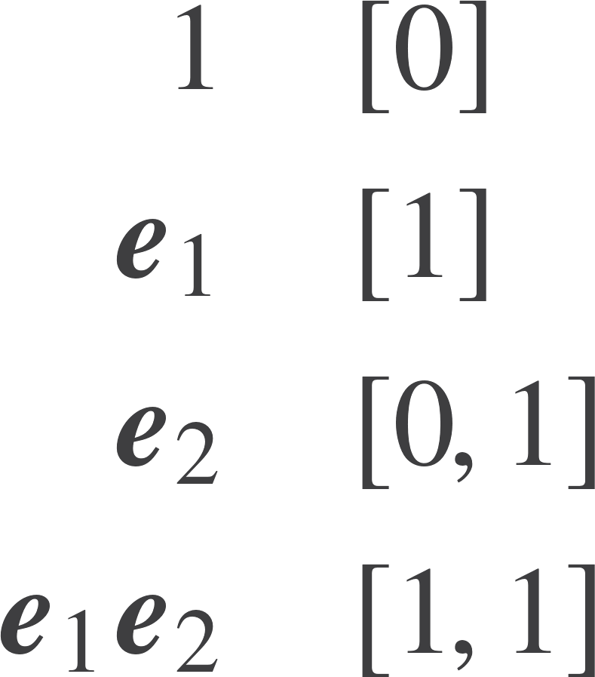
Multivectors and blades
A multivector is a sum of basis blades
2D basis
3D Basis
Zeros added to aid readability
Can see that a form of reverse binary representation will capture each basis blade

Slide 10
Strong typing for geometry
Use a newtype so that we can add Multivector to the num class.
Store each blade as a tuple of the integer represented by the reverse binary expression, and a value. A multivector is then a list (sparse representation).
Function for smaller spaces (up to 16d). Implement as an ADT, so don’t expose the constructor. blade function reads a string, E1E2, and converts to integer.
Function for exploring larger spaces. Replaces Int by Integer.
newtype Multivector n a = Mv [(n,a)]
mv :: (Num a, Eq a) => [(a,String)] -> Multivector Int a mv xs = Mv (bladeListSimp (sortBy bladeComp (map blade xs)))
longMv :: (Num a, Eq a) => [(a,String)] -> Multivector Integer a longMv xs = Mv (bladeListSimp (sortBy bladeComp (map blade xs)))

Slide 11
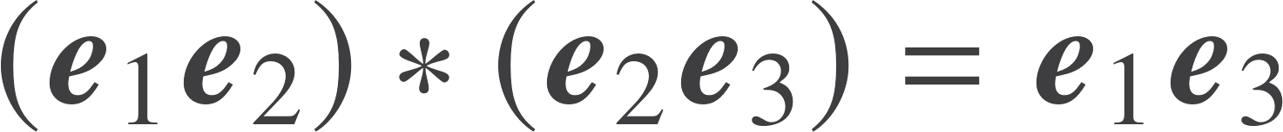
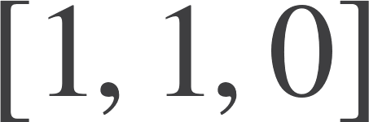

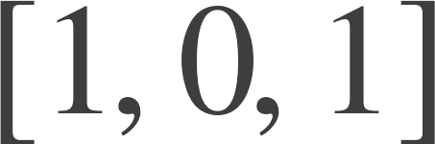
Blade product
The product of two blade results in a new blade that is a binary xor of the input blades, and a sign:
The xor is a form of long zipWith as we don’t discard the value in the longer list. Does not seem to be any simpler maths function.
resBld xs [] = xs resBld [] ys = ys resBld (x:xs) (y:ys) = ((x+y) `mod` 2) : (resBld xs ys)

Slide 12
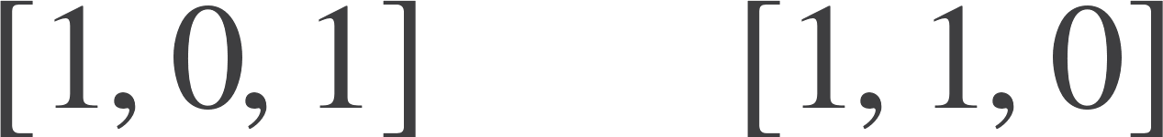
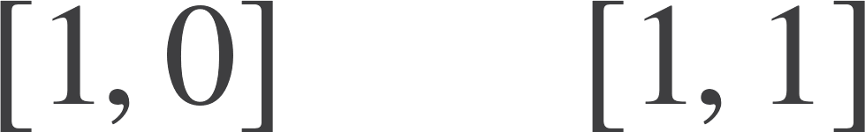

Blade product – counting swaps (blade running)
The sign in the blade product is determined by the number of swaps
2
2
Total number of swaps = 4
0
0

Slide 13
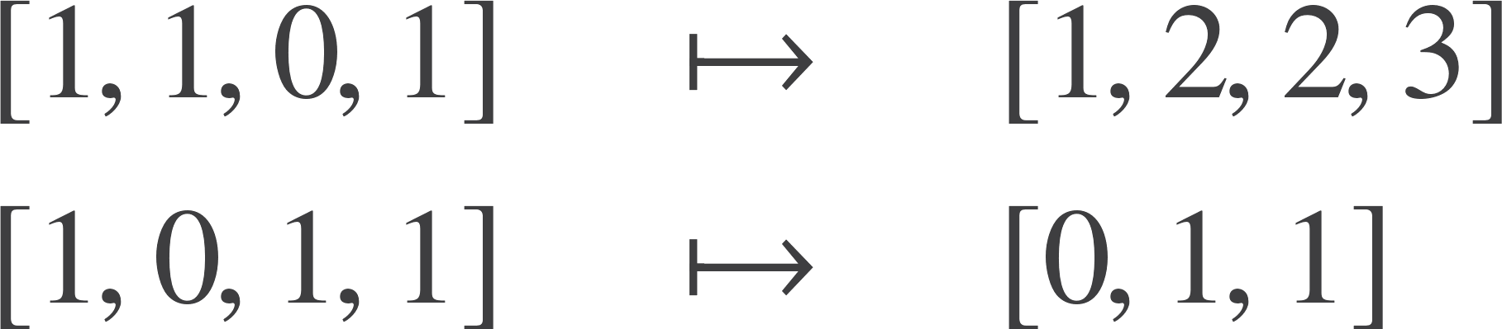

Blade product – counting swaps
NB This is the grade of [1,1,0,1]
countSwap :: [Int] -> [Int] -> Int
countSwap xs ys =foldl' (+) 0 zs where zs = zipWith (*) (tail xs) (scanl1 (+) (ys++zeroes))
By far the most compact formulation I have ever seen
Note – used laziness in zeroes to pad out RHS blade to length of LHS

Slide 14
On to multivectors
bladeProd :: (Num a, Integral n) => (n,a) -> (n,a) -> (n,a) bladeProd (n,a) (m,b) = (r,x) where (r,fn) = bldProd n m x = fn (a*b)
bladeListProduct :: (Integral n, Num a, Eq a) => [(n,a)] -> [(n,a)] -> [(n,a)]
bladeListProduct xs ys = bladeListSimp (sortBy bladeComp res) where res = [bladeProd x y | x <- xs, y <- ys]
Take all of the blades and multiply them all together.
Sort the result so that common blades are together.
Simplify the final sum.
That’s it!

Slide 15
Adding some class
Can now write A*B for the multivector product in code. Code is now much closer to the maths it represents.
(May not seem like much, but I’ve always wanted to be able to do this.)
instance (Integral n, Eq a) => Eq (Multivector n a) where (Mv xs) == (Mv ys) = xs == ys
instance (Integral n, Num a, Eq a) => Num (Multivector n a) where (Mv xs) * (Mv ys) = Mv (bladeListProduct xs ys) (Mv xs) + (Mv ys) = Mv (bladeListAdd xs ys) fromInteger n = Mv [(0,fromInteger n)] negate (Mv xs) = Mv (bldListNegate xs) abs (Mv xs) = Mv xs signum (Mv xs) = Mv xs

Slide 16
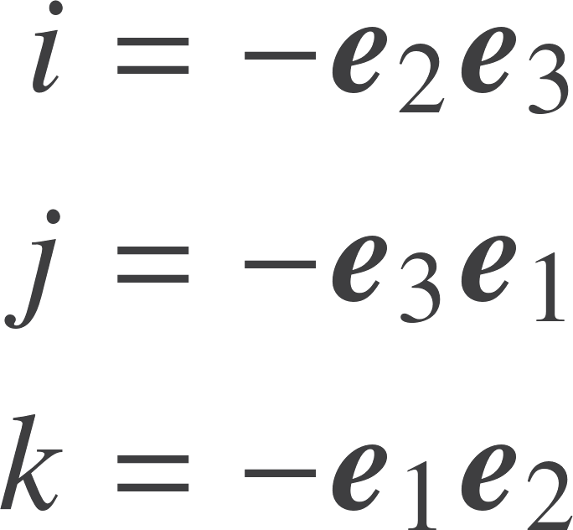
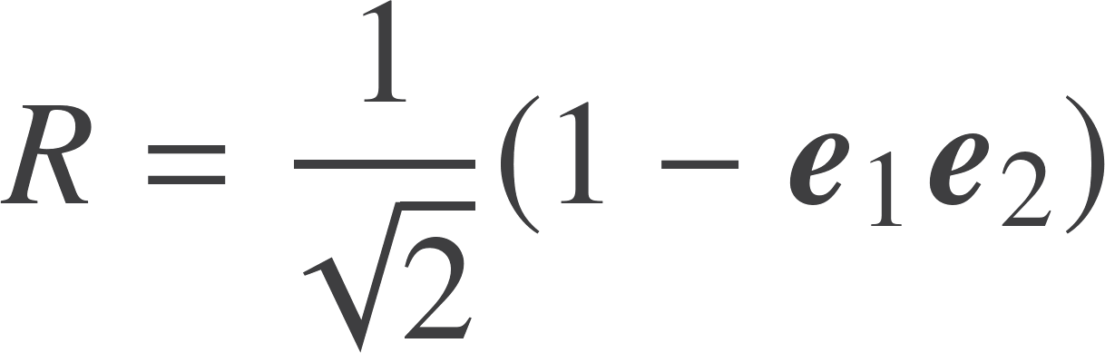

Typical session
Set

Slide 17
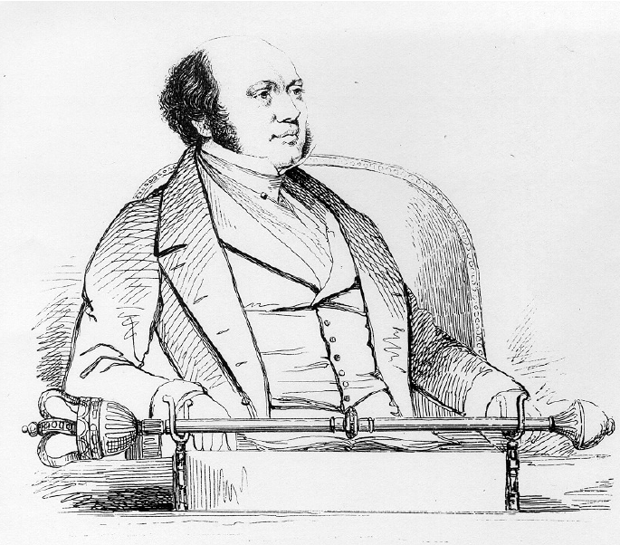
Typical session
Set
Find

Slide 18
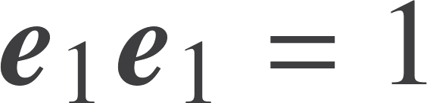

3D Algebra
Summarise as:

Slide 19
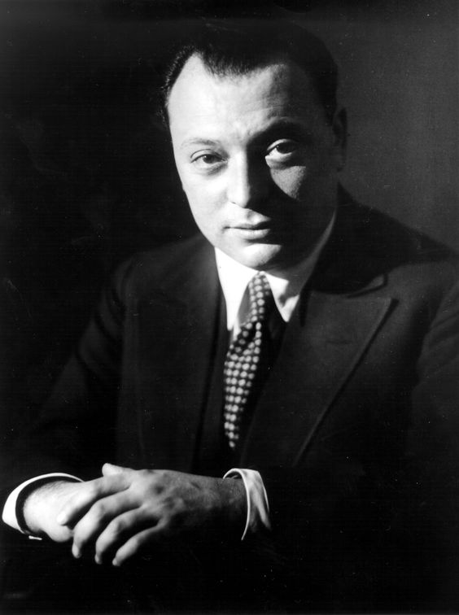

3D Algebra
Summarise as:

Slide 20


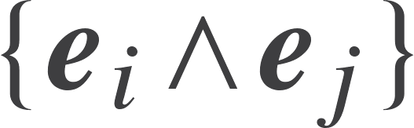
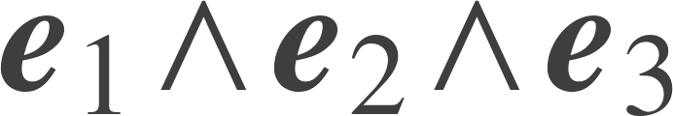
3D Basis
Grade 0
1 Scalar
Grade 1
3 Vectors
Grade 2
3 Plane / bivector
Grade 3
1 Volume / trivector
A linear space of dimension 8
Note the appearance of the binomial coefficients - this is general
General elements of this space are called multivectors

Slide 21
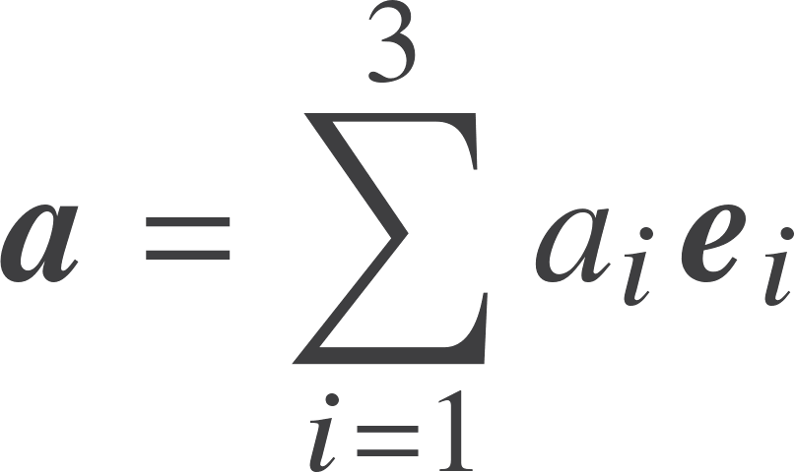
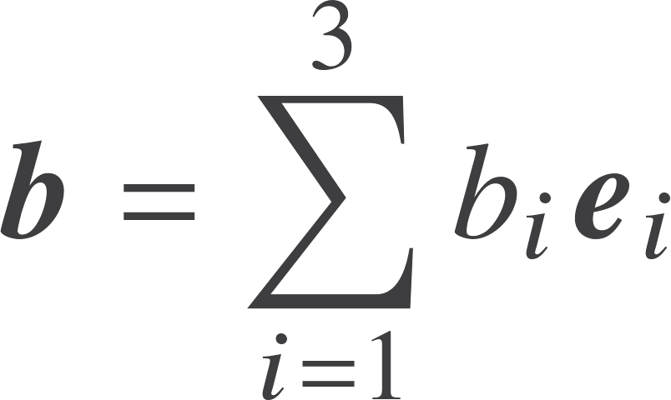
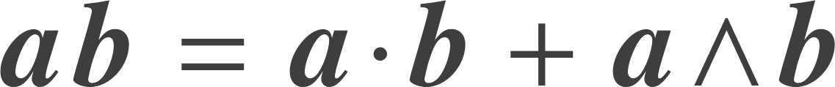
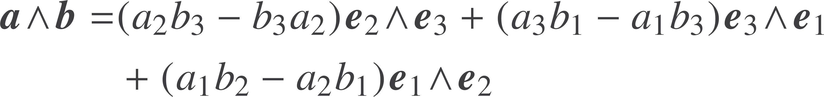
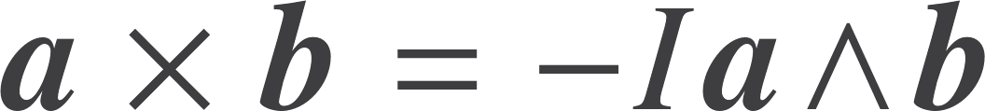
Products in 3D
We recover the cross product from duality:
Can only do this in 3D

Slide 22
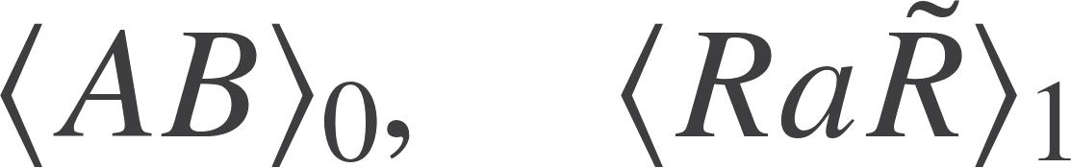
Projection
Most expressions in GA take the form
The angle brackets denote projecting out a given grade
Laziness helps here!
No need to manually simplify the code. We only calculate the bit of the product that we need.
A valuable optimization for free.
projGrade :: (Integral n, Num a) => Multivector n a -> Int -> Multivector n a projGrade (Mv xs) m = Mv (filter isGrade xs) where isGrade (fst,_) = bladeGrade fst == m
rs = projGrade (a*b) 0

Slide 23
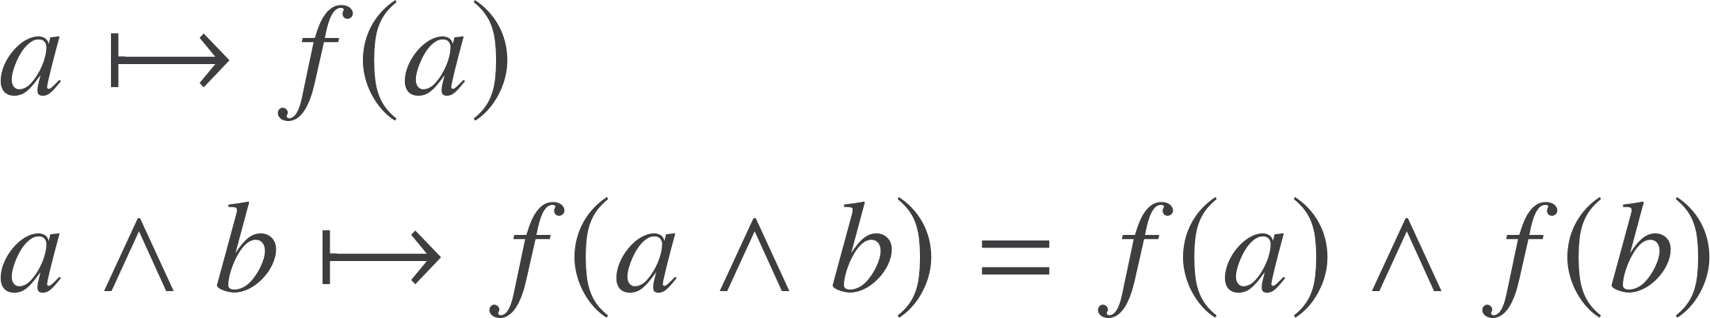
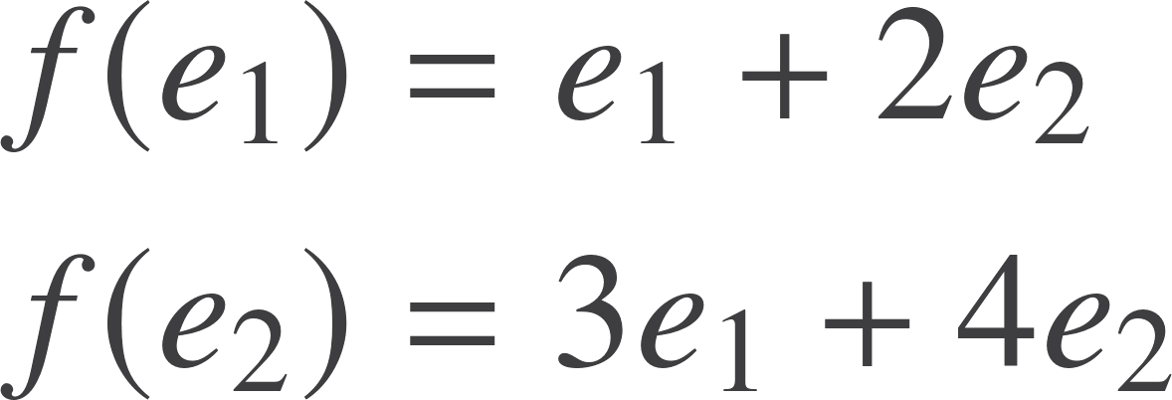
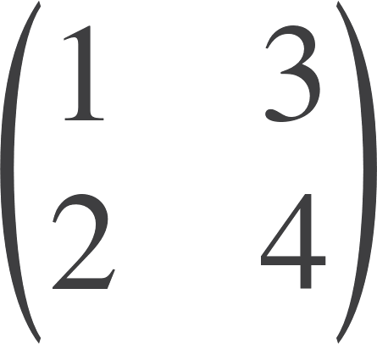

Outermorphism
Mathsy name for a simple concept
2D example
Matrix form

Slide 24
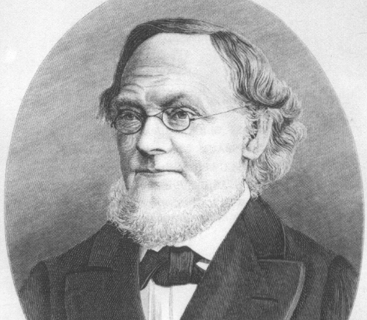

Outermorphism
Mathsy name for a simple concept
2D example
Matrix form
Any dimension, any signature

Slide 25
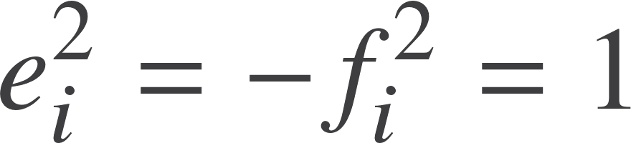
Fine details
Turns out to be really useful to cope with different signatures, so interleave positive and negative signature basis vectors.
Gives us special relativity, conformal geometry …
Want to add memorization. Not completely clear on best way. Optimization not consistent with polymorphism.
Other optimization work would be valuable.
Blade | Bit vector | Integer
1 | 0 | 0
e1 | 1 | 1
f1 | 01 | 2
e2 | 001 | 4
f2 | 0001 | 8
e1f1 | 11 | 3
e1e2 | 101 | 5

Slide 26
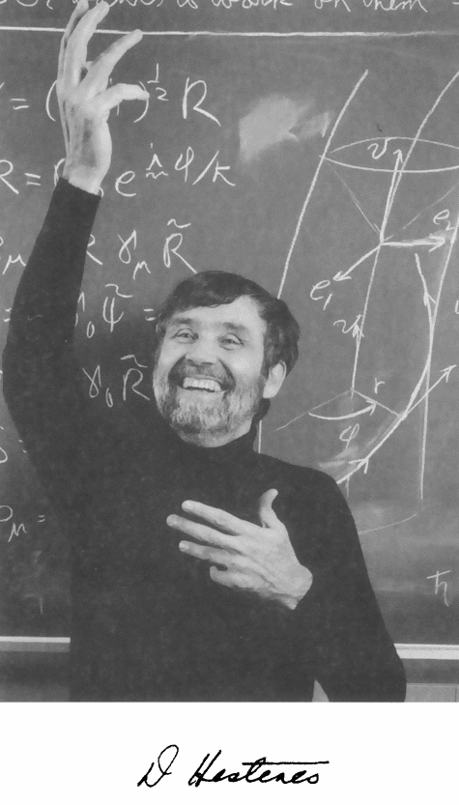
Unification
Design choices in mathematics mirror those in computer science
Coordinate geometry
Complex analysis
Vector calculus
Tensor analysis
Matrix algebra
Lie groups
Lie algebras
Spinors
Gauge theory
Grassmann algebra
Differential forms
Quantum computing
Twistors
Quaternions
Octonions
Pauli operators
Dirac theory
QFT
Gravity…

Slide 27
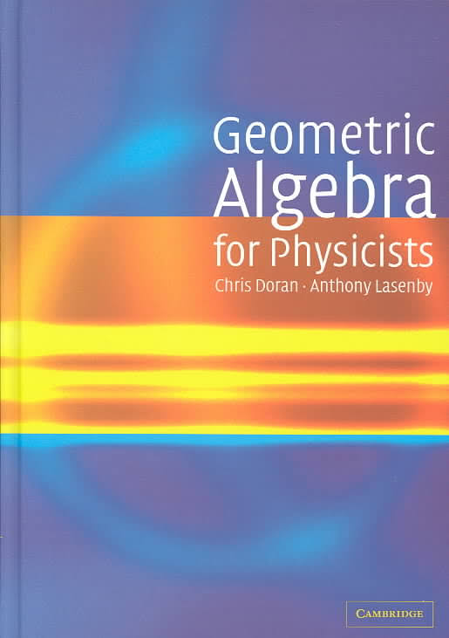
Thank You!
Resources
geometry.mrao.cam.ac.uk chris.doran@arm.com
cjld1@cam.ac.uk
@chrisjldoran
#geometricalgebra
github.com/ga

