Slide 1
PCI Drivers
Ted Baker • Andy Wang
CIS 4930 / COP 5641

Slide 2
The PCI Interface
A bus is made up of both an electrical interface and a programming interface
  This chapter focuses on the programming aspect
PCI (Peripheral Component Interconnect)
  A set of specifications of how parts of a computer should interconnect

Slide 3
The PCI Interface
A replacement for the ISA standard (bare metal kind of bus)
Goals
  Better performance
  Platform independence
  Simplify adding and removing peripherals to the system

Slide 4
The PCI Interface
Better performance
  Higher clock rate (than ISA)
  66 MHz/133 MHz
  32-bit data bus

Slide 5
The PCI Interface
Platform independence
  Supports autodetection of interface boards
  Jumperless
  Automatically configured at boot time
    Device driver then access the configuration information to complete initialization
    Without the need to perform probing

Slide 6
PCI Addressing
Each PCI peripheral is identified by a 16-bit address <a 8-bit bus number, a 5-bit device number, and a 3-bit function number>
  Sometimes a 32-bit address (prefix with a 16-bit domain number)
Linux uses pci_dev to specify PCI devices to hide the 16-bit address

Slide 7
PCI Addressing
Workstations feature at least two PCI buses
  A bridge is a PCI peripheral to join two buses
  Overall layout of a PCI system is a tree
    Each bus is connected to an upper-layer bus, up to bus 0 at the root of the tree

Slide 8
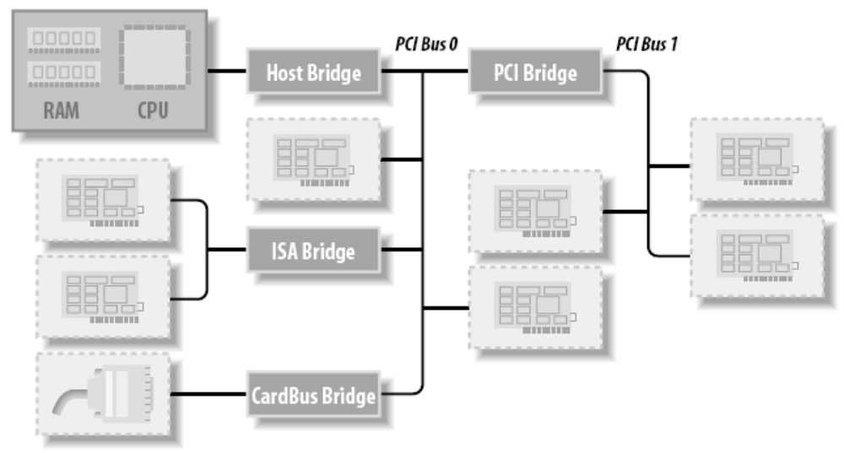
PCI Addressing

Slide 9
PCI Addressing
To see the list of devices
  /sbin/lspci
00:00.0 Host bridge: Intel Corp. E7520 Memory Controller Hub (rev 0a)
00:00.1 Class ff00: Intel Corp. E7525/E7520 Error Reporting Registers (rev 0a)
00:01.0 System peripheral: Intel Corp. E7520 DMA Controller (rev 0a)
00:02.0 PCI bridge: Intel Corp. E7525/E7520/E7320 PCI Express Port A (rev 0a)
00:04.0 PCI bridge: Intel Corp. E7525/E7520 PCI Express Port B (rev 0a)
00:06.0 PCI bridge: Intel Corp. E7520 PCI Express Port C (rev 0a)
00:1c.0 PCI bridge: Intel Corp. 6300ESB 64-bit PCI-X Bridge (rev 02)
00:1d.0 USB Controller: Intel Corp. 6300ESB USB Universal Host Controller (rev 02)
00:1d.1 USB Controller: Intel Corp. 6300ESB USB Universal Host Controller (rev 02)
00:1d.4 System peripheral: Intel Corp. 6300ESB Watchdog Timer (rev 02)
<bus:device.function> in hex

Slide 10
PCI Addressing
To see the bus topology
  /sbin/lspci -tv
-[0000:00]-+-00.0 Intel Corp. E7520 Memory Controller Hub
+-00.1 Intel Corp. E7525/E7520 Error Reporting Registers
+-01.0 Intel Corp. E7520 DMA Controller
+-02.0-[0000:01-03]--+-00.0-[0000:02]--
| +-00.1 Intel Corp. 6700/6702PXH I/OxAPIC Interrupt Controller A
| +-00.2-[0000:03]--
| \-00.3 Intel Corp. 6700PXH I/OxAPIC Interrupt Controller B
+-04.0-[0000:04]--
+-06.0-[0000:05]--
+-1c.0-[0000:06]--+-01.0 Intel Corp. 82541GI/PI Gigabit Ethernet Controller
| \-02.0 Intel Corp. 82541GI/PI Gigabit Ethernet Controller
+-1d.0 Intel Corp. 6300ESB USB Universal Host Controller
+-1d.1 Intel Corp. 6300ESB USB Universal Host Controller
+-1d.4 Intel Corp. 6300ESB Watchdog Timer
+-1d.5 Intel Corp. 6300ESB I/O Advanced Programmable Interrupt Controller
+-1d.7 Intel Corp. 6300ESB USB2 Enhanced Host Controller
+-1e.0-[0000:07]----01.0 ATI Technologies Inc Rage XL
+-1f.0 Intel Corp. 6300ESB LPC Interface Controller
+-1f.1 Intel Corp. 6300ESB PATA Storage Controller
\-1f.3 Intel Corp. 6300ESB SMBus Controller
<domain:bus> in hex

Slide 11
PCI Addressing
> more /proc/pci
PCI devices found:
Bus 0, device 0, function 0:
Class 0600: PCI device 8086:3590 (rev 10).
Bus 0, device 0, function 1:
Class ff00: PCI device 8086:3591 (rev 10).
Bus 0, device 1, function 0:
Class 0880: PCI device 8086:3594 (rev 10).
IRQ 169.
Non-prefetchable 32 bit memory at 0xdd000000 [0xdd000fff].
Bus 0, device 2, function 0:
Class 0604: PCI device 8086:3595 (rev 10).
IRQ 169.
Master Capable. No bursts. Min Gnt=7.

Slide 12
PCI Addressing
A PCI device can be addressed in three ways
  Memory locations (shared by all)
    32-bit or 64-bit
    Can be mapped at boot time to avoid collisions
  I/O ports (shared by all)
    32-bit

Slide 13
PCI Addressing
  Configuration registers
    Uses geographical addressing
    Never collide
    A PCI driver can access its devices without probing
      Just read from the configuration space
        256 bytes for each device function
        4 bytes holds a unique function ID

Slide 14
Boot Time
At power on
  A PCI device remains inactive
    Responds only to configuration transactions
    No memory and no I/O ports mapped
    Interrupt disabled

Slide 15
Boot Time
  A PCI motherboard firmware (BIOS, NVRAM, PROM) performs configuration transactions with each PCI device
    Allocates non-overlapping memory region

Slide 16
Boot Time
To see a device’s information
  Check /sys/bus/pci/devices
> ls –l /sys/bus/pci/devices/0000:00:01.0
...
-r--r--r-- 1 root root 4096 May 22 14:15 class
-rw-r--r-- 1 root root 256 May 22 14:15 config
-rw-r--r-- 1 root root 4096 May 22 19:00 detach_state
-r--r--r-- 1 root root 4096 May 22 14:15 device
-r--r--r-- 1 root root 4096 May 22 14:15 irq
drwxr-xr-x 2 root root 0 May 22 19:13 power/
-r--r--r-- 1 root root 4096 May 22 14:15 resource
-r--r--r-- 1 root root 4096 May 22 19:00 subsystem_device
-r--r--r-- 1 root root 4096 May 22 19:00 subsystem_vendor
-r--r--r-- 1 root root 4096 May 22 14:15 vendor
Assigned IRQ
Memory resources allocated

Slide 17
Configuration Registers and Initialization
Each PCI device features at least a 256-byte address space
  First 64 bytes standardized
  PCI registers are always little-endian
    Need to watch out for byte ordering
    Use macros defined in <asm/byteorder.h>

Slide 18
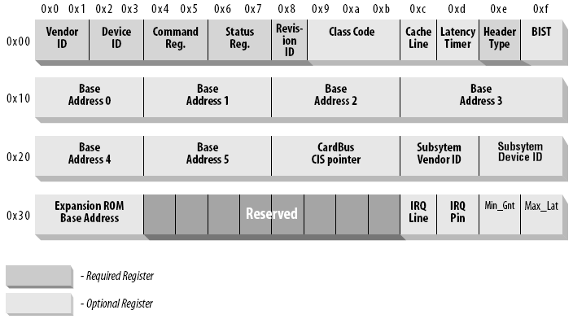
Configuration Registers and Initialization

Slide 19
Configuration Registers and Initialization
vendorID (16-bit register)
  Identifies a hardware manufacturer
    E.g., 0x8086 for Intel
    A global registry maintained by the PCI Special Interest Group

Slide 20
Configuration Registers and Initialization
deviceID (16-bit register)
  decided by the manufacturer
  A device driver signature = <vendorID, deviceID>
class (16-bit value)
  Top 8 bits identify the base class (group)
    E.g., network group contains Ethernet and token ring classes

Slide 21
Configuration Registers and Initialization
A PCI driver tells the kernel what kind of device it supports via a data structure
  #include <linux/mod_devicetable>
  struct pic_dev_id {
  __u32 vendor, device;
  __u32 subvendor, subdevice;
  __u32 class, class_mask;
  kernel_ulong_t driver_data;
  };
If a driver can handle any vendor/subvendor or device/subdevice ID, use PCI_ANY_ID

Slide 22
Configuration Registers and Initialization
Use two helper functions to initialize struct pci_device_id
  /* set subvendor and subdevice fields to PCI_ANY_ID */
  PCI_DEVICE(vendor, device);
  /* set vendor/subvendor and device/subdevice fields to PCI_ANY_ID */
  PCI_DEVICE_CLASS(device_class, device_class_mask);

Slide 23
Configuration Registers and Initialization
Example
  Create a list of pci_device_id structures
  /* drivers/usb/host/ehci-hcd.c: */
  static const struct pci_device_id pci_ids[] = {
  /* handle any USB 2.0 EHCI controller */
  { PCI_DEVICE_CLASS(((PCI_CLASS_SERIAL_USB << 8) | 0x20),
  ~0),
  .driver_data = (unsigned long) &ehci_driver, },
  { /* end: all zeroes */ }
  };

Slide 24
Configuration Registers and Initialization
More Example
/* in drivers/i2c/busses/i2c-i810.c */
static struct pci_device_id i810_ids[] = {
{ PCI_DEVICE(PCI_VENDOR_ID_INTEL,
PCI_DEVICE_ID_INTEL_82810_IG1) },
{ PCI_DEVICE(PCI_VENDOR_ID_INTEL,
PCI_DEVICE_ID_INTEL_82810_IG3) },
{ 0, },
};

Slide 25
MODULE_DEVICE_TABLE
To export pci_device_id structure to the user space, call
  MODULE_DEVICE_TABLE(pci, i810_ids);
  Allows depmod to pull the data out of the module and add to /lib/modules/<KERNEL_VERSION>/modules.pcimap
# pci module vendor device subvendor subdevice class class_mask driver_data
parport_pc 0x00001106 0x00000686 0xffffffff 0xffffffff 0x00000000 0x00000000 0x0
parport_pc 0x00001283 0x00008872 0xffffffff 0xffffffff 0x00000000 0x00000000 0x0
parport_pc 0x0000131f 0x00001020 0xffffffff 0xffffffff 0x00000000 0x00000000 0x0
parport_pc 0x0000131f 0x00001021 0xffffffff 0xffffffff 0x00000000 0x00000000 0x0
parport_pc 0x0000131f 0x00002020 0xffffffff 0xffffffff 0x00000000 0x00000000 0x0
parport_pc 0x0000131f 0x00002021 0xffffffff 0xffffffff 0x00000000 0x00000000 0x0
parport_pc 0x00001407 0x00008000 0xffffffff 0xffffffff 0x00000000 0x00000000 0x0
The hotplug system uses this file to load the proper module

Slide 26
Registering a PCI Driver
To register, create struct pci_driver (see <linux/pci.h>)
Some important fields
  /* need to be unique */
  /* normally the same as the module name of the driver
  displayed in /sys/bus/pci/drivers/ */
  const char *name;
  /* pointer to the pci_device_id table declared earlier */
  const struct pci_device_id *id_table;

Slide 27
Registering a PCI Driver
  /* pointer to a probe function in the PCI driver */
  /* if the PCI driver claims the PCI device, return 0 */
  /* else return a negative error value */
  int (*probe) (struct pci_dev *dev,
  const struct pci_device_id *id);
  /* called when the PCI device is removed from the system */
  void (*remove) (struct pci_dev *dev);
  /* called when the PCI device is suspended */
  int (*suspend) (struct pci_dev *dev, u32 state);
  /* called to resume from the suspended state */
  int (*resume) (struct pci_dev *dev);

Slide 28
Registering a PCI Driver
Creating a struct pci_driver requires initializing four fields
  static struct pci_driver pci_driver = {
  .name = "pci_skel",
  .id_table = ids,
  .probe = probe,
  .remove = remove,
  };

Slide 29
Registering a PCI Driver
To register, call pci_register_driver
  Returns 0 on success
  Returns a negative error number on failure
  static int __init pci_skel_init(void) {
  return pci_register_driver(&pci_driver);
  }

Slide 30
Registering a PCI Driver
pci_register_driver does not complain if no devices were bound to the driver
  Allows a driver to be loaded before the device appears to reduce the time to initialize the device

Slide 31
Registering a PCI Driver
To unload a PCI driver, call pci_unregister_driver
  Calls the remove function before it returns
  static void __exit pci_skel_exit(void) {
  return pci_unregister_driver(&pci_driver);
  }

Slide 32
Old-Style PCI Probing
To find a PCI device, call
struct pci_dev *pci_get_device(unsigned int vendor,
unsigned int device,
struct pci_dev *from);
  Cannot be called from the interrupt context
  If a PCI device with matching vendor and device IDs is found, increment the reference count and return it to the caller

Slide 33
Old-Style PCI Probing
  Prevents the device from disappearing without notice
  After the driver is done with the PCI device, call pci_dev_put(dev) to decrement the count
  from points to the previous search point
    To reduce the search time
    Set to NULL for the first search

Slide 34
Old-Style PCI Probing
Example
struct pci_dev *dev;
dev = pci_get_device(PCI_VENDOR_FOO, PCI_DEVICE_FOO, NULL);
if (dev) {
/* Use the PCI device */
...
pci_dev_put(dev);
}

Slide 35
Old-Style PCI Probing
To find a PCI device with additional subsystem vendor and device IDs, call
struct pci_dev *pci_get_subsys(unsigned int vendor,
unsigned int device,
unsigned int ss_vendor,
unsigned int ss_device,
struct pci_dev *from);
  Works just like pci_get_device

Slide 36
Old-Style PCI Probing
To find a PCI device connected to a specific bus with matching device and function numbers, call
struct pci_dev *pci_get_slot(struct pci_bus *bus,
unsigned int devfn);
  Cannot be called from interrupt context
  If found, increment the count and return the device
  Call pci_dev_put(dev) after use

Slide 37
Enabling the PCI Device
In the probe function, the driver must call pci_enable_device
int pci_enable_device(struct pci_dev *dev);
  Wakes up the device
  Assigns its interrupt line and I/O regions

Slide 38
Accessing the Configuration Space
To access configuration space
  The CPU must write and read registers in the PCI controller via a standard interface
  The endian conversion is handled automatically

Slide 39
Accessing the Configuration Space
#include <linux/pci.h>
/* where is the byte offset from the beginning of the configuration space */
/* value fetched from the configuration space is returned through the val pointer */
/* returns a negative error number on failure */
int pci_read_config_byte(struct pci_dev *dev, int where,
u8 *val);
int pci_read_config_word(struct pci_dev *dev, int where,
u16 *val);
int pci_read_config_dword(struct pci_dev *dev, int where,
u32 *val);

Slide 40
Accessing the Configuration Space
/* value being written is passed as val */
int pci_write_config_byte(struct pci_dev *dev, int where,
u8 val);
int pci_write_config_word(struct pci_dev *dev, int where,
u16 val);
int pci_write_config_dword(struct pci_dev *dev, int where,
u32 val);

Slide 41
Accessing the Configuration Space
Can use symbolic names to get to different configuration space offsets
#include <linux/pci.h>
static unsigned char skel_get_revision(struct pci_dev *dev) {
u8 revision;
pci_read_config_byte(dev, PCI_REVISION_ID, &revision);
return revision;
}

Slide 42
Accessing the Configuration Space
Without the access to struct pci_dev, call a different set of functions
int pci_bus_read_config_byte(struct pci_bus *bus,
unsigned int devfn, int where,
u8 *val);
int pci_bus_read_config_word(struct pci_bus *bus,
unsigned int devfn, int where,
u16 *val);
int pci_bus_read_config_dword(struct pci_bus *bus,
unsigned int devfn, int where,
u32 *val);

Slide 43
Accessing the Configuration Space
int pci_bus_write_config_byte(struct pci_bus *bus,
unsigned int devfn, int where,
u8 val);
int pci_bus_write_config_word(struct pci_bus *bus,
unsigned int devfn, int where,
u16 val);
int pci_bus_write_config_dword(struct pci_bus *bus,
unsigned int devfn, int where,
u32 val);

Slide 44
Accessing the I/O and Memory Spaces
A PCI device implements up to six I/O address regions
  A region is a generic I/O address space that is either memory-mapped or port-mapped

Slide 45
Accessing the I/O and Memory Spaces
Most devices implement I/O registers in memory regions
  I/O registers should not be cached
    Identified by the memory-is-prefetchable bit
      Prefetchable means caching is okay
        E.g., video memory
      Nonprefetchable cannot be optimized
        E.g., control registers

Slide 46
Accessing the I/O and Memory Spaces
Size and the current location of I/O regions are reported via 32-bit configuration registers
  Symbolic names PCI_BASE_ADDRESS_0 to PCI_BASE_ADDRESS_5

Slide 47
Accessing the I/O and Memory Spaces
I/O regions of PCI devices have been integrated into the generic resource management
  Can use the following functions
  /* returns the first address (memory address/IO port) associated with one of the six PCI IO regions */
  /* set bar to 0 to 5 to select the region */
  unsigned long pci_resource_start(struct pci_dev *dev,
  int bar);

Slide 48
Accessing the I/O and Memory Spaces
  /* returns the last usable address of the I/O region number bar */
  unsigned long pci_resource_end(struct pci_dev *dev,
  int bar);
  /* if associated I/O regions exist, return IORESOUCE_IO or IORESOURCE_MEM in the flags */
  /* returns IORESOURCE_PREFETCH in the flags to indicate whether compiler optimizations need to be disabled */
  /* returns IORESOURCE_READONLY in the flags to indicate whether a memory region is write protected */
  unsigned long pci_resource_flags(struct pci_dev *dev,
  int bar);

Slide 49
PCI Interrupts
By the time Linux boots, firmware has already assigned a unique interrupt number to the device
  One byte (up to 256 interrupt lines) stored in configuration register 60 (PCI_INTERRUPT_LINE)
  result = pci_read_config_byte(dev, PCI_INTERRUPT_LINE,
  &myirq);
  if (result) {
  /* deal with error */
  }

Slide 50
PCI Interrupts
To read the assigned interrupt number
  result = pci_read_config_byte(dev, PCI_INTERRUPT_LINE,
  &myirq);
  if (result) {
  /* deal with error */
  }

Slide 51
PCI Interrupts
If the device doesn’t support interrupts
  Register 61 (PCI_INTERRUPT_PIN) is 0
    However, the driver should know
  Else, it tells which pin (out of four) is used for interrupt

Slide 52
Hardware Abstractions
In the PCI world, the only hardware-dependent operations are the ones that read and write configuration registers
  Everything else is achieved by directly reading and writing I/O and memory address space

Slide 53
Hardware Abstractions
The relevant structure contains two fields
#include <linux/pci.h>
/* actual definitions are in drivers/pci/pci.c */
struct pci_ops {
int (*read)(struct pci_bus *bus, unsigned int devfn,
int where, int size, u32 *val);
int (*write)(struct pci_bus *bus, unsigned int devfn,
int where, int size, u32 val);
};

Slide 54
A Look Back: ISA (Industry Standard Architecture)
Advantages
  ISA devices can be homemade
  Cheap
Disadvantages
  Slow
  Tightly bound to the PC architecture
  Lack of geographical addressing

Slide 55
Hardware Resources
An ISA device can be equipped with I/O ports, memory areas, and interrupt lines
  Many supports only 1024 ports
  Memory range between 640KB to 1MB
    Competing with PC BIOS and VGA video cards
  Limited number of interrupt lines

Slide 56
ISA Programming
Registries of I/O ports and IRQ lines
Probing of I/O ports
Autodetection for the interrupt lines

Slide 57
The Plug-and-Play Specification
PnP devices implements relocatable I/O regions (similar to PCI devices)
  Defines a way to geographically address the interface boards via a card select number
  Requires BIOS to be PnP-aware
  Example: /drivers/net/3c509.c

Slide 58
PC/104 and PC/104+
Allow circuit boards to be stacked vertically
PC/104 maps to the ISA standard
PC/104+ maps to the PCI standard

Slide 59
Other PC Buses
MCA (Micro Channel Architecture)
EISA (Extended ISA)

Slide 60
MCA
IBM standard in PS/2 computers
  Multimaster DMA
  32-bit address and data lines
  Shared interrupt lines
  Geographical addressing to access configuration registers

Slide 61
MCA
A device driver can check MCA_bus to see if it is running on MCA
  See <asm/processor.h>

Slide 62
EISA
32-bit extension to ISA
  Address and data lines
  Multimaster DMA
  Shared interrupt lines
  Configured by software without OS support

Slide 63
EISA
Designed to host jumperless devices
  Used by Ethernet devices and SCSI controllers
A device can check EISA_bus to check if the host computer carries an EISA bus
  See <asm/processor.h>

Slide 64
External Buses
USB, Firewire IEEE1284 (Parallel-port-based external bus)
Similar to PCMCIA/CardBus and SCSI
Usually split into two levels
  Driver for the controller
  Driver for the hardware

