Slide 1
Building and Running Modules
Ted Baker • Andy Wang
CIS 4930 / COP 5641

Slide 2
Setting Up Your Test System
For Linux 2.6.x
  Building modules requires a configured and built kernel tree
    Can obtain one from kernel.org
  2.6 modules are linked against object files found in the kernel source tree

Slide 3
The Hello World Module
#include <linux/init.h>
#include <linux/module.h>
MODULE_LICENSE(“Dual BSD/GPL”);
static int hello_init(void) {
printk(KERN_ALERT “Hello, world\n”);
return 0;
}
static void hello_exit(void) {
printk(KERN_ALERT “Goodbye, cruel world\n”);
}
module_init(hello_init);
module_exit(hello_exit);
No main function

Slide 4
The Hello World Module
#include <linux/init.h>
#include <linux/module.h>
MODULE_LICENSE(“Dual BSD/GPL”);
static int hello_init(void) {
printk(KERN_ALERT “Hello, world\n”);
return 0;
}
static void hello_exit(void) {
printk(KERN_ALERT “Goodbye, cruel world\n”);
}
module_init(hello_init);
module_exit(hello_exit);
Invoked when the
module is loaded

Slide 5
The Hello World Module
#include <linux/init.h>
#include <linux/module.h>
MODULE_LICENSE(“Dual BSD/GPL”);
static int hello_init(void) {
printk(KERN_ALERT “Hello, world\n”);
return 0;
}
static void hello_exit(void) {
printk(KERN_ALERT “Goodbye, cruel world\n”);
}
module_init(hello_init);
module_exit(hello_exit);
Invoked when the
module is removed

Slide 6
The Hello World Module
#include <linux/init.h>
#include <linux/module.h>
MODULE_LICENSE(“Dual BSD/GPL”);
static int hello_init(void) {
printk(KERN_ALERT “Hello, world\n”);
return 0;
}
static void hello_exit(void) {
printk(KERN_ALERT “Goodbye, cruel world\n”);
}
module_init(hello_init);
module_exit(hello_exit);
Micros to indicate which module
initialization and exit functions
to call

Slide 7
The Hello World Module
#include <linux/init.h>
#include <linux/module.h>
MODULE_LICENSE(“Dual BSD/GPL”);
static int hello_init(void) {
printk(KERN_ALERT “Hello, world\n”);
return 0;
}
static void hello_exit(void) {
printk(KERN_ALERT “Goodbye, cruel world\n”);
}
module_init(hello_init);
module_exit(hello_exit);
This module bears
a free license

Slide 8
The Hello World Module
#include <linux/init.h>
#include <linux/module.h>
MODULE_LICENSE(“Dual BSD/GPL”);
static int hello_init(void) {
printk(KERN_ALERT “Hello, world\n”);
return 0;
}
static void hello_exit(void) {
printk(KERN_ALERT “Goodbye, cruel world\n”);
}
module_init(hello_init);
module_exit(hello_exit);
The ordering
matters sometimes

Slide 9
The Hello World Module
#include <linux/init.h>
#include <linux/module.h>
MODULE_LICENSE(“Dual BSD/GPL”);
static int hello_init(void) {
printk(KERN_ALERT “Hello, world\n”);
return 0;
}
static void hello_exit(void) {
printk(KERN_ALERT “Goodbye, cruel world\n”);
}
module_init(hello_init);
module_exit(hello_exit);
~= printf in C library
No floating-point
support

Slide 10
The Hello World Module
#include <linux/init.h>
#include <linux/module.h>
MODULE_LICENSE(“Dual BSD/GPL”);
static int hello_init(void) {
printk(KERN_ALERT “Hello, world\n”);
return 0;
}
static void hello_exit(void) {
printk(KERN_ALERT “Goodbye, cruel world\n”);
}
module_init(hello_init);
module_exit(hello_exit);
Indicates the message
priority
Note that no ‘,’ after
KERN_ALERT

Slide 11
Module Loading/Unloading
% make –C /home/awang/linux-2.6.25.3 M=`pwd` modules
Notice the quote ‘`’

Slide 12
Module Loading/Unloading
% make –C /home/awang/linux-2.6.25.3 M=`pwd` modules
make[1]: Entering directory ‘/usr/src/linux-2.6.25.3’
CC [M] /home/awang/hello/hello.o
Building modules, stage 2.
MODPOST
CC /home/awang/hello/hello.mod.o
LD [M] /home/awang/hello/hello.ko
make[1]: Leaving directory ‘/usr/src/linux-2.6.25.3’
%

Slide 13
Module Loading/Unloading
% make –C /home/awang/linux-2.6.25.3 M=`pwd` modules
make[1]: Entering directory ‘/usr/src/linux-2.6.25.3’
CC [M] /home/awang/hello/hello.o
Building modules, stage 2.
MODPOST
CC /home/awang/hello/hello.mod.o
LD [M] /home/awang/hello/hello.ko
make[1]: Leaving directory ‘/usr/src/linux-2.6.25.3’
% su
Password:

Slide 14
Module Loading/Unloading
% make –C /home/awang/linux-2.6.25.3 M=`pwd` modules
make[1]: Entering directory ‘/usr/src/linux-2.6.25.3’
CC [M] /home/awang/hello/hello.o
Building modules, stage 2.
MODPOST
CC /home/awang/hello/hello.mod.o
LD [M] /home/awang/hello/hello.ko
make[1]: Leaving directory ‘/usr/src/linux-2.6.25.3’
% su
Password:
root#

Slide 15
Module Loading/Unloading
% make –C /home/awang/linux-2.6.25.3 M=`pwd` modules
make[1]: Entering directory ‘/usr/src/linux-2.6.25.3’
CC [M] /home/awang/hello/hello.o
Building modules, stage 2.
MODPOST
CC /home/awang/hello/hello.mod.o
LD [M] /home/awang/hello/hello.ko
make[1]: Leaving directory ‘/usr/src/linux-2.6.25.3’
% su
Password:
root# /sbin/insmod ./module.ko

Slide 16
Module Loading/Unloading
% make –C /home/awang/linux-2.6.25.3 M=`pwd` modules
make[1]: Entering directory ‘/usr/src/linux-2.6.25.3’
CC [M] /home/awang/hello/hello.o
Building modules, stage 2.
MODPOST
CC /home/awang/hello/hello.mod.o
LD [M] /home/awang/hello/hello.ko
make[1]: Leaving directory ‘/usr/src/linux-2.6.25.3’
% su
Password:
root# /sbin/insmod ./module.ko
Hello, world
root#
Might be printed to
/var/log/messages

Slide 17
Module Loading/Unloading
% make –C /home/awang/linux-2.6.25.3 M=`pwd` modules
make[1]: Entering directory ‘/usr/src/linux-2.6.25.3’
CC [M] /home/awang/hello/hello.o
Building modules, stage 2.
MODPOST
CC /home/awang/hello/hello.mod.o
LD [M] /home/awang/hello/hello.ko
make[1]: Leaving directory ‘/usr/src/linux-2.6.25.3’
% su
Password:
root# /sbin/insmod ./module.ko
Hello, world
root# /sbin/rmmod module.ko
Either module or
module.ko

Slide 18
Module Loading/Unloading
% make –C /home/awang/linux-2.6.25.3 M=`pwd` modules
make[1]: Entering directory ‘/usr/src/linux-2.6.25.3’
CC [M] /home/awang/hello/hello.o
Building modules, stage 2.
MODPOST
CC /home/awang/hello/hello.mod.o
LD [M] /home/awang/hello/hello.ko
make[1]: Leaving directory ‘/usr/src/linux-2.6.25.3’
% su
Password:
root# /sbin/insmod ./module.ko
Hello, world
root# /sbin/rmmod module.ko
Goodbye cruel world
root#
Might be printed to
/var/log/messages

Slide 19
Kernel Modules vs. Applications
Applications
  Can access various functions in user-level libraries (e.g., printf in C library)
Kernel modules
  No user-level libraries
  printk is defined within the kernel
    Exported to modules
  Should include only header files defined within the kernel source tree

Slide 20
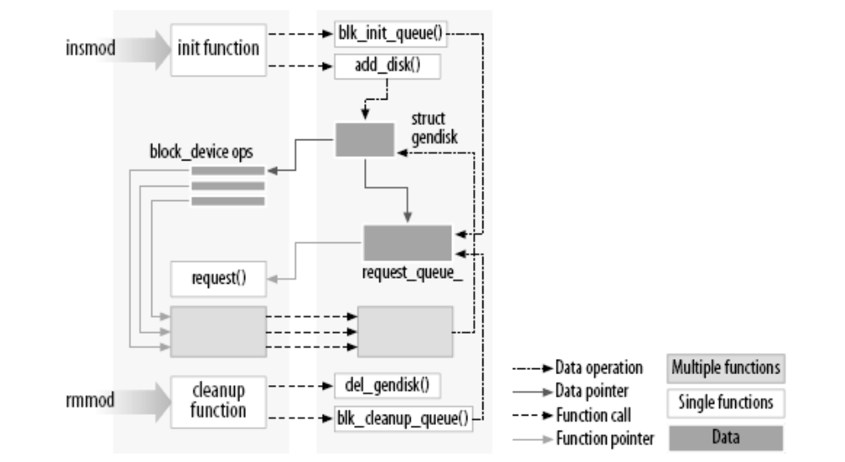
Linking a Module to the Kernel

Slide 21
Threads/Processes
Thread: A sequential execution stream
Address space: Chunks of memory and everything needed to run a program
Process: An address space + thread(s)

Slide 22
User Space and Kernel Space
Kernel modules run in kernel space
  Execute in the supervisor mode
  Everything is allowed
  Share the same address space
Applications run in user space
  Execute in the user mode
  Restricted access to hardware
  Each has its own address space

Slide 23
System Calls
System calls allow processes running at the user mode to access kernel functions that run under the kernel mode
Prevent processes from doing bad things, such as
  Halting the entire operating system
  Modifying the MBR

Slide 24
Hardware Interrupts
Can suspend user-level processes
  Transfers execution from user space to kernel space
  Interrupts are handled by separate threads
    Not related to any user-level processes
    Asynchronous

Slide 25
Role of a Module
Extend kernel functionality
  Modularized code running in kernel space

Slide 26
Concurrency in the Kernel
Sources of concurrency
  Hardware interrupts
  Kernel timers
  Multiple CPUs
  Preemption

Slide 27
Handling Concurrency
Kernel code needs to be reentrant
  Capable of running in more than one thread execution context at the time
  Prevent corruption of shared data
  Avoid race conditions
    Results depend on the timing of their executions

Slide 28
The Current Process
Most actions performed by the kernel are done on behalf of a specific process
To access the current process
  struct task_struct *current;
    #include <asm/current.h>
    #include <linux/sched.h>

Slide 29
The Current Process
Print the current process ID and command name
  printk(KERN_INFO “The process is \“%s\” (pid %i)\n”, current->comm, current->pid);

Slide 30
A Few Other Details
Limited address space for kernel
  Should dynamically allocate and deallocate space for large data structures
Functions starting with __ should be used with caution
Kernel does not support floating point arithmetic

Slide 31
Compiling Modules
Details on compiling the kernel
  Documentation/kbuild
Required tools with matching versions
  Compiler, module utilities, and so on...
  If the version is too new can cause problems as well
  Documentation/Changes

Slide 32
Simplest Makefile
obj-m := hello.o
One module to be built from hello.o
Resulting module is hello.ko

Slide 33
More on Makefiles
Suppose you have a module called module.ko
Generated from file1.c and file2.c
obj-m := module.o
module-objs := file1.o file2.o

Slide 34
More on Makefiles
To make, type the following in the directory containing the module source and Makefile
make –C /home/awang/linux-2.6.25.3 M=`pwd` modules
Changing to the
kernel source directory

Slide 35
More on Makefiles
To make, type the following in the directory containing the module source and Makefile
make –C /home/awang/linux-2.6.25.3 M=`pwd` modules
Move back to the
module source directory

Slide 36
A More Elaborate Makefile
# If KERNELRELEASE is defined, we’ve been invoked from the
# kernel build system and can use its language
ifneq ($(KERNELRELEASE),)
obj-m := hello.o
# Otherwise we were called directly from the command
# line; invoke the kernel build system.
else
KERNELDIR ?= /lib/modules/$(shell uname –r)/build
PWD := $(shell pwd)
modules:
$(MAKE) –C $(KERNELDIR) M=$(PWD) modules
clean:
rm –fr *.o *~ core .*.cmd *.ko *.mod.c .tmp_versions
endif
Kernel release version

Slide 37
Loading and Unloading Modules
insmod
  Links unresolved symbol in the module to the symbol table of the kernel
  more /proc/modules to see a list of currently loaded modules
rmmod
  Removes a kernel module

Slide 38
Loading and Unloading Modules
rmmod
  Removes a kernel module
  Fails when the kernel believes that it is still in use
    Or, something has gone wrong
    Might need to reboot to remove the module

Slide 39
Version Dependency
Module’s code has to be recompiled for each version of the kernel
  Sensitive to kernel version, compiler version, and various configuration variables
If things don’t match
  root# /sbin/insmod hello.ko
  Error inserting ‘./hello.ko’: -1 Invalid module format

Slide 40
Version Dependency
Possible remedies
  Check /var/log/messages for specific causes
  Change KERNELDIR as needed

Slide 41
The Kernel Symbol Table
Addresses of global functions and variables
A module can export its symbols for other modules to use
Module stacking
  E.g., MSDOS file system relies on symbols exported by the FAT module

Slide 42
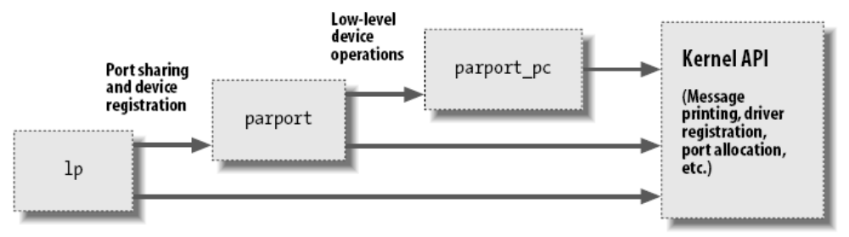
Module Stacking Example
Stacking of parallel port driver modules
Can use modprobe to load all modules required by a particular module

Slide 43
Expert Module Symbols
In module header files
Use the following macros
  EXPORT_SYMBOL(name);
  EXPORT_SYMBOL_GPL(name);
_GPL makes the symbol available only to GPL-licensed modules

Slide 44
Defending against Namespace Problems
Declare all functions and global variables static unless you mean to export them
Use a module-unique prefix for all exported symbols

Slide 45
Preliminaries
Just about all module code includes the following header files
  <linux/module.h>
    Symbols and functions needed by modules
  <linux/init.h>
    Allows you to specify initialization and cleanup functions

Slide 46
Initialization and Shutdown
Initialization function
  Registers any facility, or functionality offered by the module
static int __init initialization_function(void) {
/* initialization code here */
}
module_init(initialization_function);

Slide 47
Initialization and Shutdown
Initialization function
  Registers any facility, or functionality offered by the module
static int __init initialization_function(void) {
/* initialization code here */
}
module_init(initialization_function);
Indicates that the module loader can drop this function
after the module is loaded, making its memory available

Slide 48
Initialization and Shutdown
Initialization function
  Registers any facility, or functionality offered by the module
static int __init initialization_function(void) {
/* initialization code here */
}
module_init(initialization_function);
Mandatory to specify the initialization function

Slide 49
The Cleanup Function
Unregisters various functionalities and returns all resources
static void __exit cleanup_function(void) {
/* Cleanup code here */
}
module_exit(cleanup_function);

Slide 50
The Cleanup Function
Unregisters various functionalities and returns all resources
static void __exit cleanup_function(void) {
/* Cleanup code here */
}
module_exit(cleanup_function);
Indicates that this function is for unloading only

Slide 51
The Cleanup Function
Unregisters various functionalities and returns all resources
static void __exit cleanup_function(void) {
/* Cleanup code here */
}
module_exit(cleanup_function);
Needed to specify the cleanup function

Slide 52
Error Handling During Initialization
static int __init my_init_function(void) {
int err;
/* registration takes a pointer and a name */
err = register_this(ptr1, “skull”);
if (err) goto fail_this;
err = register_that(ptr2, “skull”);
if (err) goto fail_that;
err = register_those(ptr3, “skull”);
if (err) goto fail_those;
return 0; /* success */
fail_those: unregister_that(ptr2, “skull”);
fail_that: unregister_this(ptr1, “skull”);
fail_this: return err; /* propagate the error */
}

Slide 53
Error Handling During Initialization
static int __init my_init_function(void) {
int err;
/* registration takes a pointer and a name */
err = register_this(ptr1, “skull”);
if (err) goto fail_this;
err = register_that(ptr2, “skull”);
if (err) goto fail_that;
err = register_those(ptr3, “skull”);
if (err) goto fail_those;
return 0; /* success */
fail_those: unregister_that(ptr2, “skull”);
fail_that: unregister_this(ptr1, “skull”);
fail_this: return err; /* propagate the error */
}
Check <linux/errno.h>
for error codes

Slide 54
Cleanup Function
static void __exit my_cleanup_function(void) {
unregister_those(ptr3, “skull”);
unregister_that(ptr2, “skull”);
unregister_this(ptr1, “skull”);
return err;
}

Slide 55
Other Code Patterns
int __init my_init(void) {
int err = -ENOMEM;
item1 = allocate_thing(arg1);
item2 = allocate_thing2(arg2)
if (!item1 || !item2) goto fail;
err = register_stuff(item1, item2);
if (!err) {
stuff_ok = 1;
} else {
goto fail;
}
return 0;
fail:
my_cleanup();
return err;
}

Slide 56
Other Code Patterns
void my_cleanup(void) {
if (item1) release_thing(item1);
if (item2) release_thing2(item2);
if (stuff_ok) unregister_stuff();
return;
}
No __exit when it is called by nonexit code

Slide 57
Module-Loading Races
A facility is available once a register call is completed
Kernel can make calls to registered functions before the initialization function completes
Obtain and initialize all critical resources before calling the register function

Slide 58
Module Parameters
Include moduleparam.h, stat.h
Need to use the following macros
  module_param(name, type, permission)
  module_param_array(name, type, num, permission)

Slide 59
Example Use of Module Parameters
Allow the “hello world” module to say hello to someone a number of times
%/sbin/insmod ./hello.ko someone=“Mom” times=2
Hello Mom
Hello Mom
%

Slide 60
Example Use of Module Parameters
Need to use the module_param macro
static char *someone = “world”;
static int times = 1;
module_param(times, int, S_IRUGO);
module_param(someone, charp, S_IRUGO);
Read-only flag, defined in stat.h

Slide 61
Support Parameter Types
bool
charp
  Memory allocated for user provide strings
int, long, short, uint, ulong, ushort
  Basic integers

Slide 62
User Level Facilities
X server
Some USB drivers
Various daemons/threads

Slide 63
User Level Facilities
+ Fast development
+ C library support
+ Conventional debugger
+ Fault isolation
+ Portability
Interrupts not available
Privileged access required for direct memory access
Poor performance

