Slide 1

Secure Automatic Network Topology Creation Tool
Problem Statement
Manual network monitoring and topology creation are time-consuming, error-prone, and make security threats difficult to detect. SANTMS automatically discovers devices, generates network topology, monitors network health, and identifies security risks through a centralized management system. Domain:Web Development/Network Security Team Name:karnikaperiyasamy
HACK
MATRIX

Slide 2

THE PROBLEM
Manual Mapping Network diagrams are drawn and updated by hand — slow, tedious and error-prone.
No Live Visibility Existing tools rarely show the real-time state of devices and connections.
Delayed Threat Detection Security issues are often noticed only after they cause visible disruption.
Who is affected? Network Administrators → Security Teams → Organizations & Network Users

Slide 3
WHY THIS PROBLEM EXISTS
Fragmented tooling
Manual-first legacy workflows
No real-time feedback loop
->
CORE PROBLEM
->
USER CONSEQUENCE
->
REAL IMPACT
Current Approach: Discovery + monitoring + security are handled through disconnected tools → manual documentation → delayed detection / higher risk → poor network visibility and slower response.

Slide 4
OUR SOLUTION
INTRODUCING SECURE AUTOMATIC NETWORK TOPOLOGY CREATION TOOL Secure automatic network topology creation enables network administrators to automatically discover network devices, generate an interactive topology map, monitor network status, and analyze security risk from one centralized dashboard.
USER ↓ NETWORK INPUT ↓ Secure automatic network topology creation ↓ DISCOVERY + TOPOLOGY + MONITORING + SECURITY ANALYSIS ↓ ACTIONABLE NETWORK INSIGHTS ↓ FASTER, MORE RELIABLE NETWORK MANAGEMENT
Core capabilities Capability Value 01 Automatic Discovery — Detect active devices without manual input. 02 Interactive Topology — Visualize how devices connect in a live map. 03 Security + Monitoring — Continuously track network health and flag risks.
Built for network administrators who need a faster, more reliable way to see — and secure — everything on their network.

Slide 5
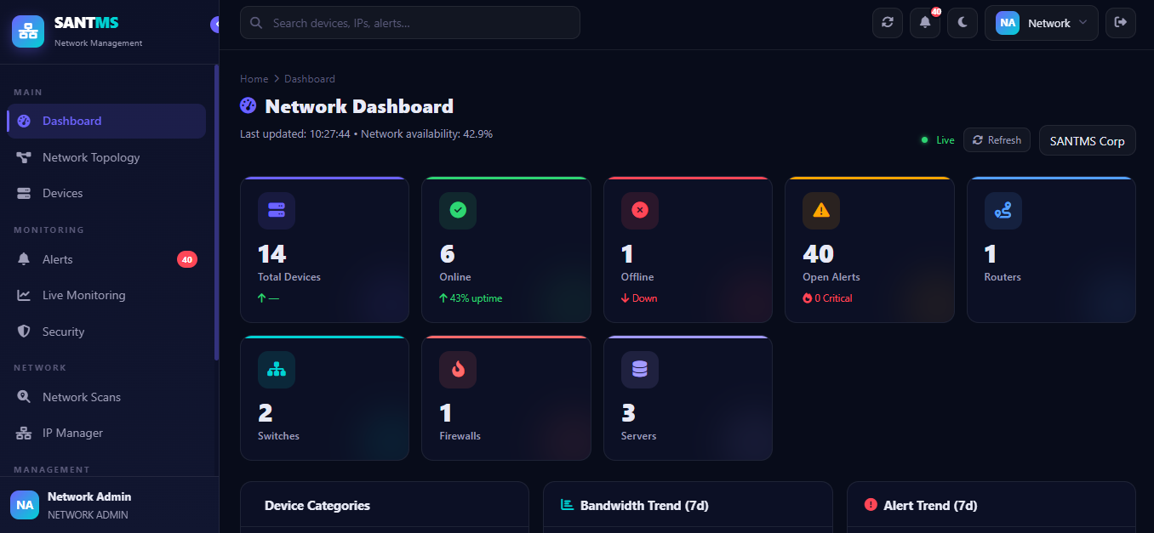
PROTOTYPE / PRODUCT EXPERIENCE
Network Dashboard
User journey 01 — INPUT Network devices and network environment. ↓ 02 — PROCESS Secure automatic network topology creation discovers devices, builds topology and monitors status/security. ↓ 03 — OUTPUT Interactive topology, device status, alerts and reports. ↓ 04 — ACTION Administrator investigates issues and takes informed network-security action.
Device Management
Every discovered device is listed with live status, type, and IP. Admins can search, filter, and drill into any device for its connection history and risk flags.
Prototype experience: Input → Discovery & Processing → Topology / Monitoring / Security Outcome

Slide 6
WHAT MAKES US DIFFERENT?
WHY THIS APPROACH?
TRADITIONAL TOOLS
PROPOSED SYSTEM
Visibility Static, manually drawn diagrams Security Periodic, manual audits Documentation Hand-maintained, quickly outdated Access Control Shared logins, no accountability Reporting Scattered across disconnected tools
Live, auto-generated interactive topology Continuous, automated risk analysis Always in sync with the real network Role-based access + full audit trail One-click, centralized reports
Secure automatic network topology creation tool is differentiated by combining discovery, topology, monitoring, security analysis, access control and reporting in one system.

Slide 7
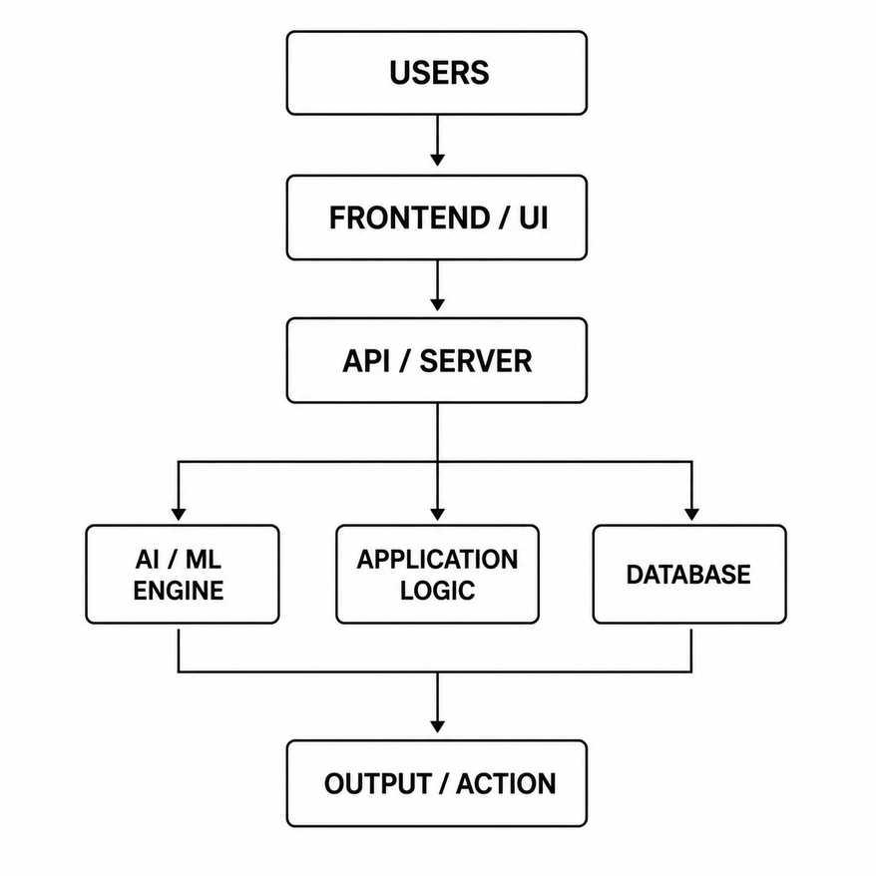
TECHNICAL ARCHITECTURE
Workflow Network → Discovery → Device Identification → Topology Generation → Monitoring → Security Analysis → Reports
Tech stack: Frontend:HTML / CSS / JavaScript Backend:Spring Boot ,Java Database:PostgreSQL APIs:REST APIs Security:Role-Based Access Control
Only technologies used in the implementation are shown.

Slide 8
FEASIBILITY + IMPACT
FEASIBILITY
IMPACT
Technical Spring Boot, PostgreSQL and REST are mature, documented technologies. Implementation approach Web dashboard + REST backend + relational data layer. Operational Runs on standard hardware with no specialized equipment or licenses required. Hackathon MVP Functional UI, network discovery, topology generation, monitoring/security features and reporting workflow.
Who benefits? Network administrators and security teams. What improves? Reduced manual work, faster network mapping, improved security visibility, real-time monitoring and easy report generation. Why does it matter? Administrators can see and secure the network faster with less manual effort. Prototype → MVP → Pilot → Scale

Slide 9
IMPLEMENTATION ROADMAP
WHAT HAPPENS NEXT?
NOW Hackathon Prototype Core workflow Functional UI Initial validation
NEXT MVP User testing Reliability Security Refinement
LATER Deployment Real-world pilot Analytics Integrations
SCALE Expansion More users More domains More locations
Critical point Already built Core discovery, topology, dashboard, monitoring/security workflow and access/reporting foundation.
Planned Cloud deployment, AI-based anomaly detection, mobile app and multi-site support.

Slide 10
TEAM + EXECUTION
SECURE AUTOMATIC NETWORK TOPOLOGY CREATION TOOL IMPLEMENTATION
This project was designed, built, and deployed independently — covering every layer from database to UI. Skills applied Full-stack development — Spring Boot backend, vanilla JS frontend Database design — PostgreSQL schema, security & RBAC Network logic — topology generation, monitoring & risk analysis
Why I can execute this solution As the sole developer, I handled full-stack development, PostgreSQL database design, security/risk logic, role-based access, dashboard UX, testing and deployment for Secure automatic network topology creation.

