Slide 1


SwiftAid
Emergency Medical Response System
A smart, real-time healthcare dispatch and SOS platform built to drastically reduce ambulance response times and save lives — one tap at a time.
HACKATHON PITCH 2024
EMRS PLATFORM
🎤 Speaker Notes: Good morning/afternoon. My name is [Name] and I'm here to present SwiftAid — an Emergency Medical Response System that we built because every second in a medical emergency is the difference between life and death. In the next five minutes, I'll show you how we're reimagining emergency healthcare dispatch from the ground up.

Slide 2
Every Second Counts — But the System Doesn't
Medical emergencies are chaotic, confusing, and often deadly — not because of a lack of ambulances, but because of a lack of coordination. The current system is broken.
⏱ Slow Response
📋 No Patient Data
🏥 Zero Coordination
Average ambulance response times exceed 10–15 minutes in urban areas — critical minutes lost to dispatch inefficiency.
Paramedics arrive blind — no blood type, no allergies, no medical history. Treatment is delayed while they figure it out.
Hospitals aren't alerted until the patient arrives. ER teams are unprepared, beds aren't ready, and time is wasted.
🎤 Speaker Notes: Let me paint a picture. Someone collapses on the street. A bystander calls an ambulance — but the dispatcher has to manually locate the nearest available unit, check hospital capacity, and relay information over radio. The patient's medical history? Nobody has it. The hospital? They don't know the patient is coming. By the time the ambulance arrives, precious minutes — sometimes the difference between life and death — have already been lost. This is the problem SwiftAid solves.

Slide 3

Introducing SwiftAid
SwiftAid is an end-to-end Emergency Medical Response System — a unified platform connecting patients, ambulances, hospitals, and administrators in real time. From the moment an emergency is triggered to the moment a patient is safely admitted, every step is intelligent, coordinated, and instantaneous.
Patient SOS
Live Support
User triggers emergency alert instantly
Real-time tracking and first-aid guidance
AI Dispatch
Prepared Arrival
System assigns ambulance and notifies hospital
Patient reaches hospital ready for care
SwiftAid is not just an app — it is a complete emergency ecosystem built for the real world, with three interconnected dashboards and an AI-powered dispatch engine working in unison.
🎤 Speaker Notes: SwiftAid is a complete emergency response ecosystem. Here's how it works in four steps: First, the patient triggers an SOS. Second, our AI instantly dispatches the nearest ambulance and alerts the nearest hospital with capacity. Third, while help is on the way, the patient receives live first-aid guidance and can track their ambulance in real time. Fourth, when the patient arrives, the hospital is already prepared. Every piece of this system talks to each other in real time — no silos, no delays.

Slide 4
Feature 1: The One-Tap SOS App
The patient experience is designed for maximum simplicity under maximum stress. In a medical emergency, there is no time for complexity.
🩸 Pre-Saved Medical Profile
🆘 Instant SOS Trigger
🤖 AI First-Aid Guidance
Users store their name, blood type, allergies, and pre-existing conditions. This data is instantly available to paramedics the moment an SOS is triggered.
Type symptoms, hit the massive "SEND SOS" button. GPS location is captured automatically and the request is fired to the central server in milliseconds.
While waiting, the app delivers symptom-specific, AI-driven first-aid instructions — empowering patients or bystanders to take life-saving action immediately.
🎤 Speaker Notes: Let me walk you through the patient experience. Before any emergency happens, users pre-save their medical profile — blood type, allergies, existing conditions. When an emergency strikes, they simply type their symptoms and tap one giant SEND SOS button. The app instantly captures their GPS location and fires the request to our central server. But here's what sets us apart — while they wait, our AI analyzes their symptoms and delivers real-time first-aid instructions. So a bystander dealing with a cardiac event gets CPR guidance. Someone experiencing an allergic reaction gets epinephrine instructions. This feature alone can save lives before the ambulance even arrives.

Slide 5
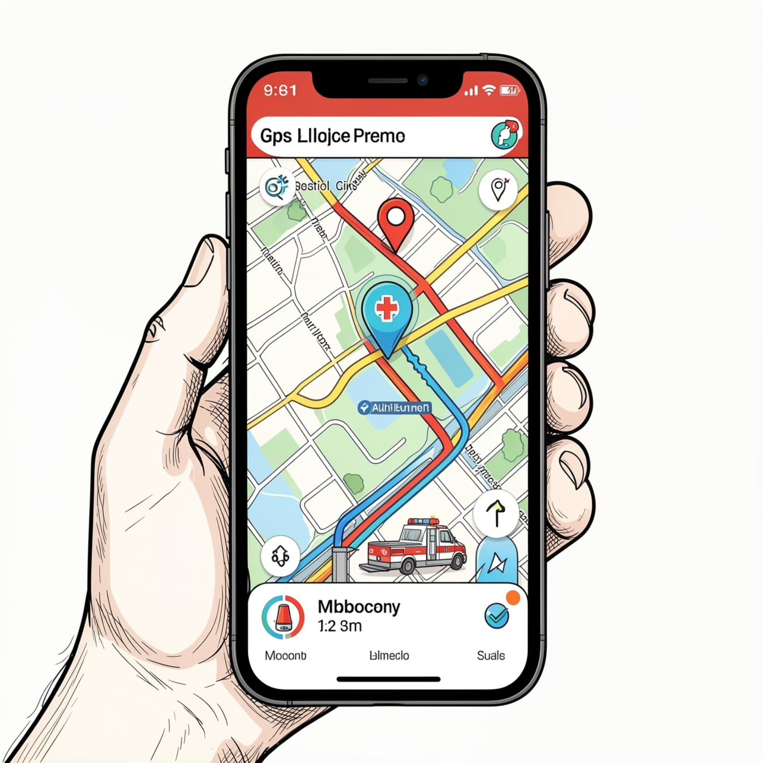
Feature 2: Live Tracking & Direct Communication
Once an ambulance is dispatched, SwiftAid transforms the waiting period from passive anxiety into active, informed coordination. Patients are never left in the dark.
📍 Live GPS Polling
📞 One-Click Call
The app uses watchPosition to continuously stream the patient's live, moving coordinates to responders — even if the patient is being transported.
A direct "Call Ambulance" button connects the patient to the dispatched driver or paramedic en route — no middleman, no delays.
✅ Smart Status Handling
The app manages real-time emergency resolution and handles edge cases like "No Hospitals Available" instantly, rerouting without user intervention.
🎤 Speaker Notes: Once the ambulance is dispatched, the experience doesn't stop. Our app uses watchPosition API to continuously stream the patient's live coordinates to responders — so even if the patient is moving, the ambulance always knows where to go. There's also a one-click call button that connects the patient directly to the paramedic en route — no going through a dispatcher. And our system intelligently handles edge cases. If the nearest hospital has no capacity, SwiftAid instantly reroutes to the next available facility. The patient never has to think about it.

Slide 6
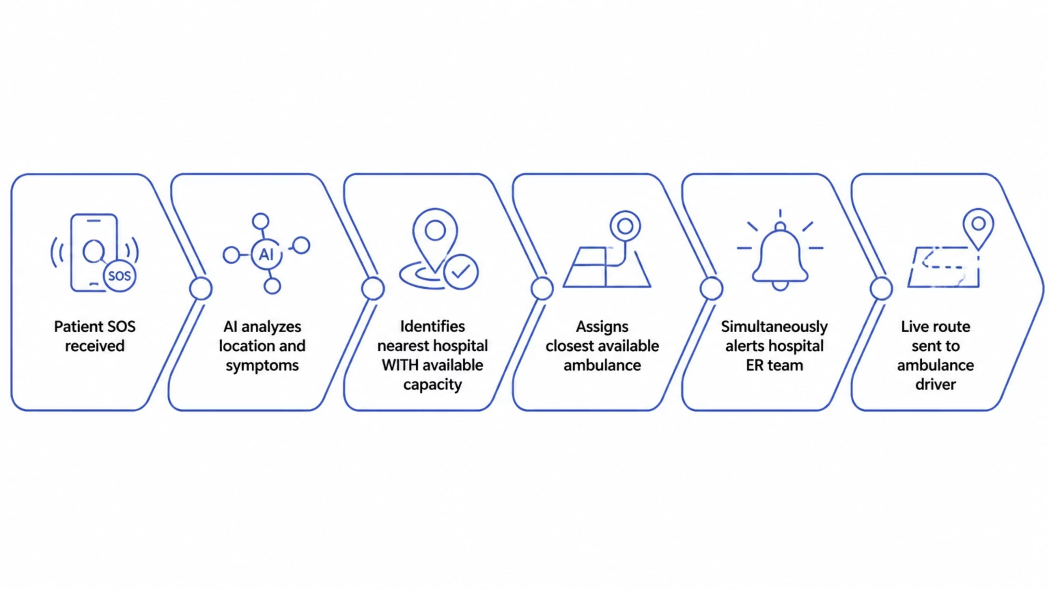
Feature 3: Smart Dispatch & AI Triaging
The brain of SwiftAid is our intelligent dispatch algorithm. It eliminates human error and manual coordination, making the right decision in milliseconds — not minutes.
Our backend automatically evaluates hospital bed capacity, ambulance availability, traffic conditions, and patient severity to make the optimal dispatch decision — every single time.
🎤 Speaker Notes: This is the intelligence layer of SwiftAid. When an SOS comes in, our backend doesn't just find the nearest hospital — it finds the nearest hospital WITH capacity. It checks real-time bed availability, assigns the closest available ambulance, and simultaneously alerts the ER team. All of this happens in milliseconds. There's no human dispatcher making manual calls, no radio chatter, no guessing. The algorithm considers patient severity, traffic, distance, and capacity to make the optimal decision every single time.

Slide 7
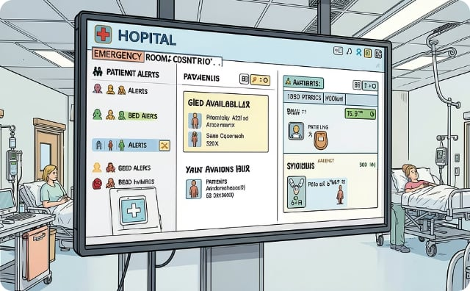



Feature 4: Three Powerful Dashboards
SwiftAid serves every stakeholder in the emergency response chain with purpose-built, real-time dashboards — giving each user exactly the information and tools they need.
🏥 Hospital Dashboard
🚑 Ambulance Dashboard
🖥 Admin Dashboard
Live incoming patient alerts let ER teams prepare before arrival. Real-time bed capacity management ensures no patient is turned away.
Turn-by-turn GPS routing to the patient, full access to pre-saved medical details, and direct contact with the destination hospital — all in one view.
A bird's-eye view of the entire city's emergency ecosystem — fleet management, response time analytics, and system-wide health monitoring.
🎤 Speaker Notes: SwiftAid has three purpose-built dashboards. The Hospital Dashboard gives ER teams live alerts of incoming patients — so they can prep the trauma bay and manage bed capacity before the patient even arrives. The Ambulance Dashboard gives paramedics turn-by-turn routing, the patient's full medical profile, and a direct line to the receiving hospital. And the Admin Dashboard gives city-level operators a bird's-eye view of the entire emergency ecosystem — fleet status, response time analytics, and system health. Every stakeholder has exactly what they need, when they need it.

Slide 8

Built on a Modern, Scalable Tech Stack
SwiftAid is engineered for performance, reliability, and scale — using battle-tested technologies chosen specifically for real-time, geospatial, and high-availability requirements.
Frontend
React.js + Vite for blazing-fast load times. Lucide-React icons. Glassmorphism UI design for a modern, intuitive experience across all devices.
Backend
Node.js / Python REST APIs powering the dispatch engine, AI triage logic, and real-time communication layer between all three dashboards.
Database
MongoDB with native geospatial query support for location-based ambulance and hospital matching, plus real-time data handling for live tracking.
🎤 Speaker Notes: Under the hood, SwiftAid is built for the real world. Our frontend uses React.js and Vite for fast, responsive performance with a glassmorphism UI that's intuitive even under stress. The backend runs on Node.js and Python REST APIs, handling our dispatch engine and AI triage logic. And we chose MongoDB specifically for its native geospatial query capabilities — which is essential for finding the nearest ambulance and hospital in real time. This stack is production-ready and scales to city-wide deployment.

Slide 9

The Road Ahead: What's Next for SwiftAid
SwiftAid is already a functional, life-saving prototype. But our vision extends far beyond — into predictive intelligence, wearable integration, and city-wide emergency infrastructure.
Phase 1 — Now
Phase 3 — Scale
Core SOS app, live tracking, smart dispatch, and three dashboards fully operational and hackathon-ready.
Pilot partnerships with city ambulance services and private hospitals. Real-world deployment and response time validation.
1
2
3
4
Phase 2 — Next
Phase 4 — Vision
Smartwatch auto-SOS integration using fall detection and heart rate anomaly triggers. No tap required — the watch calls for help automatically.
AI-powered predictive dispatch using traffic patterns and historical emergency data. City-wide emergency intelligence network.
🎤 Speaker Notes: What you've seen today is Phase 1 — a fully functional, hackathon-ready platform. But our roadmap is ambitious. Phase 2 brings smartwatch integration — using fall detection and heart rate anomalies to trigger an SOS automatically, with no tap required. Imagine an elderly person falling at home and their watch calling for help before they can even speak. Phase 3 is real-world pilot partnerships with ambulance services and hospitals. And Phase 4 is our moonshot — predictive AI dispatch that anticipates emergencies before they escalate using traffic patterns and historical data. This isn't just a prototype. This is the future of emergency response.

Slide 10
SwiftAid — Because Every Second Is a Life
"The question isn't whether technology can save lives in emergencies. The question is — why isn't it already doing so?"
SwiftAid is not just a hackathon project. It is a life-saving tool built for the real world, with real features, a real tech stack, and a real roadmap to deployment. We are ready to build it. We are ready to scale it. We are ready to save lives.
🚀 Built
🌍 Scalable
❤️ Impactful
Full-stack, real-time platform
City-wide deployment ready
Lives saved, every day
🎤 Speaker Notes: To close — SwiftAid is not just a hackathon project. It is a fully functional, real-time emergency response platform with a clear path to real-world deployment. We've built the SOS app, the live tracking, the smart dispatch algorithm, and three powerful dashboards. We have the tech stack, the architecture, and the vision. What we need now is the opportunity to put this in the hands of the people who need it most. Every second counts. SwiftAid makes every second count. Thank you — we'd love to take your questions.

