Slide 1













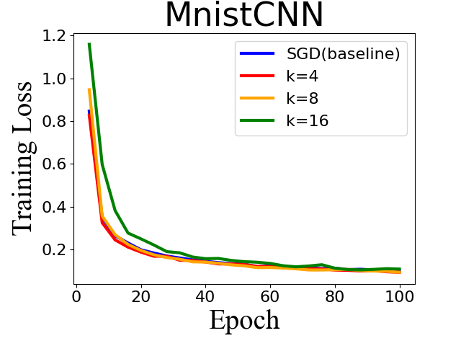
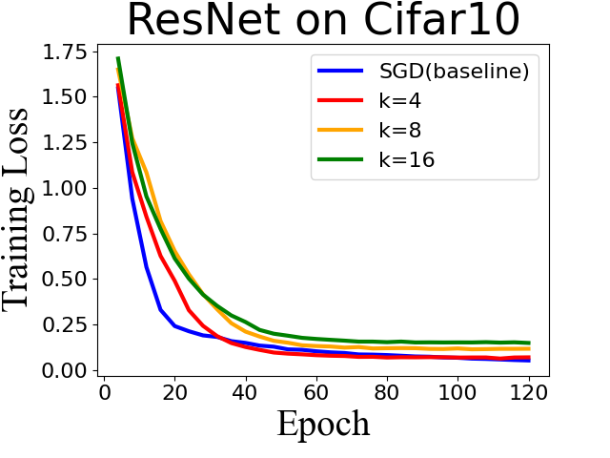





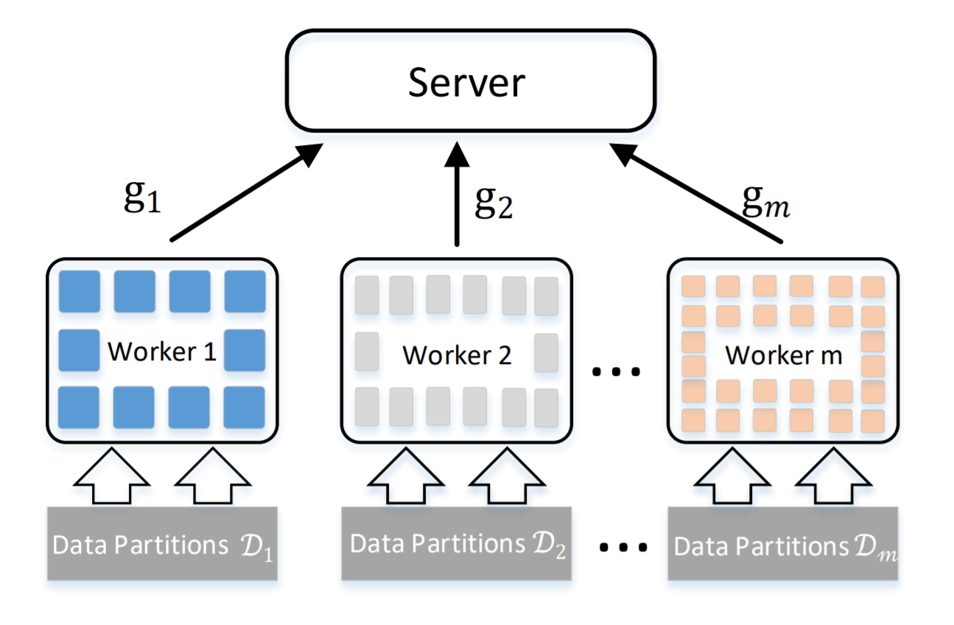

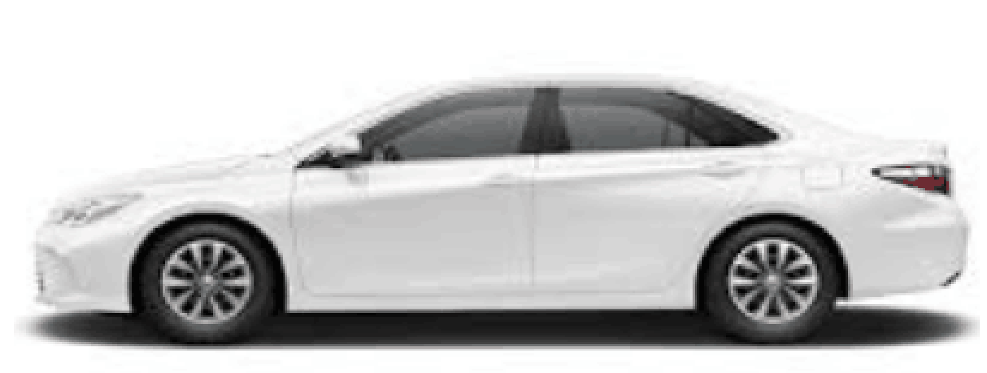

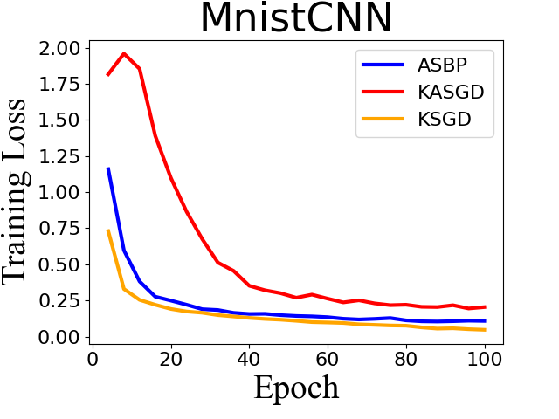
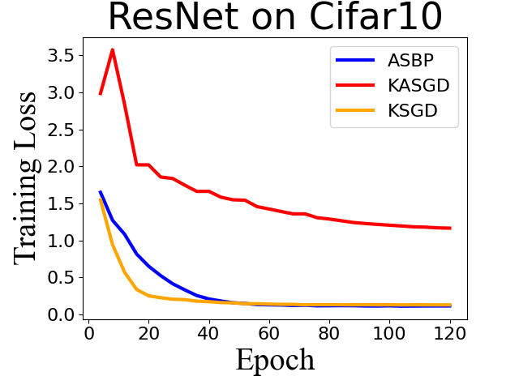
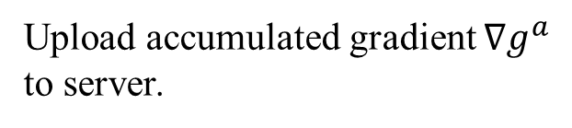
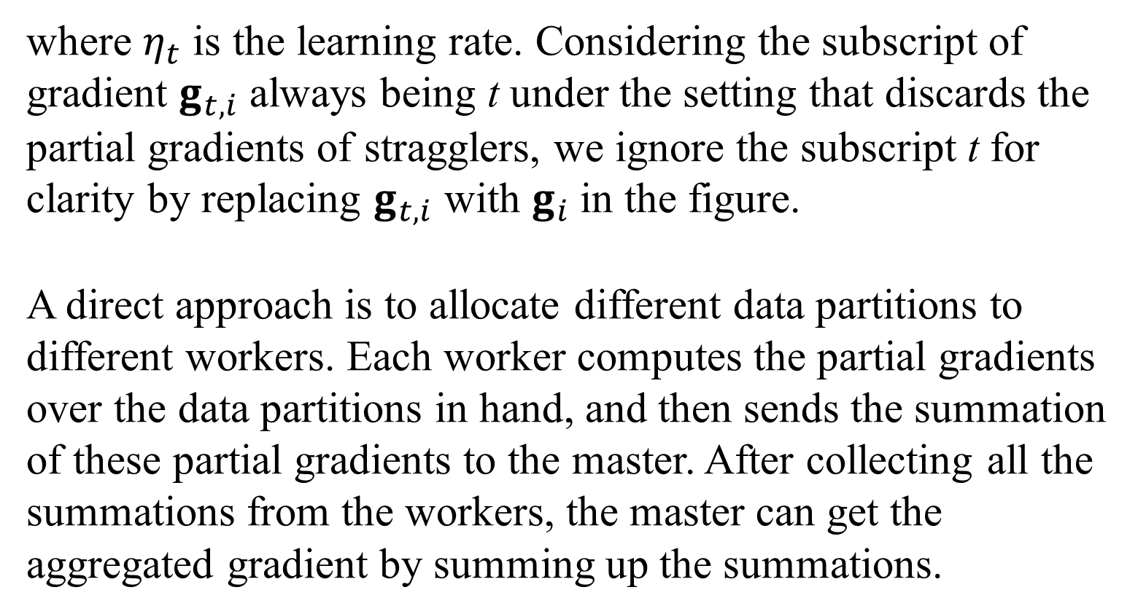
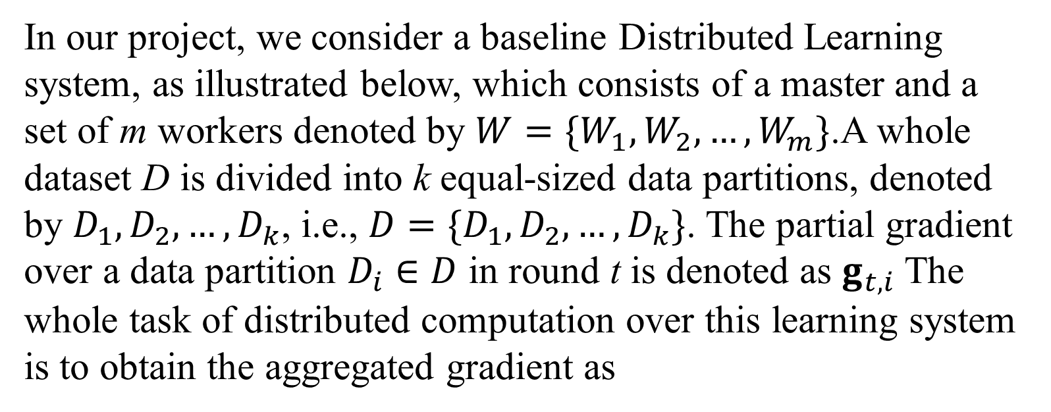
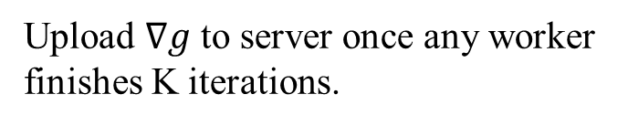

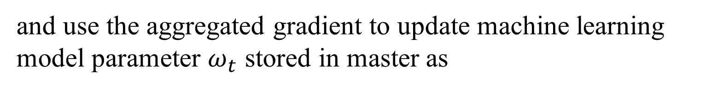
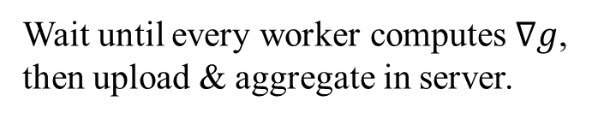
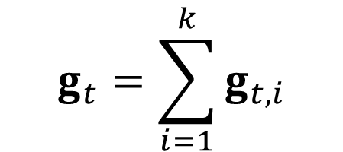
Always Synchronize All Workers for Asynchronous Parallel Scheme via Broadcast
Yang Yutong, Chen Kailin, Tan Zhiren, Shi Hao
National University of Singapore, School of Computing, CS5260
Introduction
Local SGD (LSGD)
Asynchronous LSGD
We then compare the communication cost and accuracy in different K from 4 to 16. For Mnist all experiments with different K achieve a similar training loss and test accuracy. In ResNet model the convergence loss gets higher when K increases, which is because the gradient varieties increase when communication loss is less frequent. On the other hand, the communication cost is reduced significantly by 1/K comparing to baseline.
Federated Learning (FL) has enabled multiple mobile devices to collaboratively train a centralized machine learning model without sharing their private dataset. Most commonly used FL algorithms are synchronous(e.g. Local SGD), where the server aggregates the updated models from all involved workers and returns the aggregated global model back to them via broadcast communication. However, such synchronous algorithms are also susceptible to performance degradation in heterogeneous environments. Although asynchronous algorithms(e.g. Asynchronous Local SGD) break the limitation of heterogeneity, they can not benefit from the broadcast acceleration. Considering that broadcast is much more efficient than point-to-point in the edge learning scenario, we tried to apply broadcast to A-LSGD and proposed APSB.
All workers upload the cumulative gradient to the server after each K iterations. After aggregation, the server broadcasts new parameters, replacing local parameters in all workers.
After any worker completes K iterations, the cumulative gradient is uploaded immediately. After the server is updated, the local parameter of the worker is replaced with the new parameter.
Wait until every worker computes $∇g$, then upload & aggregate in server.
Server transfers model to workers. Workers adopt and start new round of K iterations.
The local update frequency of LSGD is K. Its communication cost is only 1/K of normal distributed learning, which is synchronized after each iteration. However, the larger the K is, the more unstable the convergence effect is. Additionally, workers that iterate faster will be blocked by slower workers.
Upload $∇g$ to server once any worker finishes K iterations.
Server transfers model to the worker. Worker adopts and starts new round of K iterations.
The local update frequency of A-LSGD is K. In A-LSGD, workers do not block each other, which shows the robustness to heterogeneity.
Comm Cost | K=1 | K=4 | K=8 | K=16
MnistCNN (Mb) | 427 | 104 | 61 | 26
ResNet (Gb) | 260 | 68 | 32 | 17
Background
Test Accuracy | K=1 | K=4 | K=8 | K=16
MnistCNN | 98.9% | 99.0% | 98.6% | 98.4%
ResNet | 72.4% | 70.2% | 66.7% | 60.3%
Distributed Learning
Methods
In our project, we consider a baseline Distributed Learning system, as illustrated below, which consists of a master and a set of m workers denoted by $W=\{W_{1}, W_{2}, …, W_{m}\}$.A whole dataset D is divided into k equal-sized data partitions, denoted by $D_{1}, D_{2}, …, D_{k}$, i.e., $D=\{D_{1}, D_{2}, …, D_{k}\}$. The partial gradient over a data partition $D_{i}∈D$ in round t is denoted as $g_{t,i}$The whole task of distributed computation over this learning system is to obtain the aggregated gradient as
APSB
Application
After any worker completes K iterations, the cumulative gradient is uploaded immediately. The server broadcasts the new parameters to all workers after updating. If a worker is in the i-th iteration (i < K) when receiving the broadcast, it will update the local parameters after the i-th iteration and continue the remaining k-i iterations, where the cumulative gradient of previous i iterations will not be invalidated.
Application
In the machine learning field, federated learning with wireless communications has attract increasing interest considering the availability of unprecedented amount of data and advancements in computing and parallel processing. Distributed learning scheme adapting wireless communication is particularly appealing because the traditional model-driven approaches are not rich enough to capture the growing complexity and heterogeneity of the modern wireless networks.
As an asynchronous algorithm, APSB is tolerant to devices with various computation speed to compute parallelly. The increase of communication interval K significantly alleviates the communication overhead where the data transfer speed in wireless network is usually limited. Utilizing the factor that all devices can receive broadcast operation reduces stimulatingly with the same cost of p2p transfer, APSB reduces the gradient latency and stabilizes the iteration step for large K.
$$g_{t}=\sum_{i=1}^{k}{g_{t,i}}$$
Upload accumulated gradient $∇g^{a}$ to server.
Server broadcasts model to all worker. Workers adopt new model and continue iterations.
Thread 1
Upload & aggregate as model1
and use the aggregated gradient to update machine learning model parameter $ω_{t}$ stored in master as
Worker A
$$ω_{t+1}=ω_{t}−η_{t}g_{t}$$
Replace model0
as current model
Replace model1
as current model
where $η_{t}$ is the learning rate. Considering the subscript of gradient $g_{t,i}$ always being t under the setting that discards the partial gradients of stragglers, we ignore the subscript t for clarity by replacing $g_{t,i}$ with $g_{i}$in the figure.
A direct approach is to allocate different data partitions to different workers. Each worker computes the partial gradients over the data partitions in hand, and then sends the summation of these partial gradients to the master. After collecting all the summations from the workers, the master can get the aggregated gradient by summing up the summations.
Thread 2
Download model0
Download model1
Worker B
We set K = 3 and assume aggregation at server node cost 0 time.
Upload & aggregate
as model0
The local update frequency of APSB is K/N. In APSB, workers that iterate faster will not be blocked by slower workers.
Results
We conduct a series of experiment to elaborate the performance of APSB on CNN and ResNet. The experiment is implemented with Pytorch and execute them on heterogeneous cluster containing 9 virtual machines (with 8 workers and 1 server), with GCC Linux Red Hat 4.8.5-16 operating system and supporting OpenMPI.
We first use MnistCNN and ResNet on Cifar10 to evaluate the performance between APSB and A-LSGD setting K = 8. Although A-LSGD could still converge for simple model like MnistCNN, for ResNet it has a high chance of convergence failure during experiment even when K = 2, making it infeasible for learning larger model like this. We also include LSGD as baseline to show that APSB can achieve a performance approaching to synchronous distributed algorithms with same setting.
Contact
Our Group:
https://github.com/karnina/APSB
tswddd@gmail.com
zhiren.tan@u.nus.edu
kailinc@comp.nus.edu.sg
e0576183@u.nus.edu

