Slide 1

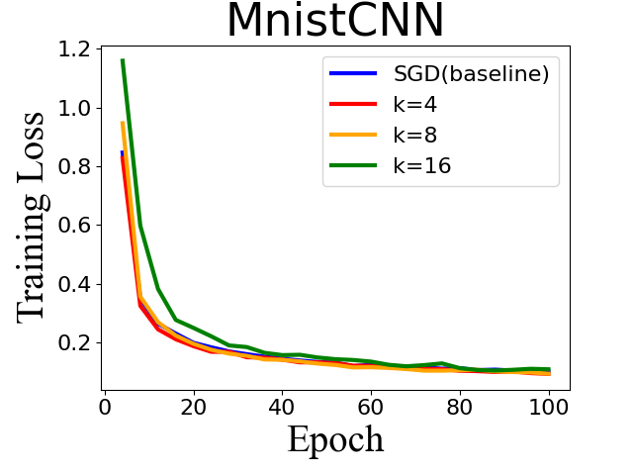
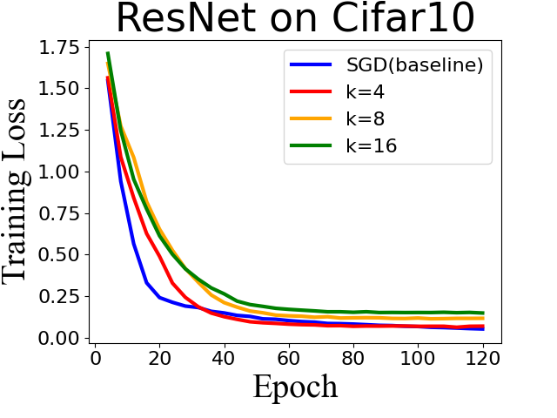
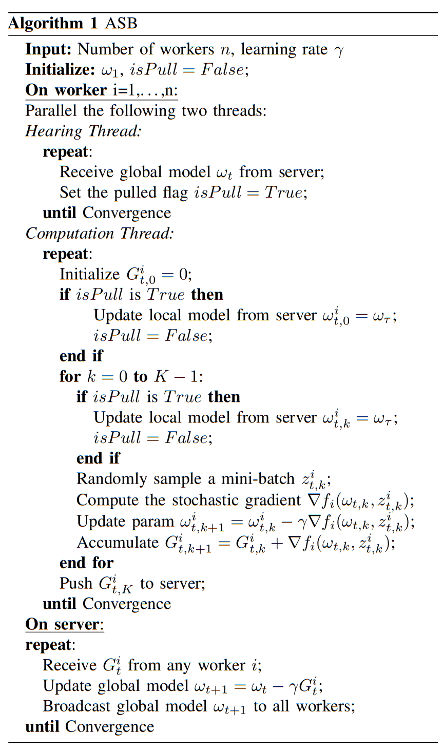



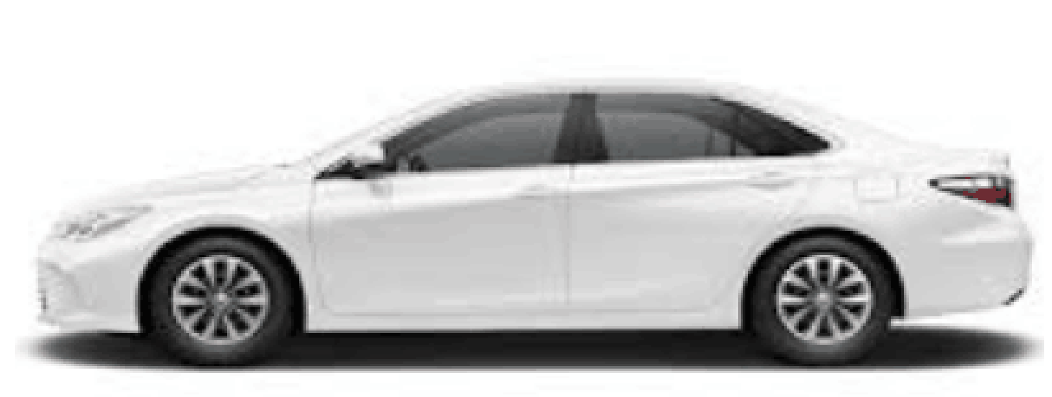
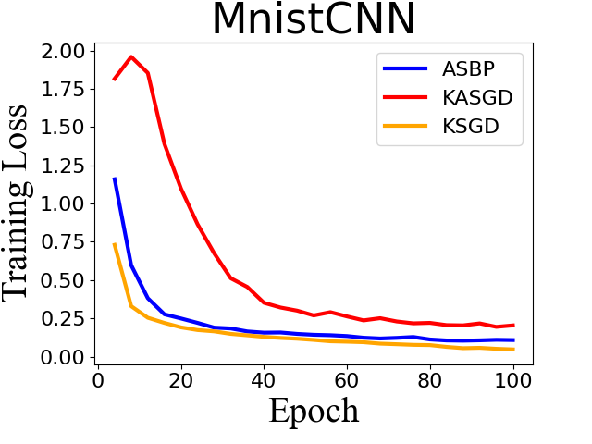
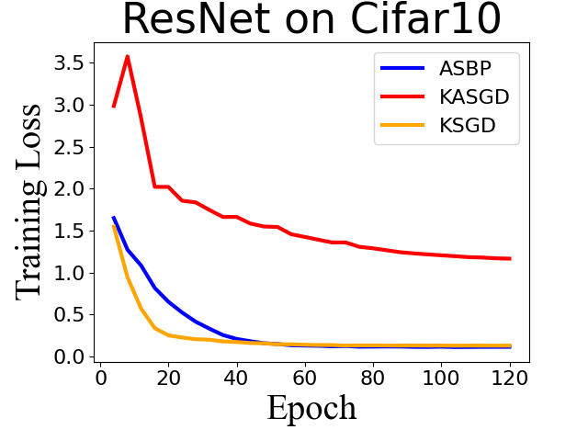
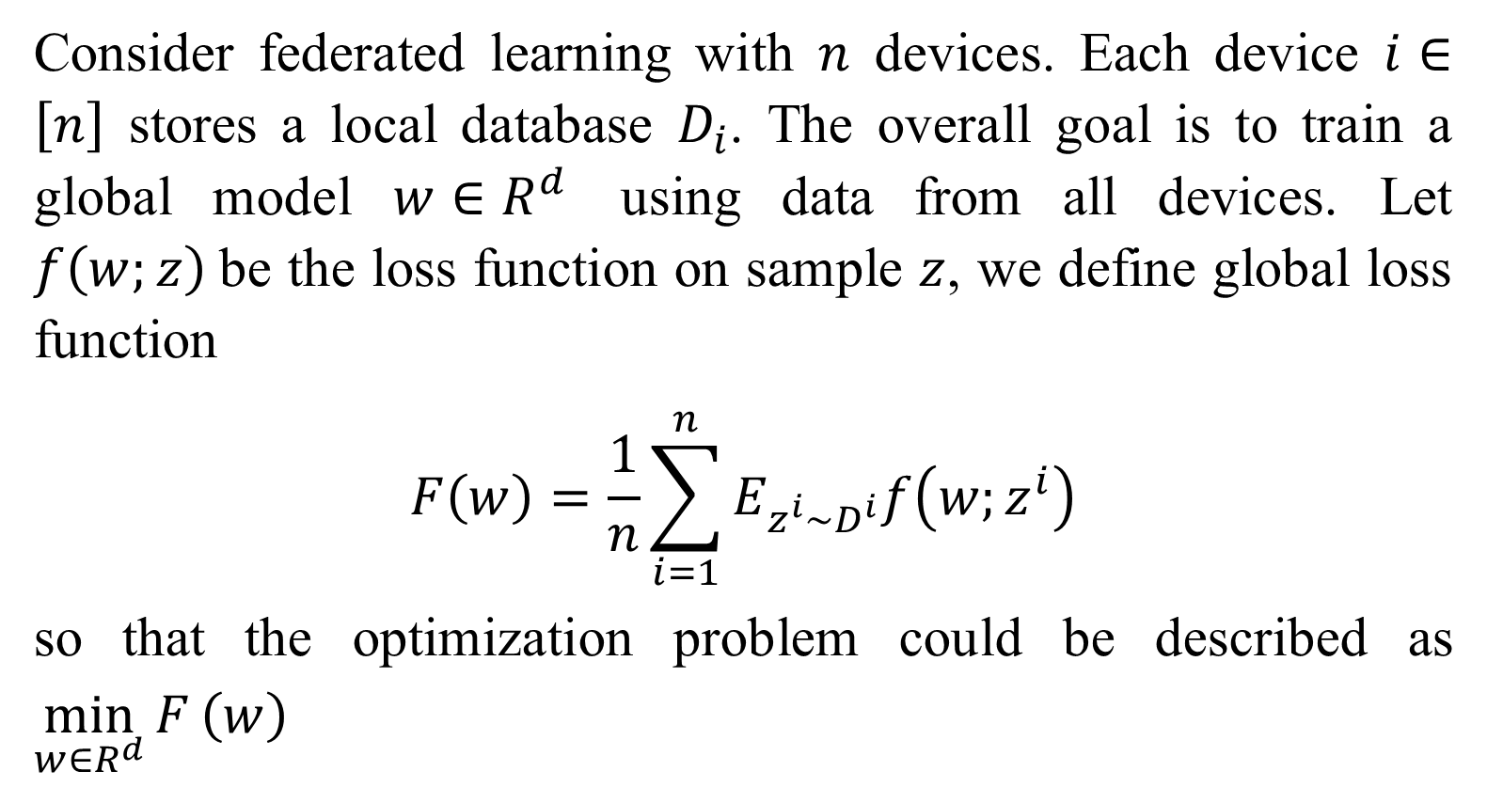
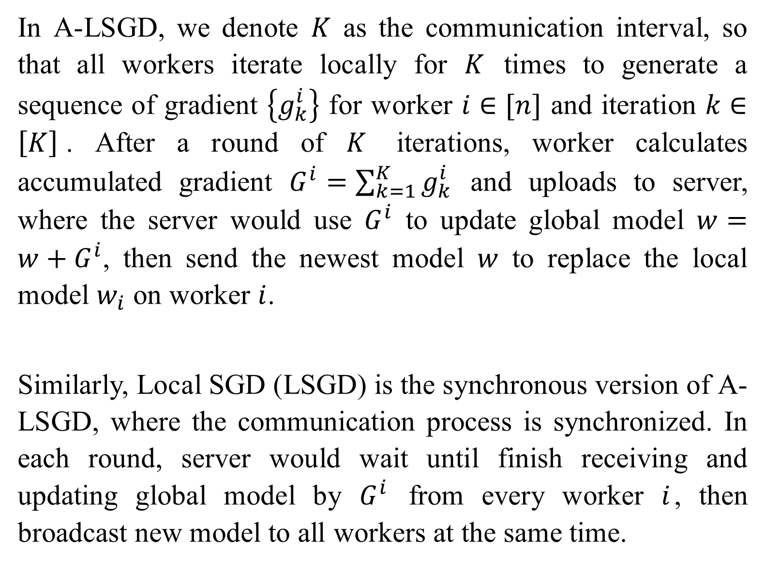
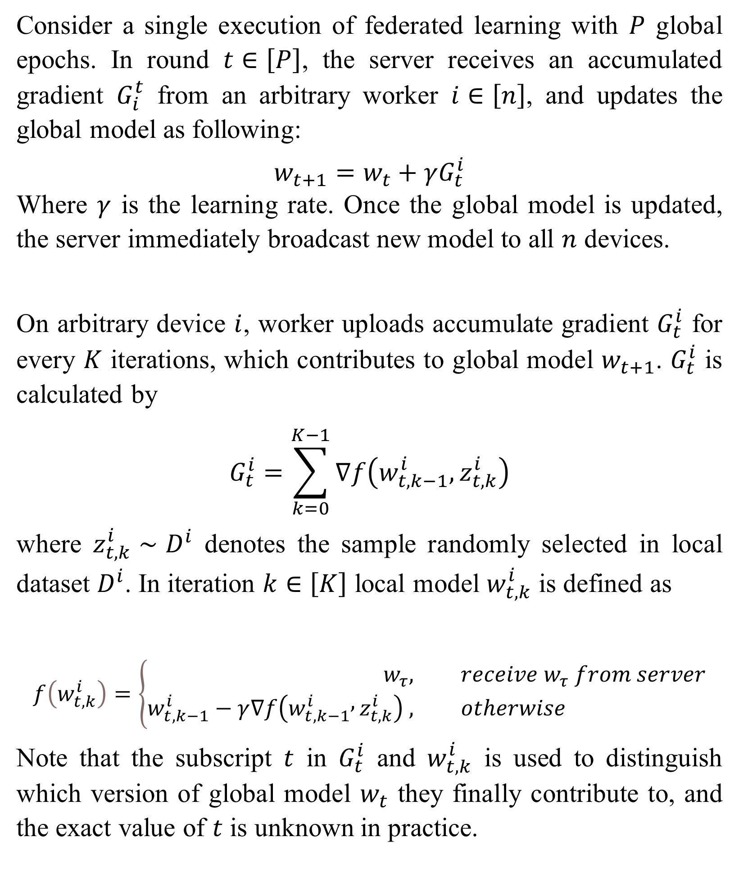
Always Synchronize All Workers for Asynchronous Parallel Scheme via Broadcast
Yang Yutong, Chen Kailin, Tan Zhiren, Shi Hao
National University of Singapore, School of Computing, CS5260
Introduction
Methods
We then compare the communication cost and accuracy in different K from 4 to 16. For Mnist all experiments with different K achieve a similar training loss and test accuracy. In ResNet model the convergence loss gets higher when K increases, which is because the gradient varieties increase when communication loss is less frequent. On the other hand, the communication cost is reduced significantly by 1/K comparing to baseline.
Federated Learning (FL) has enabled multiple mobile devices to collaboratively train a centralized machine learning model without sharing their private dataset. Most commonly used FL algorithms are synchronous(e.g. Local SGD), where the server aggregates the updated models from all involved workers and returns the aggregated global model back to them via broadcast communication. However, such synchronous algorithms are also susceptible to performance degradation in heterogeneous environments. Although asynchronous algorithms(e.g. Asynchronous Local SGD) break the limitation of heterogeneity, they can not benefit from the broadcast acceleration. Considering that broadcast is much more efficient than point-to-point in the edge learning scenario, we tried to apply broadcast to A-LSGD and proposed APSB.
APSB
Consider a single execution of federated learning with $P$ global epochs. In round $t∈\left[P\right]$, the server receives an accumulated gradient $G_{i}^{t}$ from an arbitrary worker $i∈\left[n\right]$, and updates the global model as following:
$$w_{t+1}=w_{t}+γG_{t}^{i}$$
Where $γ$ is the learning rate. Once the global model is updated, the server immediately broadcast new model to all $n$ devices.
On arbitrary device $i$, worker uploads accumulate gradient $G_{t}^{i}$ for every $K$ iterations, which contributes to global model $w_{t+1}$. $G_{t}^{i}$ is calculated by
$$G_{t}^{i}=\sum_{k=0}^{K−1}{∇f\left(w_{t,k−1}^{i},z_{t,k}^{i}\right)}$$
where $z_{t,k}^{i}∼D^{i}$ denotes the sample randomly selected in local dataset $D^{i}$. In iteration $k∈\left[K\right]$ local model $w_{t,k}^{i}$ is defined as
$$f\left(w_{t,k}^{i}\right)=\left\{\begin{aligned}w_{τ}, &receive w_{τ} from server \\ w_{t,k−1}^{i}−γ∇f\left(w_{t,k−1}^{i} , z_{t,k}^{i}\right) , &otherwise\end{aligned}\right.$$
Note that the subscript $t$ in $G_{t}^{i}$ and $w_{t,k}^{i}$ is used to distinguish which version of global model $w_{t}$ they finally contribute to, and the exact value of $t$ is unknown in practice.
Comm Cost | K=1 | K=4 | K=8 | K=16
MnistCNN (Mb) | 427 | 104 | 61 | 26
ResNet (Gb) | 260 | 68 | 32 | 17
Background
Test Accuracy | K=1 | K=4 | K=8 | K=16
MnistCNN | 98.9% | 99.0% | 98.6% | 98.4%
ResNet | 72.4% | 70.2% | 66.7% | 60.3%
Problem Definition
Consider federated learning with $n$ devices. Each device $i∈\left[n\right]$ stores a local database $D_{i}$. The overall goal is to train a global model $w∈R^{d}$ using data from all devices. Let $f\left(w;z\right)$be the loss function on sample $z$, we define global loss function
$$F\left(w\right)=\frac{1}{n}\sum_{i=1}^{n}{E_{z^{i}∼D^{i}}f\left(w;z^{i}\right)}$$
so that the optimization problem could be described as $\min_{w∈R^{d}}{F}\left(w\right)$
Application
Application
In the machine learning field, federated learning with wireless communications has attract increasing interest considering the availability of unprecedented amount of data and advancements in computing and parallel processing. Distributed learning scheme adapting wireless communication is particularly appealing because the traditional model-driven approaches are not rich enough to capture the growing complexity and heterogeneity of the modern wireless networks.
As an asynchronous algorithm, APSB is tolerant to devices with various computation speed to compute parallelly. The increase of communication interval K significantly alleviates the communication overhead where the data transfer speed in wireless network is usually limited. Utilizing the factor that all devices can receive broadcast operation reduces stimulatingly with the same cost of p2p transfer, APSB reduces the gradient latency and stabilizes the iteration step for large K.
Related Work
Worker A
Thread 1
Upload & aggregate as model1
Thread 2
Replace model0
as current model
Download model1
Replace model1
as current model
In A-LSGD, we denote $K$ as the communication interval, so that all workers iterate locally for $K$ times to generate a sequence of gradient $\left\{g_{k}^{i}\right\}$ for worker $i∈[n]$ and iteration $k∈\left[K\right]$. After a round of $K$ iterations, worker calculates accumulated gradient $G^{i}=\sum_{k=1}^{K}{g_{k}^{i}}$ and uploads to server, where the server would use $G^{i}$ to update global model $w=w+G^{i}$, then send the newest model $w$ to replace the local model $w_{i}$ on worker $i$.
Similarly, Local SGD (LSGD) is the synchronous version of A-LSGD, where the communication process is synchronized. In each round, server would wait until finish receiving and updating global model by $G^{i}$ from every worker $i$, then broadcast new model to all workers at the same time.
Worker B
Download model0
Upload & aggregate
as model0
We set K = 3 and assume aggregation at server node cost 0 time.
Results
We conduct a series of experiment to elaborate the performance of APSB on CNN and ResNet. The experiment is implemented with Pytorch and execute them on heterogeneous cluster containing 9 virtual machines (with 8 workers and 1 server), with GCC Linux Red Hat 4.8.5-16 operating system and supporting OpenMPI.
We first use MnistCNN and ResNet on Cifar10 to evaluate the performance between APSB and A-LSGD setting K = 8. Although A-LSGD could still converge for simple model like MnistCNN, for ResNet it has a high chance of convergence failure during experiment even when K = 2, making it infeasible for learning larger model like this. We also include LSGD as baseline to show that APSB can achieve a performance approaching to synchronous distributed algorithms with same setting.
Contact
Our Group:
https://github.com/karnina/APSB
tswddd@gmail.com
zhiren.tan@u.nus.edu
kailinc@comp.nus.edu.sg
e0576183@u.nus.edu

