Slide 1

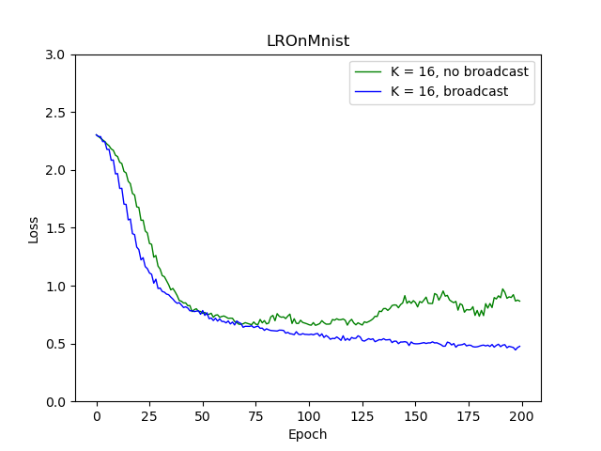


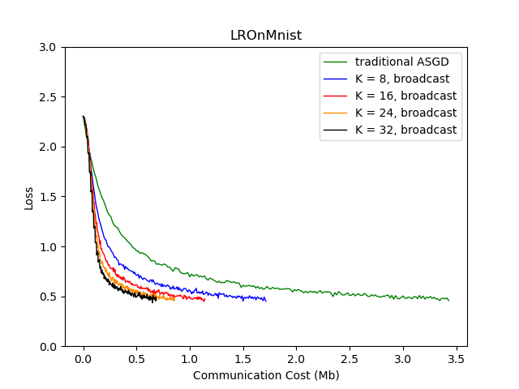











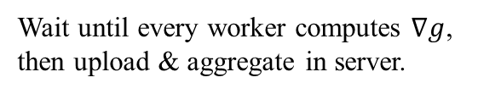








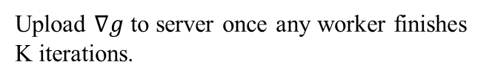
Always Synchronize All Workers for Asynchronous Parallel Scheme via Broadcast
Yang Yutong, Chen Kailin, Tan Zhiren, Shi Hao
National University of Singapore, School of Computing, CS5260
Introduction
Methods
Results
Discussion
Communication cost has always been the bottleneck in distributed learning. The KSGD and KASGD methods using K-average are hence proposed to effectively reduce the communication cost. Synchronous KSGD updates all worker parameters by broadcast, while asynchronous KASGD cannot use broadcast. Considering that broadcast is much more efficient than point-to-point in the edge learning scenario, we tried to apply broadcast to KASGD and proposed ASPB.
ASPB
The reason why ASB works better than KASGD is that workers update more frequently. The advantage of ASPB in respect of KSGD is its heterogeneity tolerance. The communication efficiency of ASPB is the same as that of KSGD and KASGD.
After any worker completes K iterations, the cumulative gradient is uploaded immediately. The server broadcasts the new parameters to all workers after updating. If a worker is in the i-th iteration (i < K) when receiving the broadcast, it will update the local parameters after the i-th iteration and continue the remaining k-i iterations, where the cumulative gradient of previous i iterations will not be invalidated.
Background
Thread 1
Upload & aggregate
as model1
Edge Learning
Worker A
Replace model0
as current model
Replace model1
as current model
Thread 2
Download model0
Download model1
Worker B
Upload & aggregate
as model0
We set K = 3 and assume aggregation at server node cost 0 time
KSGD
Server broadcasts model to all worker. Workers adopt new model and continue iterations.
All workers upload the cumulative gradient to the server after each K iterations. After aggregation, the server broadcasts new parameters, replacing local parameters in all workers.
Workers that iterate faster will be blocked by slower workers
The local update frequency is K/N
Application
ASBP is suitable for Edge Learning or Federate Learning, where the number of terminals is usually large and the iteration speed varies greatly. Moreover, in the WIFI environment, the server's communication cost of broadcasting to all workers is the same as that of transmitting data to a single worker. Therefore, it can make full use of the advantages of broadcasting and allow workers to obtain updates as much as possible under the same communication cost.
Conclusion
Server transfers model to workers. Workers adopt and start new round of K iterations.
The communication cost is 1/K of normal distributed learning (synchronized after each iteration)
The larger K is, the more unstable the convergence effect is
Workers that iterate faster will be blocked by slower workers
The local update frequency is K
KASGD
After any worker completes K iterations, the cumulative gradient is uploaded immediately. After the server is updated, the local parameter of the worker is replaced with the new parameter.
Server transfers model to the worker. Worker adopts and starts new round of K iterations.
Contact
Communication cost is larger than KSGD
Robust to heterogeneity
Workers do not block each other
The local update frequency is K
kailinc@comp.nus.edu.sg
kailinc@comp.nus.edu.sg
kailinc@comp.nus.edu.sg
kailinc@comp.nus.edu.sg

Slide 2
Always Synchronize All Workers for Asynchronous Parallel Scheme via Broadcast
Yang Yutong, Chen Kailin, Tan Zhiren, Shi Hao
National University of Singapore, School of Computing, CS5260
Introduction
Methods
Results
Discussion
Objectives
Conclusion

