Slide 1
Advanced Internet Computing
WS 2013/14
Topic 2: Crowdsourcing
Bernhard Gößwein
David Riepl
Robert Kapeller
Notes:
Vorstellung des Themas und der Referenten.

Slide 2
Topic description
Plan and implement Sentiment analysis for products and companies mentioned in article-feeds
  Gather feed-contents
    (Pre-scan articles for keywords)
  Crowd: Identify keywords for products and/or companies
  Crowd: Rate keywords in conjunction with article
  REST interface for sentiment querying
Implement Crowd sourcing simulator
  (MobileWorks was not reliable...)
Notes:
Kurzer Überblick über Inhalt.

Slide 3
Technology
Python
Django
  REST / JSON
SQLLite
Bootstrap (for GUI, mockups)
Notes:
Kurzer Überblick über Inhalt.

Slide 4
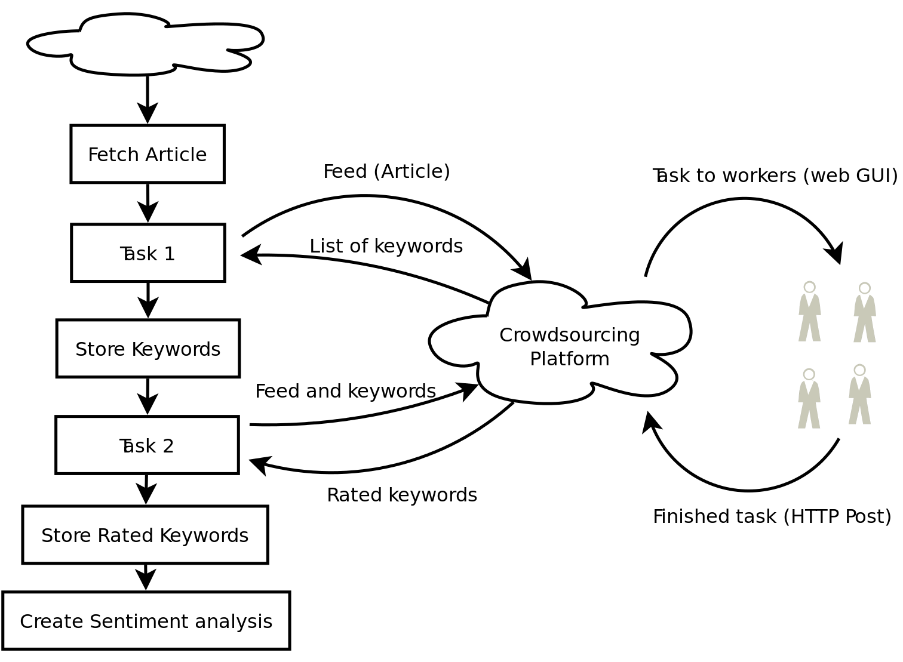
Task flow
Notes:
Kurzer Überblick über Inhalt.

Slide 5
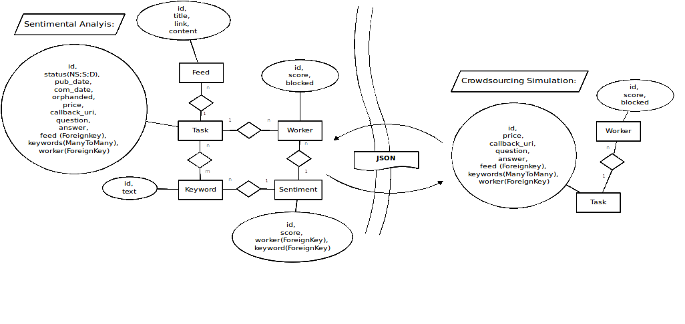
DB Model
Notes:
Kurzer Überblick über Inhalt.

Slide 6
Thank you
Thank you!
Now lets see it in action!
Notes:
Kurzer Überblick über Inhalt.

