Slide 1
Simulation of Electrical Method to investigate on subsurface ground structure
Geophysical imaging
Amini

Slide 2
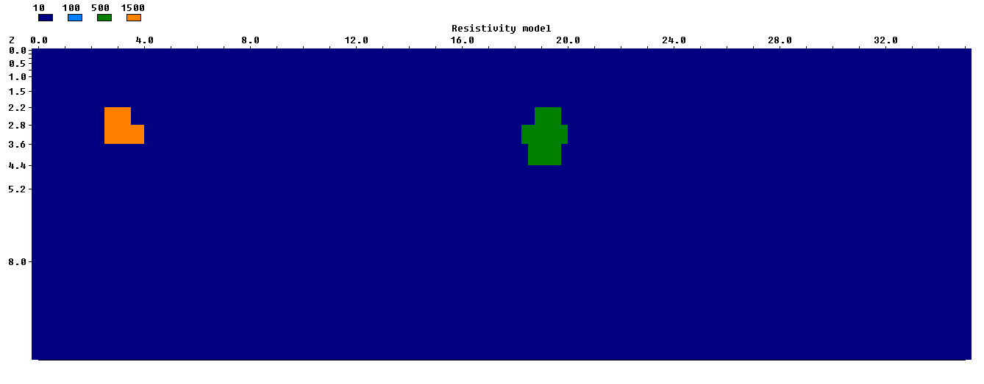
Using the RES2MOD simulator, the sketched model is presented in the figure bellow.

Slide 3
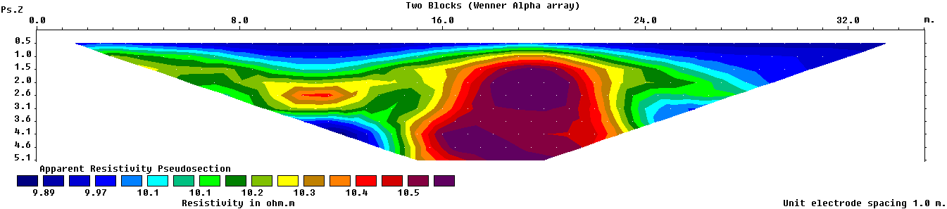
The Apparent resistivity pseudosection is shown in the figure below based on Wenner alpha order of the electrodes.
In this example, 36 electrodes were used while the space between each two electrode was 1 meter.

Slide 4
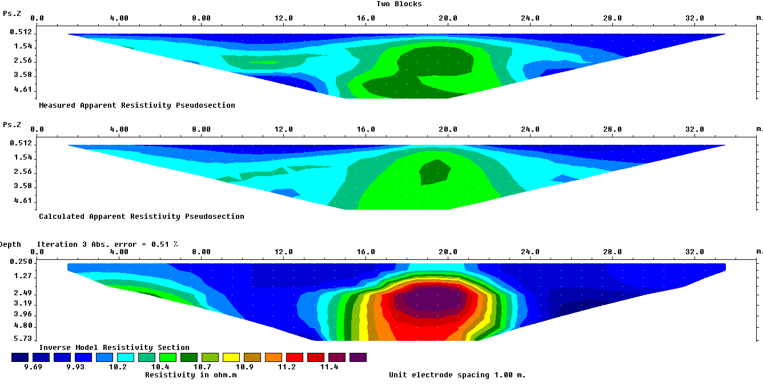
To proceed with the simulation, the inversion model resistivity returns a more precise result in simulation.
The default settings of Res2dinx application returned the following result.
Damping Factor : 0.15
Vertical to horizontal flatness filter ratio : 1
damping factor with depth : 1.05

Slide 5
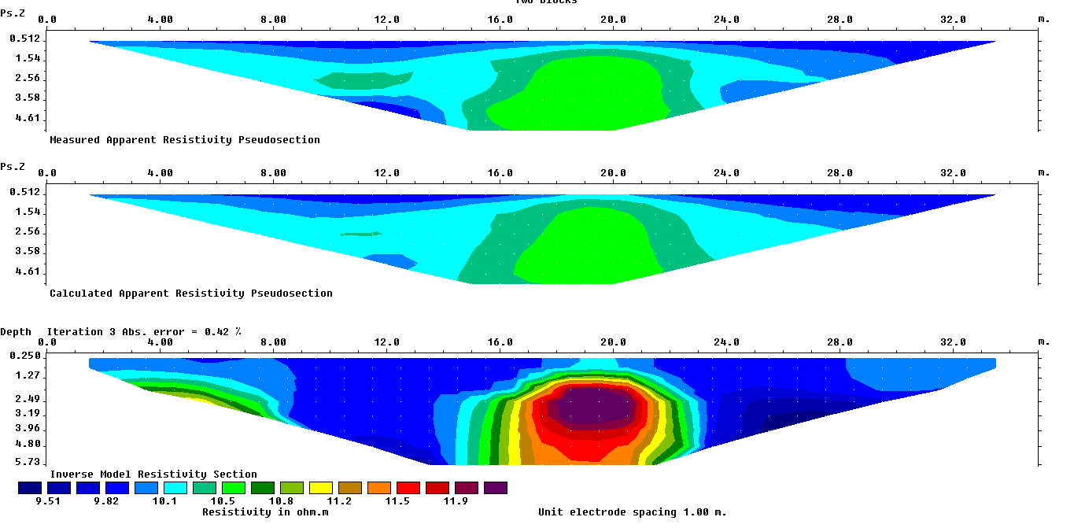
To have a better result, it is tried to change constraints. The following figure is a result on the constraints written in the right side of the figure.
Damping Factor : 0.05
Vertical to horizontal flatness filter ratio : 1
damping factor with depth : 1.05

Slide 6
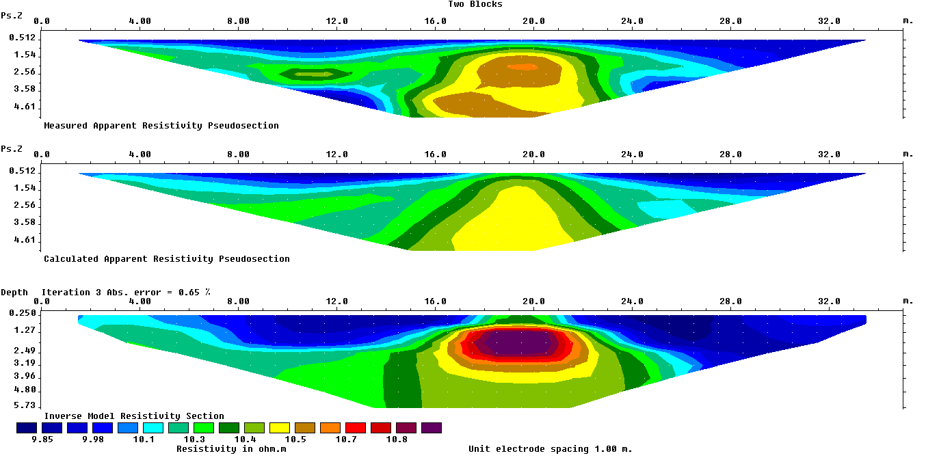
By fixing the damping factor on 0.05 and changing the ratio of vertical to horizontal flatness filter by one unit, the result became worse (as can be seen in the figure bellow). So, I changed it
Again to 1.
Damping Factor : 0.05
Vertical to horizontal flatness filter ratio : 2
damping factor with depth : 1.05

Slide 7
Changing the other options did not improve the result, therefore, this setting is selected as an optimal one. It can be seen that the positions of both anomalies are stated in the result.
Damping Factor : 0.05
Vertical to horizontal flatness filter ratio : 1
damping factor with depth : 1.05

