Slide 1
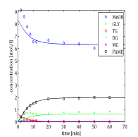


Kinetic model
Errors of diffferent orders of magnitude
Balancing overall
error measure
Concave error measure $+$ regularization
→ robust and unique fit
$$k=\arg{\min{∑log\left(1+ε\right) +λ\left\|k\right\|}}$$

